Slide 1


Assembly Bindings, Binding Redirections & Debugging
Andrej Čižmárik

Slide 2
Motivation: Weird Assembly Load Errors
Failure to load an assembly during runtime
Assembly binding fails usually manifest using an exception
TypeLoadException, FileNotFoundException, FileLoadException or BadImageException
System.IO.FileLoadException: Could not load file or assembly ‘MyCoolAssembly, Version=1.2.3, Culture=neutral, PublicKeyToken=367d582291c765f7’ or one of its dependencies. The located assembly’s manifest definition does not match the assembly reference

Slide 3
Assembly Binding & .NET Framework
Somewhat successful approach to solve the DLL Hell [1] problem
However:
Way too strict and complex rules for real-world applications [2]
Introduces new problem: Assembly Binding Redirects
https://en.wikipedia.org/wiki/DLL_Hell
https://learn.microsoft.com/en-us/dotnet/framework/deployment/how-the-runtime-locates-assemblies

Slide 4
Assembly Binding Failure
Our Awesome Application
Dependency A
NewtonSoft.Json (version 13.0.2)
Dependency B
NewtonSoft.Json (version 12.0.3)

Slide 5
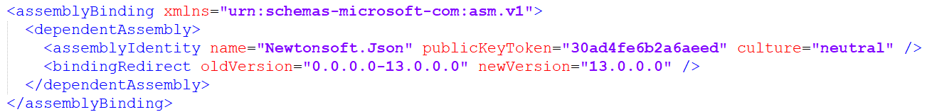
Assembly Binding Fixed
Our Awesome Application
Dependency A
NewtonSoft.Json (version 13.0.2)
Dependency B
NewtonSoft.Json (version 12.0.3)

Slide 6
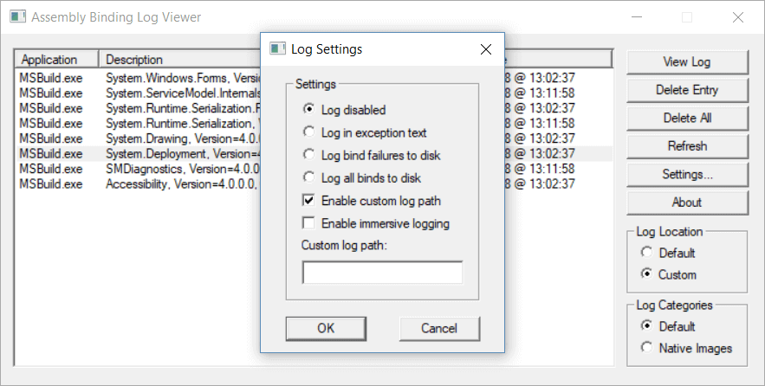
Fusion
Original application shipped with every .NET Framework installation
Very clumsy, old and error-prone UI

Slide 7
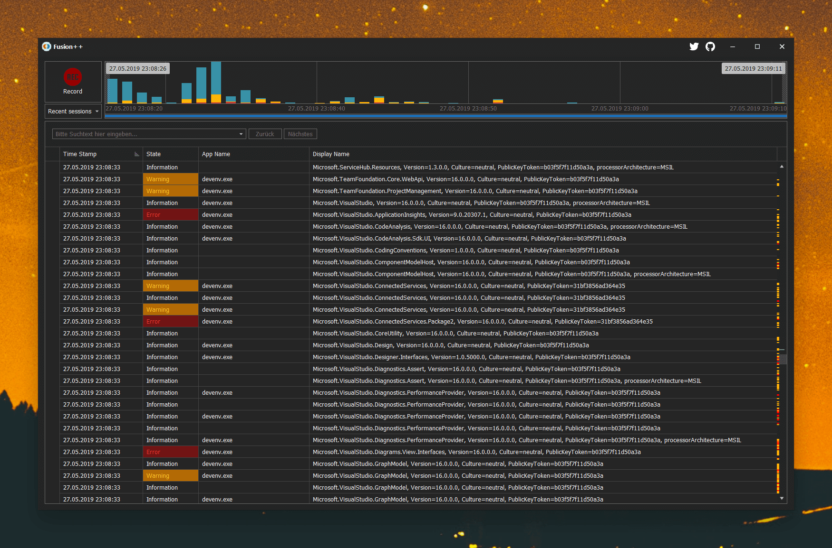
Fusion++
Modern, open-source alternative to original fusion
https://github.com/awaescher/Fusion

Slide 8
Examples

Slide 9
What about .NET Core?
Assembly versions do not need to strictly match build / runtime
New runtime approach
Ignore strong naming
Allow almost any version at runtime
AssemblyLoadContext (replaces AppDomains)

Slide 10
.NET 7 & AOT Native Interoperability
Andrej Čižmárik

Slide 11
Motivation for AOT
Compile .NET class libraries into native libraries (static or shared)
Linked with a lightweight runtime (no need for JIT, metadata, …)
Better startup times (methods are already compiled)
Overall performance improvements
Small executables

Slide 12



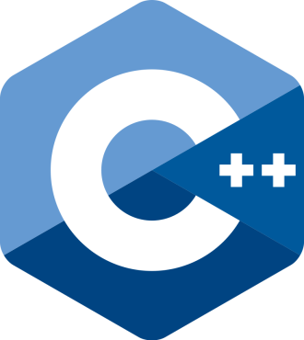

Use-cases for AOT
Interoperability with native environments
C, C++, Pascal, Rust…
Short-lived cloud applications (for example, Azure Functions)
No lag from JIT, execute faster, pay less ☺
Access to restricted platforms (no runtime code generation)

Slide 13
Disadvantages of AOT
Many NuGets are not compatible yet
Reflection can get tricky
Some use-cases are not supported out of the box and require additional configuration (for example, do not strip metadata)
Diagnostics can get tricky
Can not use managed debugger, profiler…
However, application can be analyzed using managed build
No support for dynamic loading and runtime code generation

Slide 14
Example: Calling C# from C [1/2]
[UnmanagedCallersOnly(EntryPoint = “csharp_add_method")]
internal static int Add(int arg1, int arg2)
{
return arg1 + arg2;
}
Create native entrypoint using UnmanagedCallersOnly
This method can not be called from managed code
However, it can call other managed code
Publish with /p:PublishAot=true p:NativeLib=Shared –r win-x64

Slide 15
Example: Calling C# from C [2/2]
Implement sample C application
#include <stdint.h>
int32_t csharp_add_method(int32_t a, int32_t b);
int main()
{
printf("Hello world!");
printf("%d", csharp_add_method(1, 2));
}

Slide 16
Example: Reflection and AOT
Let’s now consider that we need to do some reflection-heavy stuff, such as serialization using Newtonsoft.Json NuGet
We need to instruct IL Linker not to strip metadata
Add file rd.xml in the root folder of C# library
<Directives xmlns="http://schemas.microsoft.com/netfx/2013/01/metadata"> <Application> <Assembly Name="Newtonsoft.Json" Dynamic="Required All"/> </Application> </Directives>

Slide 17

Example: DotVVM VS Code Extension
We are working on libDotvvmSpy (cca 8.2MB library)
AOT-compiled class library that uses ILSpy to inspect assemblies
Used to inspect classes for @viewmodel auto-completion
Native node plugin
(loaded by LS)
VSIX
(TypeScript)
Node bindings
(C++)
libDotvvmSpy
(AOT-compiled C#)
Svelte Language Server
(TypeScript)
ICSharp.Decompiler
(AOT-compiled C#)

Slide 18
Configuring AOT
IlcInvariantGlobalization – remove support for non-english cultures
IlcOptimizationPreference – prefer speed or executable size
IlcGenerateStackTraceData – disable metadata for stack traces
Configurability is quite powerful: https://github.com/nikouu/TinyWordle

