Slide 1
CS 5010
Week 2 Alan Jamieson

Slide 2
What are we talking about today?
Java deep dive
Testing
Object-oriented design

Slide 3
First things first
Hello, World.

Slide 4
Types - primitive vs reference/object
Java splits their data types into two buckets - primitive and reference
Primitive data types have limited functionality built-in to the data type and represent “essential” types:
Integral types - int, long, etc.
Decimal types - float, double
Booleans
Characters
Reference types have functions/procedures attached to them and are more complex than primitive types

Slide 5
Examples of Reference Types
ArrayList Random Exception
Stack StringBuilder Time
Wrapper classes PrintStream File
What kind of type is String?

Slide 6
Scoping - public vs private
Scoping rules and keywords control the visibility of named fields (variables) and functions.
Public - visible outside of the class mechanisms (frequently instantiation)
Private - only visible within the class mechanism
Static - available without instantiation
Protected - public, but only to subclasses

Slide 7
Class types - class vs interface
For Java, the default unit is a class.
class name{ //stuff
}
One kind of special class is an interface (one abstraction):
interface name{ //non-implemented stuff }

Slide 8
Interfaces and inheritance
Interfaces represent a contract of sorts detailing function prototypes that are guaranteed to exist in any implementing class.
Interfaces should have no implementation details! This includes variable fields (however constants - static final fields - can be included).
A class can inherit from multiple interfaces - this is the only instance of multiple inheritance allowed by Java.
Interfaces cannot be instantiated.
Another abstraction is the abstract class - similar to interfaces but allows for some implementation detail, including regular variable fields.

Slide 9
Let’s look at an example
Duration interface + quick implementation

Slide 10
Error handling - exceptions
Outside regular debugging practices, the mechanism that Java uses for runtime issues is the Exception.
Exceptions are reference types and can encapsulate several different kinds of errors like I/O exceptions, empty stack, null pointers, and out of bounds.
General format:
Duration time;
try { time = new HmsDuration(1, -47, 20); } catch (IllegalArgumentException e) { // This will be executed only if an IllegalArgumentException is thrown by the above method call }

Slide 11
Test-driven development
This is a big focus for this course, specifically with unit testing.
Two different “big-tent” kinds:
White-box tests - tests that are typically done after implementation, informed by the implementation details.
Black-box tests - tests that are focused on what the method/function is supposed to do, and testing based on that.
The general idea for TDD is that we’re focused on the Black-box version, without having to write significant amounts of manual tests. Automation is good.

Slide 12
Unit testing
Generally thought of as the standard for automated testing, coming to the forefront of testing and SA in the early 2000s.
By definition, these are automated tests that ensure a “unit” of a program is good for incorporation into the whole.
This is a natural testing process for OOD because we have easy units to consider - classes!
For our testing purposes, we’ll use JUnit.

Slide 13
JUnit Intro
JUnit is an automated testing framework.
Procedure:
Create a new java class that will hold your tests.
Import org.junit.Test and org.junit.Assert.*
There could be others depending on use case.
Use setUp() and tearDown() methods to do some initialization and cleanup.
Create @test methods to test your unit using assertions.
Create a runner - not needed in Eclipse.
If you are using Eclipse, there’s an easy way to set up your testing class:
New -> JUnit Test Case

Slide 14
Quick demo

Slide 15
Process
“Testing shows the presence, not the absence of bugs.” - Edsger Dijkstra
Write the interface, including prototypes.
Consider pre-condition and post-condition for each of the methods.
Write a “dummy” implementation of the interface with empty implementations to ensure that there are no quick compile errors.
Consider each method in isolation - what do we need to test in order to test the behavior and ensure that the expected behavior matches actual behavior.
Consider any exceptional cases. Incorporate those into your tests.

Slide 16
Example
HMSDuration implementation of the Duration interface

Slide 17
Getting started exercise
Create an interface for Shape with at least one method to calculate area.
Create a class that implements Shape with at least the constructor as well as the required methods from Shape.
Create a JUnit test class that tests the methods for your created class.
Run the test.

Slide 18
Let’s start talking about design
When we talk about OO design the fundamental benefit of OO programming is the idea of modularization.
How do we decompose our problems into sensical components s.t.:
They are easily understood
They are easily maintained
They retain sufficient functionality
They can be easily replaced

Slide 19
Benefit of interfaces - polymorphism
Polymorphism - (Oxford def.) the condition of occurring in several different forms
For programming this allows for utilization of parent classes/interfaces to reference objects in their hierarchy without needing to know specifics:
This shape below could be anything - Rectangle, Circle, etc.:
Shape s = q.shapeBuilder();

Slide 20
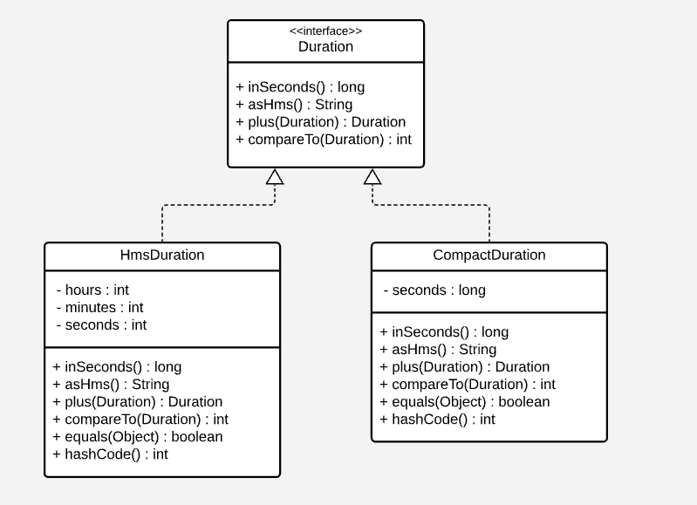
Consider

Slide 21
Our duration example again

Slide 22
On your radar:
Take a look at the github site. Over the next week it will be populated with a syllabus and some resources.
Be prepared for recitation on Thursday.
Refresh your knowledge about:
Basic Java programming
Interface implementation
UML

