Slide 1
The GLOBIOM test service
Albert Brouwer

Slide 2
Outline
Purpose
History
Deployment
Use
Future

Slide 3
Purpose: automated testing
Automated testing is essential in scientific software because it enforces rigor, protects reproducibility, and prevents silent regressions that can corrupt results or invalidate published findings. It guarantees that complex numerical pipelines remain trustworthy as models evolve.

Slide 4
Purpose: automated testing of GLOBIOM to:
Catch regressions and errors early in the development cycle
Reduce manual testing burden
Expand test coverage far beyond what would be practical manually
Produce metrics for verifying/improving model code/performance/outcomes
Integrate with version control for traceable changes
Guard cross-platform and containerization compatibility
Increase confidence in model results

Slide 5
Automated testing of everyday software
Automated testing for everyday software can be simple and light because most features can be checked in small pieces, one at a time, on a regular laptop. Developers can quickly run these tiny checks while they work, catching mistakes early—long before the software becomes big or complex. This doesn’t require a large testing system or special infrastructure; it’s more like proofreading each paragraph as you write, instead of waiting to review the whole book at the end.

Slide 6
Purpose: testing big GAMS models
Large, data‑heavy GAMS models cannot be tested the way everyday software can because their behavior depends on running the entire system at once. They pull in huge datasets and interact through tightly linked equations, so changing one part affects everything else. You can’t check them in tiny pieces on a laptop—only full, time‑consuming runs reveal whether results still make sense. These models behave like whole ecosystems: only by simulating the complete environment can you see if a change truly works.
⇒ a resource-heavy custom approach is required.

Slide 7
Purpose: overcome challenges
Acquiring resources in a provisionable format.
Scaling resources with demand.
GLOBIOM VCS is on Subversion (internal only)
GLOBIOM is partially on P: (internal only)
Making the testing available as a service to the team.
Dealing with Ann Ominous

Slide 8

Ann Ominous

Slide 9

Windows Ann Ominous

Slide 10

Jenkins (sign in demo)
A self‑hosted test-automation engine prized for its deep configurability. It remains broadly adopted—about 28% usage in 2026—especially where there is need for full control of tailored on‑prem test pipelines.
The core GLOBIOM team can sign in to the Jenkins GLOBIOM test service at
https://jenkins.iiasa.ac.at

Slide 11
History: Hudson
2004 — ➡ Kohsuke Kawaguchi creates Hudson at Sun Microsystems as a Java‑based CI tool to automate builds and spare his team broken integrations.
2005 — Hudson’s first public release ships as an open‑source and quickly gains traction.

Slide 12
History: Hudson
2004 — Kohsuke Kawaguchi creates Hudson at Sun Microsystems as a Java‑based CI tool to automate builds and spare his team broken integrations.
2005 — ➡ Hudson’s first public release ships as an open‑source and quickly gains traction.

Slide 13
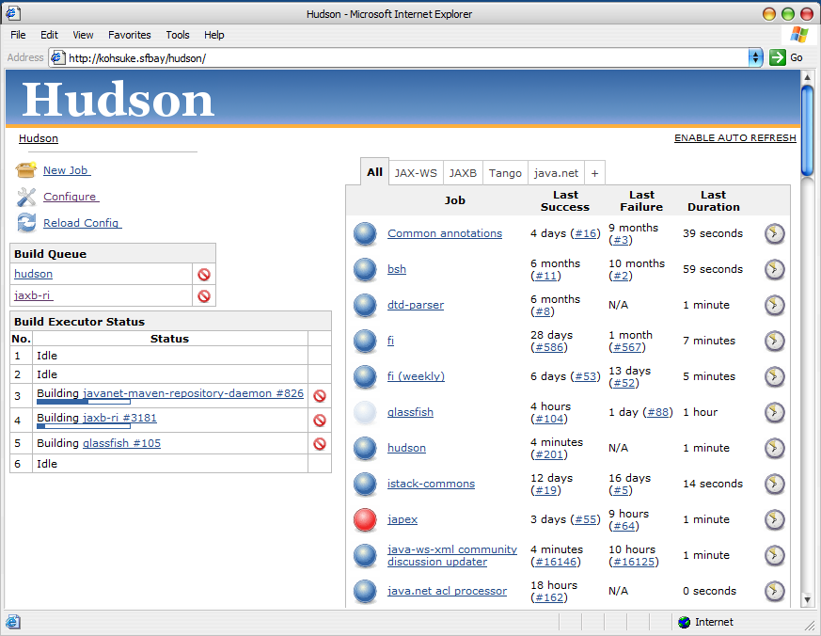
History: Hudson screenshot

Slide 14

Emerging Linux dominance
2006-2009 — Linux started to dominate, impacting Sun business model.

Slide 15


History: Jenkins
2010 — Oracle acquires Sun, tensions rise as Oracle asserts control and seeks to trademark the Hudson name, triggering governance disputes.
Larry Ellison
Kohsuke Kawaguchi

Slide 16
History: Jenkins
Early 2011 — The community, led by Kawaguchi, forks Hudson into Jenkins, rejecting Oracle’s stewardship.
2011 — Kawaguchi departs and co‑founds CloudBees, becoming the commercial steward and evangelist of Jenkins’ future ecosystem.
2011 onward — Jenkins—the renamed, community‑owned continuation—quickly eclipses Hudson, becoming the dominant CI platform with a vast plugin ecosystem.

Slide 17

Jenkins ecosystem (plugin demo)
The rich Jenkins ecosystem features a vast plugin library (2,000+ plugins) that enables flexible, end‑to‑end automation across nearly any technology stack, powered by a large and active open‑source community that continuously expands its capabilities.

Slide 18
History: CTBTO (free-style configuration demo)
Jenkins for automated testing of seismic, hydroacoustic, and infrasound processing software.
Virtual machine (VM) image with integrated Oracle database.
Scaled by deploying more “worker agent” VM instances.
“Free style” GUI-configured Jenkins projects.

Slide 19

History: mitigating the Jenkins Web-UI monstrosity
Pipeline: scripts for test description.
Configuration as code: serialize configuration settings as text.
To be managed via Git.
  See https://iiasa.github.io/Data_Stewards/managing-code-and-data.html

Slide 20
History: IIASA
Ominous challenges. Set up a Jenkins test server using test pipeline scripts. Deployed on Linux via many tickets. Issues with:
By-proxy maintenance and upgrades.
Slow storage.
Multi-tenancy resource exhaustion.
Outages.
No scaling.
Added a Jenkinsfile pipeline script to the GLOBIOM Trunk.
Automated testing of GLOBIOM as far as the test server would allow.

Slide 21
History: readying GLOBIOM for testing
Readied the GLOBIOM Fable, GLOBIOM Prerelease, and GLOBIOM Trunk for automated testing:
Removed platform dependencies:
  Converted use of GDXXRW/Office to xl2gdx.R/gdxrrw.
  Path casing errors.
  Path separators.
  FILE statement delimiting.
  …
Normalized Model/0_executebatch.gms,
added include/environment.gms, …
Mirrored P: data GLOBIOM needs on GitLab.

Slide 22
History: Kubernetes
Kubernetes: helps coordinate computers to jointly run apps like Jenkins or the Accelerator so that they can grow smoothly when needed.
Let’s use Kubernetes!
Five years later, after several unusable clusters, bartered into being a usable Kubernetes cluster for IBF by sacrificing limpopo 2, 3, and 4. And then buying more storage.
Also used for Accelerator “routines”.

Slide 23
Now: Jenkins test service deployed on IBF Kubernetes cluster
A mashup of container build scripting, Kubernetes orchestration resources, configuration as code, Jenkins plugins, and Jenkinsfile pipeline scripting, all managed with Git.
Instantiates clean-slate test agents for every test run.
Pulls GLOBIOM from GitHub/Subversion and P: data from GitLab.
Patches GLOBIOM for testing
  For all code-path-modifying differing-by-one setting relative to default.
Runs GLOBIOM from A to Z.
  With the exception of “Compile” and “Model” test projects.

Slide 24
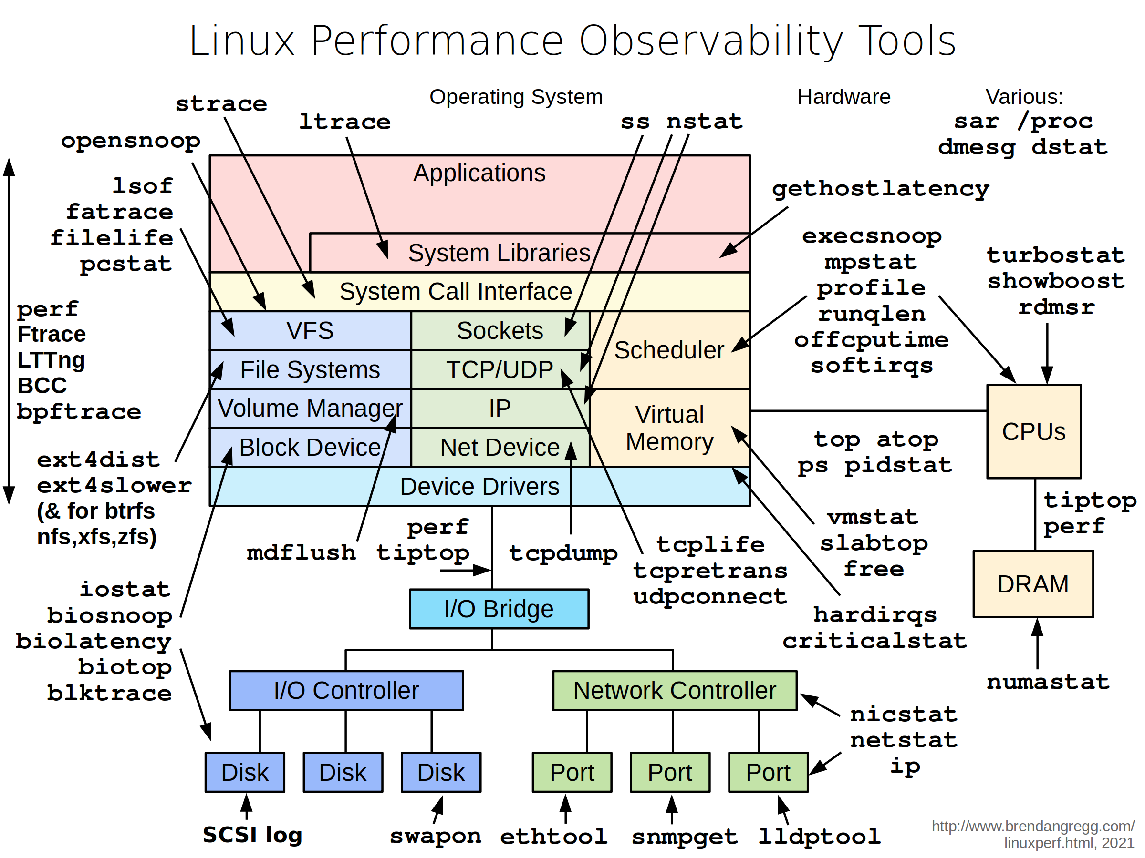
Agent container
Has all the IBF canonical GAMS versions, R, Python, and packages that GLOBIOM needs.
Also instrumented for GAMS post-mortem.

Slide 25
GLOBIOM testing (demo)
Views
Projects
Parameters
Pipeline
Build
Changes
Plots/Metrics

Slide 26
Future
Expand plots/metrics
Add more branches
Scale up storage
GitHub issue tracking integration
Integrate GAMS dig analysis
More agent kinds or Jenkins instances
…

