Slide 1
The openWEMI idea
Work – Expression – Manifestation - Item

Slide 2
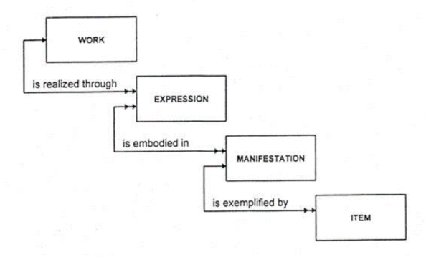
FRBR-LRM WEMI
Notes:
This is the WEMI that we have all encountered before. It encompasses both relational database concepts and in its later incarnation, those of object-oriented design. It is strictly linear, each “thing” linking to the next thing, and no way to jump between them if you need to, and no obvious way to extend the model. In the documentation, each box defines the data elements that are allowed in that box. Both models include the attributes or elements that are valid for each “box”.

Slide 3
The motivator: non-traditional uses of WEMI concepts
FaBiO – FRBR-aligned Bibliographic Ontology
Akoma-Ntoso – Use of FRBR entities to describe legal document versions
FRIR – Functional Requirements of Information Resources
The Music Ontology
Colon classification
Fast Fashion Ontology
Notes:
There are examples of folks that have discovered and used WEMI for their purposes. These resemble the library model but also differ from it in important ways. This was my original impetus for thinking about a more general approach to defining a less constrained model – one that can easily accommodate non-library uses. I ran into these interesting uses of WEMI outside of FRBR – outside of “bibliographic records”
What is interesting is that people from rather far-flung information areas have found WEMI useful for their purposes. As we’ll see, these examples use WEMI but not as defined in the original FRBR model.
Each of these is a vocabulary, some of which are not yet actionable, but some are being used today. And “used” means that they must be implemented as code.

Slide 4
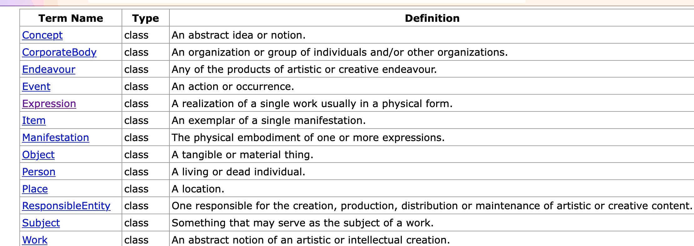
No library schema for frbr/wemi
(at vocab.org)
Notes:
2005, with a group in the UK who were designing an RDF-based library catalog
IFLA did not create a metadata model for FRBR (they continue to insist that FRBR/LRM is a conceptual model, even though RDA embodies it in code -- ?) so this is still the only one available and it is defined as an RDF vocabulary
The Core here is all of the classes (all three FRBR groups) and the properties that are relationships between them, like from Work to Expression, etc. And the bibliographic relationships like “translation of”
Added some classes, like Endeavour, that included the entire bibliographic item – aka all of WEMI – something that IFLA stated clearly was not part of the FRBR model.
This is used by FaBiO, Music Ontolgy and others – in part because there is nothing else.

Slide 5
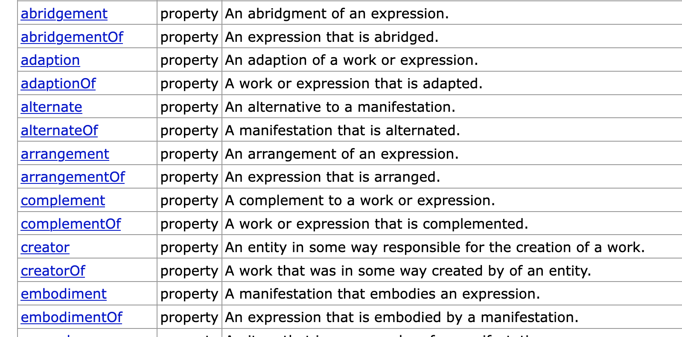
Notes:
It also includes the primary bibliographic relationships, although I have not seen these used in the wild.

Slide 6
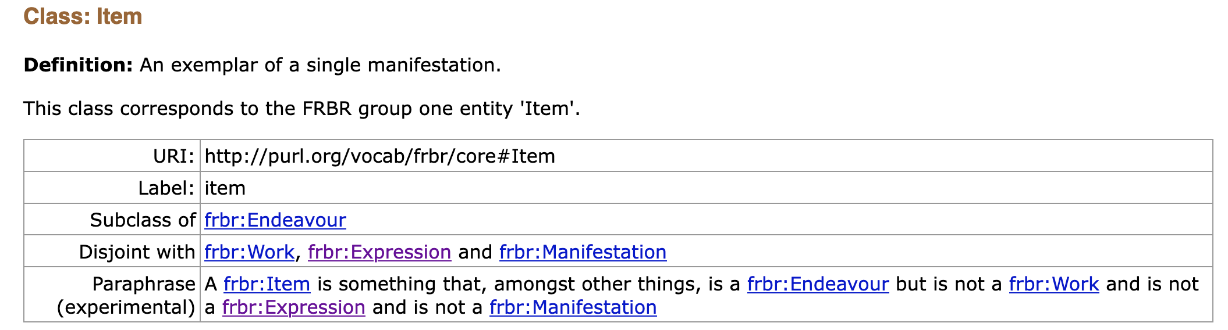
built-in constraints

Slide 7
The openWEMI proposal
Classes
properties
openwemi:Endeavor
openwemi:Work
openwemi:Expression
openwemi:Manifestation
openwemi:Item
openwemi:expresses (range: Work)
openwemi:manifests (range: Work or Expression)
openwemi:instantiates (range: Work or Expression or Manifestation)

Slide 8
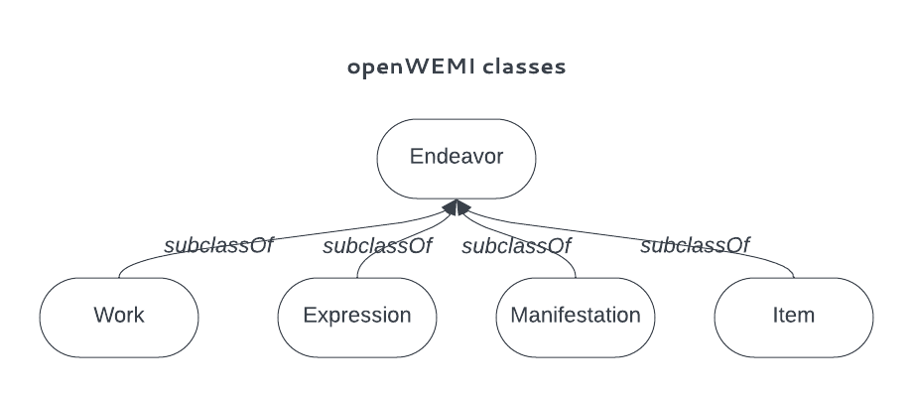
endeavor is the superclass that holds it together

Slide 9
and allows other classes to be created at a high level to complement openwemi
subclassOf
MyShape

Slide 10
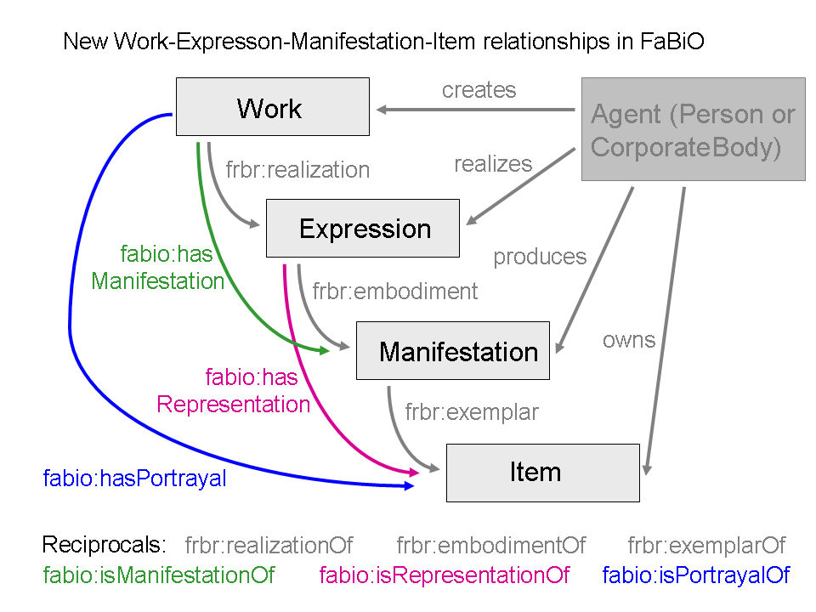
entity relationships
openwemi:Work
openwemi:Expression
openwemi:Manifestation
openwemi:Item
Notes:
FRBR relationships are linear and you can’t “skip” entities; openwemi allows other relationships between entities as long as they do not defy the general concepts, which is that the level of abstraction goes from Work (the most abstract) to Item (the least). In keeping with the RDF concept that your data may be incomplete without being wrong, this permits people to create the data they have on hand, and can fill in more at another time. It also allows different interpretations of the WEMI stack – for example, someone describing a sculpture may prefer to use Work and Item because the Item is unique and therefore there is no need to describe different expressions or manifestations.

Slide 11
Added properties
commonWork
commonExpression
commonManifestation
commonItem
For use between disparate metadata entities. Subject and object may be totally different in their format and content.
Notes:
Developed by Ross Singer at vocab.org many years ago. They are in the spirit of openwemi because they allow the use of the wemi concepts without any constraints on what the format or metadata coding of the subject and object are. These could be used, for example, to say that a song in musicbrainz and a youtube video of a cover of the song entail the same work. A book in Amazon and in a library database may be a commonManifestation. It doesn’t say any more than that. commonItem may not have application but we put it out there – someone may find a use for it.

Slide 12
very broad Definitions
LRM
openWEMI
Work: "An abstract notion of an artistic or intellectual creation.”
Expression: "An expression of a work in signs.”
Manifestation: "The physical embodiment of one or more expressions”
Item: "An exemplar of a single manifestation."
Endeavor: “A creation”
Work: "An abstract notion of an artistic or intellectual creation.”
Expression: ”A perceivable form of a creation.”
Manifestation: "The physical embodiment of a creation”
Item: "An exemplar of a creation."
Notes:
Note that in LRM, each definition refers to the entity “above” it; so a manifestation embodies an expression; and item is an exemplar of a manifestation. This enforces the linearity of that model, which we have specifically eliminated from openwemi.

Slide 13
we hope for resource-specific subclasses and subproperties
openWEMI:Work
textile:Work
textile:Quilt
textile:Shawl
music:Work
music:Symphony
Notes:
How do I see these used, since they are very broad? We saw this with FaBiO and the Music ontology: you define your own w, ex, etc., with your own definitions, but that follow the general concepts. This is how the metadata examples we found are using FRBRcore from vocab.org.

Slide 14
The openwemi working group
Phil Barker
Sean Petiya
Ross Singer
Graeme Williams
Karen Coyle (chair)

Slide 15
Links again
https://dcmi.github.io/openwemi/
https://github.com/dcmi/openwemi

