Slide 1
The Created Work
kcoyle@kcoyle.net

Slide 2
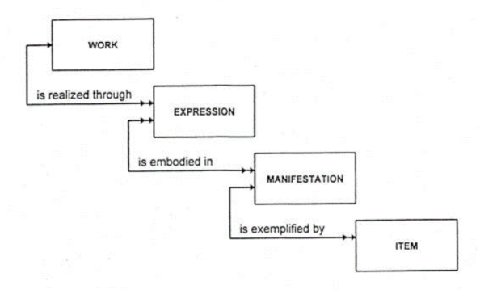
FRBR-LRM WEMI

Slide 3
Sample non-library uses of FRBR concepts
FaBiO – FRBR-aligned Bibliographic Ontology
Akoma-Ntoso – Use of FRBR entities to describe legal document versions
FRIR – Functional Requirements of Information Resources
The Music Ontology

Slide 4
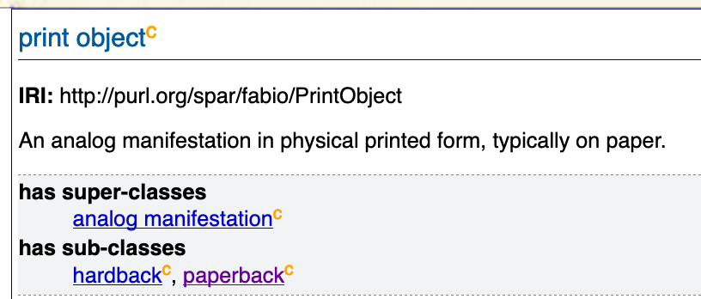
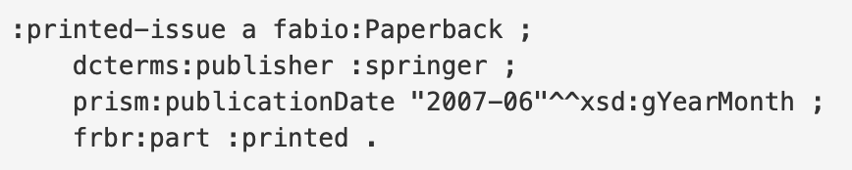
FaBiO – FRBR Aligned Bibliographic Ontology

Slide 5
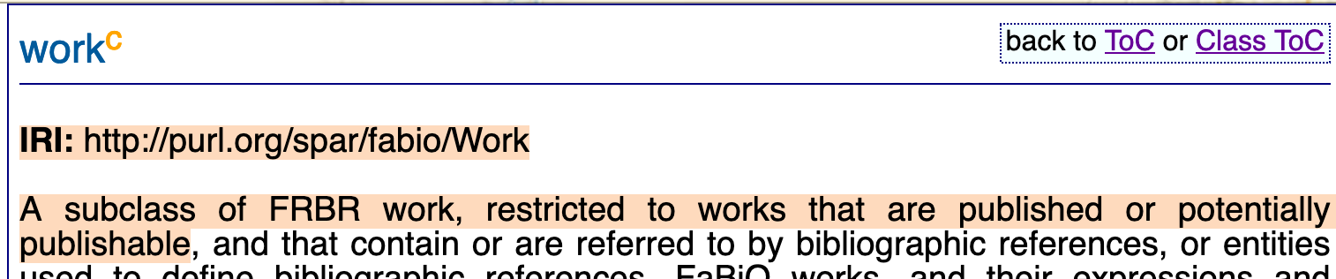
FaBiO – FRBR Aligned Bibliographic Ontology

Slide 6
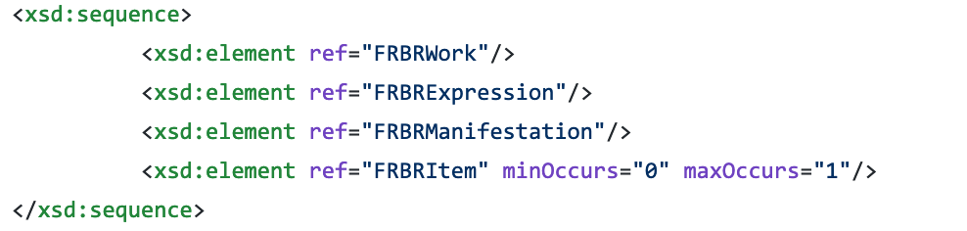
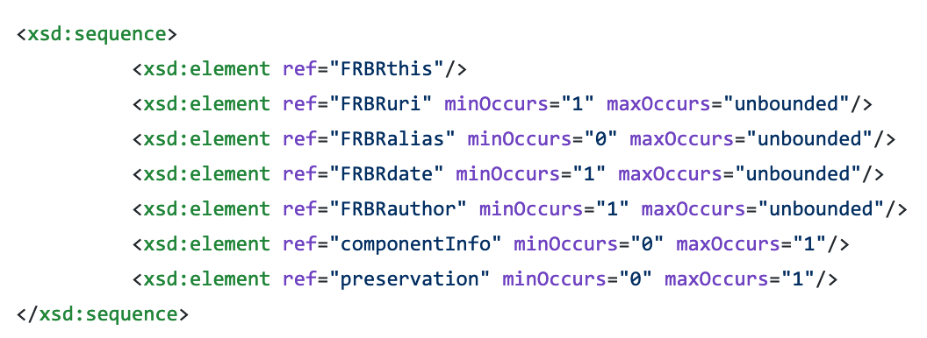
Akoma-Ntoso – an XML schema for legal documentation

Slide 7
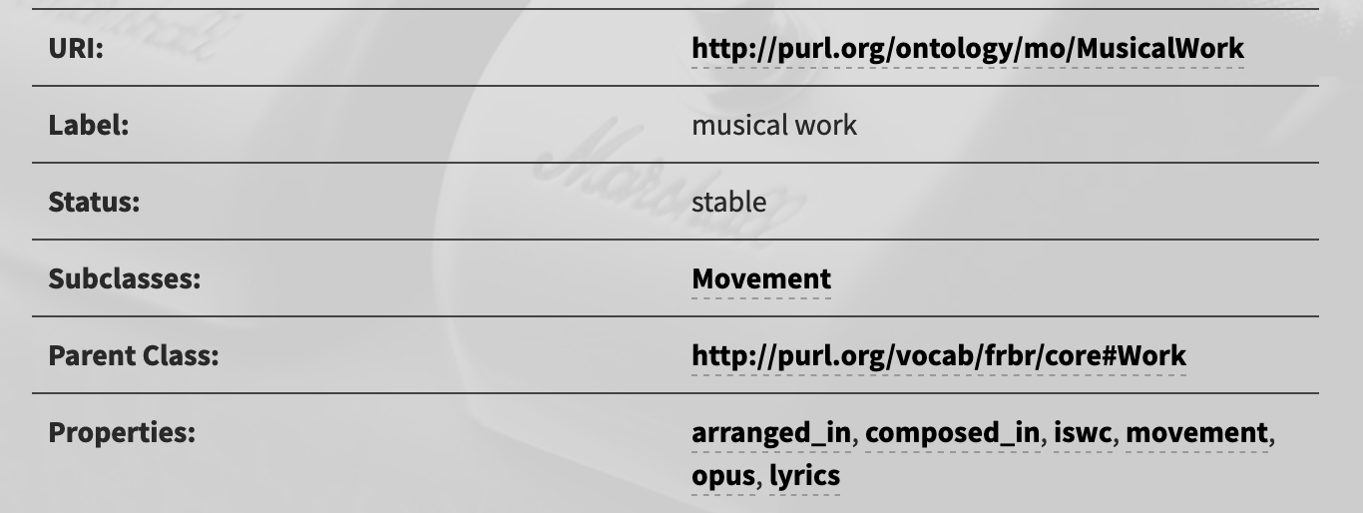
The Music Ontology

Slide 8
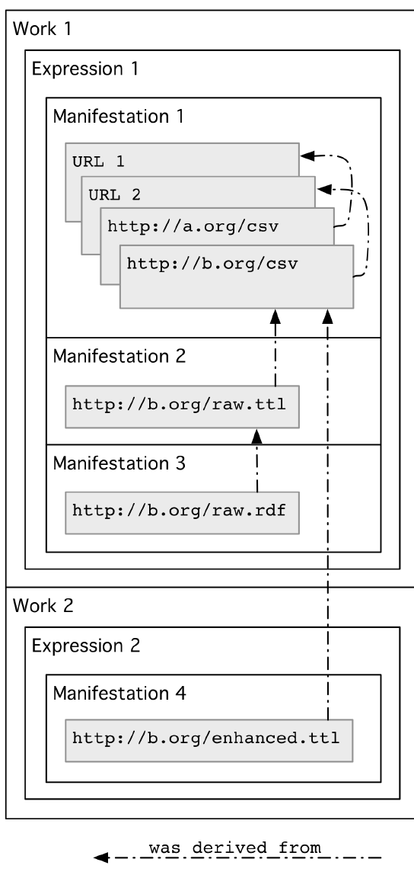
Functional Requirements of Information Resources

Slide 9
Subclasses of FRBR entities
FRBR Core
FaBiO Work
MusicO Work
Akoma Work
FRIR Work

Slide 10
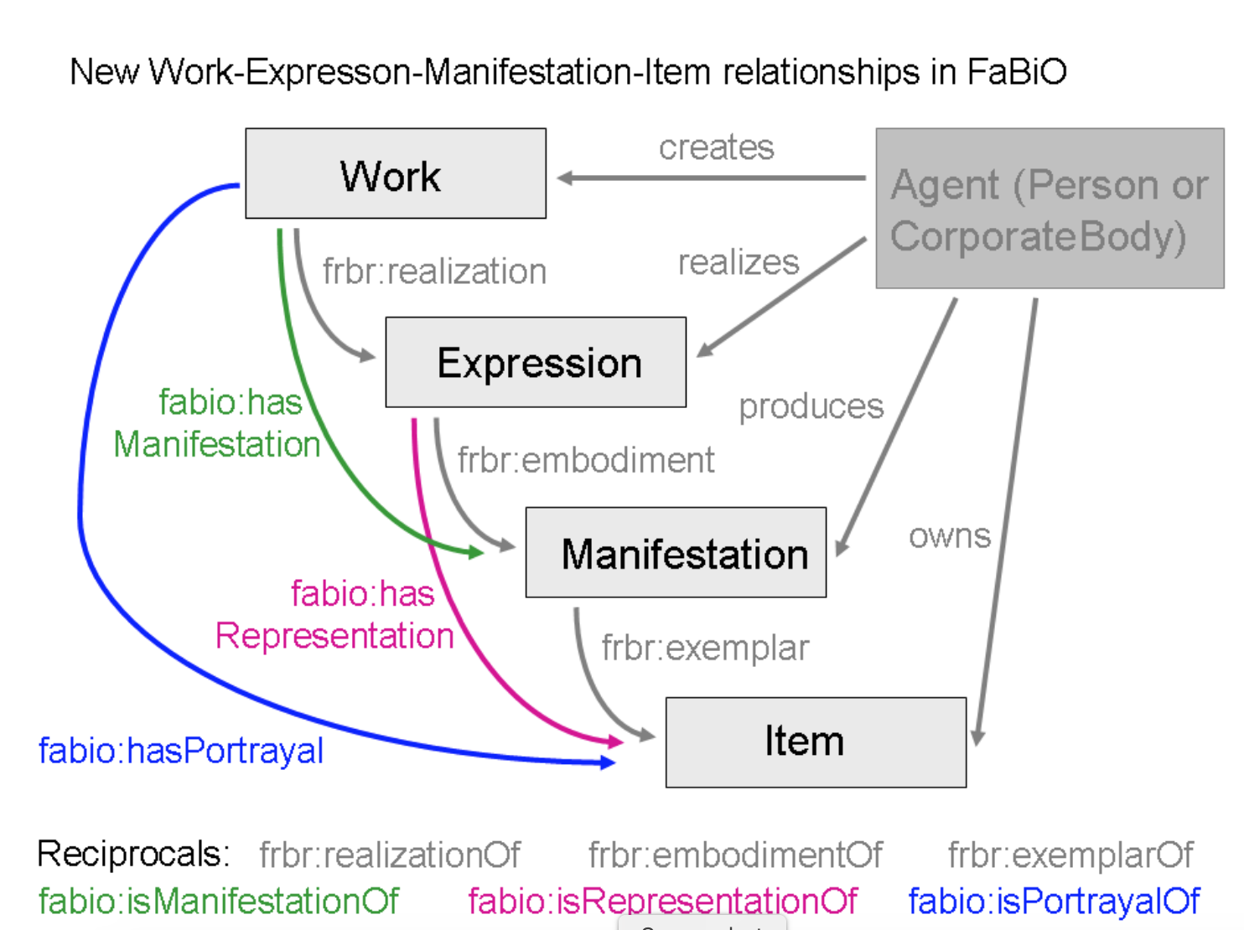
Subclasses? or not?

Slide 11
created work
FRBR/LRM
FaBiO Work
MusicO Work
Akoma Work
FRIR Work
Notes:
These are all profiles of something that does not exist yet – an unconstrained set of classes for created works.

Slide 12
created expression
created work
created manifestation
created item
FaBiO Work
MusicO Work
Akoma Work
FRIR Work

Slide 13
created expression
Created Works Ontology
created work
created manifestation
created item
Akoma-Ntoso
Library Reference Model
FaBiO
FRIR

Slide 14
Proposed: Created Work Ontology
created expression
created manifestation
created item
created work
Subclasses
Akoma-Ntoso Work
MusicalWork
FaBiO Work
FRBR Work
FRIR Work

Slide 15

CWO (pronounced COW?)* * h/t Joachim
any entity can be iterative (e.g. a work of a work)
any entity can have relationships/links to any other entity
no entity has an inherent dependency on any other entity
any entity can be used alone or in concert with other entities
no entities are disjoint
anyone can define additional entities or subclasses
individual profiles using the model may recommend or limit attributes and relationships, but the model itself will not have restrictions

Slide 16
CrWO (pronounced CROW?)
any entity can be iterative (e.g. a work of a work)
any entity can have relationships/links to any other entity
no entity has an inherent dependency on any other entity
any entity can be used alone or in concert with other entities
no entities are disjoint
anyone can define additional entities or subclasses
individual profiles using the model may recommend or limit attributes and relationships, but the model itself will not have restrictions

Slide 17
Thank you and links
http://purl.org/spar/fabio/
http://www.akomantoso.org/ (also: https://github.com/oasis-open/legaldocml-akomantoso/)
http://tw.rpi.edu/media/2012/02/07/d641/EX_ISSI-2011-09-0138.R1_McCusker.pdf (FRIR)
http://musicontology.com/specification/
http://vocab.org/frbr/core
http://kcoyle.blogspot.com/2019/01/frbr-without-fr-or-br.html
http://kcoyle.net/beforeAndAfter/c10-978-0-8389-1364-2.pdf
http://kcoyle.net/WEMIpres.pdf
kcoyle@kcoyle.net

