Slide 1
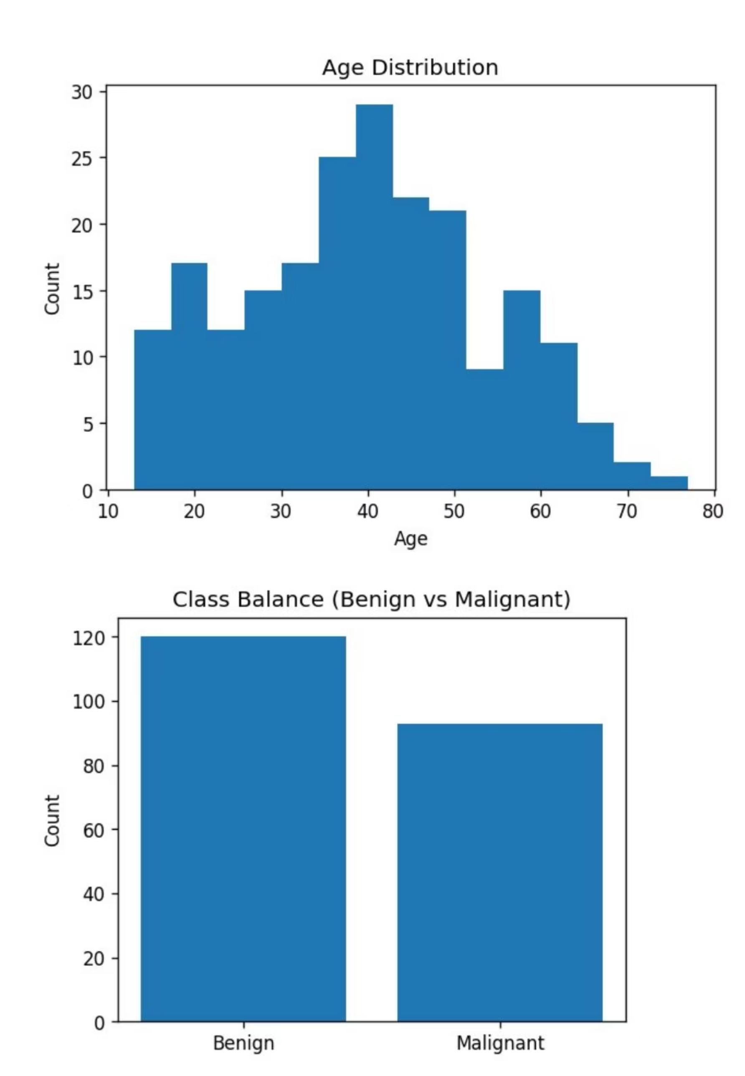
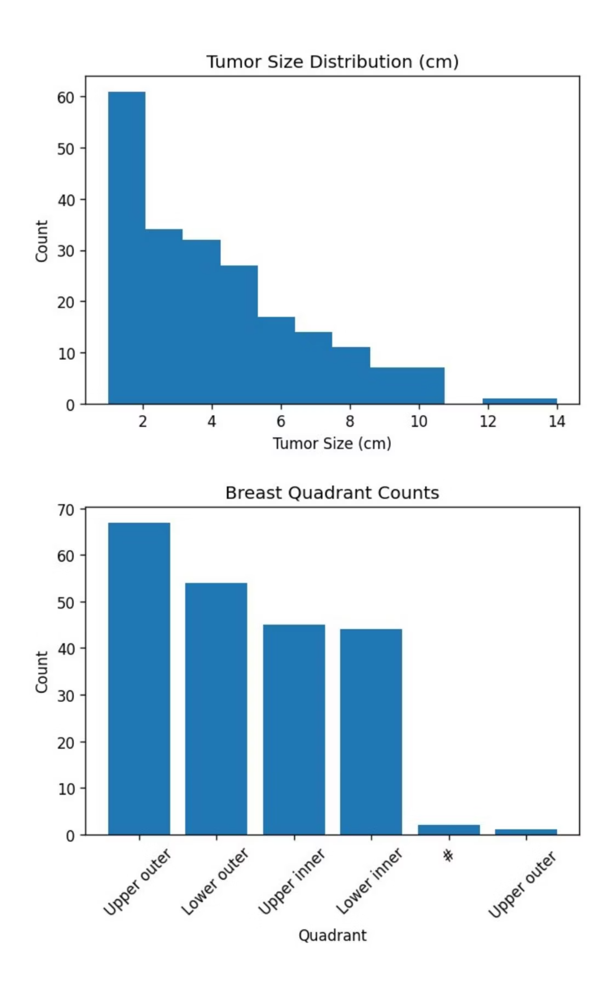
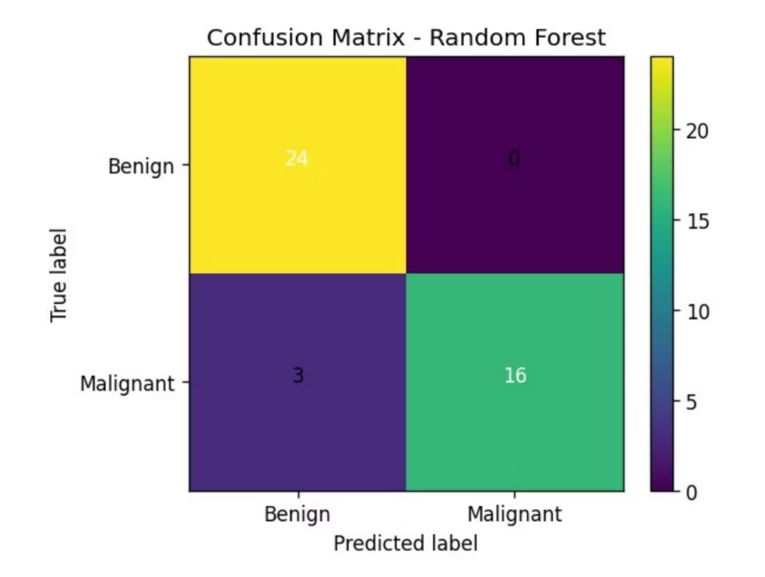
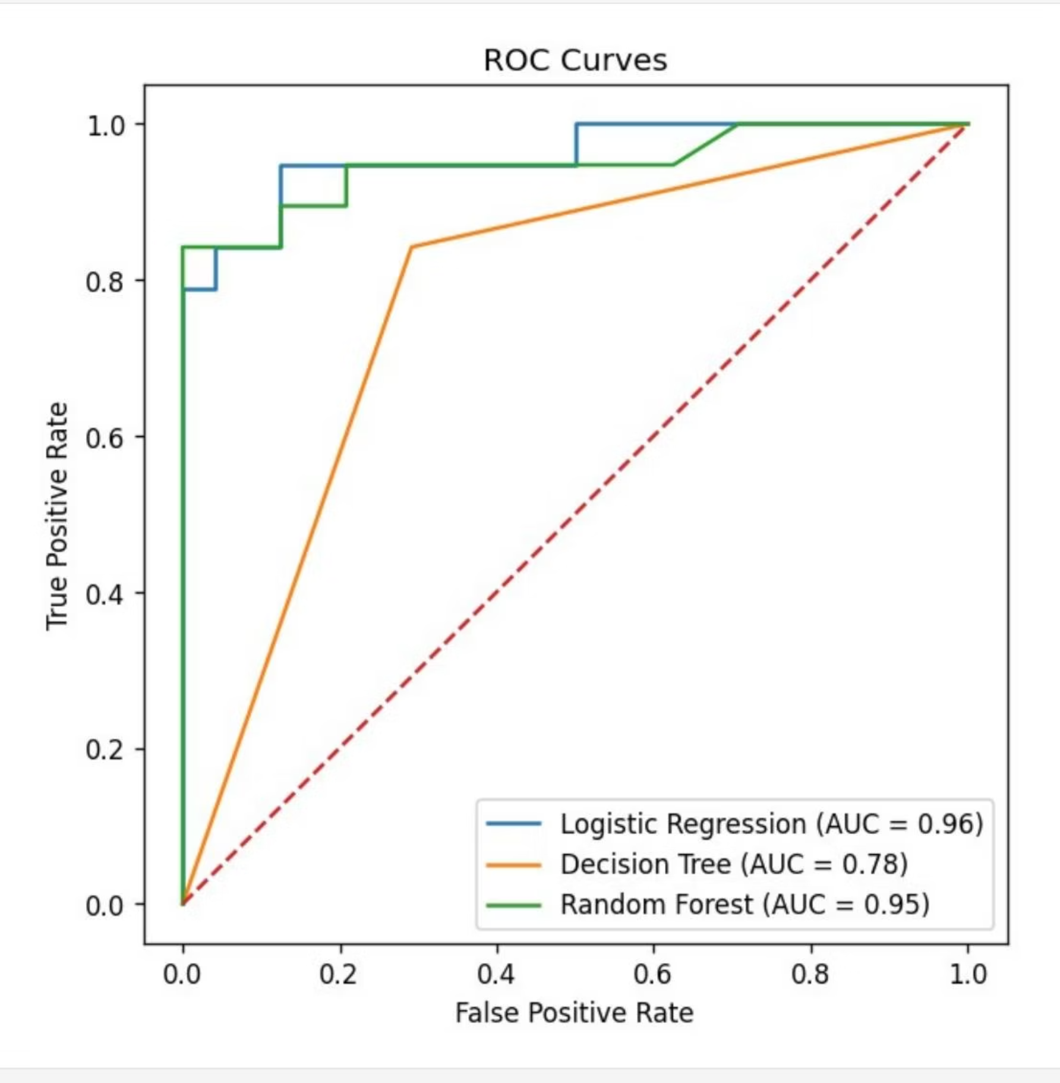
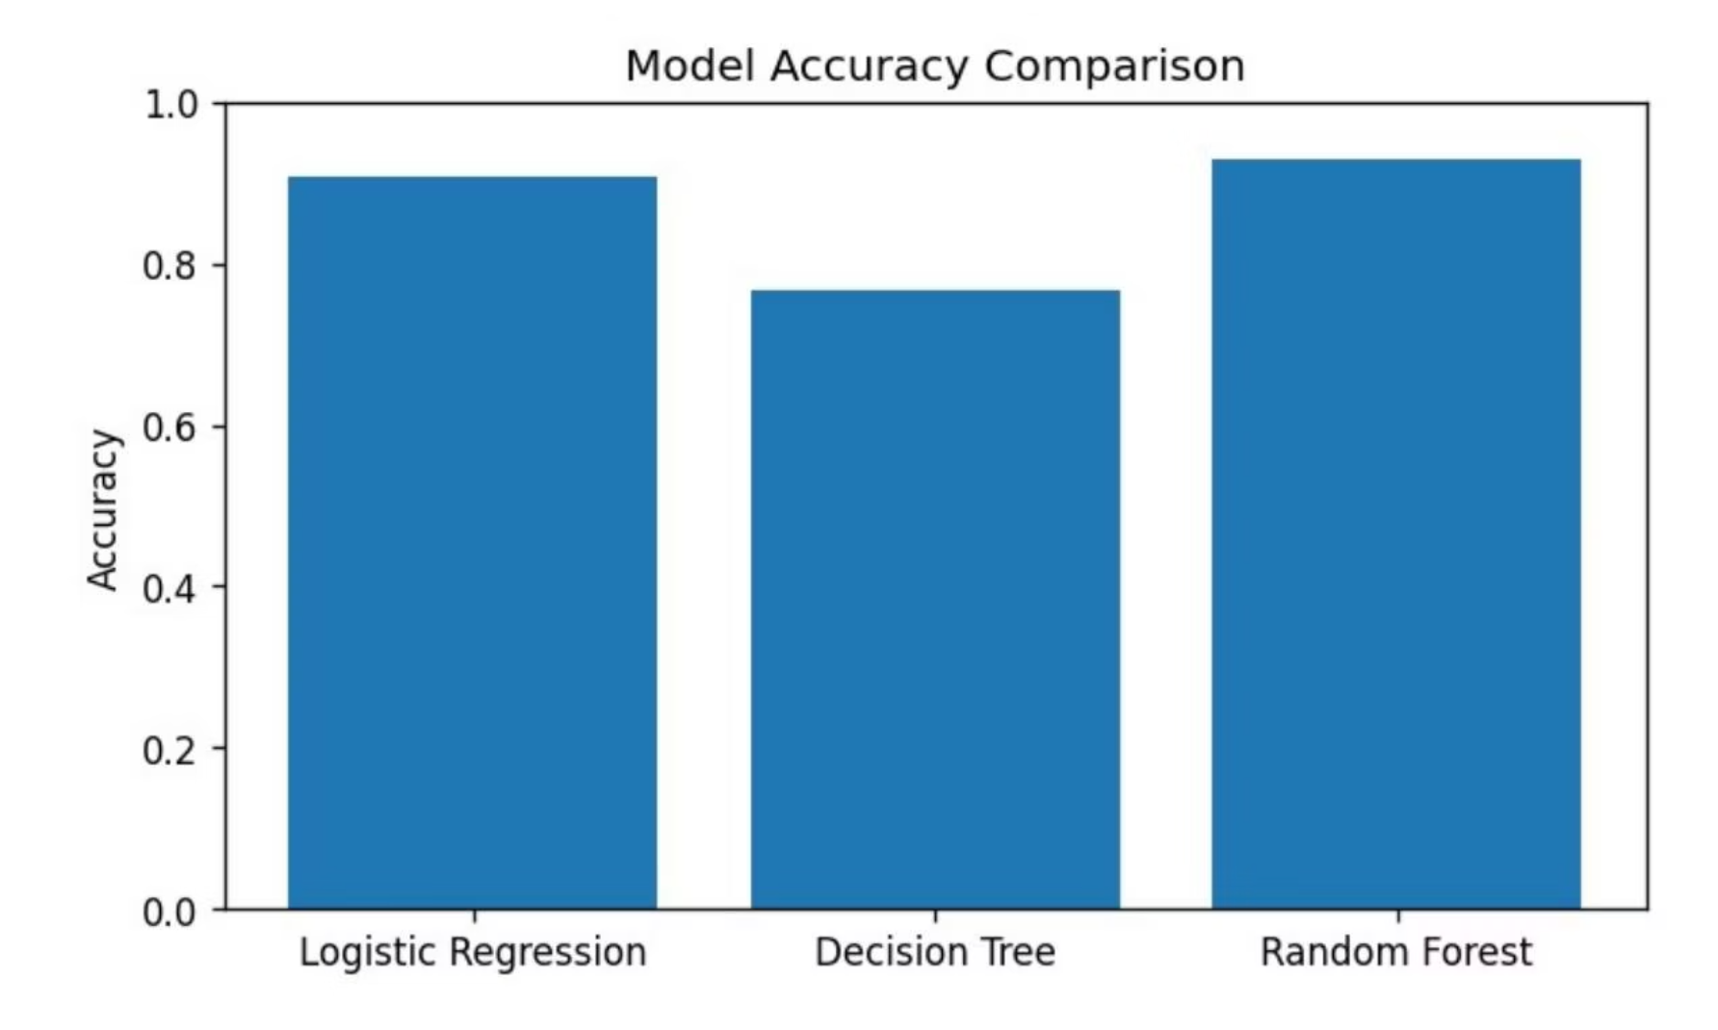
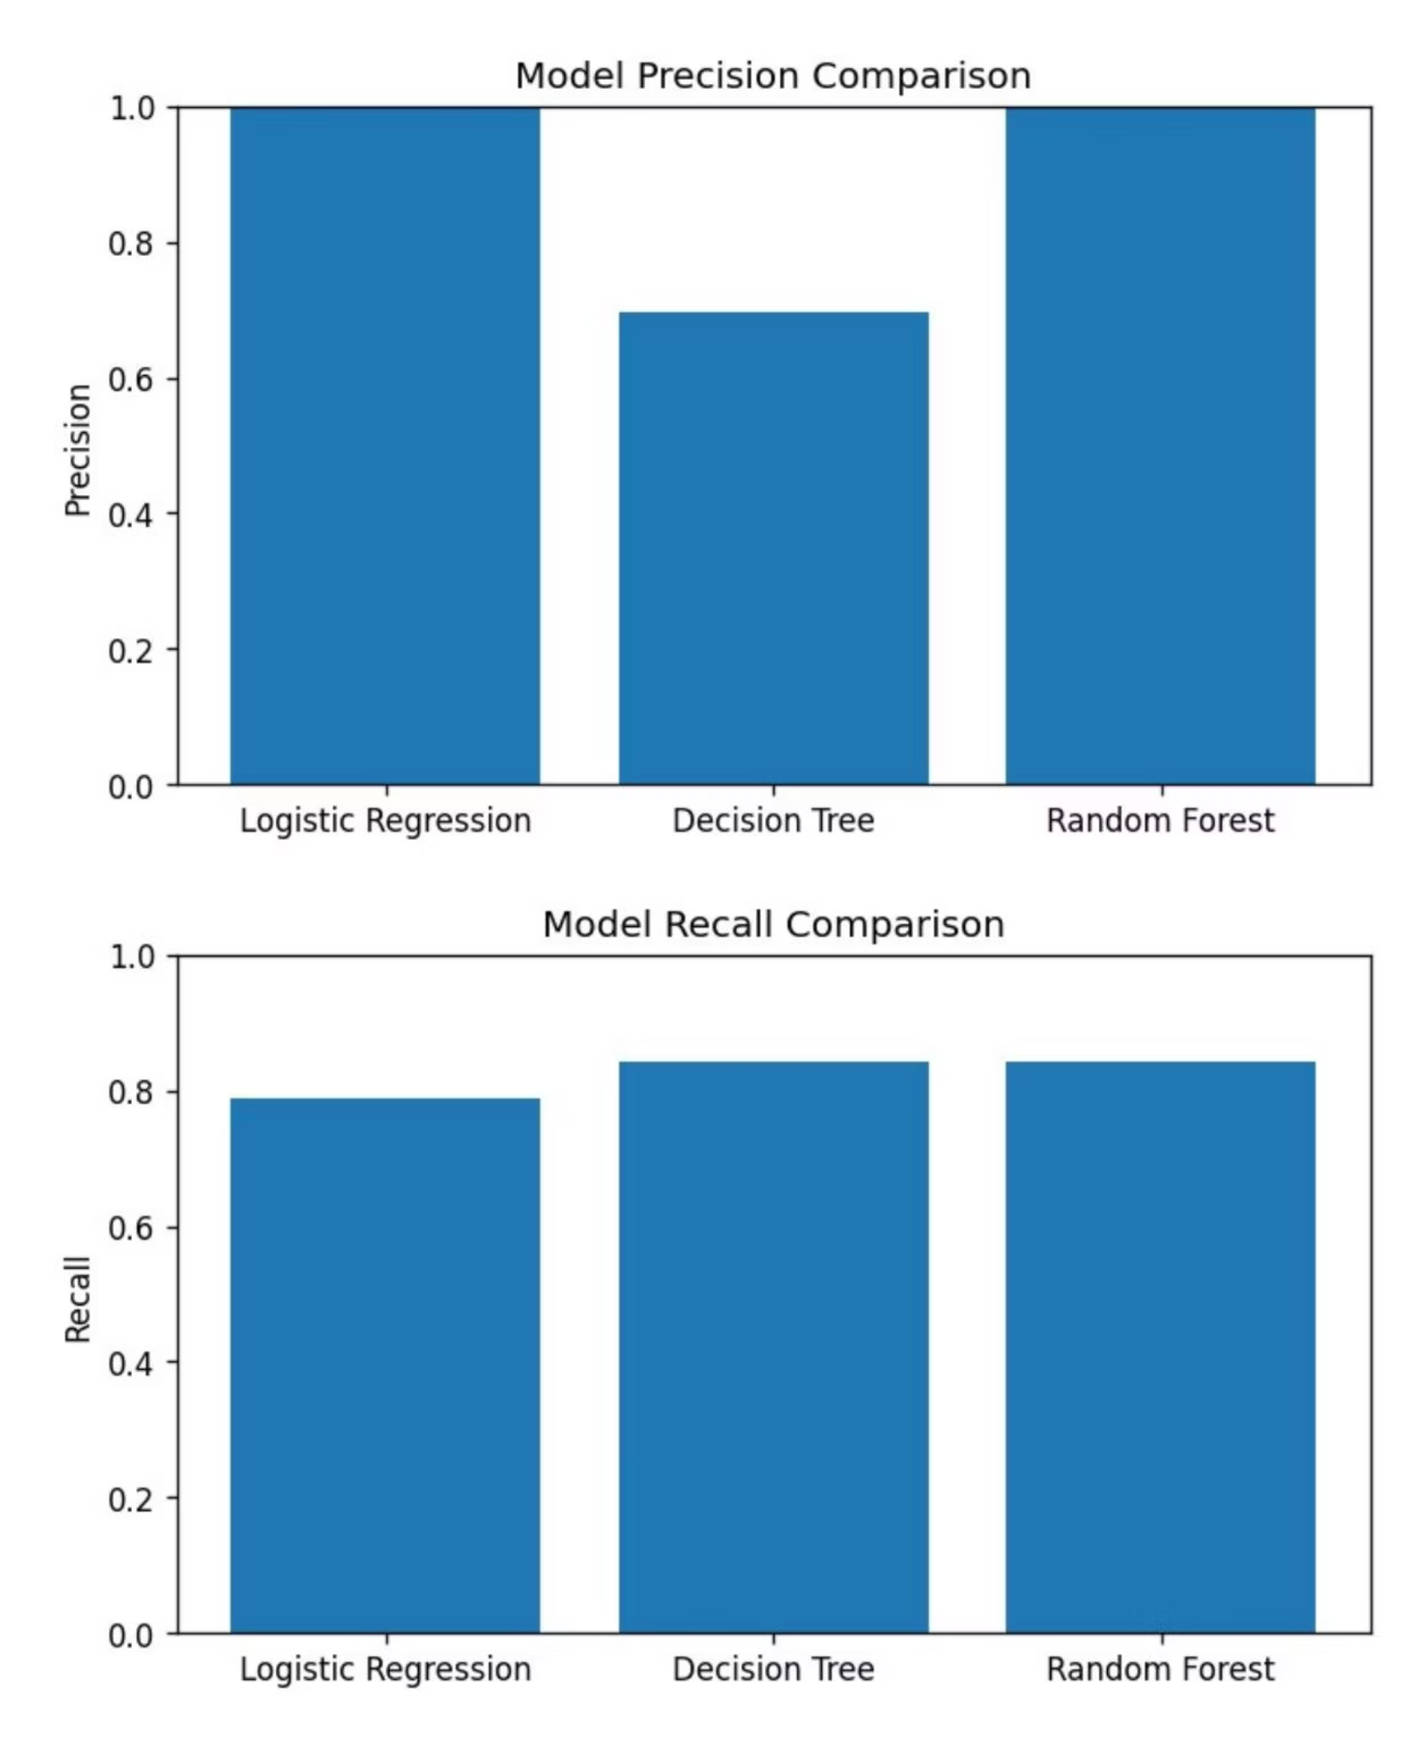
Breast Cancer Detection: A Machine Learning Approach
This presentation outlines a machine learning project focused on breast cancer detection using a Kaggle dataset. We will cover the key steps from data exploration to model evaluation, aiming to build a robust predictive model.
01
02
03
Introduction & Problem Statement
Imports & Dependencies
Load & Explore Dataset
04
05
06
Data Preprocessing
Model Training
Model Evaluation
07
Conclusion & Next Steps
Dataset Loading and Initial Inspection
The dataset, "breast-cancer-dataset.csv," contains 213 entries and 11 columns. Initial inspection reveals a mix of numerical and categorical data types, including patient age, tumor size, and diagnosis results.
Quick Data Inspection & Cleaning
Data cleaning involves converting range-like columns to numeric midpoints, one-hot encoding categorical fields, and creating a binary target column (1 for Malignant, 0 for Benign). Missing values are handled by filling numeric NaNs with the median.
Exploratory Data Analysis (EDA)
EDA provides insights into the dataset's characteristics through visualizations of age distribution, class balance, tumor size, and breast quadrant counts. These plots help understand the data's underlying patterns and potential biases.
Data Preprocessing
Preprocessing steps include dropping unnecessary columns, one-hot encoding categorical variables like 'Breast' and 'Breast Quadrant', and scaling numeric features. The data is then split into training and testing sets (80/20 split) to prepare for model training.
Model Training
Three classification models are trained: Logistic Regression, Decision Tree, and Random Forest. Each model learns from the preprocessed training data to predict breast cancer diagnosis.
Model Evaluation
Models are evaluated using key metrics: accuracy, precision, recall, F1-score, and ROC-AUC. Confusion matrices and ROC curves are visualized to assess performance comprehensively.
Logistic Regression
Decision Tree
Random Forest
Accuracy: 0.907
Accuracy: 0.767
Accuracy: 0.930
Precision: 1.0
Precision: 0.696
Precision: 1.0
Recall: 0.789
Recall: 0.842
Recall: 0.842
F1-score: 0.882
F1-score: 0.762
F1-score: 0.914
ROC-AUC: 0.958
ROC-AUC: 0.775
ROC-AUC: 0.947
Conclusion & Next Steps
The Random Forest model achieved the highest accuracy (0.930) among the tested models. Future steps include hyperparameter tuning, cross-validation, addressing class imbalance with SMOTE, and model persistence for deployment.

