Slide 1
DSCI 415 Final Project
Jenny Ackerman

Slide 2
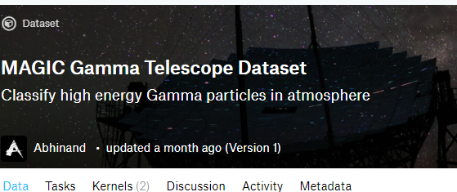
Datasets
Kaggle – MAGIC gamma telescope data
numeric data
Twitter datasets
#LaughingstockofTheWorld
#TrumpisaLaughingStock

Slide 3
MAGIC Gamma Telescope data
Telescope data measuring both:
primary gamma wavelengths
background gamma wavelengths
All numeric data and a class column

Slide 4
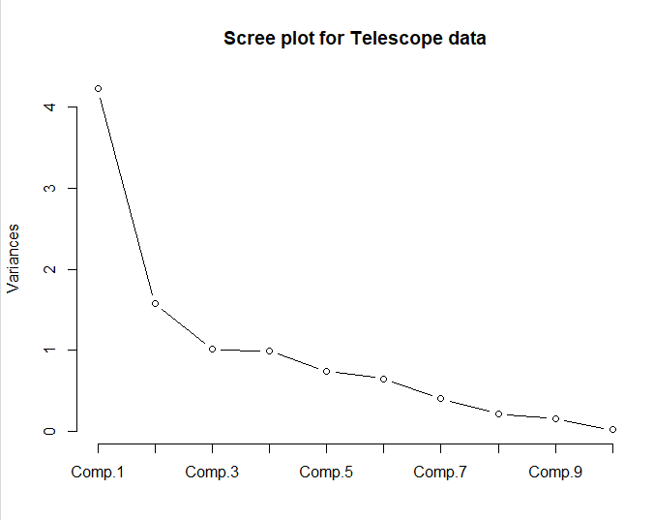
PCA on MAGIC data
Used a Scree plot to determine that I should use 4 components

Slide 5
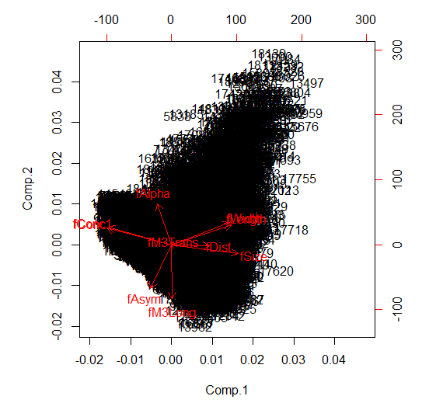
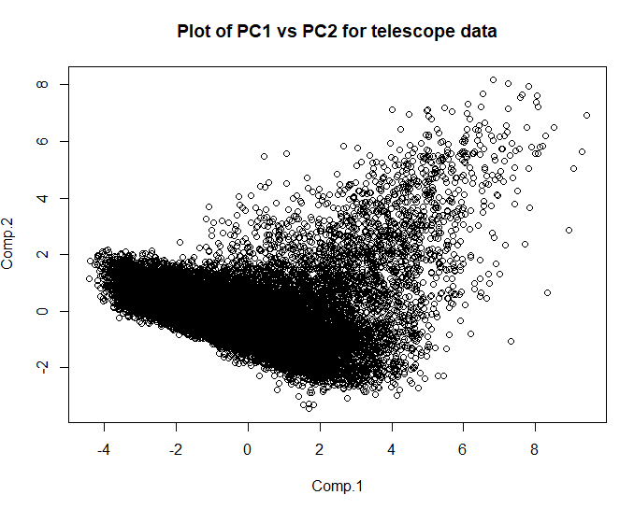

Slide 6
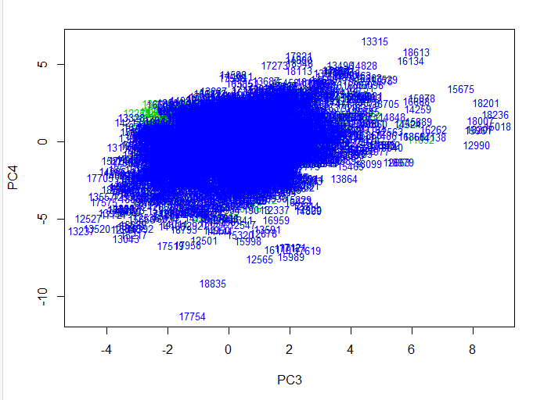
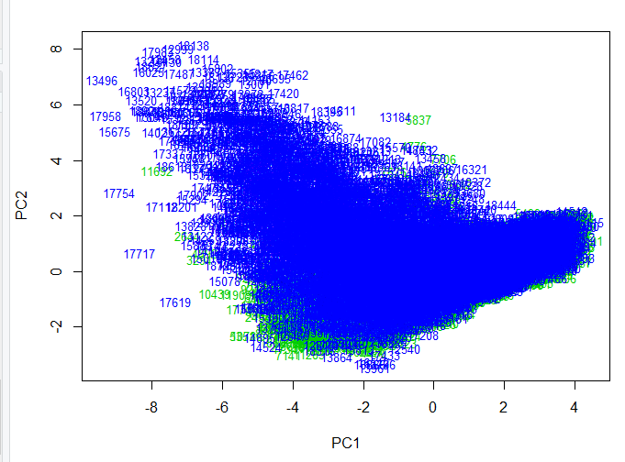
First 4 PC graph

Slide 7
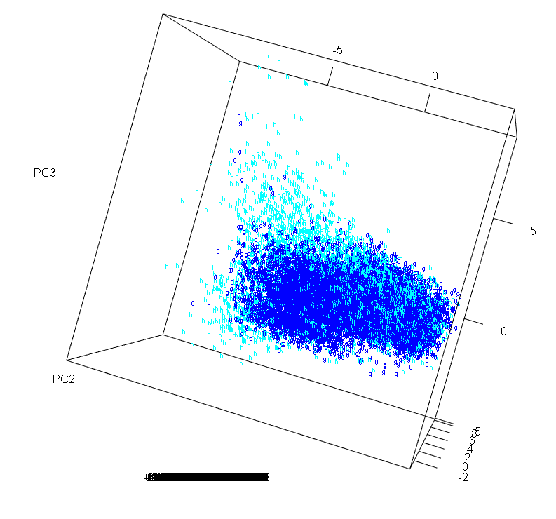

Slide 8

Twitter Data
Combined both datasets into one
Cleaned the text as best

Slide 9
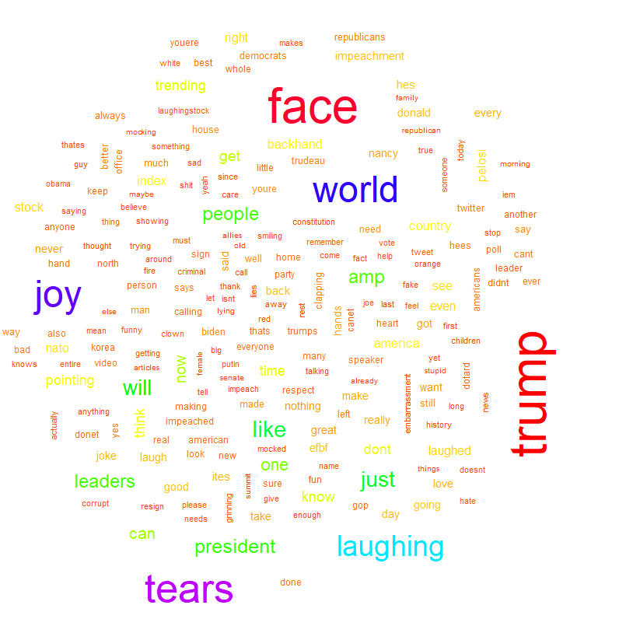
Word Clouds
min.freq=50

Slide 10

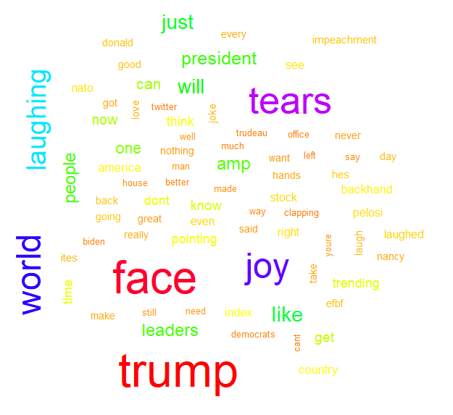
min.freq=100

Slide 11
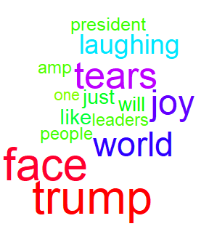
min.freq =300

Slide 12
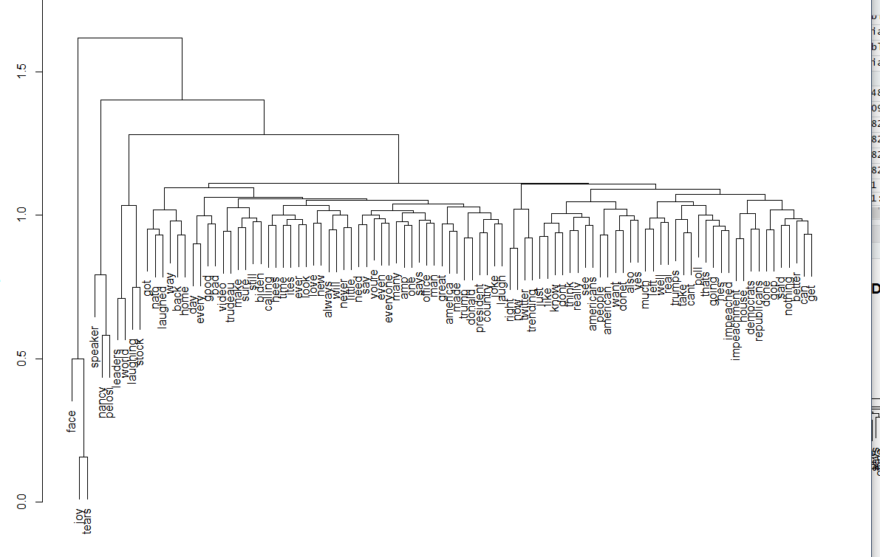
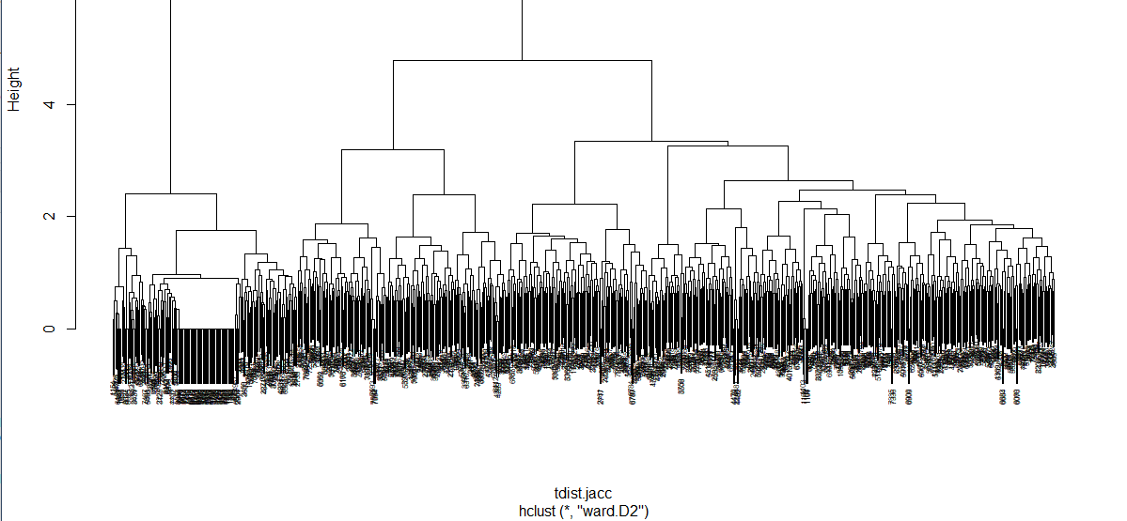
Clustering Tweets
Used Jaccard’s Method with ward’s linkage

Slide 13
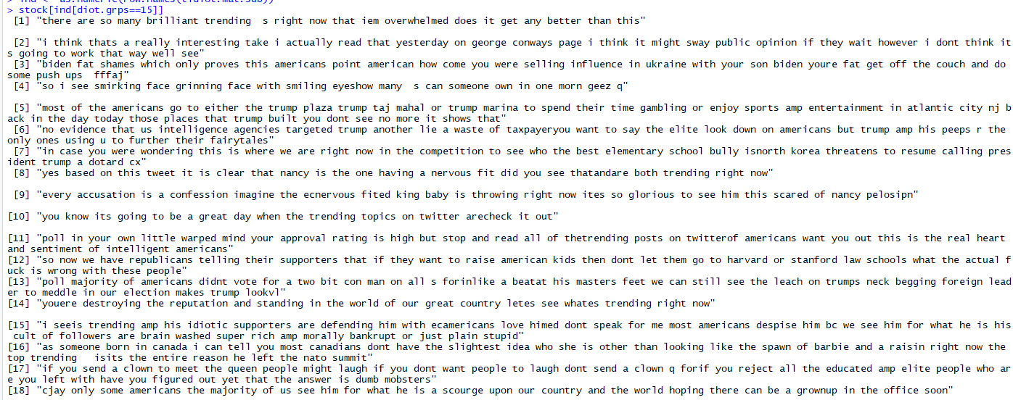

Slide 14
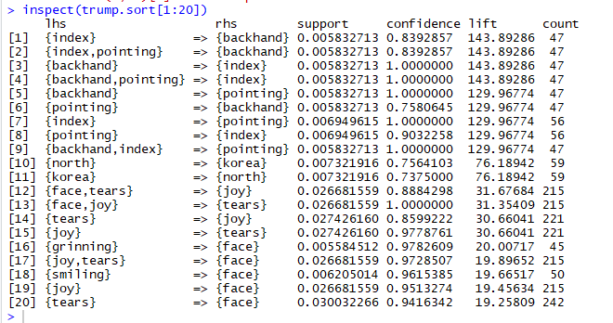
Association Rules with Tweets

Slide 15
