Slide 1
Nice Ride: A Minneapolis Bike Share Program
Jenny Ackerman

Slide 2
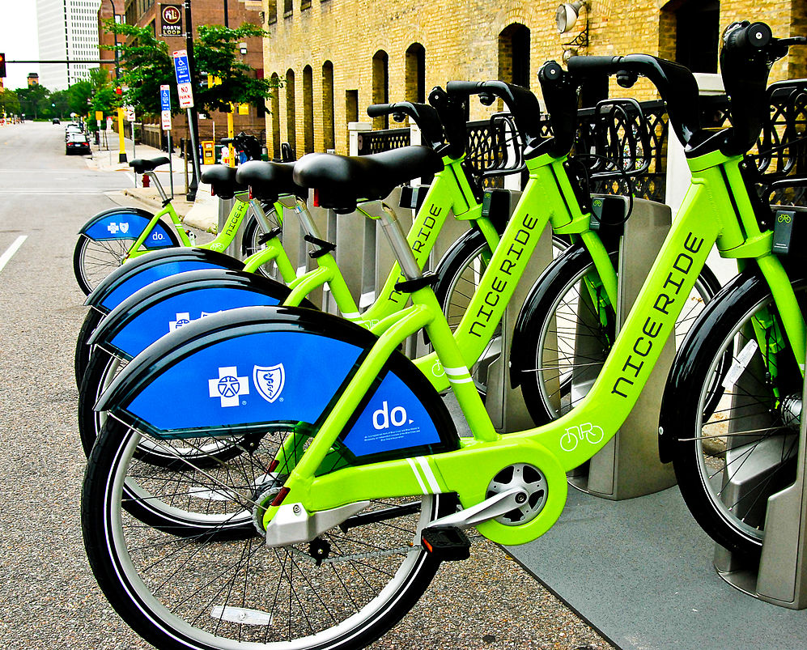
Nice Ride
a nonprofit bike share program
based in Minneapolis- St. Paul MN
April- November Season
3,000 bikes in service and 400 stations in the twin cities
https://en.wikipedia.org/wiki/Nice_Ride_Minnesota
Notes:
Nice Ride is a nonprofit bike share program that was started in 2010. Nice Ride provides bikes to the Minneapolis - St.Paul region. The Bike share season runs from the first week in April to the first week in November every year, during the winter months the bikes are stored and looked at for repairs.

Slide 3

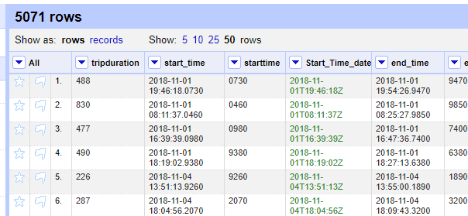
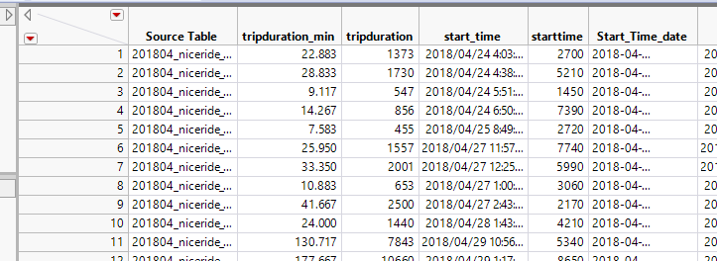
Nice Ride System Data
General Bikeshare Feed Specification (GBFS)
Start Station
End Station
Bike Type, (Classic, Dockless)
User Type, (Customer, Subscriber)
Trip Duration (secs)

Slide 4
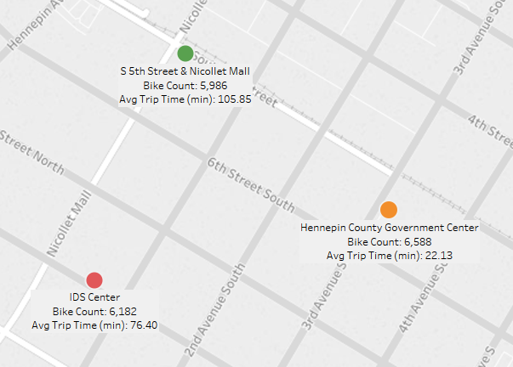
Starting Station
Downtown Minneapolis
Classical Riders only
Starting location of the bikes
Station name
Average Trip duration
number of bikes that started a trip from this location

Slide 5
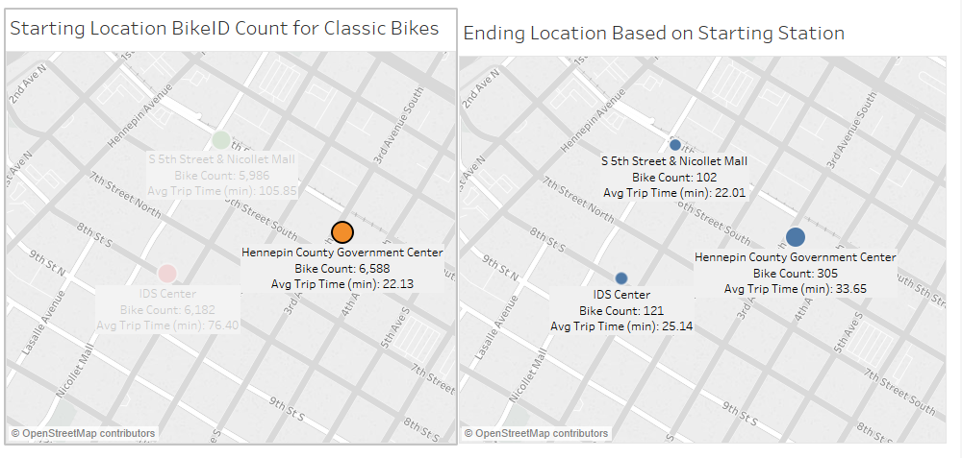

Slide 6
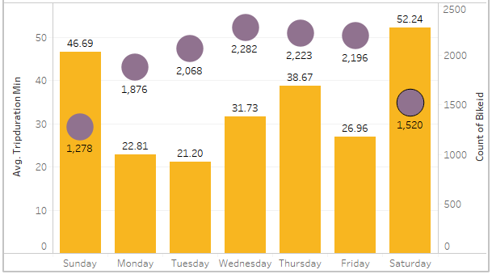

Avg. Trip Length & Bike ID by Day for Dockless Riders

Slide 7
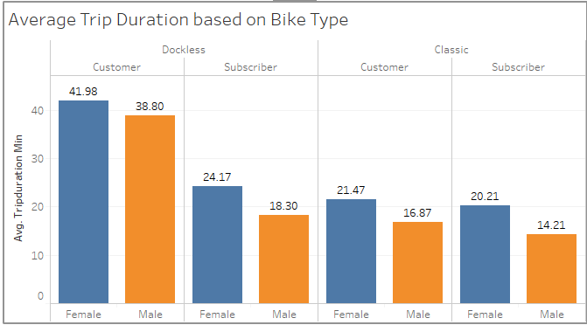
Average Trip Duration

Slide 8
Next Areas to Explore
Stations vs Dockless bikes
Compare to Other Cities
Peak Times for Bike Use
Maintenance Stations

Slide 9
References
Nice Ride Website
https://www.niceridemn.com/
Nice Ride System Data
https://www.niceridemn.com/system-data
Nice Ride Wiki Page
https://en.wikipedia.org/wiki/Nice_Ride_Minnesota
Nice Ride Index DataBucket
https://s3.amazonaws.com/niceride-data/index.html

