Slide 1






Java Bus Reservation System
DEPARTMENT OF COMPUTER APPLICATIONS
Guided by :
Mr.Dr.M . Prakash M.sc,M.phil, PhD.
Computer science
Presented by :
A.Madhan Vishnupriyan (7172210008)
S.Christopher(7172210003)
B.Manoj kumar(7172210009)

Slide 2
AGENDA
⮚ Objective
⮚ Existing System
⮚ Proposed System
⮚ System Specifications
⮚ Module Description
⮚ Data Flow Diagram

Slide 3
Objective
⮚
The Bus Reservation System is a dynamic web-based application that simplifies booking and managing bus tickets, offering secure interfaces for passengers (search, book, view history) and admins (manage buses, bookings, users).
Key features include user registration, real-time bus searches by route/date, seat booking, and a centralized admin dashboard for system control.
It automates manual ticketing, ensuring real-time data access, operational speed, and accuracy for transport companies and passengers.
The system streamlines processes, enhances transparency, and improves the overall travel experience for all users.
⮚
⮚
⮚

Slide 4
Existing System
⮚
The current system forces passengers to visit physical ticket counters or depend on third-party booking agents, offering no digital reservation options or online access for customers.
Frequent overbooking occurs because the manual process cannot track seat availability in real-time, leading to conflicts and customer dissatisfaction when buses are full.
All records are maintained through paper documents and disconnected files, making user management, cancellation processing, and report generation extremely time-consuming.
The outdated desktop-only interface lacks proper security measures and mobile compatibility, creating a poor user experience vulnerable to unauthorized access.
⮚
⮚
⮚

Slide 5
Proposed System
⮚
Our web-based system enables 24/7 online bookings from any device, eliminating physical counter dependence through secure digital reservations.
Real-time seat tracking with instant availability updates prevents overbooking while showing accurate capacity data to all users simultaneously.
A centralized SQL database consolidates all operations - from user profiles to booking history - with automated reporting tools for admins.
Modern security protocols (encrypted logins, SQL injection protection) combine with responsive mobile design for safe, accessible ticket management.
⮚
⮚
⮚

Slide 6
System Requirements
Frontend : JSP with HTML/CSS/JS
Backend : Java Servlets (Tomcat server)
Database : SQLite
Tool : Visual Studio Code
⮚
⮚
⮚
⮚

Slide 7
Hardware Requirements
Processor : Dual-core processor @ 2.0 GHz or higher
RAM : 4 GB or HIgher
Storage : 128 GB HDD or SSD
Operating System : Windows 10 (64-bit), macOS 10.14+, or Ubuntu 18.04+
Network : Stable internet connection
⮚
⮚
⮚
⮚
⮚

Slide 8
⮚
Features of JSP with HTML/CSS/JS :
JSP with HTML/CSS/JS enables dynamic server-side content generation that renders interactive client-side web pages.
Features of Java Servlets (Tomcat server) :
Java Servlets : Java Servlets are server-side Java programs that handle HTTP requests and generate dynamic web content.
Tomcat server: Apache Tomcat is a lightweight, open-source servlet container that runs Java Servlets and JSPs.
Features of SQLite :
SQLite is a lightweight, serverless, self-contained SQL database engine embedded directly into applications.
⮚
⮚

Slide 9
Modules
User Module
Admin Module
Bus Management Module
Booking Module
Ticket Module
Payment Module
⮚
⮚
⮚
⮚
⮚
⮚

Slide 10
⮚
User Module :
Handles user registration, login, and profile access. Users can view available buses, book tickets, and manage their bookings.
Admin Module :
Allows admin to log in securely, manage buses and routes, view all bookings, and generate system usage reports.
Bus Management Module :
Admin can add, edit, or delete bus details, set timings, seat count, and assign routes and statuses.
⮚
⮚

Slide 11
⮚
Booking Module :
Lets users search buses, select routes, choose seats, and confirm bookings with fare calculation.
Ticket Module :
Displays the booking summary with details like bus info, seat number, and fare, along with an option to cancel the ticket.
Payment Module :
Simulates a payment gateway for completing bookings and confirms transaction status to the user.
⮚
⮚

Slide 12
Data Flow Diagram

Slide 13
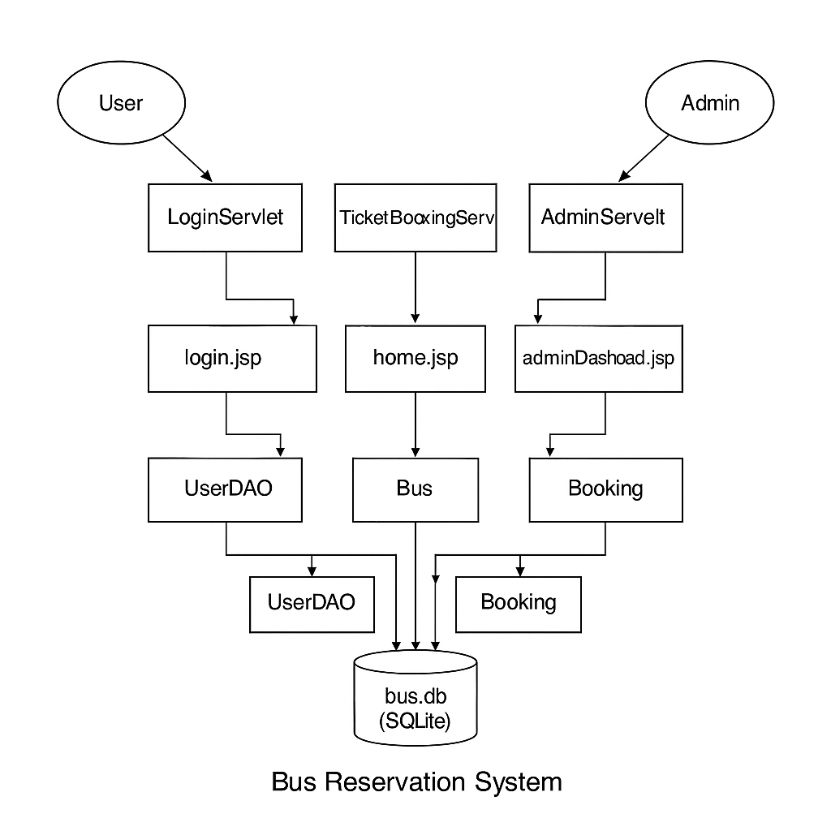
Level 0 :

Slide 14
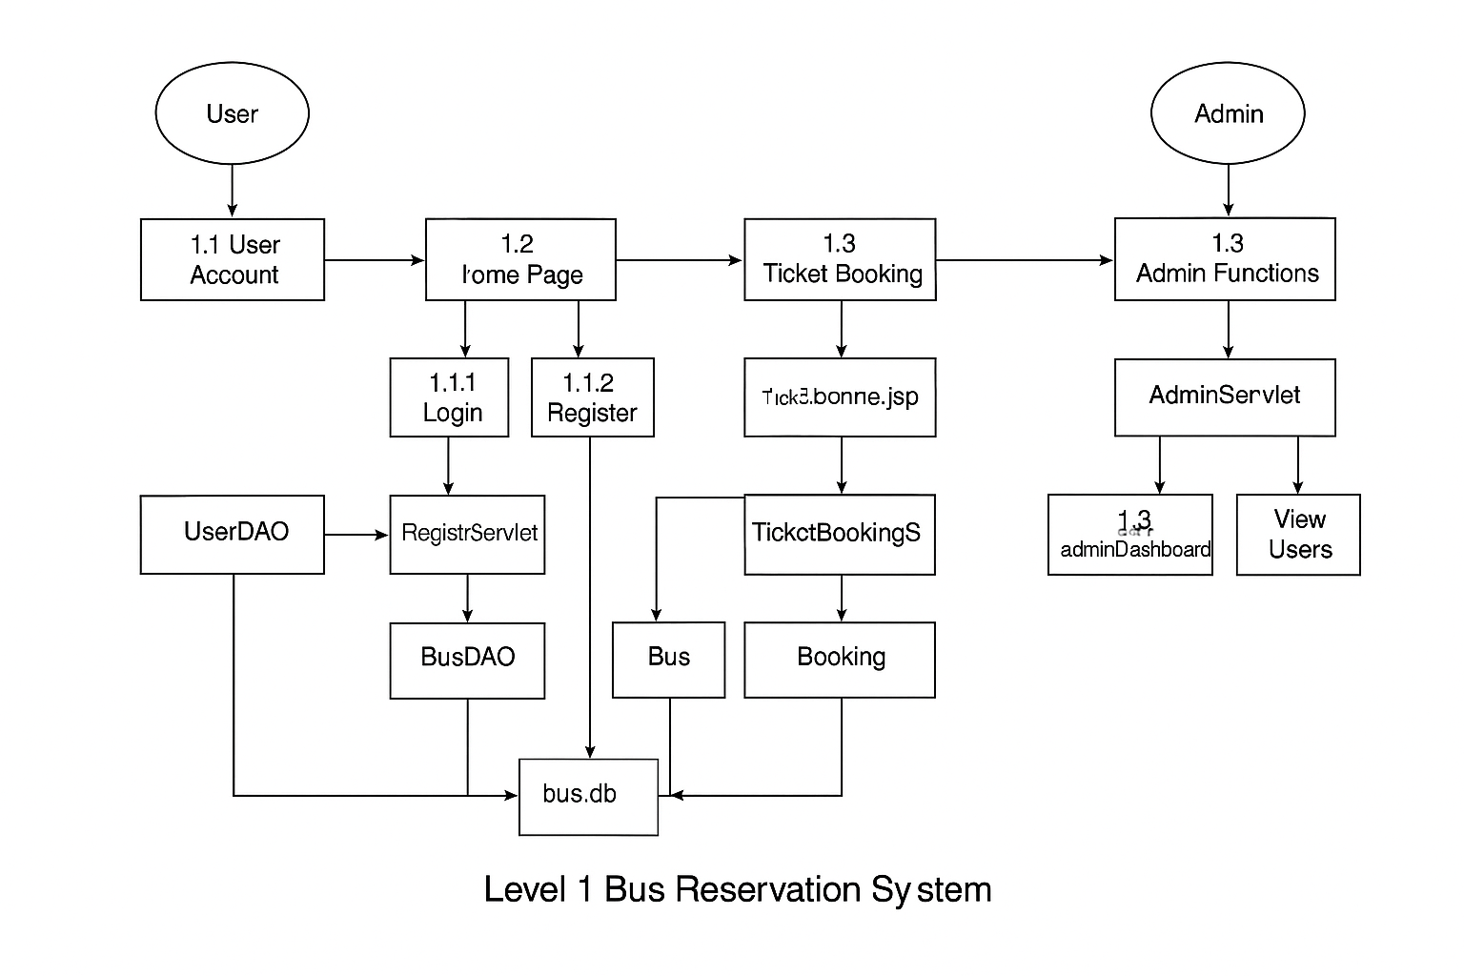
Level 1 :

Slide 15
Use Case Diagram

Slide 16
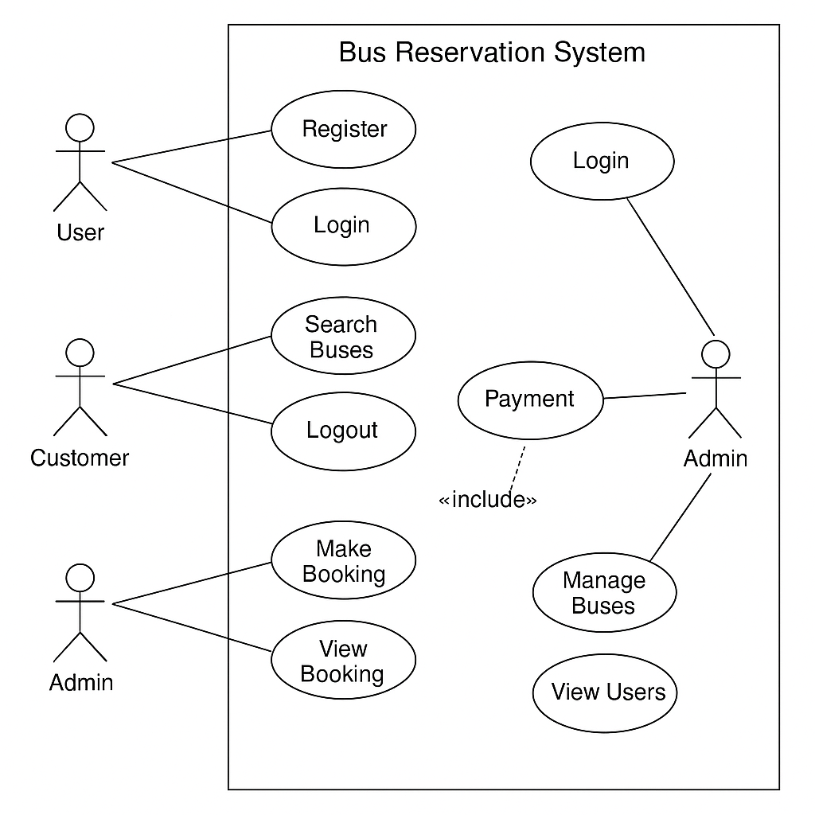

Slide 17
Thank You !

