Slide 1
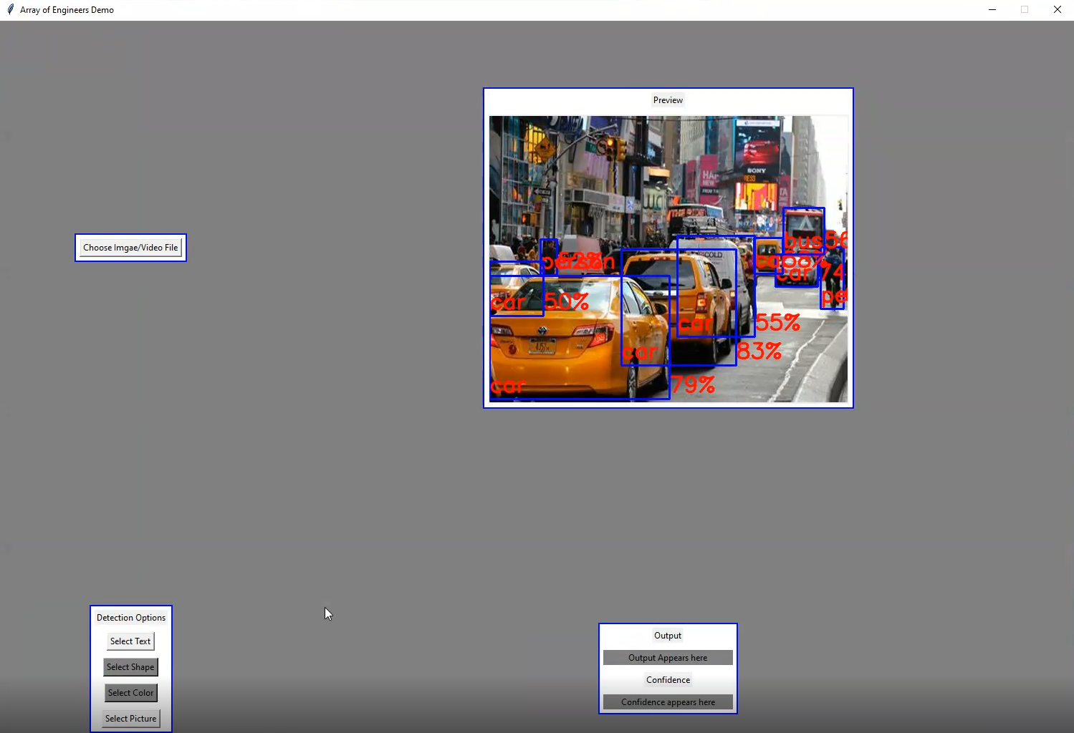
Project
Used Neural Network to identify and verify VGA input
Developed with python, Tensorflow models, and Keras models
Compatible with Xilinx’s PetaLinux and run on embedded ARM processor
Implemented Text and Object detection
Built Gui
Uses CV2 for image processing
Uses Pillow for file browsing
Video feed added but not implemented

Slide 2
Text Detection and Object Detection
Text Detection uses Keras-OCR model
Works on English Language
Correctly detects text and outputs it
Object detection uses Tensorflow hub model
Has label file with roughly 100 objects
Uses Pandas and Matplotlib for output file with detections
Displays top 3 objects detected with confidences\
Correctly detects and displays other objects on output image and outputs them with their confidences

Slide 3
Conclusion
Project set-up for future students or AoE employees to continue work
Needs detections implemented on video feed
Needs checks for detections
Needs adjustable window capture
Could use more GUI development
Other goals achieved
AoE did not know if this was possible but with more development it could be a good asset to their company

