Slide 1
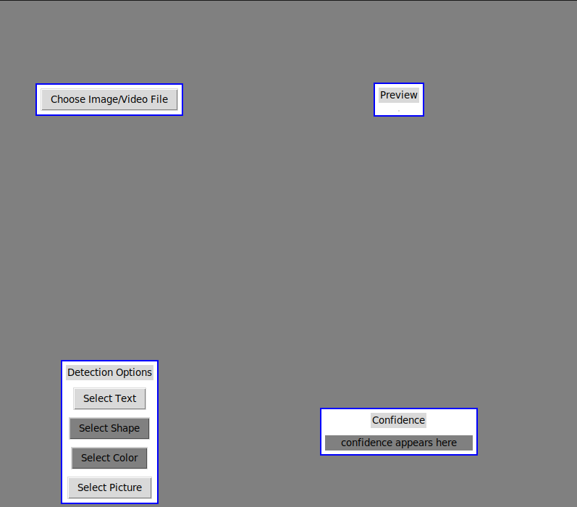


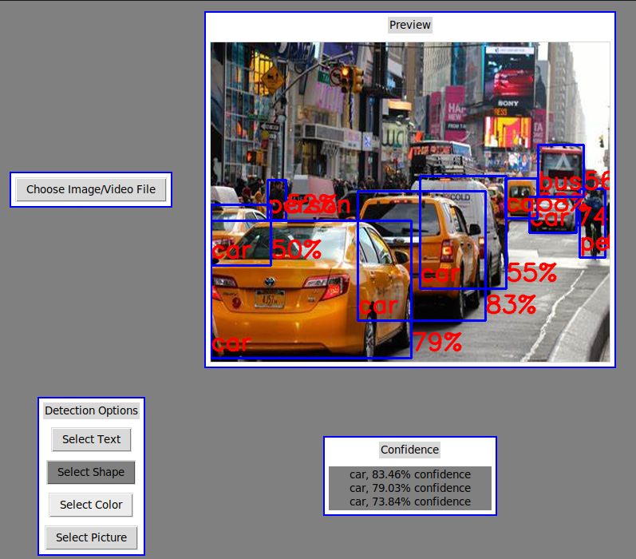
AoE: Machine Learning Object Detection and Text Detection on Embedded Hardware
Austin Ackerman, Sam Isaacs, Brennan Luttrell
Client: Array of Engineers
(Michael Lingg, Principal Research Engineer)
Array of Engineers
Gui
Text Detection
Object Detection
Technical Details
Problem:
The user needs have an interface to interact with the machine learning algorithm. We needed to create a GUI which allows the user to input their picture and select what type of detection will be performed on it. The GUI will also need to display a preview of the user’s image and show where objects in it have been detected. Finally, the GUI must display the algorithm’s confidence when detecting objects.
Solution:
We built a GUI which talks to the machine learning algorithm, so that when the user selects an image and it is loaded in the display window, the algorithm has it and is ready to detect text or objects. When the user selects text detection, the outputs are sent to the terminal. If the user selects object detection, the GUI will show where the detected objects in the image are by drawing boxes around them. The name of the detected object and the algorithm’s confidence in its prediction are also displayed alongside the box drawn around a particular object. The top three object-confidence pairings also appear below the display window.
Software Components:
Gui is created and displayed using Tkinter
Image module in Pillow opens selected file
CV2 reads and restructures selected file
Text Detection – Keras OCR creates predictions on what text is read
Object Detection – Tensorflow Hub creates predictions on what objects are seen
Pandas is also used in object detection to parse output data and predictions
Metaplotlib used for plotting predictions for object detection
Array of Engineers delivers embedded software, circuit design, and automated testing solutions for customers in government and across the commercial sector.
Problem:
Array of Engineers has posed the question, “Is it possible to run ML text detection algorithms on embedded hardware running PetaLinux, via a VGA data stream?”.
Solution:
Similarly, to Object Detection python was used as the main coding language and the program can run on embedded systems. However, text detection does not come with confidence levels with the corresponding predictions, also no boxes were created for the output preview. This was because a different set of modules was used and Metaplotib has yet to cooperate. CV2 is used for image processing and Keras OCR is used as our text detection model. The program can successfully detect and print text in input images.
Problem:
Array of Engineers has posed the question, “Is it possible to run ML object detection algorithms on embedded hardware running PetaLinux, via a VGA data stream?”.
Solution:
Using Python as the coding language and vetting the associated software components making sure they run on embedded systems, the program can run successfully on embedded hardware. Using a TensorFlow Hub object detection model and label, CV2 for image processing, and Pandas to format the output, the program can successfully detect objects from a label file. Using Pillow, a user can browse their system for images that will be used as the input VGA data. Using Metaplotlib, the program draws detection boxes with the associated TensorFlow Hub label from the metadata around each detection.
Figure 2: View of the GUI before a detection (object or text) is performed.
Project Description
Goal:
Array of Engineers has tasked Team AoE to create a program that can successfully run machine learning algorithms for ML object and text detection, using an embedded ARM processor running PetaLinux.
Conclusion
There are a few next steps for a group who might pick up this project next. A feature that would be added is a way to confirm that the algorithm’s predictions are correct. Another task to complete is smaller area detection and VGA video support.
Figure 1: View of the GUI after a text detection is performed.
Figure 3: View of the GUI after an object detection is performed.

