Slide 1

GPars
Code Camp - June 2016
Presented by - Vishal and Nakul

Slide 2
Agenda
Problems
GPars Introduction
Getting started with GPars
Data Parallelism and concepts
Actors
Agents
Dataflow
Conclusion

Slide 3

Single Core vs Multi Core

Slide 4
GPars History
2008: In October 2008, Vaclav Pech started a pet open-source project called GParallelizer with the intention to build several easy-to-use Groovy-based DSLs.
2009: In September 2009, Dierk Koenig, Alex Tkachman, Russel Winder and Paul King joined the team, when the project moved to Codehaus under a new name — GPars.
The team made their first release under the new project name in December 2009 when GPars 0.9 came out with a fancy User Guide.
Bundeled in Groovy since 1.8

Slide 5
Introduction
GPars (Groovy Parallel Systems) is an open-source concurrency and parallelism library for Java and Groovy that gives you a number of high-level abstractions for writing concurrent and parallel code in Groovy (map/reduce, fork/join, asynchronous closures, actors, agents, dataflow concurrency and other concepts), which can make your Java and Groovy code concurrent and/or parallel with little effort.
With GPars your Java and/or Groovy code can easily utilize all the available processors on the target system.

Slide 6
Introduction Continued..
Many high-level concepts, such as actors and dataflow have been around for quite some time: parallel computers have been in use, at least in data centres if not on the desktop, long before multi-core chips hit the hardware mainstream.
This is what GPars enables for the Groovy and Java languages, allowing Groovy and Java programmers to use higher-level abstractions and therefore make developing concurrent and parallel software easier and less error prone.

Slide 7
Concepts
Map Reduce
Data parallelism
Asynchronous Processing
Parallel Collections
Actors
Dataflow

Slide 8
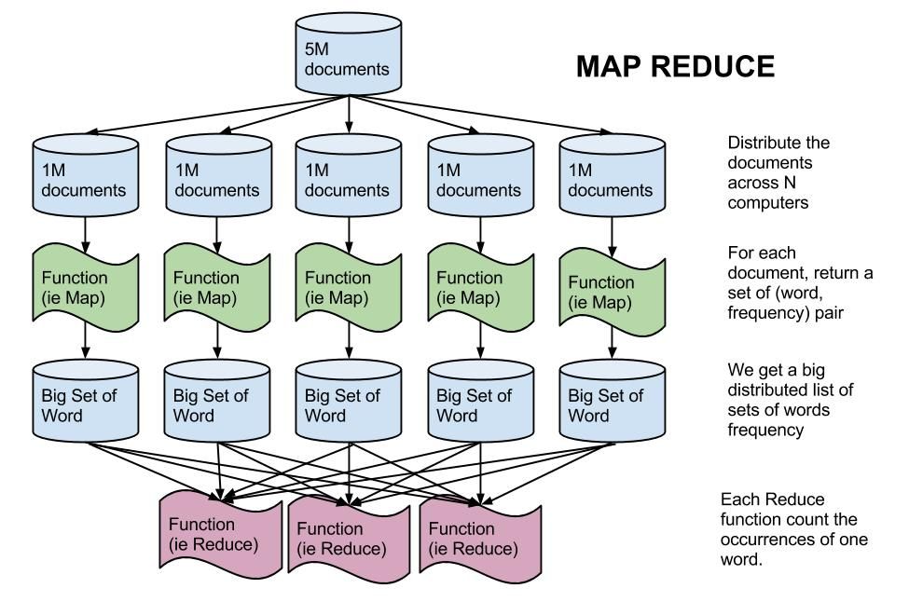
Map Reduce Concept

Slide 9
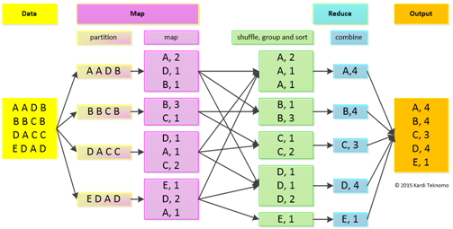
Map Reduce Example

Slide 10
Getting started with GPars
Dependency for Gradle
"org.codehaus.gpars:gpars:1.2.1"
Dependency for Maven
<dependency> <groupId>org.codehaus.gpars</groupId> <artifactId>gpars</artifactId> <version>1.2.0</version> </dependency>

Slide 11
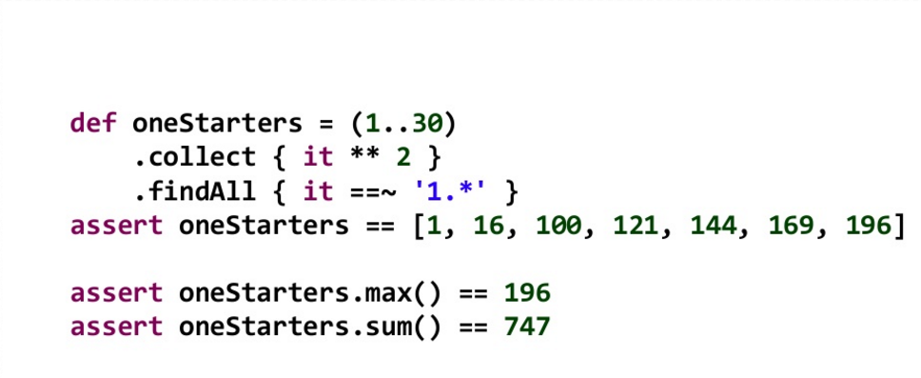
Groovy Sequential Collection

Slide 12
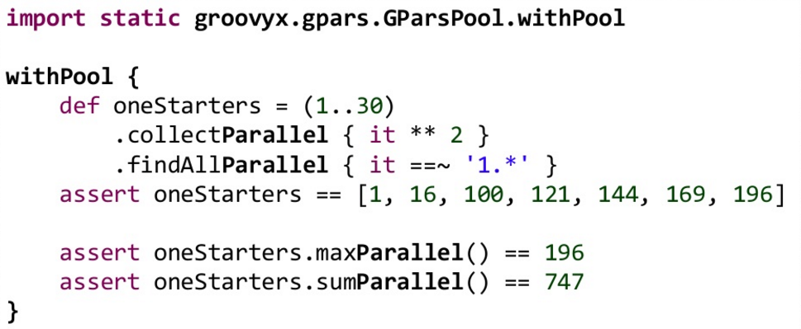
GPars Parallel Collection

Slide 13
Data Parallelism
Dealing with data frequently involves manipulating collections
Lists, arrays, sets, maps, iterators, strings etc. can be viewed as collections of items
Common pattern to process such collections is to take elements sequentially, one-by-one, and make an action for each of the items in row.
E.g min() function – Iterates over the collection sequentially to find the minimum value

Slide 14
Data Parallelism - Parallel Collection
The GParsPool class enables a ParallelArray-based (from JSR-166y) concurrency DSL for collections and objects.
GParsPool.withPool(){ .. }
GParsPool.withPool(){ ForkJoinPool pool ->.. }
GParsPool.withPool(10){ .. }
GParsPool.withExistingPool(ForkJoinPool pool){ .. }

Slide 15
Data Parallelism - Parallel Collection
Some of the methods supported are -
eachParallel() , collectParallel(),
findAllParallel() , findAnyParallel(),
groupByParallel(), minParallel(),
maxParallel(), sumParallel(),
countParallel()
Test URL - http://localhost:8080/gpars/parallelData

Slide 16
Data Parallelism - Parallel Enhancer
ParallelEnhancer makes a collection to be executed parallel without using GPars.withPool{}
Example -
def animals = ['dog' , 'ant' , 'cat' , 'whale']
ParallelEnhancer.enhanceInstance(animals)
println(animals.everyParallel{it.contains("a")} ? 'All animals contain a' : 'Some animals can live without a')

Slide 17
Data Parallelism - Map/Filter/Reduce
Can be used for the same purpose as the xxxParallel() family methods and has very similar semantics.
Can perform considerably faster if you need to chain multiple methods to process a single collection in multiple steps.
Ex- def myNumbers = (1..1000).parallel.filter{it % 2 == 0}.map{Math.sqrt it}.collection
Internally they build ParallelArray, perform required operation concurrently and destroy ParallelArray before returning

Slide 18
Data Parallelism - Map/Filter/Reduce Methods
map()
reduce()
filter()
size()
sum()
min()
max()
sort()
groupBy()
combine()

Slide 19
Data Parallelism - Asynchronous Invocation
The following methods are added to closures inside the GPars(Executors)Pool.withPool() blocks:
async() - Creates an asynchronous variant of the supplied closure, which when invoked returns a future for the potential return value
callAsync() - Calls a closure in a separate thread supplying the given arguments, returning a future for the potential return value,

Slide 20
Memoize
The memoize function enables caching of function's return values. Repeated calls to the memoized function with the same argument values will, instead of invoking the calculation encoded in the original function.
gmemoize()
gmemoizeAtMost()
gmemoizeAtLeast()
gmemoizeBetween

Slide 21
Actors Introduction
Allow for a message passing-based concurrency model
Every actor has a mailbox for messages and messages are processed one by one
Programs are collections of independent active objects that exchange messages and have no mutable shared state.
Always guarantee that at most one thread processes the actor's body.

Slide 22
Actors in action
Helps to avoid deadlock, live-lock and starvation
A great number of actors can share a relatively small thread pool
An actor with no work doesn't consume threads.
No shared mutable state.
Runs in daemon threads.

Slide 23
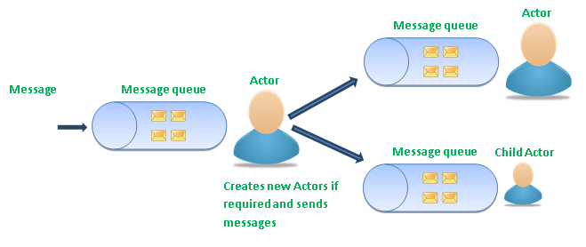
Actors

Slide 24
Actors commands
Messages can be sent to actors using
send() method
<< operator
Implicit call() method

Slide 25
Actor- Sending Messages
def passiveActor = Actors.actor{
loop {
react { msg -> println "Received: $msg"; }
}
}
passiveActor.send 'Message 1'
passiveActor << 'Message 2'
passiveActor 'Message 3'

Slide 26
Actor - Sending Messages
sendAndWait() //Blocks the caller until a reply from the actor is available.
sendAndPromise()
sendAndContinue()

Slide 27
Actor- Receiving Messages
react{ }
Closure within Actor's code is responsible to consume message from actor's inbox
react { message ->
//consume message...
}
Wait's if there is no message to be processed immediately ??
Supplied closure is not invoked directly. It is scheduled for processing by any thread in the thread pool once a message is available

Slide 28
Demo - Actors

Slide 29
Agents
Inspired by Agents in Clojure
Used when shared mutable state is required e.g Shopping Cart
Is a thread-safe non-blocking shared mutable state wrapper
Hides data and protects from direct access
Accepts messages and process them asynchronously

Slide 30
Agents in action
Messages are commands(functions) and executed inside Agent
Agent guarantees execution of a single function at a time
After reception, received function is run against the internal state of Agent and return value is new internal state of Agent
The mutable values are not directly accessible from outside

Slide 31
Agents
Requests have to be sent to Agent
Agent guarantees to process the requests seqentially on behaf of callers
Wraps a reference to mutable state held inside a single field
Messages can be sent via
'<<' operator
send() method
Implicit call() method

Slide 32
Agents
Submitted commands obtain the agent's state as a parameter.
Can call any methods on the agent's state.
Replacing the state object with a new one is also possible using the updateValue() method.
The val property waits until all preceding commands are consumed.

Slide 33
Agents
The valAsync() does not block caller.
The instantVal returns immediate snapshot of agent state.
All Agent instances share a default daemon thread pool.
Setting the threadPool property of an Agent instance will allow it to use a different thread pool.

Slide 34
Demo - Agents

Slide 35
Dataflow
Operations in Dataflow programs consists of “Black Boxes”
Inputs and Outputs are always explicitly defined.
They run as soon as all of their inputs become valid.
Dataflow program is more like series of workers in assembly line
They are inherently parallel.

Slide 36
Dataflow
Dataflow is a channel to safely and reliably transfer data from producers to their consumers
Value is set using '<<' operator
A task blocks until value has been set by another task
DF Variable can only be set only one in its lifetime
Don't have to bother with ordering and synchronizing the tasks or threads

Slide 37
Dataflow - Sample Program
def x = new DataflowVariable()
def y = new DataflowVariable()
def z = new DataflowVariable()
task { z << x.val + y.val }
task{ x << 10 }
task{ y << 5 }
println "Result : $z.val"

Slide 38
Dataflow Benefits
No race-conditions
No live-locks
Deterministic deadlocks
Completely deterministic programs
Beautiful Code

Slide 39
Demo - Dataflow

Slide 40
Tips
When chaining parallel method calls you might consider using the map/reduce API instead or resort to using the ParallelArray API directly, to avoid the Parallel Array creation overhead.
The GParsConfig.shutdown() method can be used in managed environments to properly shutdown all asynchronously run timers and free the memory from all thread-local variables.
GPars Agents are even a bit faster in processing messages than actors
In many scenarios changing the pool size from the default value may give you performance benefits. Especially if your tasks perform IO operations, like file or database access, networking and such, increasing the number of threads in the pool is likely to help performance.

Slide 41
Conclusion
You're certainly ready to build fast, robust and reliable concurrent applications.
You've seen that there are many concepts you can choose from and each has its own areas of applicability.
The ability to pick the right concept to apply to a given problem and combine it with the rest of the system is key to being a successful developer.

Slide 42
References
GPars User Guide
Groovy in Action, Second Edition - Manning Publication
Concurrency with GPars - Dr. Paul King
GPars - Gagan Agrawal

Slide 43
Github Project
Please refer below for live implementation:-
https://github.com/NexThoughts/Grails-Gpars-Example-Demo

Slide 44
Good use cases
Parallelizer: https://github.com/GPars/GPars/blob/master/src/test/groovy/groovyx/gpars/ParallelizerTest.groovy
https://github.com/GPars/GPars/blob/master/src/test/groovy/groovyx/gpars/samples/collections/DemoMapReduce.groovy
https://github.com/GPars/GPars/blob/master/src/test/groovy/groovyx/gpars/MapReduceTest.groovy

Slide 45
Questions ?

Slide 46
Thank You

