Slide 1



About_me_alex_kuo
View in Power BI
Last data refresh:
5/7/2023 12:49:00 PM UTC
Downloaded at:
5/7/2023 12:52:49 PM UTC

Slide 2
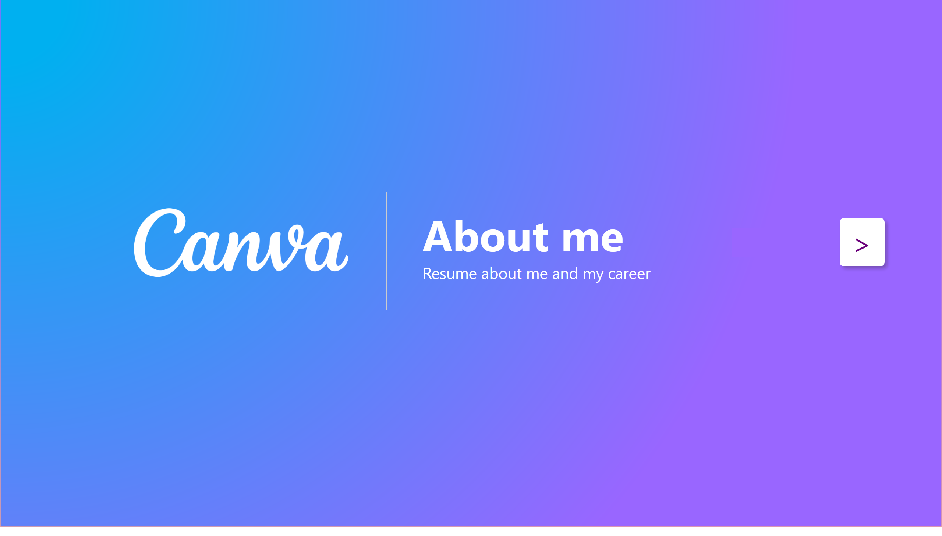
Front Page
Notes:
actionButton
No alt text provided
shape
No alt text provided
textbox
No alt text provided
image
No alt text provided
actionButton
No alt text provided

Slide 3
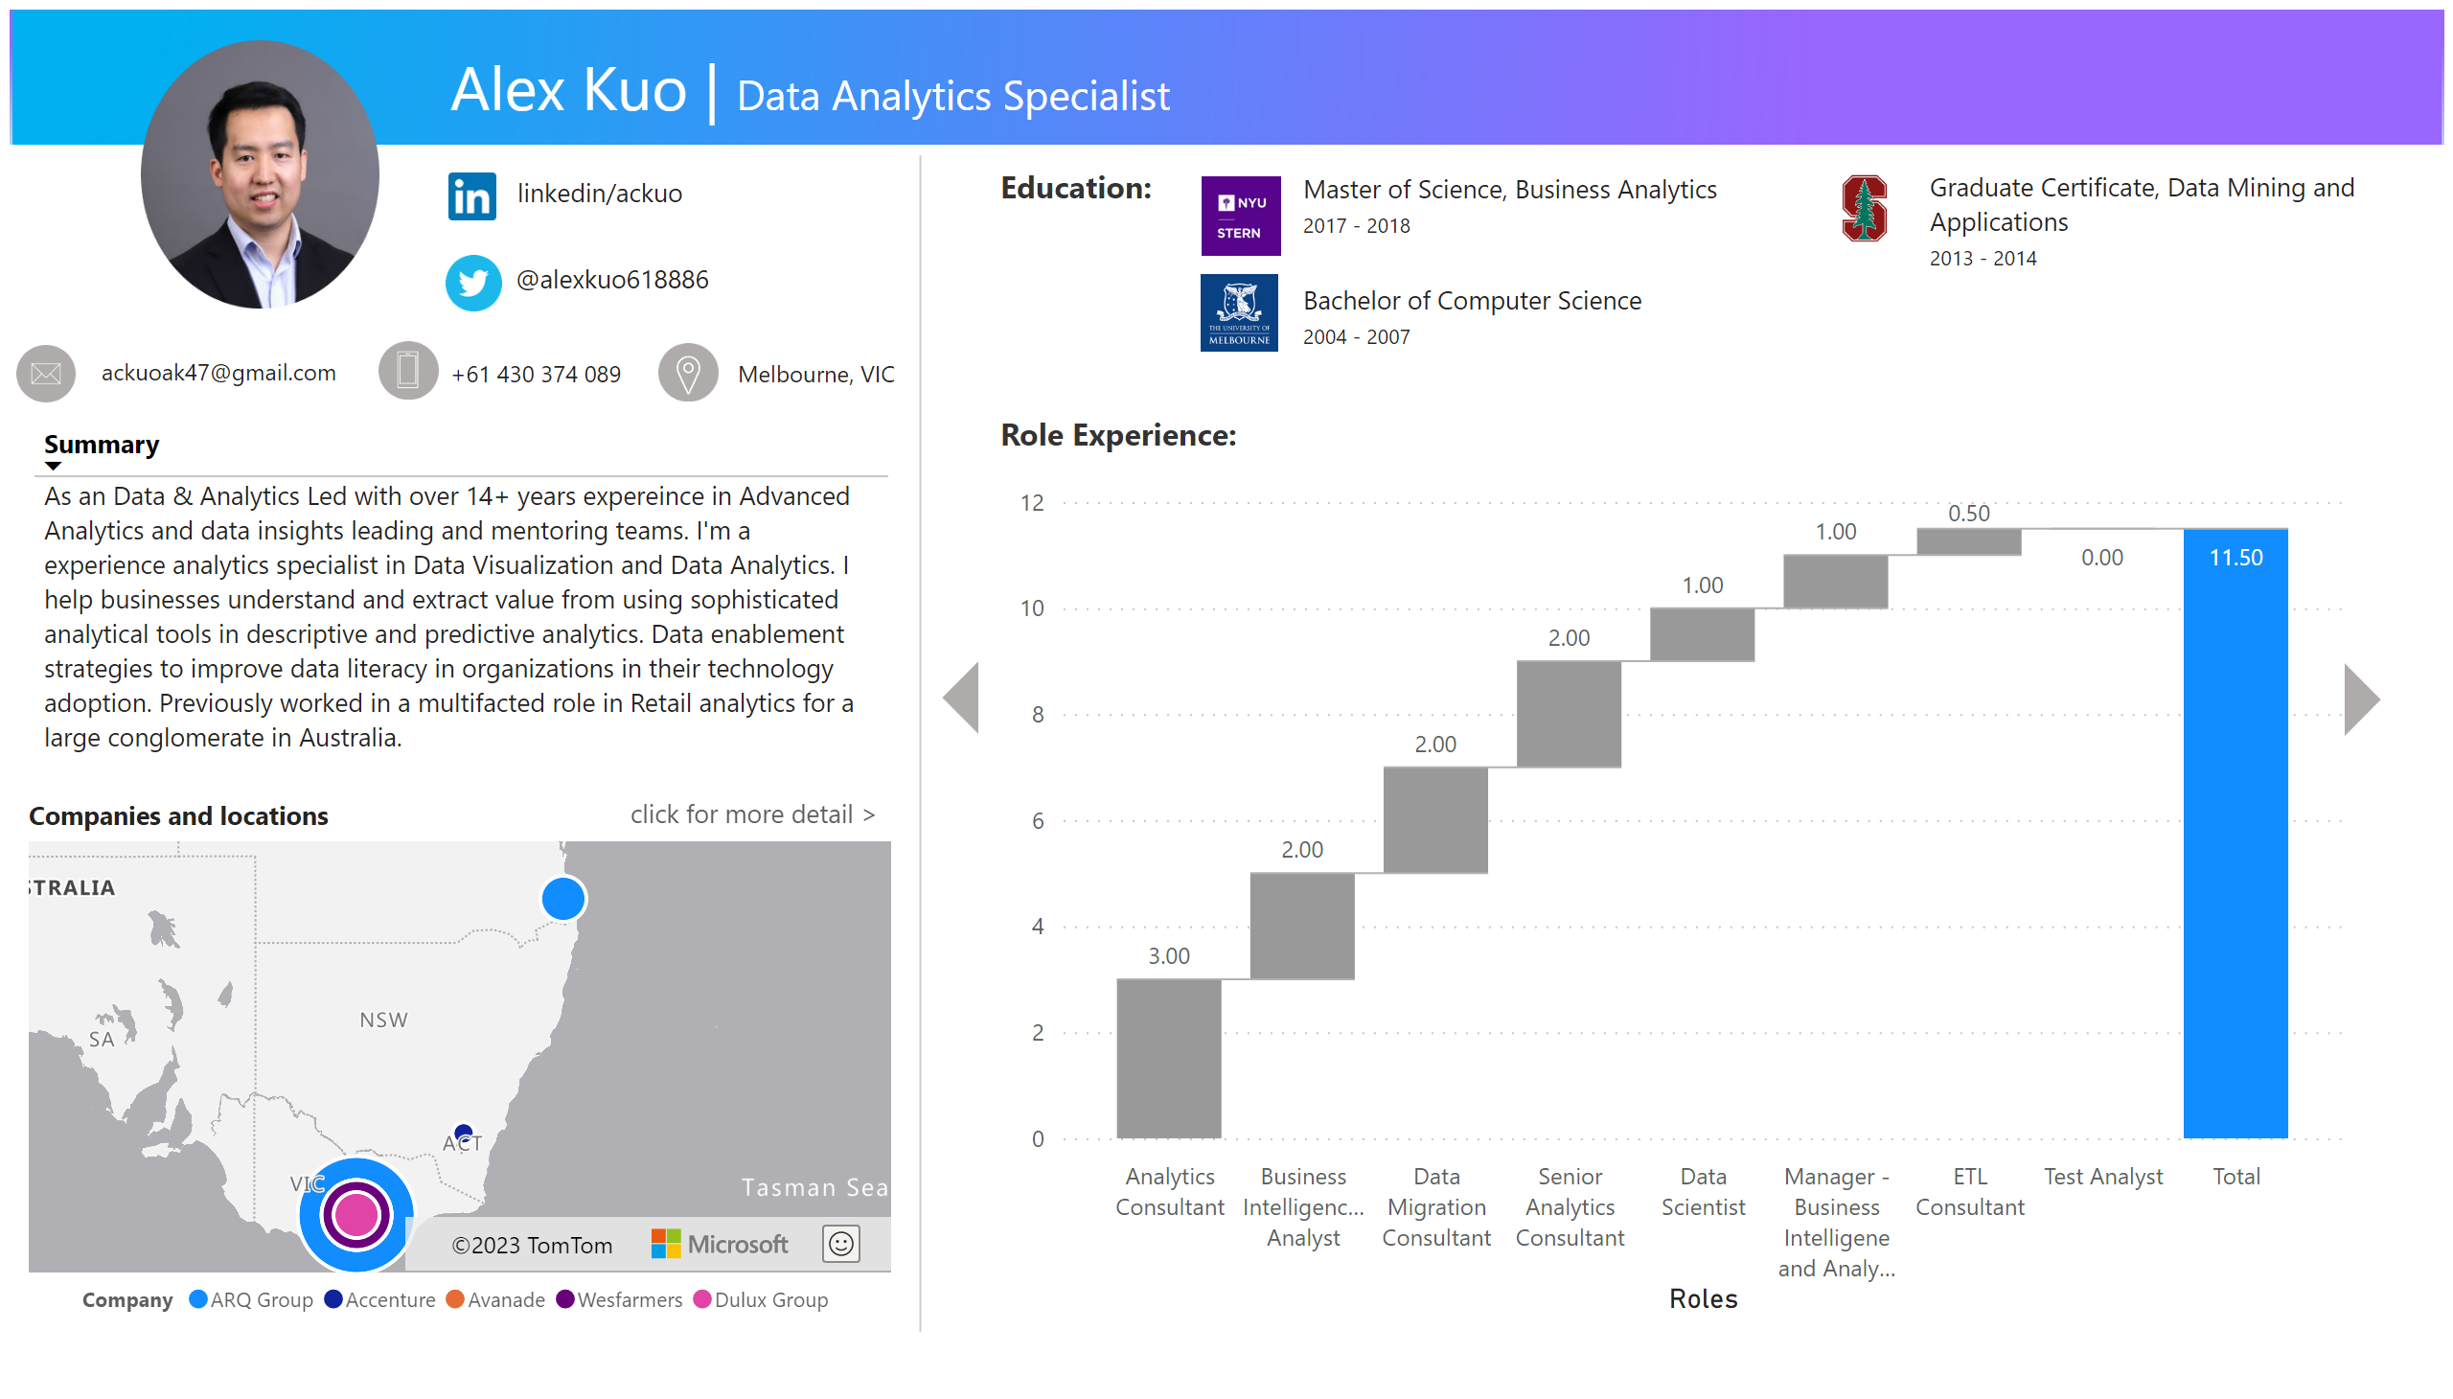
Resume
Notes:
image
No alt text provided
image
No alt text provided
image
No alt text provided
image
No alt text provided
textbox
No alt text provided
textbox
No alt text provided
textbox
No alt text provided
textbox
No alt text provided
image
No alt text provided
textbox
No alt text provided
image
No alt text provided
textbox
No alt text provided
image
No alt text provided
textbox
No alt text provided
tableEx
No alt text provided
clusteredBarChart
No alt text provided
textbox
No alt text provided
RadarChart1446119667547
No alt text provided
shape
No alt text provided
Companies and locations
No alt text provided
RadarChart1446119667547
No alt text provided
actionButton
click for more detail >
image
No alt text provided
image
No alt text provided
image
No alt text provided
actionButton
No alt text provided
actionButton
No alt text provided
waterfallChart
No alt text provided
textbox
No alt text provided
card
No alt text provided
image
No alt text provided
multiRowCard
No alt text provided
multiRowCard
No alt text provided
textbox
No alt text provided
textbox
No alt text provided
image
No alt text provided
textbox
No alt text provided
image
No alt text provided
textbox
No alt text provided
image
No alt text provided
textbox
No alt text provided
image
No alt text provided
image
No alt text provided
textbox
No alt text provided
textbox
No alt text provided
textbox
No alt text provided
clusteredBarChart
No alt text provided
image
No alt text provided
image
No alt text provided
Back Button Industry Exp
No alt text provided
image
No alt text provided
textbox
No alt text provided
image
No alt text provided
image
No alt text provided
image
No alt text provided
actionButton
No alt text provided
Button: Tech Skills (Bar)
No alt text provided
actionButton
No alt text provided
actionButton
No alt text provided
actionButton
No alt text provided

Slide 4
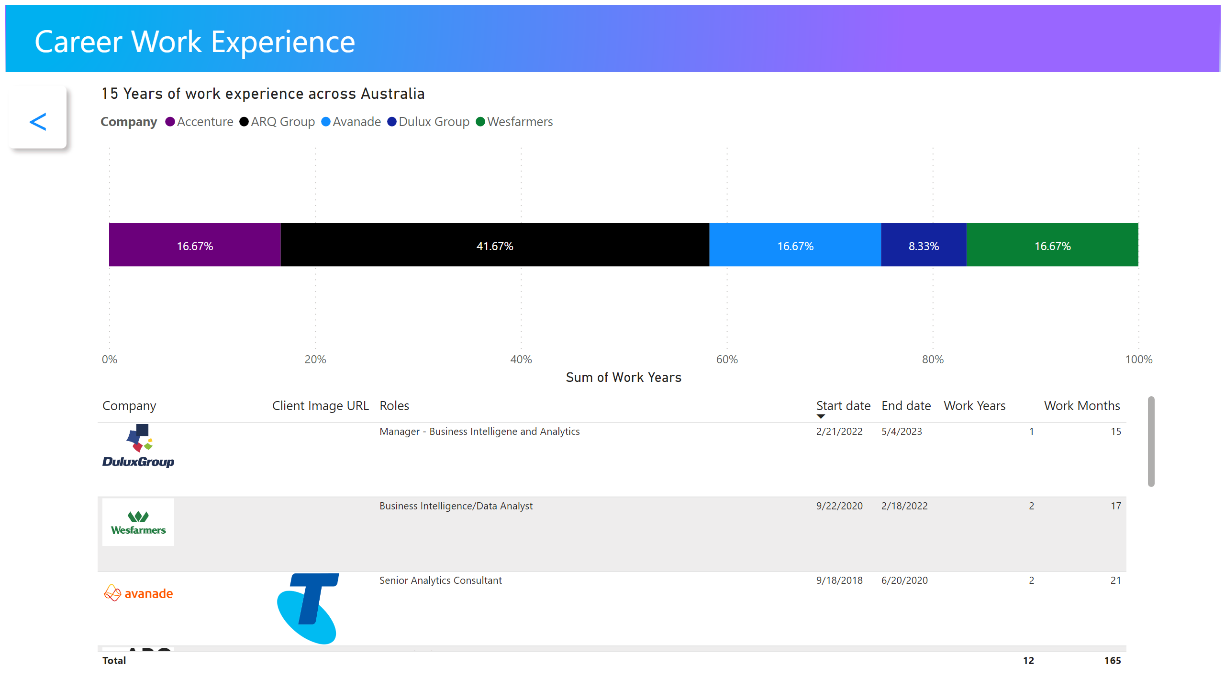
Work Experience detail
Notes:
15 Years of work experience across Australia
No alt text provided
image
No alt text provided
textbox
No alt text provided
tableEx
No alt text provided
actionButton
No alt text provided

