Slide 1
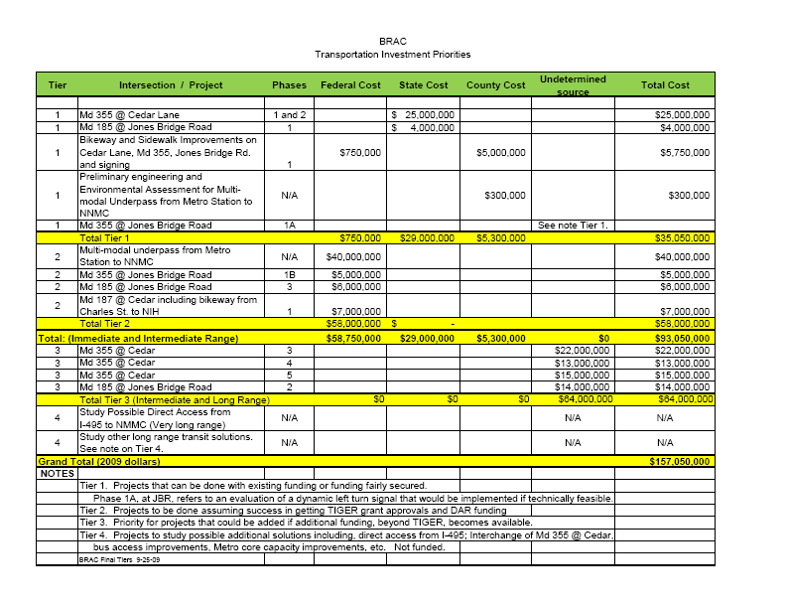
2

Slide 2
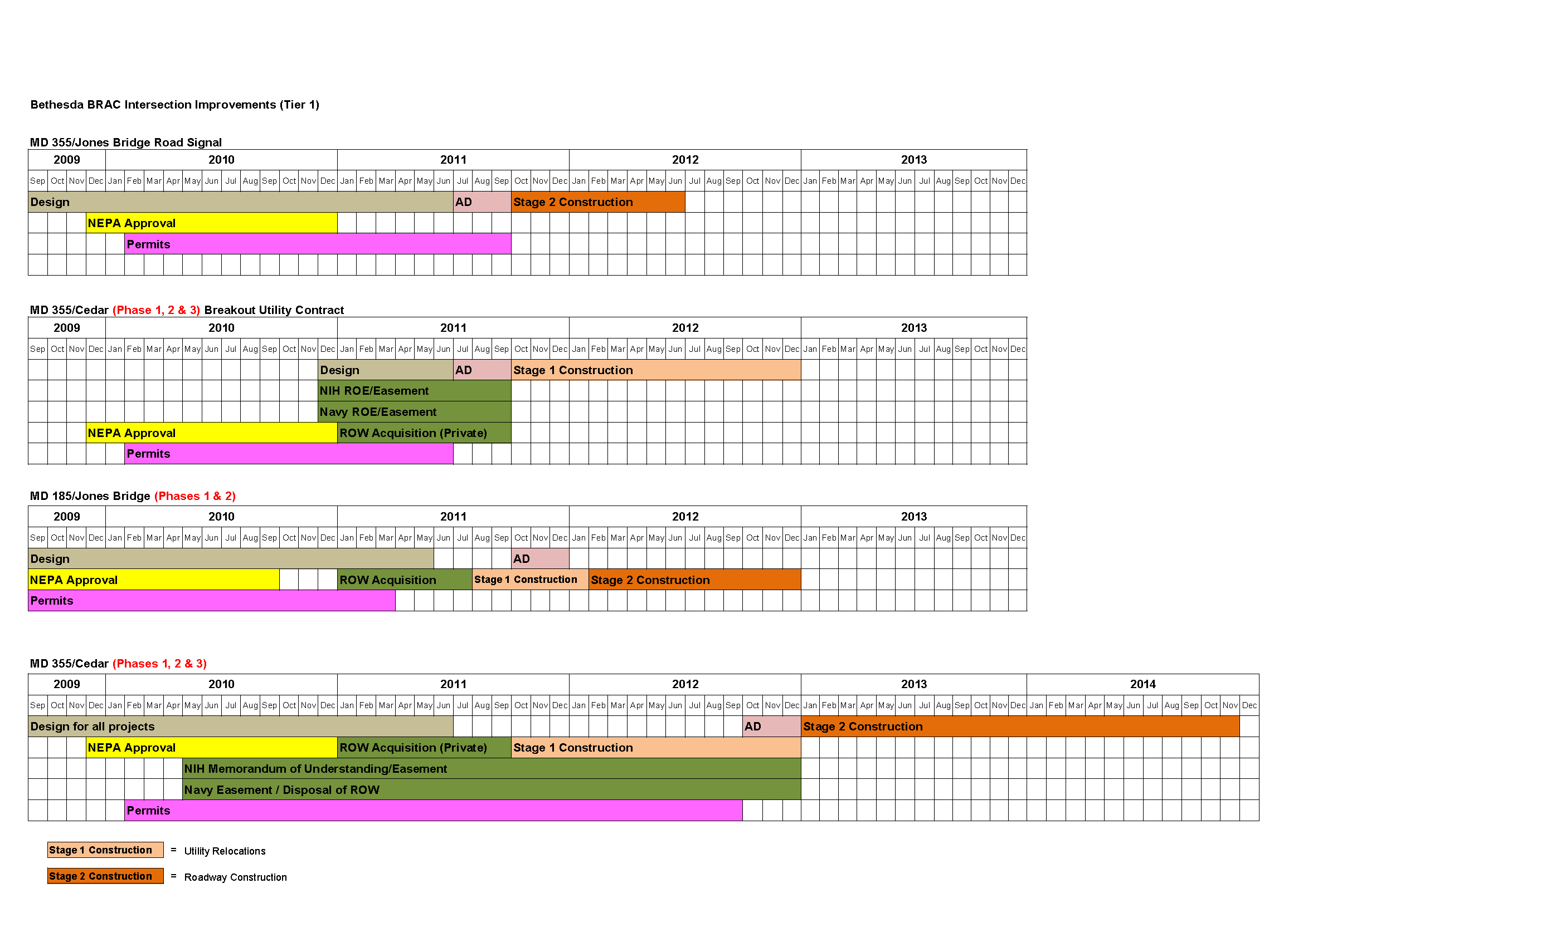
Contract 1
Contract 2
Contract 3
Need $11M from $300M DOD funding

Slide 3
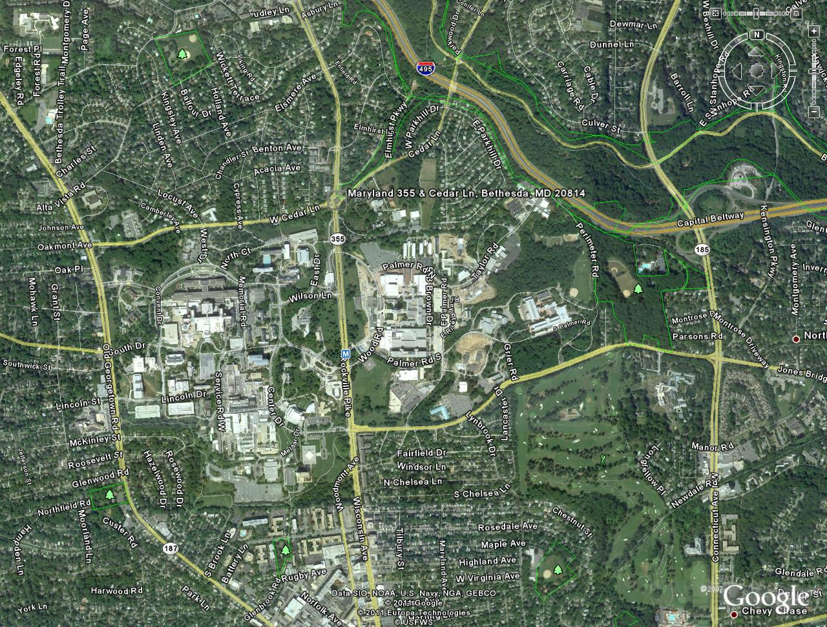
MD 355/W. Cedar Lane
MD 187/Cedar Lane
MD 185/Jones Bridge Road
MD 355/Jones Bridge Road

