Slide 1
Computer Training
By Anthony Clemente at Howard Industries

Slide 2
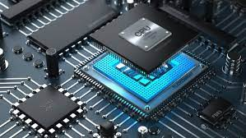
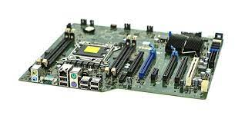
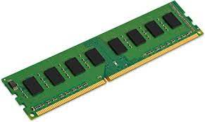
Computer Hardware – CPU & RAM
Motherboard – connects all the hardware to the CPU and defines
CPU – brain of the computer. Processes all I/O & provides instructions to other pieces of computer hardware. Measured in GHz
RAM – volatile storage that is short-term.
More RAM more memory available for programs/applications

Slide 3


Computer Hardware – Hard Drives
HDD vs. SSD
non-volatile, long-term memory
HDDs rely on a read/write head to access data while the platters are spinning
SSDs relies on interconnected flash-memory chips. SSD is faster, more reliable, smaller, but more expensive

Slide 4
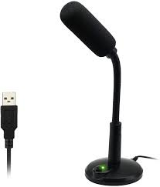
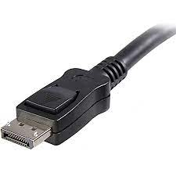
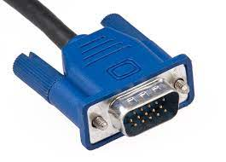
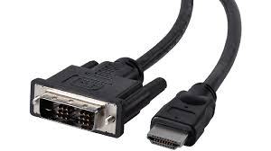
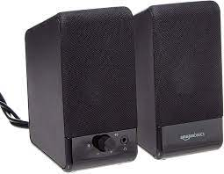
Computer Hardware – Audio/Visual
Video Cables (DVI, VGA, HDMI, DP)
Audio Devices (Speakers, Microphones)

Slide 5
File Management
Creating Folders
File storage: local, backup or server
Company server: \\telperion
Network Drive Mapping Demonstration
Reconnecting Drives
How to zip a file with 7-zip
Export to PDF, Print to PDF
Searching/sorting files
File Shortcuts, Options, Properties

Slide 6
File Extensions
Images: jpg/jpeg, jfif, png, gif, svg, tiff, bmp
Office: doc/docx, xls/xlsx, pptx, one
Sound: mp4, mp3, wav
Common: pdf, html, htm, xml, zip, exe, bat, txt
CDR – Corel
PSD – Photoshop
EPS – Photoshop
AI – Adobe Illustrator
Renaming extensions changes a file’s properties

Slide 7
Keyboard Accessibility
Keyboard Compatibility is required by W3 (World Wide Web Consortium) under WAI - Web Accessibility Initiative
Dependents include:
People with physical disabilities who cannot use the mouse.
People who are blind, and cannot see the mouse pointer on the screen.
People with chronic conditions, such as repetitive stress injuries (RSI), who should limit or avoid use of a mouse.

Slide 8
Common Keyboard Shortcuts
Shortcut | Function
Ctrl + A | Select All
Ctrl + C | Copy Selected/Highlighted Item
Ctrl + V | Paste Item in Clipboard
Ctrl + X | Copy & Delete Selected/Highlighted Item
Ctrl + F | Search a page or document for a specific string
Ctrl + P | Print
Ctrl + S | Save
Ctrl + Shift + S | Save As
Win + Shift + S | Snipping Tool
Win + L | Lock Computer

Slide 9
Outlook
Creating Folders
Organizing Emails – Rules, Moving, Archiving, Read/Unread, Flagging, Cleaning Up Folder, Running Rules, Blocking Senders
Searching for an Email
Using your Calendar
Adding a Signature
Searching for an item/task

Slide 10




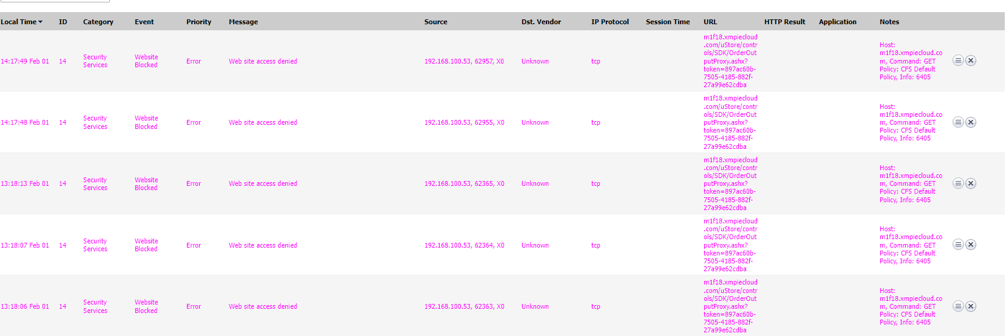
The Modern Web
Browsers – Edge, Chrome, Firefox, Brave - https://caniuse.com/?search=alert
SSL Certificates
SonicWall
Router Logs

Slide 11
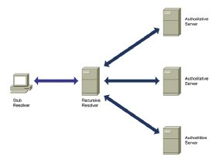
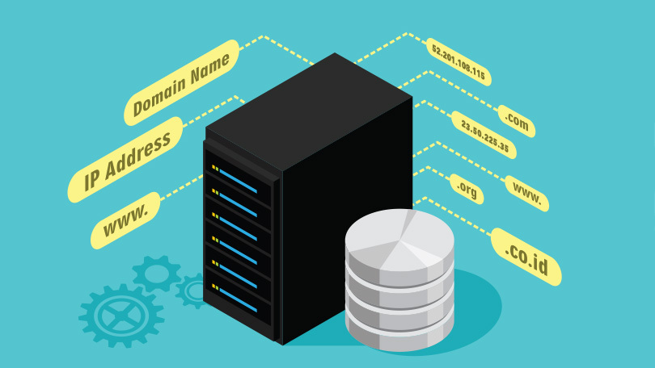
Web Servers
IP Addresses & DNS Servers
Breakdown of a URL
Webpages use HTML files to
display websites

Slide 12
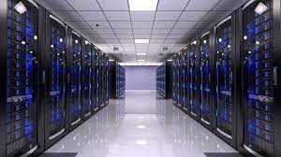
Howard Websites
Howardindustries.com
Primesignprogram.com
DMS
mail.howardindustries.com
PurelyHR
CapsuleCRM

Slide 13
Common Desktop Programs at HI
TimePunchFast
DrawingBin/Viewer
Web Browsers (Edge, Chrome, Firefox)
Microsoft Office (Word, Excel, Teams)
Zoom
Notepad
Spark

Slide 14
System Operations
System Information – Settings
System Updates - Notifications
Task Manager – Application Crash, Uptime

Slide 15
Cybersecurity
U.S. Marshals
May 13, 2020: The personal information of 387,000 former and current inmates was access by a hacker who exploited a server vulnerability in a U.S. Marshals Service database. The information exposed includes names, dates of birth, social security numbers, and home addresses.
Facebook
April 21, 2020: More than 267 million Facebook profiles have been listed for sale on the Dark Web – all for $600. Reports link these profiles back to the data leak discovered in December, with additional PII attached, including email addresses. Researchers are still uncertain how this data was exposed originally, but have noted that 16.8 million of the Facebook profiles now include more data than originally exposed.
Zoom
April 14, 2020: The credentials of over 500,000 Zoom teleconferencing accounts were found for sale on the dark web and hacker forums for as little as $.02. Email addresses, passwords, personal meeting URLs, and host keys are said to be collected through a credential stuffing attack.
T-Mobile
March 5, 2020: An unknown number of customers’ sensitive information was accessed through a T‑Mobile employee email accounts after a malicious attack of a third-party email vendor. The personal information of T-Mobile customers accessed includes names and addresses, Social Security numbers, financial account information, and government identification numbers, as well as phone numbers, billing and account information, and rate plans and features.
“2020 Data Breaches - The Worst Breaches of the Year: IdentityForce®.” We Aren't Just Protecting You From Identity Theft. We Protect Who You Are., 2 June 2020, www.identityforce.com/blog/2020-data-breaches.

Slide 16

Social Engineering
Social engineering, in the context of information security, is the psychological manipulation of people into performing actions or divulging confidential information.
Includes calls from Mysterious Nigerian Princes, pop-ups for Free Vacations/iPads, emails to change your password.
Examples:
Barbara Corcoran writing $400,000 check to hacker posing as assistant through email.
Mark Zuckerberg having his identity stolen

Slide 17
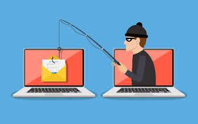
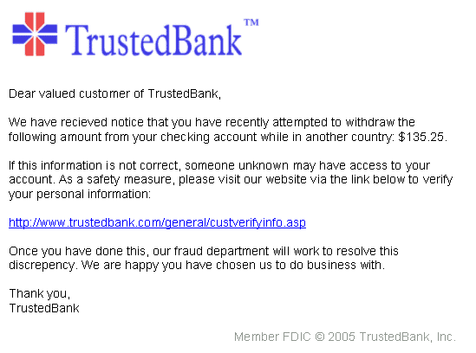
Phishing Emails
Designed to have the target click on a link or download something.
In 2017, one tactic hackers used was sending fake purchase orders in hopes that users would be tricked into clicking links the emails contained.
Currently, many are posing as job hunters, emailing HR representatives their CV/Resume in hopes that they open the file.
Furthermore, many phishing emails include documents that can download unwanted programs on a target’s computer.
Most of the time, hackers pose as an email service provider, sending the victim a message that their account has been compromised and they should change their password, by clicking on a link.
Solutions
Verify the sender’s email address.
Notify MIS of fishy emails
See if information has been stolen through a data breach reporting website such as haveibeenpwned.com or deshashed.com

Slide 18
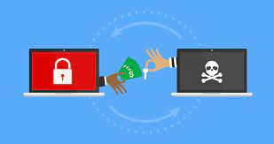
Ransomware
a type of malicious software designed to block access to a computer system until a sum of money is paid.
Can be spread through email and throughout organization.
Locks requested service and demands payment to unlock service.
Can be extremely costly and can cripple a company.

Slide 19
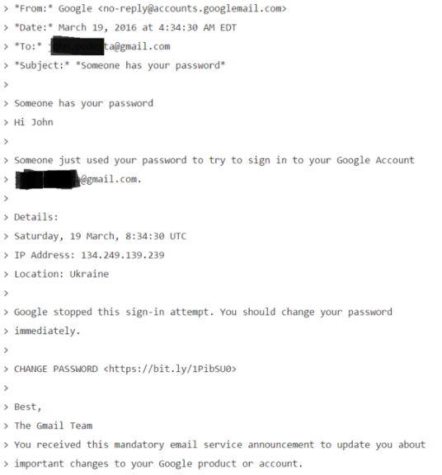
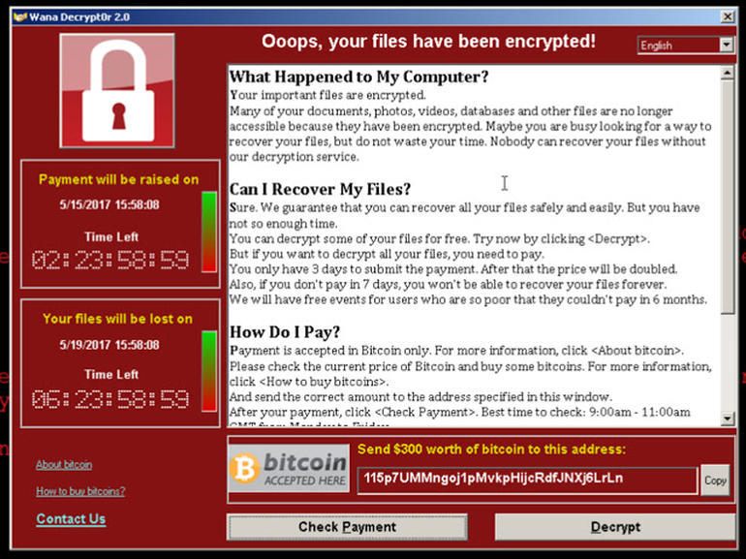

Attacks Using These Methods
Colonial Pipeline hackers paid $5 million in bitcoin
Hillary Clinton’s campaign chairman John Podesta WikiLeaks
WannaCry ransomware cost UK’s NHS £92 million

Slide 20
Microsoft Office
Word – for Documents (e.g. letters)
Excel – for Spreadsheets or other data-driven information
PowerPoint – Presentation Software
OneNote – OneNote is a digital notebook that automatically saves and syncs your notes as you work.
Teams - Microsoft Teams is a collaboration app that helps your team stay organized and have conversations—all in one place. Here's a quick look at the left hand side of Teams.
https://support.microsoft.com/en-us/office/welcome-to-microsoft-teams-b98d533f-118e-4bae-bf44-3df2470c2b12

Slide 21
Word
Insert Table, Image (Wrapping)
Mail Merge
Templates
Common Shortcut Keys
Ctrl + B -> Bold Text
Ctrl + U -> Underlined Text
Ctrl + S -> Save
Ctrl + Shift + S -> Save as

Slide 22
Excel
Sorting
Formulas
Importing Data
Formatting
Searching
Charts

Slide 23
Excel Formulas
=sum
=if
=average
=min
=max
=averageif
=count
=sumif
Many more….

Slide 24
PowerPoint
Slides
Templates
Charts

