Slide 1


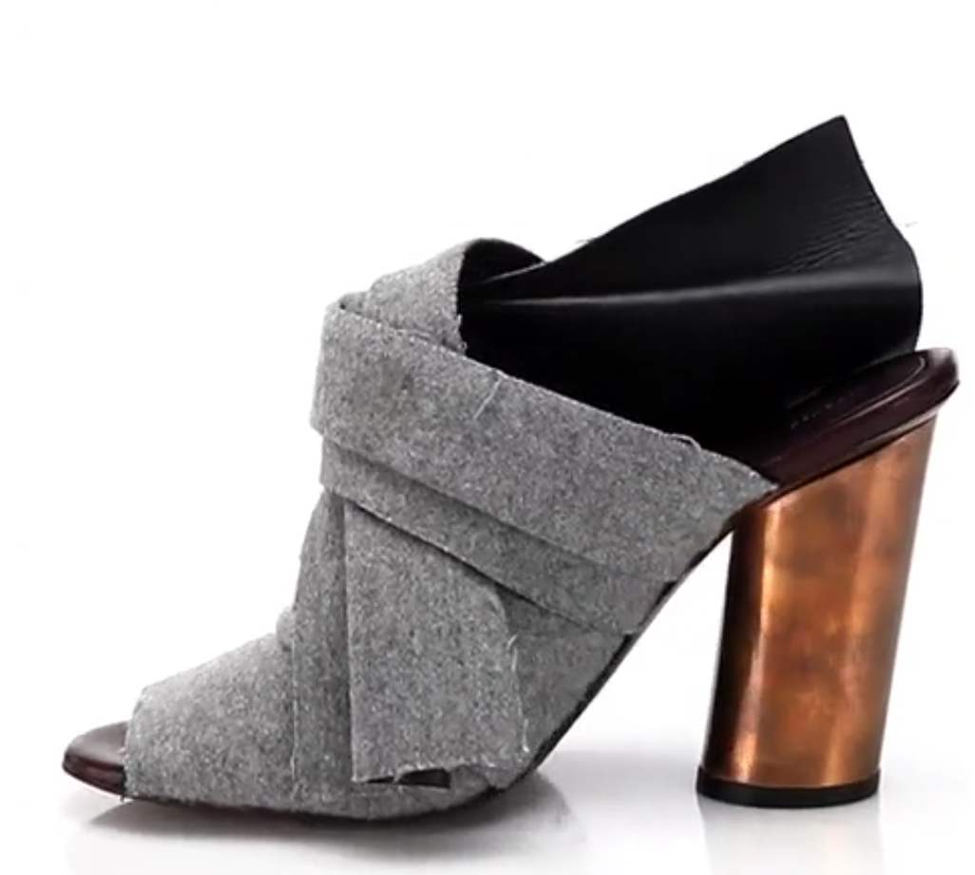
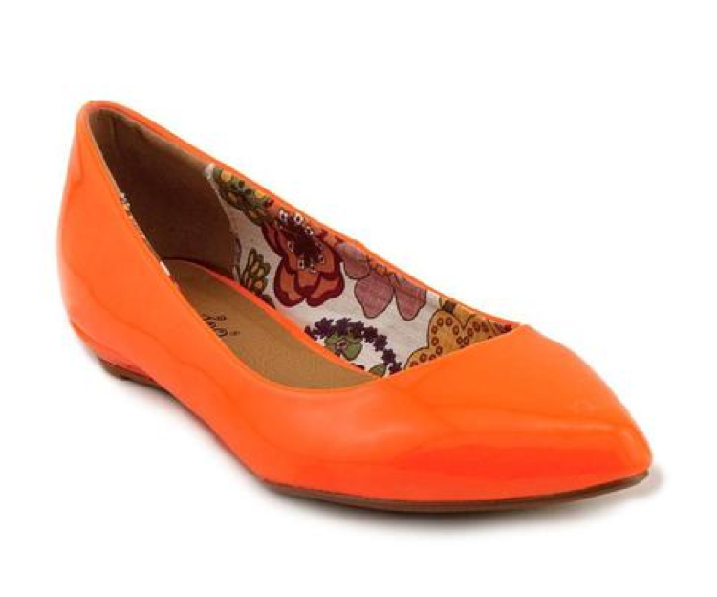
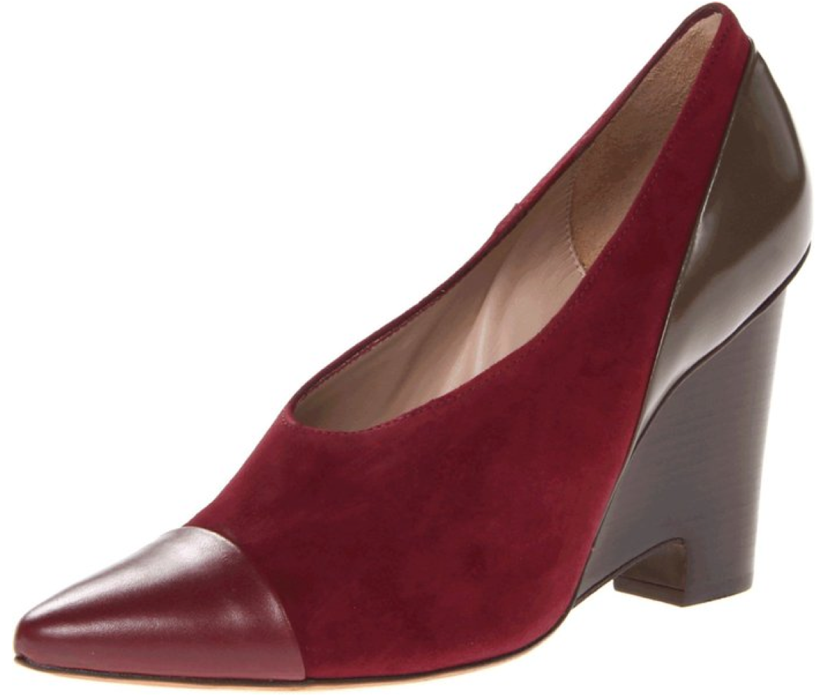
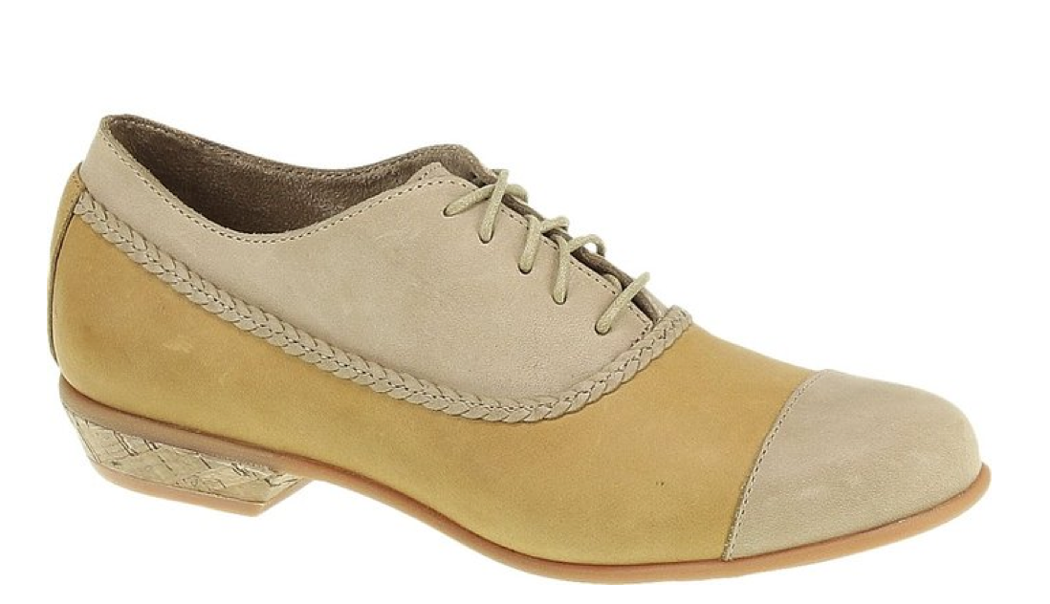
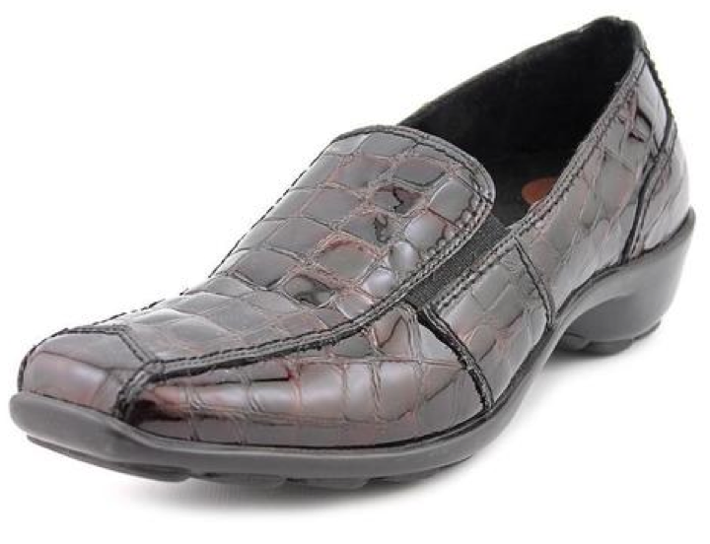
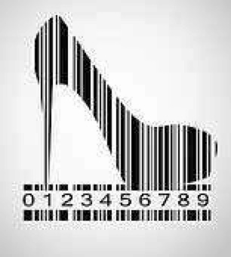
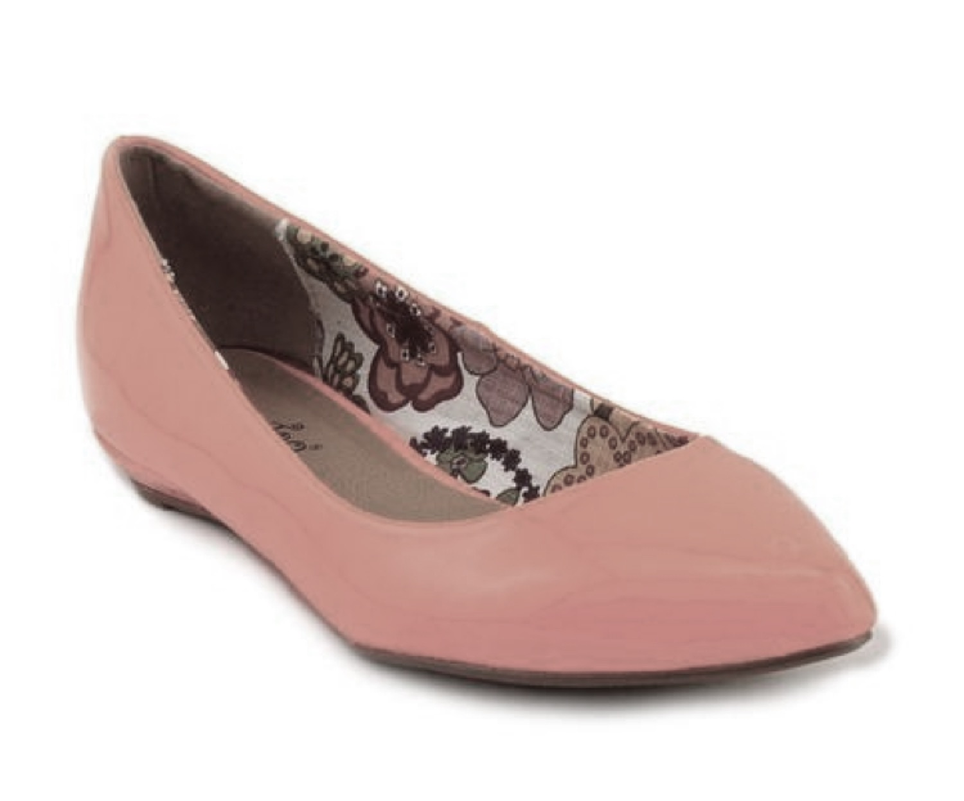
Shoes
Merchants
A typical end user
Women’s Shoes
Men’s Shoes
…
Girl’s Shoes
y₁
y₂
y₃
y₄
y_{L}
Comfort
Pumps
Sneakers
Flats
…
Lyza Clog
Lyza Clog is unavailable
100MM Runway
Felt Mule Sandals
Lips Too Women's
'Too Sliver' Patent
Casual Shoes
Size 6
1883 by Wolverine Women's Maisie Oxford Tan/Taupe Leather/Suede
1803 Women's 'Nome' Crocodile Dress Shoes Size
9
10 Crosby Women's
Ynez Pump
More Women’s Comfort Shoes
x₃
100MM Runway
Felt Mule Sandals
x₂
x₆
…
x_{N}
x₁
x₄
Lips Too Women's
Casual Shoes
Machine Learning
Model
Learn: Y=
(X)

Slide 2
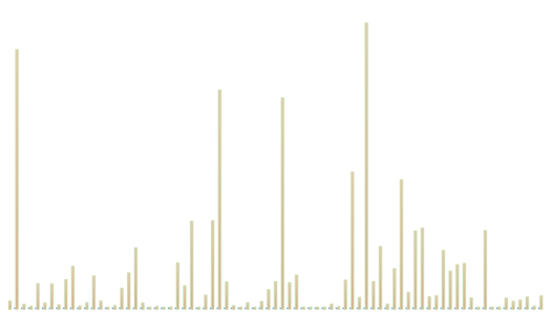
Notes:
Dec 2015

Slide 3
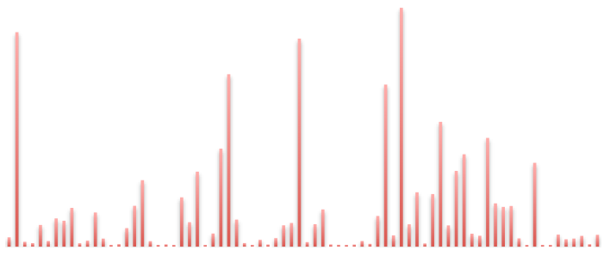
Notes:
Feb 2016

Slide 4
Notes:
Shoes problem: L1 on Dec 2015 data

Slide 5
Notes:
Slice dataset stats

Slide 6
Notes:
AmazonJ

Slide 8
Dec
2015
Feb
2016

Slide 9
hardcover guide design handbook international health business social law | heart diamond pearl 40 ring sterling chain charm 39 14k 47 bracelet watch | paperback book history god home und soul stories journey bible der die code
vhs world series time king war ball house trek christmas space dog circle | i c love day e night u single lady child woman uk good deluxe park | set 20 100 24 case kit oz 30 hand drive body wall digital ft 48 spray paper
license standard symantec system service cisco support year essential | dvd jazz media mixed country artists vol play music product pop ed | de calendar la american disc el 2013 art 2009 ray 2012 compact america
Notes:
Suspicious latent topics

Slide 10
oxford burgundy plain espresso wing madison | Oxfords > Men’s Shoes > Shoes
pr boots work mens blk composite | Boots > Men’s Shoes > Shoes
tan polyurethane life saddle stride bed | Flats > Women’s Shoes > Shoes
13 reaction york ak driving steven | Sneakers & Athletic Shoes > Men’s Shoes > Shoes
original rose bone mark lizard copper | Climbing > Men’s Shoes > Shoes
Ambiguous
annotations
Notes:
3, 5 and 6 are suspects

