Slide 1


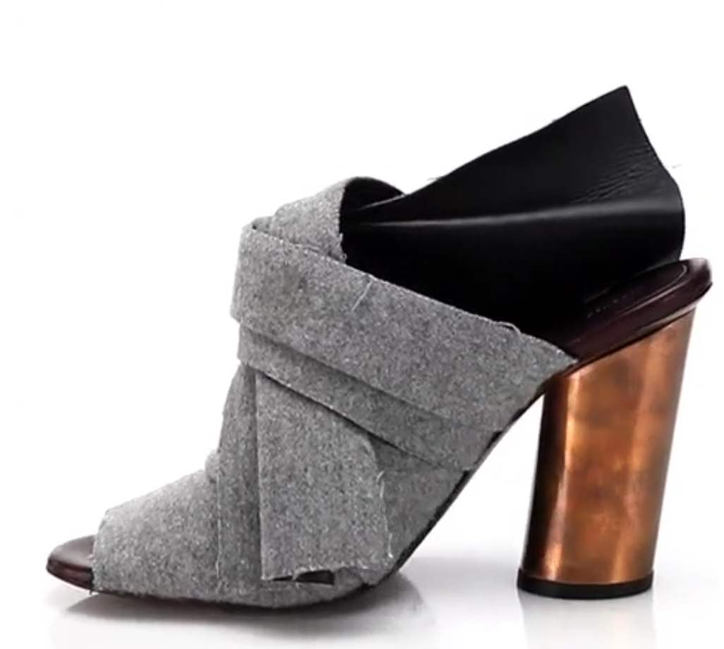
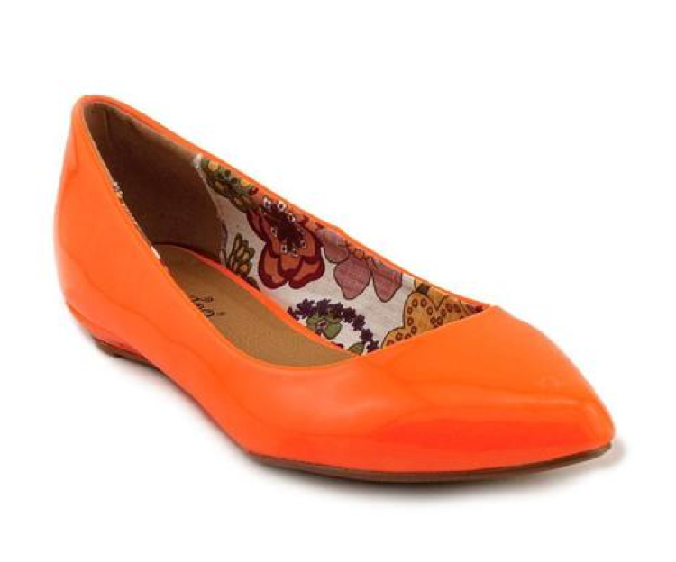
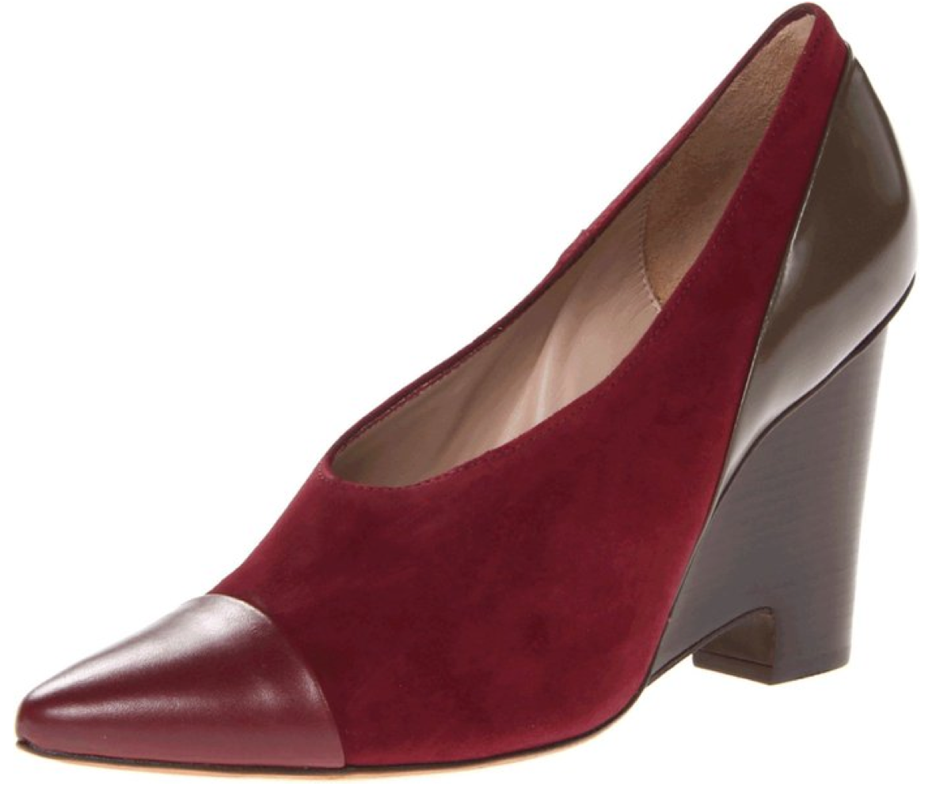
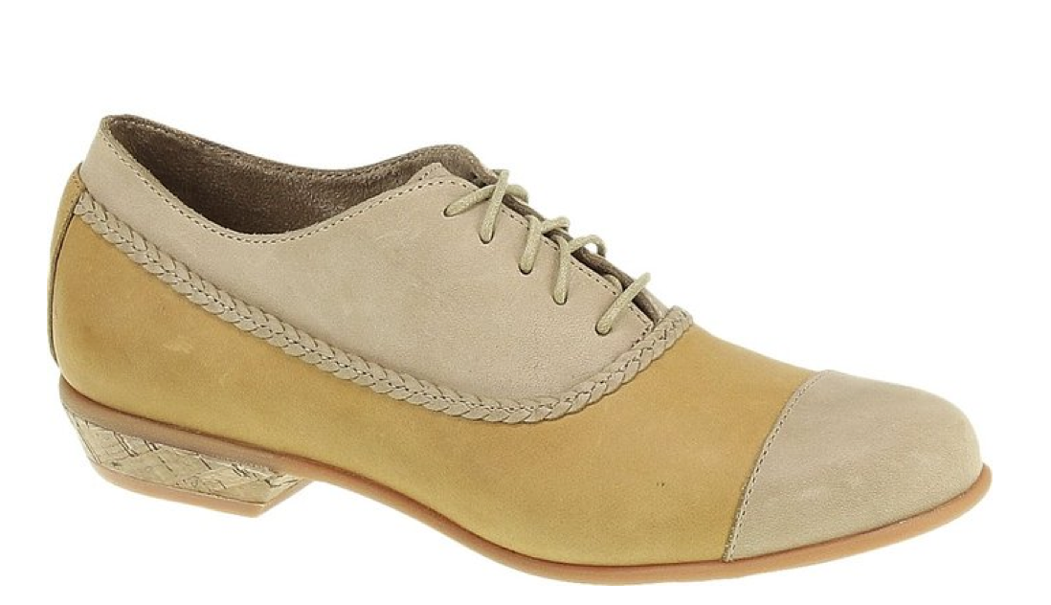
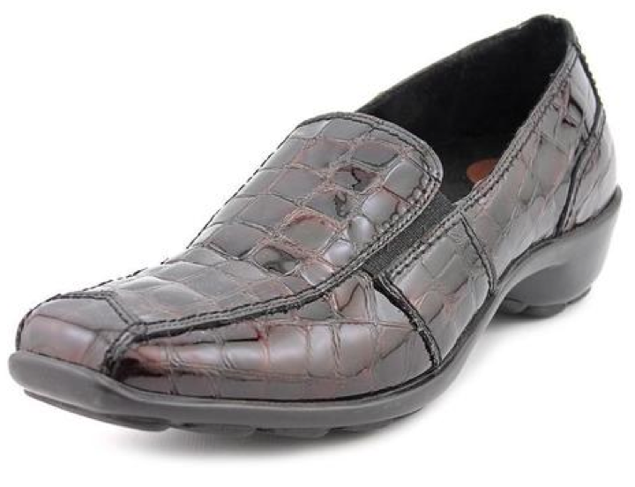
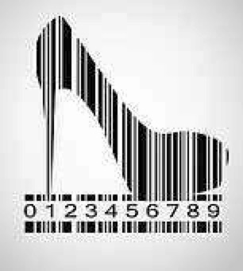
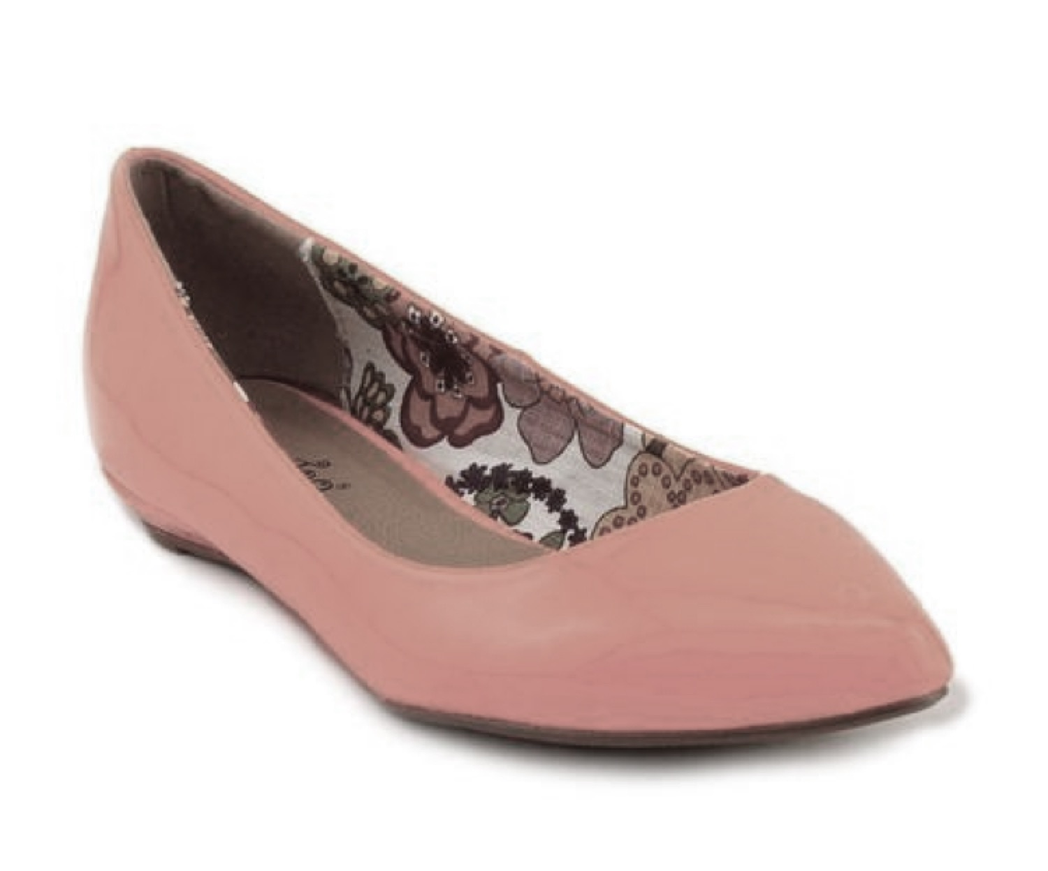
Shoes
Merchants
A typical end user
Women’s Shoes
Men’s Shoes
…
Girl’s Shoes
y₁
y₂
y₃
y₄
y_{L}
Comfort
Pumps
Sneakers
Flats
…
Lyza Clog
Lyza Clog is unavailable
100MM Runway
Felt Mule Sandals
Lips Too Women's
'Too Sliver' Patent
Casual Shoes
Size 6
1883 by Wolverine Women's Maisie Oxford Tan/Taupe Leather/Suede
1803 Women's 'Nome' Crocodile Dress Shoes Size
9
10 Crosby Women's
Ynez Pump
More Women’s Comfort Shoes
x₃
100MM Runway
Felt Mule Sandals
x₂
x₆
…
x_{N}
x₁
x₄
Lips Too Women's
Casual Shoes
Machine Learning
Model
Learn: Y=
(X)

Slide 2
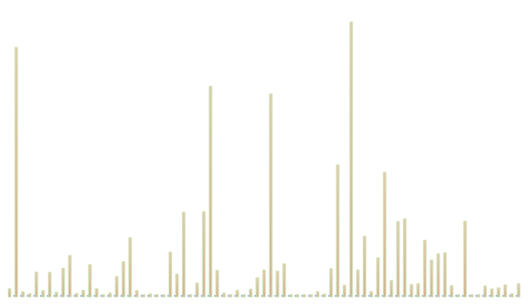
Notes:
Dec 2015

Slide 3
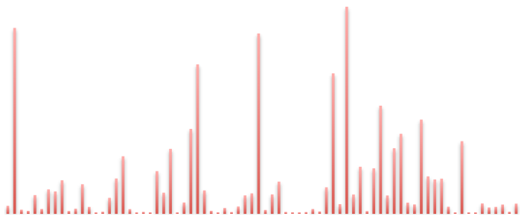
Notes:
Feb 2016

Slide 4
Notes:
Shoes problem: L1 on Dec 2015 data

Slide 5
Notes:
Slice dataset stats

Slide 6
Notes:
AmazonJ

Slide 8
Dec
2015
Feb
2016

