Slide 1
Simulator Scheduler
2013/01/18
Notes:
11/08/262011-10-19
2011-10-19

Slide 2
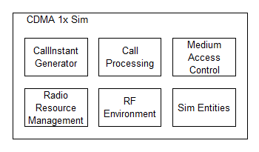
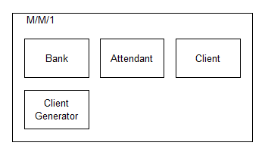
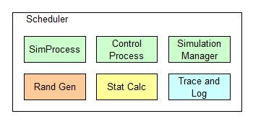
Simulator architecture
interchangeable
Notes:
11/08/262011-10-19

Slide 3
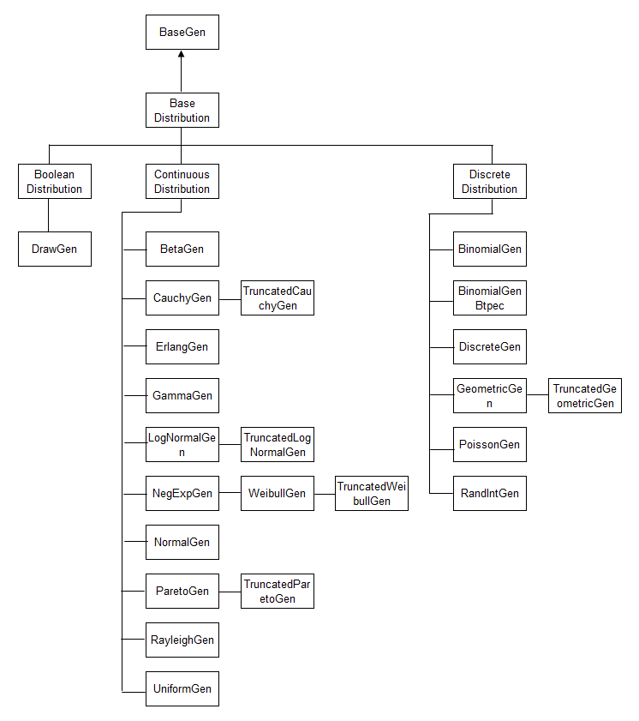
Rand Gen

Slide 4
Rand Gen Usage
NegExpGen *pArrivalTime; // distribuition that generates the arrival time
pArrivalTime = new NegExpGen(arrivalTimeSeed, (Float)1.00); // arrival time with mean = 1.00
if ((result = pAttendanceTime->nextValue( &serviceTime)) != SCH_SUCCESS)
errorTreatment( getProcessName(), result);

Slide 5
Stat calc
Class Name | Init Param | Feed Samples | Get Result
DiscreteHistogram | Int minVal, Int maxVal, Int intervals | RetCode nextSample (Int sample) | RetCode getResult (Int intervalNumber, Int *pResult)
ContinuousHistogram | Float minVal, Float maxVal, Int intervals | RetCode nextSample (Float sample) | RetCode getResult (Int intervalNumber, Int *pResult)
CumulativeHistogram | Int intervals | RetCode nextSample (Float sample) | RetCode getCumulativeResult (Int markerNumber, Float *pX, Float *pY) RetCode getDerivedResult (Int markerNumber, Float *pX, Float *pY)
DescriptiveStatistic | <No need> | RetCode nextSample (Float sample) | StdDev, Variance, Min, Max, Mean, Sum
WindowedAverage | Int winSize | RetCode nextSample (Float sample) | Float getWindowedAverage ()
Quantile | Float quantileThreshold | RetCode nextSample (Float sample) | Float getQuantile ()

Slide 6
Stat calc Usage
pDisHisto = new DiscreteHistogram(0, 10 * intervals, intervals);
if ((result=pDisHisto->nextSample ( intValue)) != SCH_SUCCESS) errorTreatment(result);
outFile << "\nHistogram Plotting\n";
for (cont = 0; cont < intervals ; cont++)
{
if ((result=pHisto->getResult(cont, &y)) != SCH_SUCCESS) errorTreatment(result);
outFile << "\t i = " << cont;
outFile << "\t y_axis = " << y << endl;
}

Slide 7
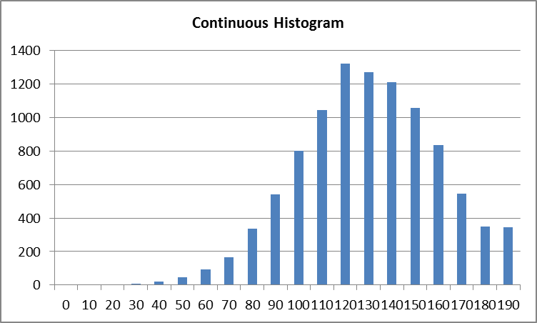
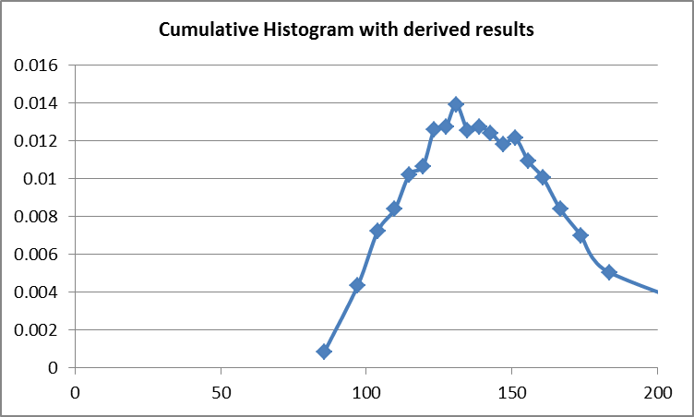
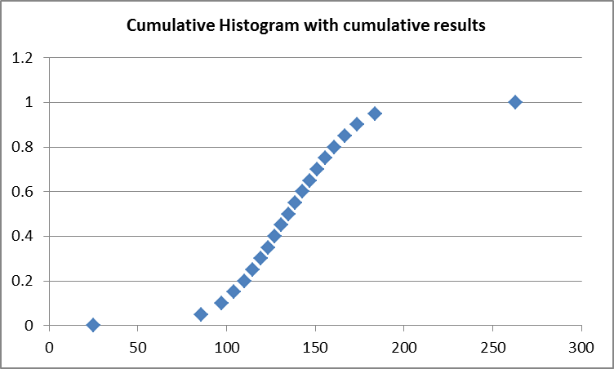
Stat Examples
 | Normal Distribution
Mean | 135
Standard Deviation | 30
Continuous Histogram
Min | 0
Max | 200
Interval | 20
Cumulative Histogram
Interval | 20

Slide 8
Sim core
Simulator
Main Thread
Scheduler Thread
Event List
Passive List
Cooperative Scheduling
Active
Process
Scheduled
Process
Passive
Process
Scheduled
Process
Passive
Process
Scheduled
Process
Passive
Process
Scheduled
Process

Slide 9
Sim Core API
Action Called in Current Process | Affect Object | Switch Context to | Current Process goes to
startProcess(newProcess, name) | add newProcess to passiveList | <No Context Switch>
activate(targetProcess) | targetProcess in eventList or passiveList | targetProcess | head of eventList
passivate() | self | head process of the eventList | head of passiveList
passivate(targetProcess) | targetProcess in eventList | <No Context Switch>
schedule(targetProcess, position) | targetProcess in eventList or passiveList | <No Context Switch>
hold(position) | self | head process of the eventList | position of eventList
terminateProcess() | self | head process of the eventList | die
terminateProcess(targetProcess) | targetProcess in eventList | <No Context Switch>
finished natually | self | head process of the eventList | die
endSimulationManager() | the whole Simulator | <Program Exit>

Slide 10
M/M/1 Simulator
passivate();
printStat();
endSimMgr();
startProcess();
activate();
startProcess();
activate();
SimulationSystem
(MainProcess)
Attendant
ClientGenerator
Loop forever
calc next arrival time
and hold;
Loop until max
number of client served
Client
Client FIFO Queue
passivate() if Q is empty;
schedule attendant
if it is passivate;
start and
activate the new client;
obtain the head client;
goes to Q;
hold() for service time;
passivate();
activate() client;
Statistics
totalClientTime
queueSize
attendantLazyTime
serviceTime
timeBetweenArrival
activate() main process;

Slide 11
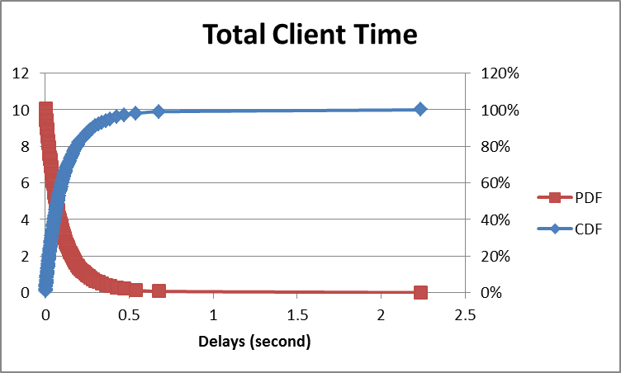
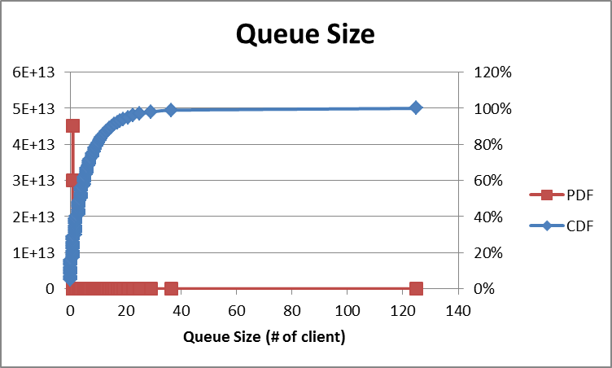
M/M/1 Simulation result
Input
Sim Output
maxClient | 1000000
arrivalRate (average) | 50 | clients per second
serviceRate (average) | 60 | clients per second
Simulation Statistics
I Simulation state | Stopped
I Simulation Time | 19963.78
I CPU Simulation Time (ms) | 162038.2
I Total Process Created | 1000018
I Total Process Terminated | 1000018
I Return Code | 0
Calc by theory
Average Delay = 1 / (60 – 50) = 0.1
Std dev Delay = 1 / (60-50) = 0.1
Average Queue Size = 50 * 0.1 = 5
Std dev Queue Size = sqrt(5 / (1-5/6)) = 5.48
Sim Stat
99% delays < 0.7 sec
50% delays < 0.074 sec
Max delay = 2.23 sec
Average = 0.12 sec
Std dev = 0.14 sec
99% queue size < 37
50% queue size < 4
Max queue size = 125
Average = 6.1
Std dev = 7.8

Slide 12

Notes:
11/08/262011-10-19

