Slide 1
PTT - Polycube Tracing Toolkit
eBPF-based tools for polycube services analysis

Slide 2
Introduction to tracing in eBPF

Slide 3
Introduction
Linux Kernel tracing can be performed in three different manners:
static tracing;
synamic tracing;
PCM’s sampling.

Slide 4
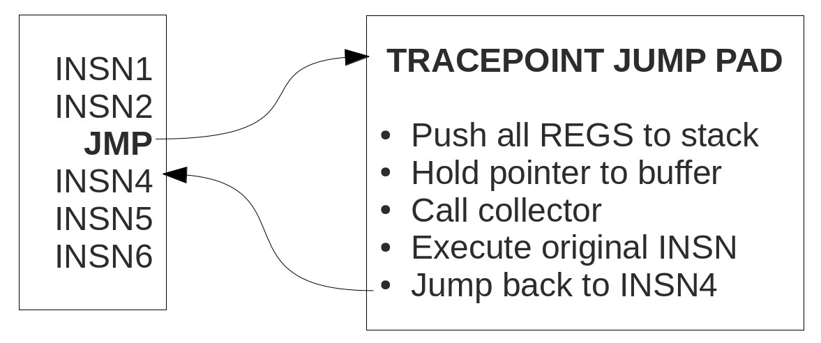
Static tracing
Tracepoints: static entity compiled with the kernel by the developer; in order to create a new tracepoint it is necessary to recompile the kernel. A tracepoint placed in code provides a hook to call a function (probe) that it is possible to provide at runtime. The tracepoint can be ON or OFF (depending on the fact a callback is attached to a tracepoint). When a tracepoint is ON, the function provided as the callback is being executed each time the tracepoint is being reached.

Slide 5
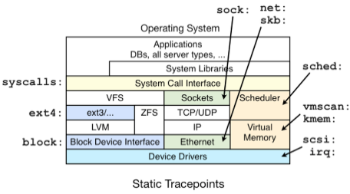
Static tracing - cont.
Trace events: built on top of tracepoints (as a higher level API), are also usable from user space (it is not needed to write kernel modules to be able to hook on them) but it is only possible to read data this way. There are several trace events in the kernel; the complete list can be found at:
/sys/kernel/debug/tracing/available_events

Slide 6
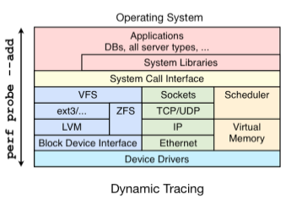
Dynamic tracing
One benefit of dynamic tracing is that it can be enabled on a live system without restarting anything. It is possible to take an already-running kernel or application and then begin dynamic instrumentation, which (safely) patches instructions in memory to add instrumentation. That means there is zero over- head or tax for this feature until you begin using it.

Slide 7
Dynamic tracing - cont.
kprobes: they use the possibility to add dinamically the tracepoints for enabling the programmer to break into any kernel routine and collect debugging and performance information non-disruptively; it is possible to trap at almost any kernel code address, specifying a handler routine to be invoked when the breakpoint is hit (although some parts of the kernel code can not be trapped (kprobes blacklist)); It is not possible to attach kprobes to functions declared as static inline.
There are currently two types of probes: kprobes, and kretprobes (also called return probes). A kprobe fires when a specified function is being called; a return probe fires when a specified function returns.

Slide 8
Polycube Tracing Tools (PTT)

Slide 9
Overview
The goal of PTT is to give the developer of a polycube service a toolkit which allows him to discover and study:
how his program works;
the performance achieved;
the bottlenecks.
Thanks to these informations, the developer is able to optimize the code and consequently improve the performance.
These tools allow to count the number of calls for each function used by the eBPF polycube services and to get some time statistics.
PTT makes use of BCC, a toolkit for creating efficient kernel tracing and manipulation programs that relays on the eBPF functionalities; thanks to this toolkit it is possible to attach kprobes and kretprobes to the functions for which it is wished to trace the performance.

Slide 10
Tools summary
PTT provides three different tools:
polycount.py: allows to monitor which kernel functions an eBPF program calls and the amount of calls for each of them;
polylat.py: measures the count and the latency of eBPF monitored functions; as result it gives a brief summary and a histograms for each monitored function showing the latency distribution in logarithmic scale (the computation of the latency can be not so precise)
polylatperc.py: measures the count and the latency of monitored functions inside eBPF service in a very precise way and gives the occurrency percentage relating to the total amount of eBPF program calls.

Slide 11
Polycount

Slide 12
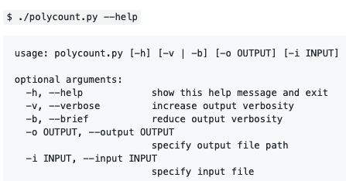
Features
polycount.py allows the developer to monitor which kernel functions his program calls and the amount of calls for each of them.
In order to tell the tool which kernel functions to monitor there are two different data structures to customize:
whitelist: by modifying this list according to the python regex syntax it is possible to tell the program whether to add a single function or a set of them to the analysis context;
blacklist: for removing a single function or a set of them from the analysis context.
For customizing these two data structures it is necessary to give the tool an input file (by using the -i option) which must contain all the whitelisted functions, a blank row and then all the blacklisted functions. There is a default file (~/PTT/polycount_functions.conf) that can be edited to customize the tracing.

Slide 13
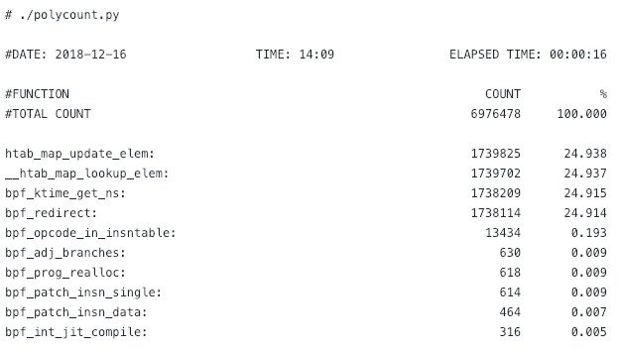
By giving the tool the following filters:
whitelist: “.*bpf.*”, “.*_map_update.*”, “__htab_map_lookup_elem”
blacklist: “.*[0-9]+.*”
The output of the tool is the following (it has been reduced for sake of brevity)

Slide 14
Polylat

Slide 15
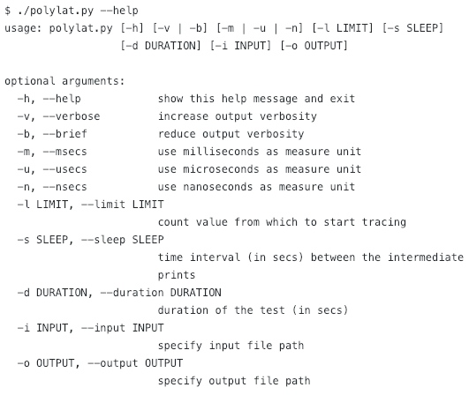
Features
The polylat.py tool allows the developer of a polycube service to monitor which kernel functions his program calls and to get some information about the latency time for each of them. The output of this tool is composed by two parts:
brief summary containing the amount of calls, the latency and the percentage over total time taken by all the traced functions;
set of histograms showing the latency distribution for each monitored function in a logarithmic scale.
The statistics obtained from this tool are inaccurate, they are useful for monitoring the distribution of values (thanks to the histograms) and the relation between the called functions inside the eBPF program. For having an accurate value of the functions latencies (without the histogram feature), please use the polylatperc.py tool.

Slide 16
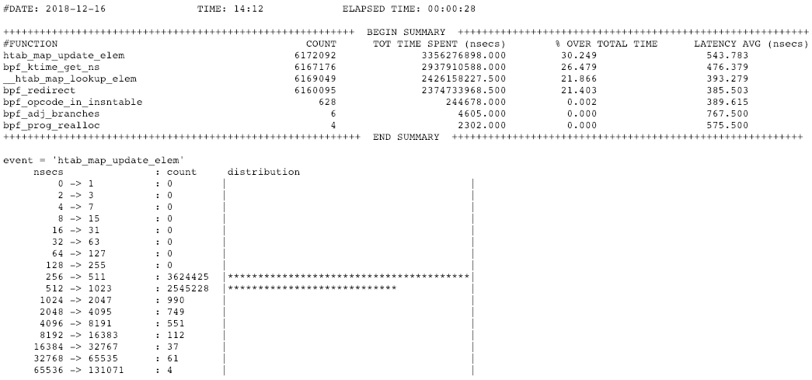

Slide 17
Polylatperc

Slide 18
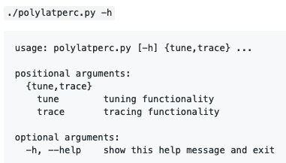
Features
The polylatperc.py tool allows the developer of a polycube service to monitor which kernel functions his program calls and the amount for each of them; in addition to this, it allows to know the total time spent by each kernel function, the average latency and the spent percentage over the total time of the eBPF program that is being monitored. All the latencies computed by this tool are very accurate, thanks to the two phases analysis (tuning and tracing) that allows to cancel the overhead intrinsic in the tracing operations.
The tool functionality is splitted into two different phases: tuning and tracing (see later).

Slide 19
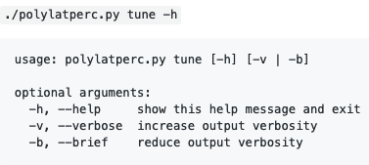
Phase 1: tune
the tool asks the developer to launch a simplebridge service in polycube and to make it work by using some traffic generator (e.g., iperf3); the true latency of the three main functions used by the tool are computed and used later (in the trace phase) for ensuring a very accurate measure of the functions latency.
The computed latencies are stored in ~/.config/PTT/tuning.conf
Tuning phase is necessary in order to face the accuracy problem, described later.

Slide 20
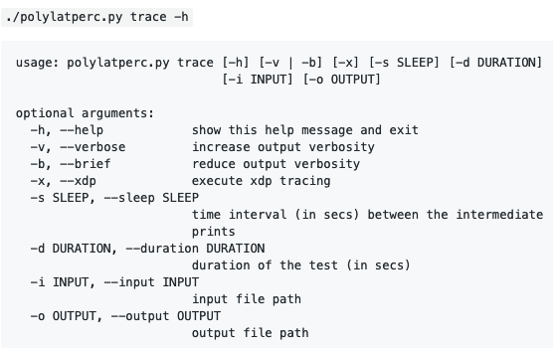
Phase 2: trace
There are two different working modes: eBPF (by default) and XDP (--xdp option)
The tool gets the latency values previously computed (in the tune phase) and uses them to calculate the latency of any function the developer wants to trace.

Slide 21
The accuracy problem
bpf_ktime_get_ns only:
#DATE: 2018-12-13 TIME: 08:48 ELAPSED TIME: 00:00:17
++++++++++++++++++++++++++++++++++++++++++++++++++++++++++ BEGIN SUMMARY ++++++++++++++++++++++++++++++++++++++++++++++++++++++++++
#FUNCTION COUNT TOT TIME SPENT (nsecs) % OVER TOTAL TIME LATENCY AVG (nsecs)
BPF PROGRAM 2790500 4550622854.000 100.000 1630.000
bpf_ktime_get_ns 2790134 1003638373.000 22.055 359.000
+++++++++++++++++++++++++++++++++++++++++++++++++++++++++++ END SUMMARY ++++++++++++++++++++++++++++++++++++++++++++++++++++++++++
htab_map_update_elem, bpf_ktime_get_ns, __htab_map_lookup_elem, bpf_redirect:
#DATE: 2018-12-13 TIME: 08:57 ELAPSED TIME: 00:00:14
++++++++++++++++++++++++++++++++++++++++++++++++++++++++++ BEGIN SUMMARY ++++++++++++++++++++++++++++++++++++++++++++++++++++++++++
#FUNCTION COUNT TOT TIME SPENT (nsecs) % OVER TOTAL TIME LATENCY AVG (nsecs)
BPF PROGRAM 1761621 9565748051.000 100.000 5430.000
htab_map_update_elem 1761634 864167503.000 9.034 490.000
bpf_ktime_get_ns 1761466 788525637.000 8.243 447.000
__htab_map_lookup_elem 1761653 738183378.000 7.717 419.000
bpf_redirect 1761639 657400371.000 6.872 373.000
+++++++++++++++++++++++++++++++++++++++++++++++++++++++++++ END SUMMARY ++++++++++++++++++++++++++++++++++++++++++++++++++++++++++

Slide 22
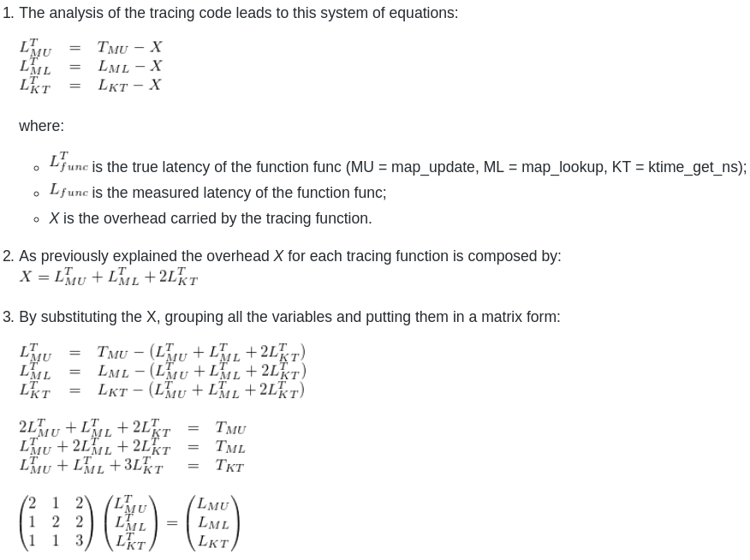
The optimization algorithm

Slide 23
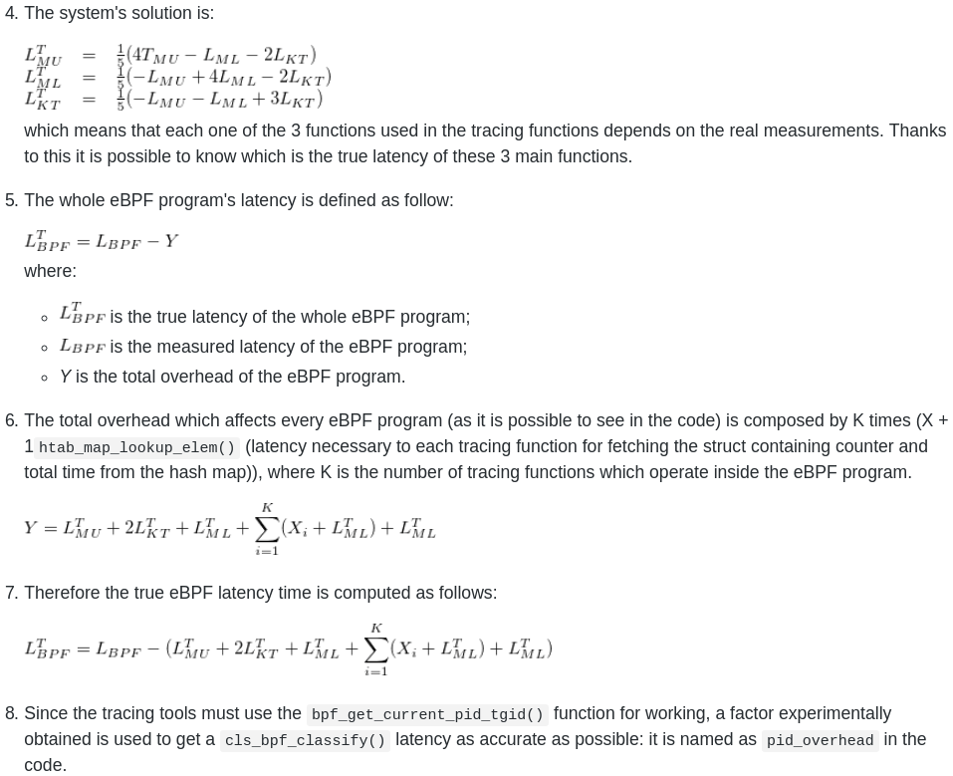
The optimization algorithm - cont.

Slide 24
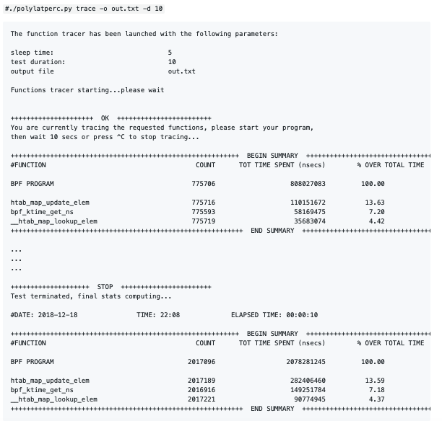

Slide 25
Thanks for your attention!
Mattia Lavacca
lavacca.mattia@gmail.com
https://github.com/mLavacca/PTT

