Slide 1
Streamly Recommendation Engine – Case Study Delivery
Tshepo Matshisevhe

Slide 2
Data Exploration & Quality Checks
Implemantation
End-to-end implementation of Streamly’s recommendation workflow
Covers: Data → Cleaning → Database → Algorithm → Web App → Demo
Built using Python, SQLite, Flask & lightweight UI
Datasets: profiles.csv, titles.csv
Performed profiling on types, nulls, duplicates, distributions
Key issues: inconsistent formatting, missing languages, duplicates, inferred accounts

Slide 3
Data Cleaning & Transformation
Standardised text fields and formats
Converted numeric, boolean, datetime fields
Parsed profile preferences
Generated clean datasets: profiles_clean.csv & titles_clean.csv
Database Design & SQLite Implementation
Created streamly.db with accounts, profiles, titles tables
Normalised structure for easy joins and extensibility
Programmatically generated schema via Notebook 03

Slide 4
Recommendation Algorithm
Heuristic scoring model using:
Age band × rating suitability
Kids-profile filtering logic
Language & genre preference match
Popularity from IMDB rating + votes
Added visualisation
Web App, API & Demo Flow
Flask backend with /api/profiles and /api/recommendations
HTML/JS frontend calling API
User flow: Start Flask → Select Profile → Get Recommendations

Slide 5
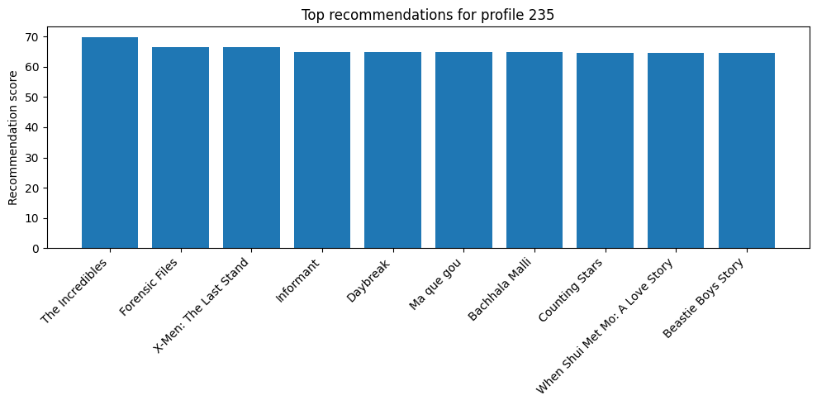
This chart shows how the scoring function ranks candidate titles for a specific profile, combining age suitability, kids logic, language, preferences and IMDB popularity.

Slide 6
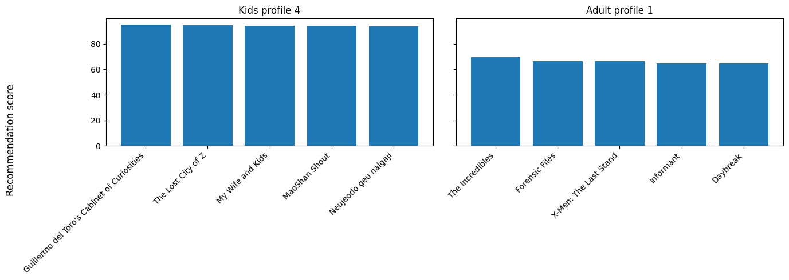
Left: Kids profile only surfacing kids content. Right: Adult profile surfacing a more mature set of titles

