Slide 1


ACM BIT Patna Welcomes you all

Slide 2

Introduction to Programming
ACM BIT Patna

Slide 3
What all we will be covering
Introduction of Computer language.
Installing and setting up IDE, compilers.
“Hello World” program.
Different components of a program.
A sample program and its analysis.

Slide 4
What is a Programming language?

Slide 5
What is a Programming language?
A programming language is a formal language that specifies a set of instructions that can be used to produce various kinds of output.
Programming languages generally consist of instructions for a computer.
Programming languages can be used to create programs that implement specific algorithms.
Different languages:
C, C++, Java, Python, etc.
Here will mainly use C / C++ for understanding.

Slide 6
How to create environment for programming?
Installing and setting up CodeBlocks.

Slide 7
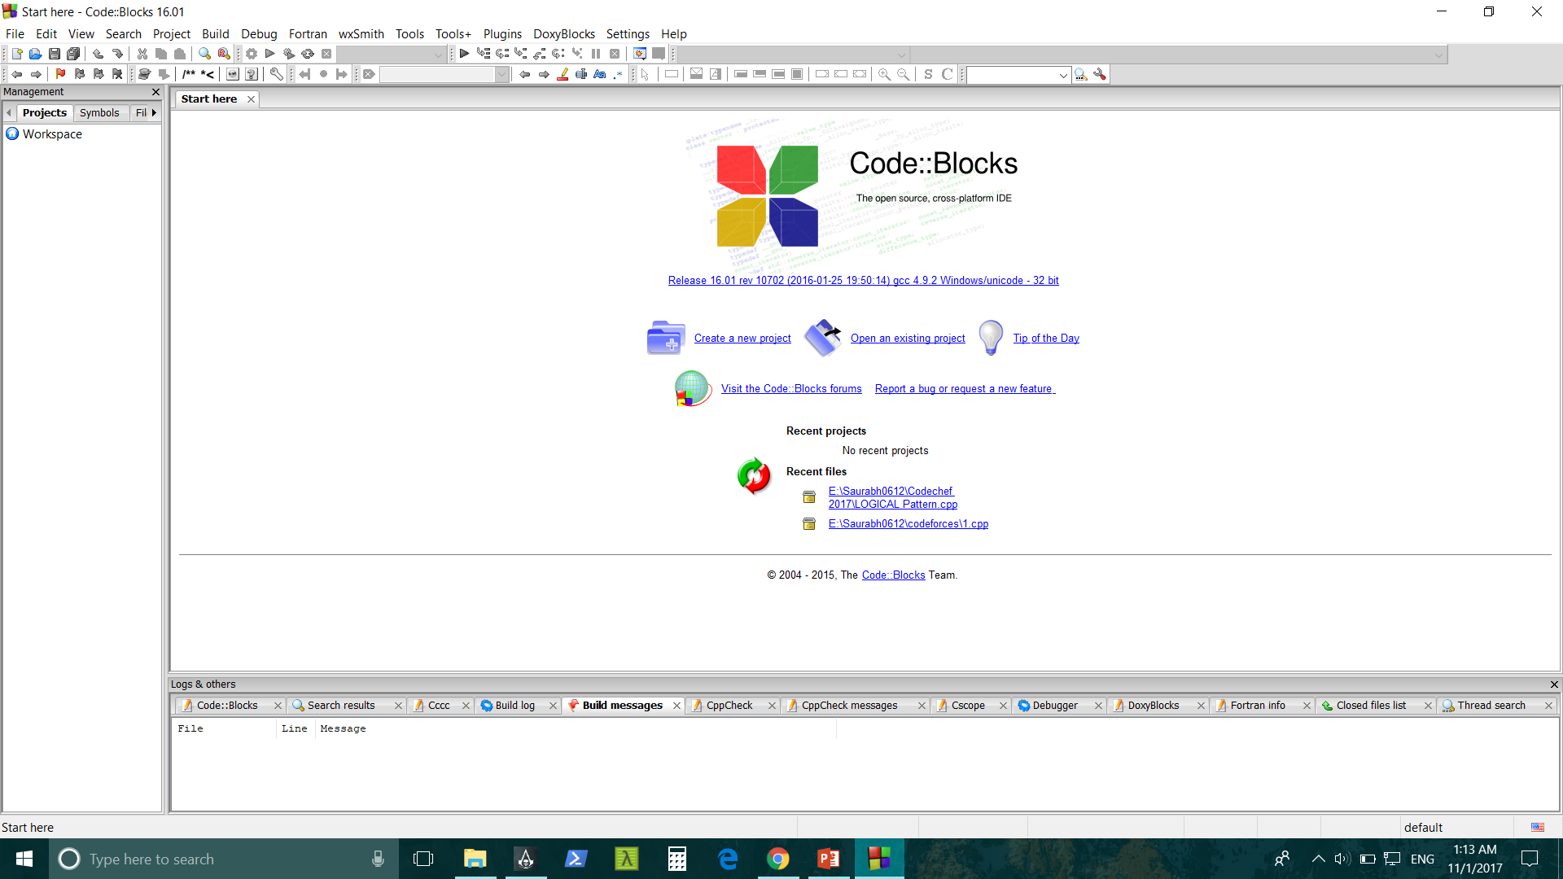
CodeBlocks

Slide 8
“Hello World” Program
#include<iostream> //In order to read or write to the standard input/output streams you need to include it.
using namespace std;
int main()
{
cout << “Hello World” << endl; // cin: standard input stream
return 0; // cout: standard output stream
}
/* return 0: Since int main have to return some value so we write return 0. return 0 also signifies program executed successfully. */

Slide 9
“Hello World” Program
#include<iostream>
using namespace std;
int main()
{
cout << “Hello World” << endl;
return 0;
}
#include<iostream>
int main()
{
std::cout << “Hello World” << std::endl;
return 0;
}
// Namespaces allow to group entities like classes, objects and functions under a name.
// cout and cin are functions from iostream class, in std namespace.

Slide 10
Sample Program
Sum of all elements of an array

Slide 11
Examples: Input : arr[] = {1, 2, 3} Output : 6 1 + 2 + 3 = 6 Input : arr[] = {15, 12, 13, 10} Output : 50

Slide 12
References
Books:
Let us C
Introduction to Algorithms, 3rd Edition (MIT Press)
Online sources:
http://www.geeksforgeeks.org/how-to-begin-with-competitive-programming/
https://www.hackerearth.com/practice/notes/getting-started-with-the-sport-of-programming/
http://codeforces.com/blog/entry/47743
https://www.topcoder.com/community/data-science/data-science-tutorials/power-up-c-with-the-standard-template-library-part-1/

