Slide 1


Slide 2
WHAT IS NOSQL?
NoSQL is an approach different from traditional relational database management systems (RDBMS).
To define NoSQL,. Relational databases rely on tables, columns, rows, or schemas to organize and retrieve data.
In contrast, NoSQL databases do not rely on these structures and use more flexible data models.
NoSQL can mean “not SQL” or “not only SQL.” NoSQL is particularly useful for storing unstructured data.

Slide 3
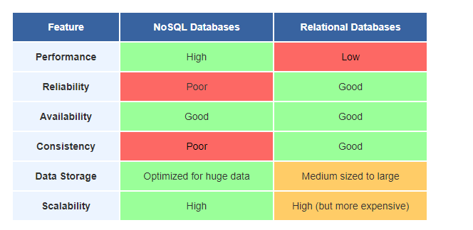

Slide 4
What is MongoDB?
Open Source NoSql Database.
Document Oriented.
Can create document without having to define structure of it first.
Instead of rows and tables in relational database, MongoDB saves data as documents within collections.
It was developed and supported by a company named 10gen.

Slide 5
When can you use MongoDB?
No clear schema definition.
In relational database adding rows and columns can reduce performance, no such issue present in MongoDB as it is schemaless.
Write load is high.
No database administrator
Environment without reliable connectivity.

Slide 6


Slide 7
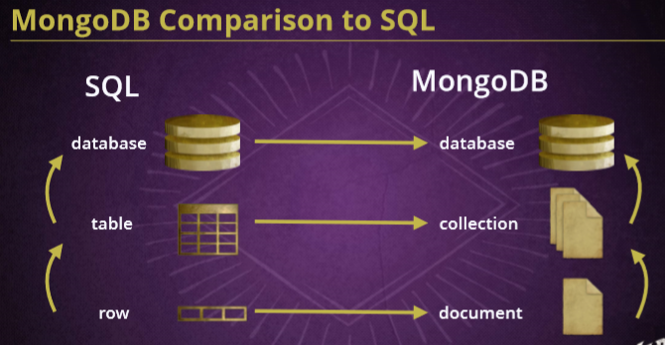

Slide 8
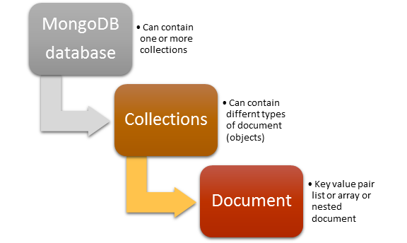

Slide 9
Installation
Windows
Visit https://www.mongodb.com/download-center#community
Select Windows 64bit/32bit
Download
Go to C--> Program Files --> MongoDB --> Server --> 3.4 --> bin
After opening the bin folder, copy the path.
5) Right-click on "This PC" and select "Properties“
6) Select "Advanced System Settings“
7) Select "Enivronment Variables“
8) Select "Path" and hit "Edit“
9) Hit “New” and paste the path there.Then hit “OK” three times.
10) Go to your "C" drive, and create a new folder "data". In that folder, create a new folder named
"db".
11) Open the CMD and type "mongod"
12) Open another CMD window, and type "mongo"

Slide 10
Ubuntu

