Slide 1
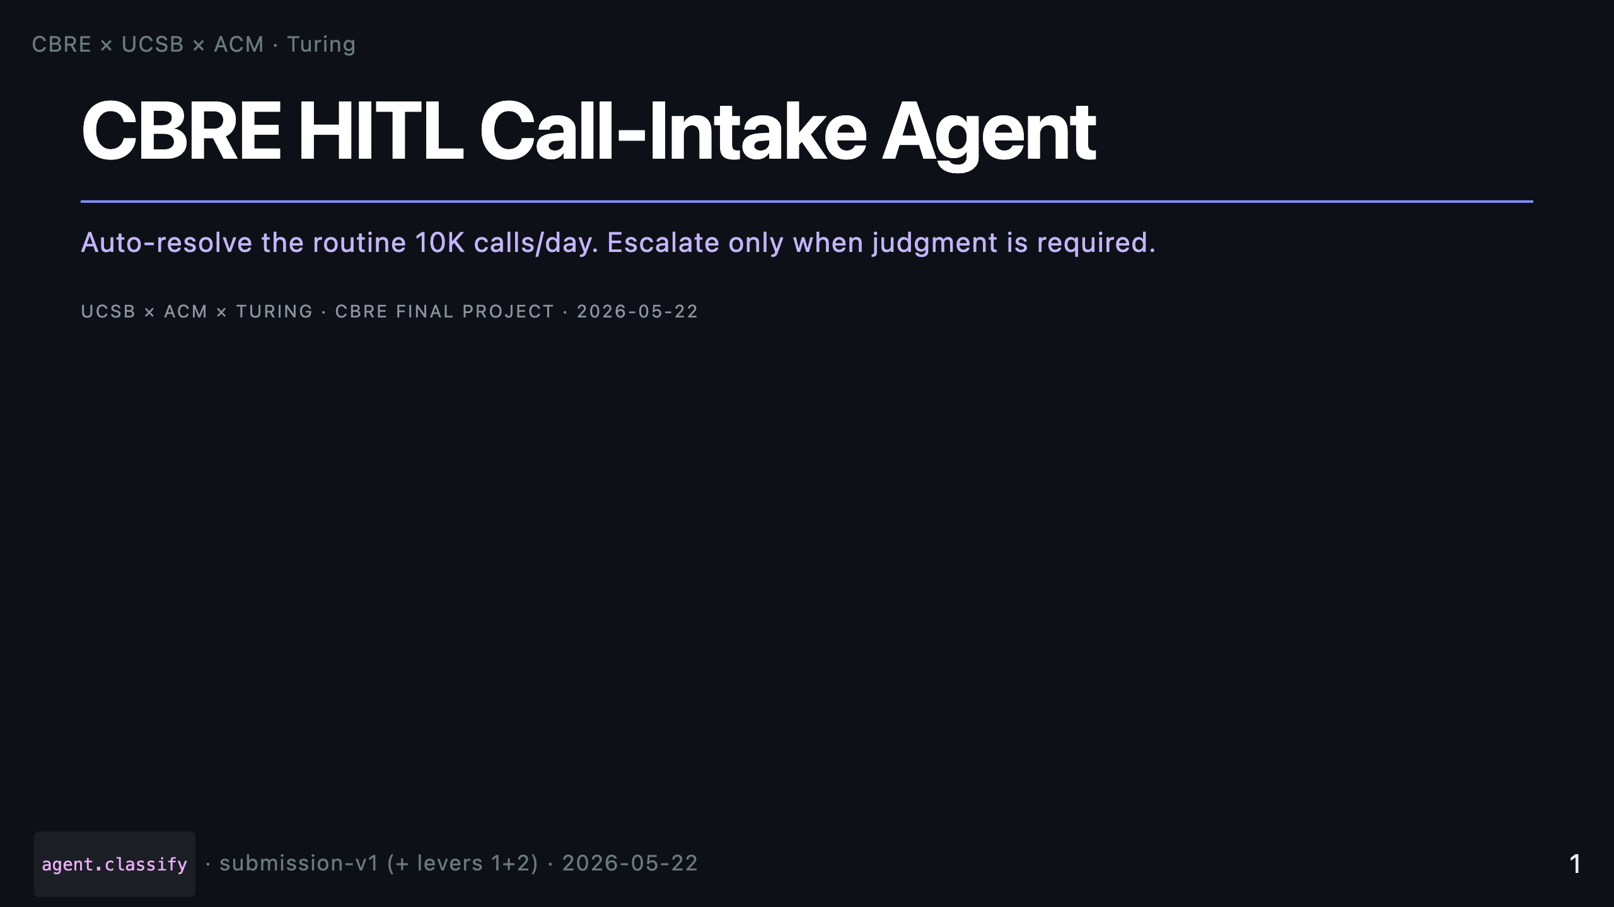
Notes:
Render with the Marp CLI (install once): npm install -g @marp-team/marp-cli marp docs/presentation.md -o docs/presentation.pdf # PDF marp docs/presentation.md -o docs/presentation.html # HTML (presenter mode shows speaker notes — press P) marp docs/presentation.md -o docs/presentation.pptx # PPTX All sources cited in slides are paths inside this repo. Diagrams are in docs/diagrams/. Numbers come from eval_runs/README.md and the design doc (docs/design_doc.md). _notes: Hi — I'm presenting the CBRE call-intake agent we've built over the last four weeks. The brief was simple to state and hard to do: take the 10K facilities calls per day that hit a human today, auto-resolve the routine ones, and escalate only when judgment is genuinely needed. I'll walk through the system, the policy we derived, the safety story, and finish with a live demo.

Slide 2
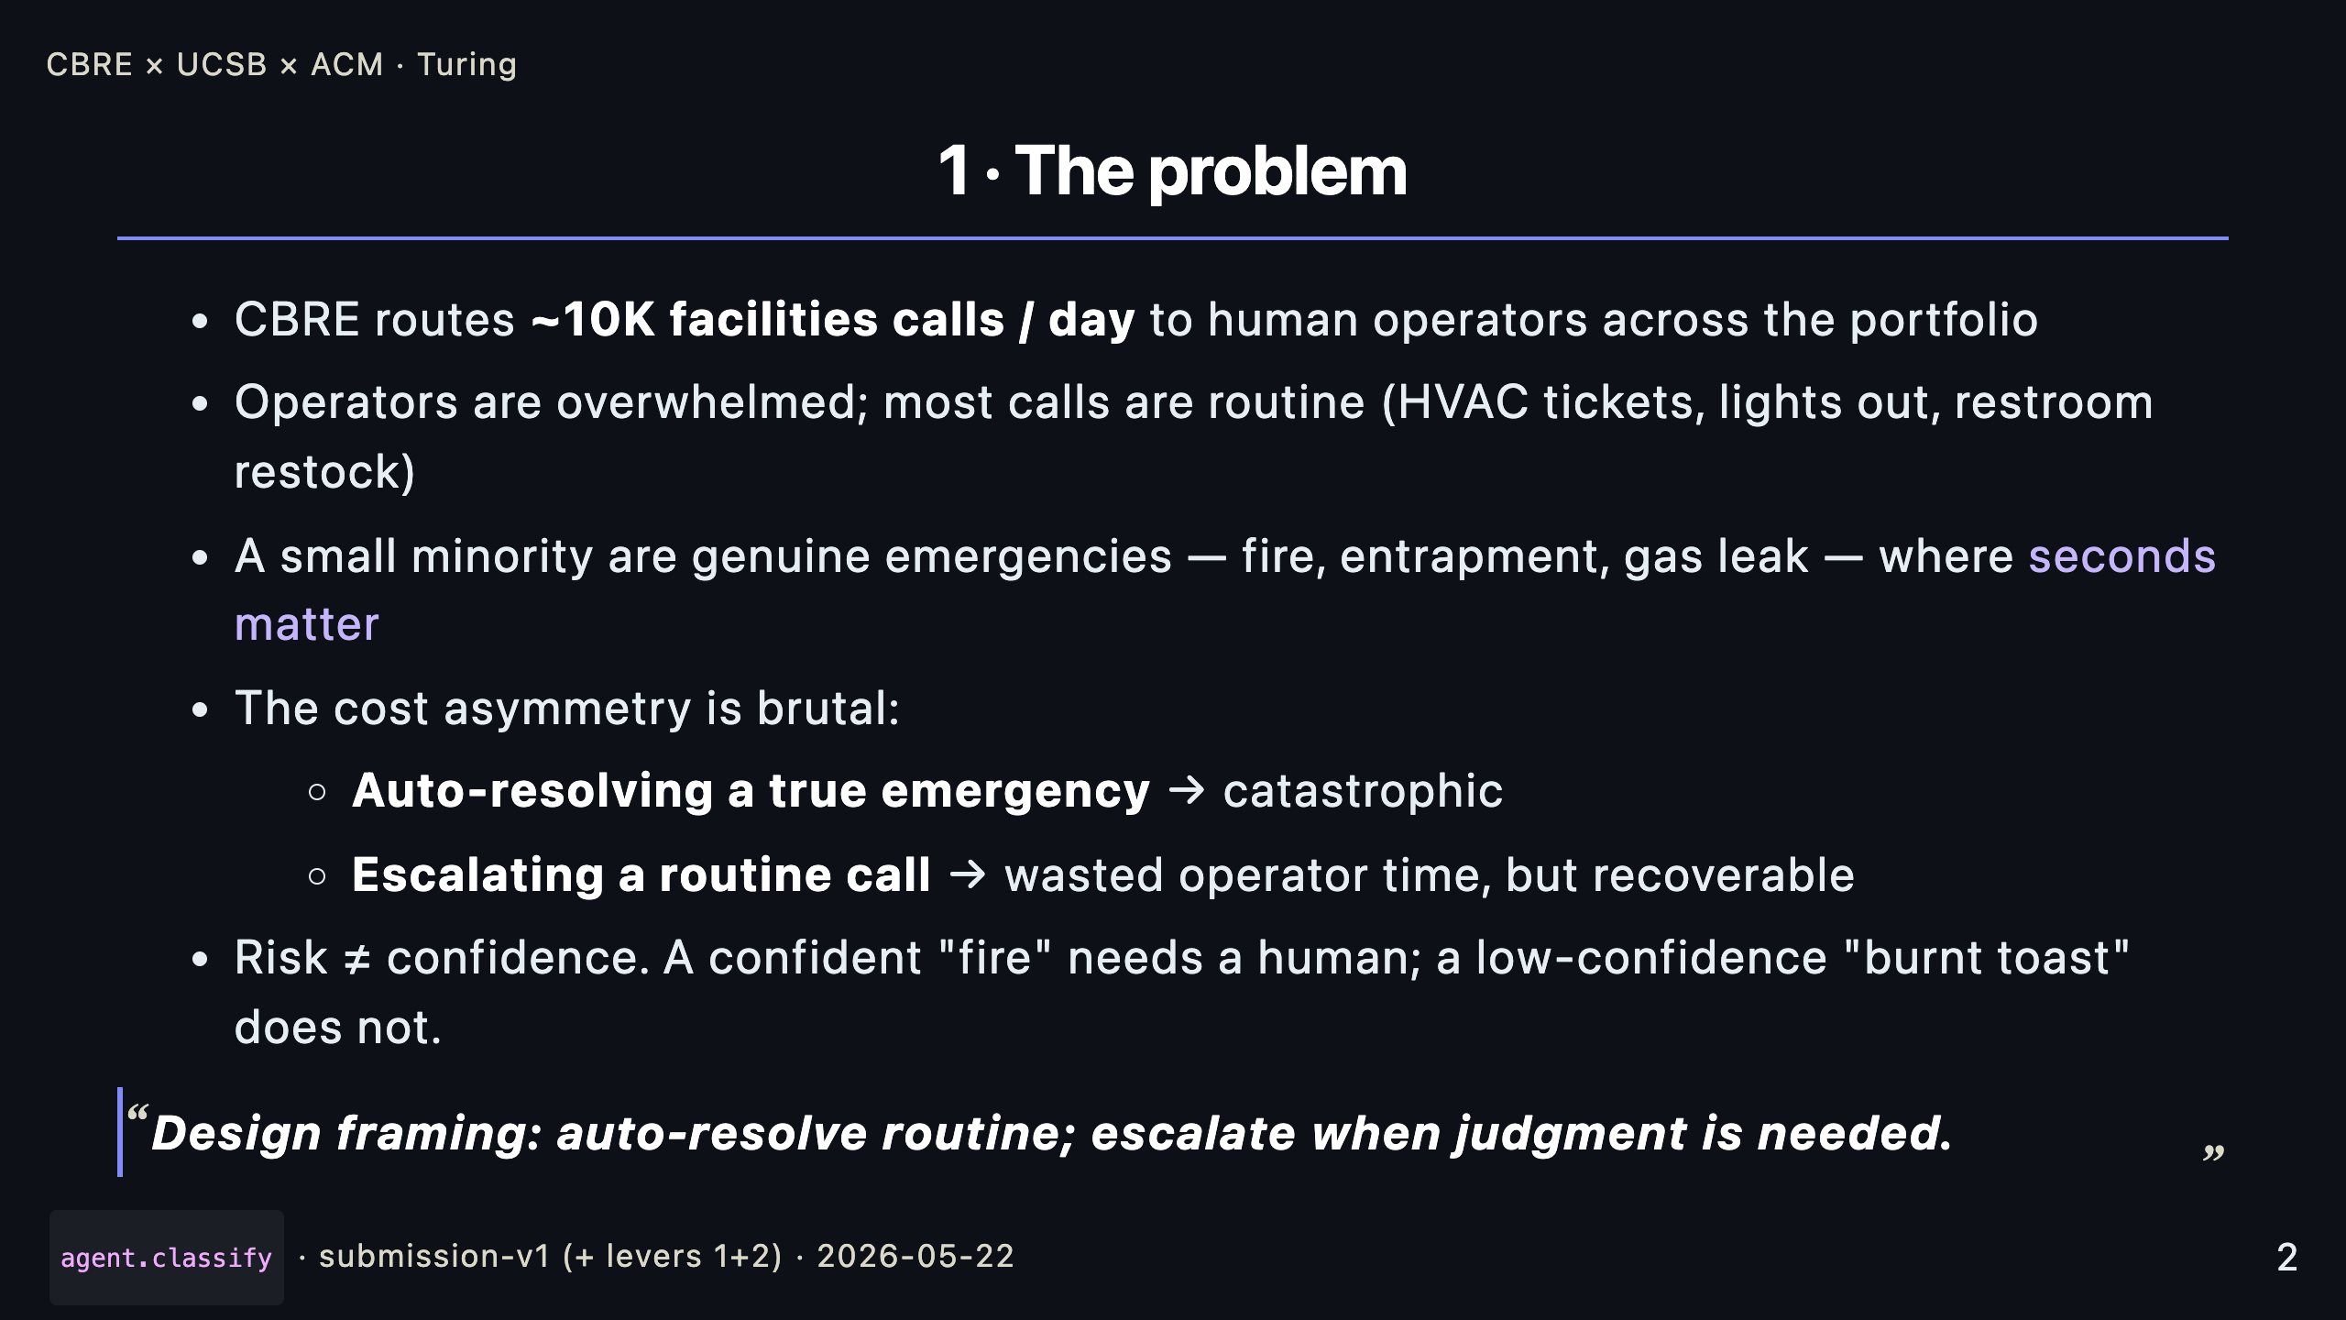
Notes:
_notes: Two things to set up before the architecture. First — scale. Ten thousand calls per day, mostly routine. Second — asymmetry. The cost of escalating a routine call is wasted operator time. The cost of auto-resolving a true emergency is catastrophic. So our risk function isn't "what's the model unsure about" — it's "P(error) × Cost(error)." That framing drives every policy decision in the deck.

Slide 3
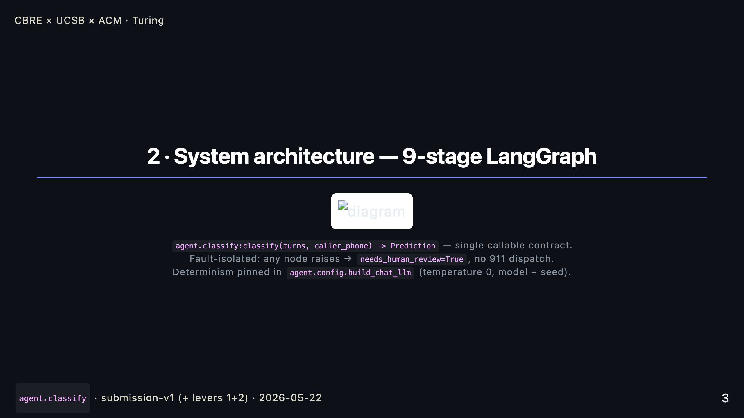
Notes:
_notes: Nine LangGraph nodes. Extract structured fields with the LLM, retrieve from a local Chroma index over the 10,000 historical tickets, classify into the hierarchical taxonomy, reconcile location (transcript beats registry beats profile), assign a risk band, hit the validator gate — that's the HITL pause — select a vendor, decide whether to ask a clarifying question, summarize, and finally assemble the trainer log. Every node is fault-isolated: if any of them raises, the pipeline degrades safely — needs_human_review goes true and we never autonomously dispatch 911. That's how we guarantee the safety story.

Slide 4
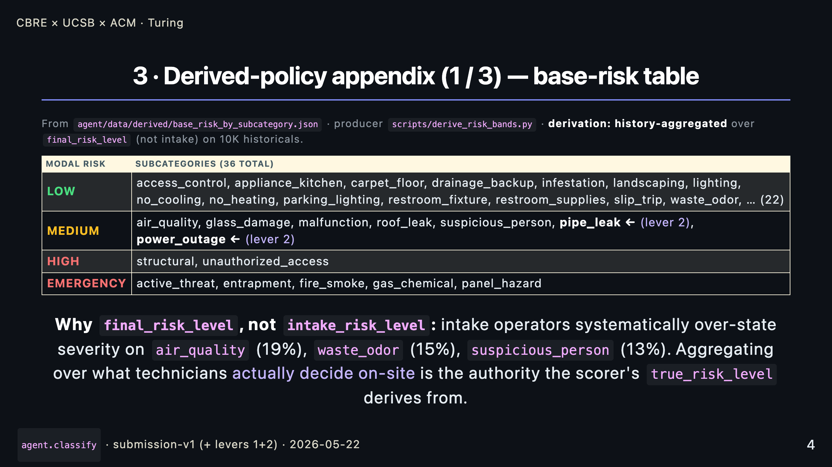
Notes:
_notes: The taxonomy gives us labels — it deliberately omits numeric policy. So the base-risk prior for each of 36 subcategories is derived by aggregating the modal final risk level across the 10,000 historical tickets. We use final, not intake, because intake operators over-escalate roughly 1 in 5 air-quality and waste-odor calls. Aggregating over the technician's on-site finding tracks exactly what the scorer uses for ground truth. The pipe_leak and power_outage demotions are lever 2 from last week's iteration — both subcategories are historically ~50/50 MEDIUM/HIGH; modal-only was over-picking HIGH and turning each into a HITL false positive. Net composite gain: +0.68.

Slide 5
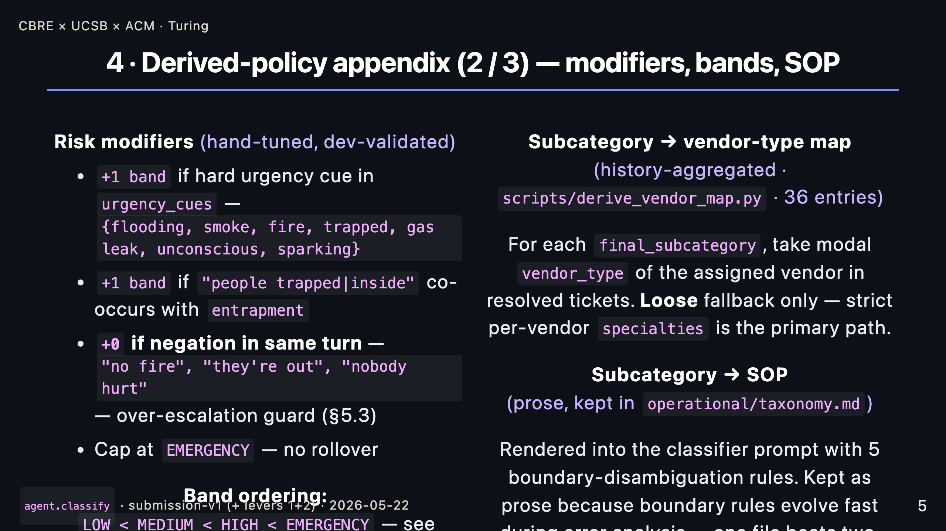
Notes:
_notes: Three more pieces of derived policy. First the modifier weights — hand-tuned, six rules — they live on top of the base prior. A hard urgency cue bumps the band up; a same-turn negation cancels the bump. That negation rule is the single most important line in the over-escalation defense — it's what stops "smoke alarm but no actual fire" from going to 911. Second, the subcategory-to- vendor-type map — derived from history, used only as a loose fallback when no vendor's specialties list names the subcategory directly. And the SOP map — we kept this as prose inside the classifier prompt with five boundary rules like "burnt food is waste_odor, not air_quality." Boundary rules evolve fast during error analysis, and one file is easier to iterate against the dev set than splitting prose and JSON.

Slide 6
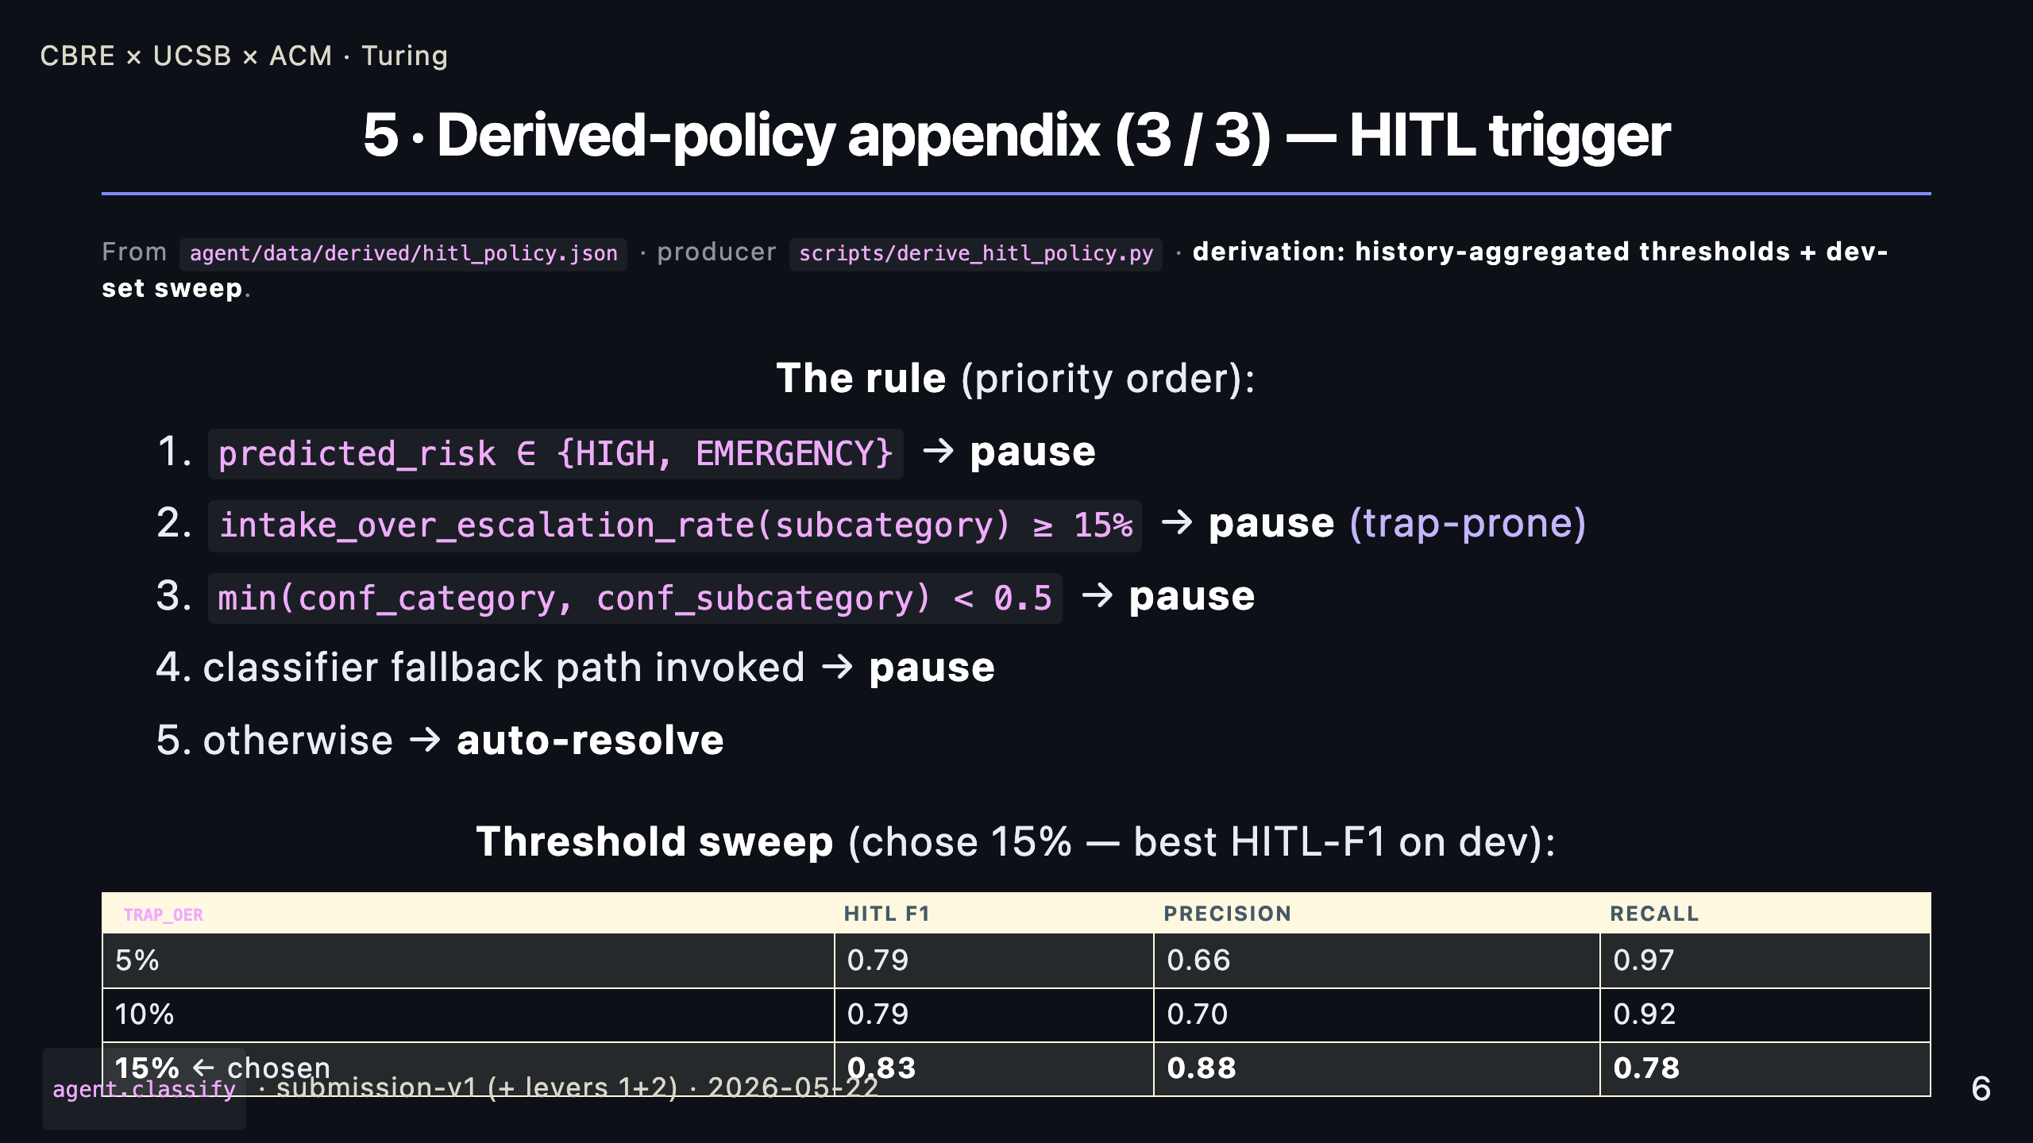
Notes:
_notes: The HITL trigger is a five-rule cascade with priority order. HIGH or EMERGENCY always pauses. Subcategories that historical intake operators over-escalate more than 15% of the time pause. Low classifier confidence pauses. Classifier fallback path pauses. Everything else auto-resolves. The 15% threshold isn't arbitrary — we did a sweep on the dev set, and 15% gives the best F1 by trading 0.19 recall for 0.22 precision relative to a 5% cutoff. The lower thresholds were too pause-happy and tanked the auto-resolution axis.

Slide 7
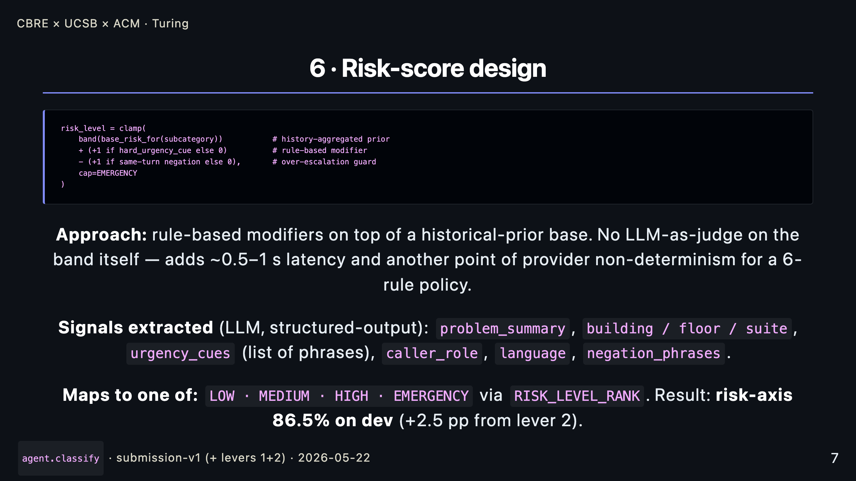
Notes:
_notes: Risk scoring in one block. Start from the history-aggregated prior for the subcategory. Add one band if the LLM extracted a hard urgency cue. Subtract that bump if there's a same-turn negation. Cap at EMERGENCY. We did NOT use LLM-as-judge for the band itself — it's a six-rule policy, the rules are auditable, and skipping that extra structured-output call saves us half a second per call and a source of non-determinism. The LLM is doing what it's good at — extracting structured cues from messy dialogue — and the deterministic layer is doing the policy.

Slide 8
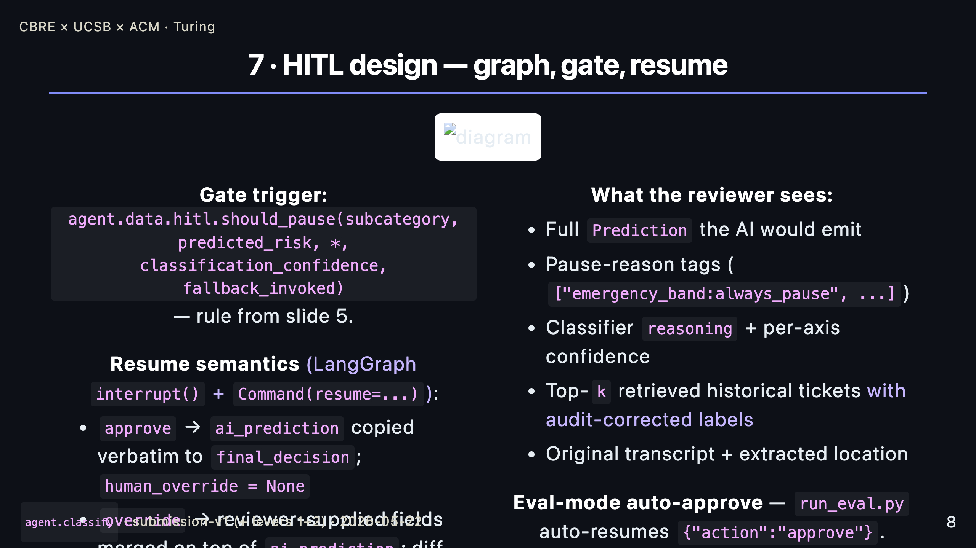
Notes:
_notes: The HITL gate uses LangGraph's interrupt-and-Command-resume pattern. When the gate fires, the pipeline pauses and the reviewer gets a payload that contains not just the AI's prediction but the WHY — pause-reason tags, the classifier's reasoning string, the top retrieved historical tickets with the QA-corrected labels rather than the original intake labels, and the raw transcript so they can spot a profile-versus-transcript conflict. Approve copies the AI's prediction straight through. Override merges only the fields the reviewer changed and records the diff in the trainer log. In eval mode there's no live reviewer, so we auto-resume "approve" — but the needs_human_review bit is preserved, because that's what the rubric grades.

Slide 9
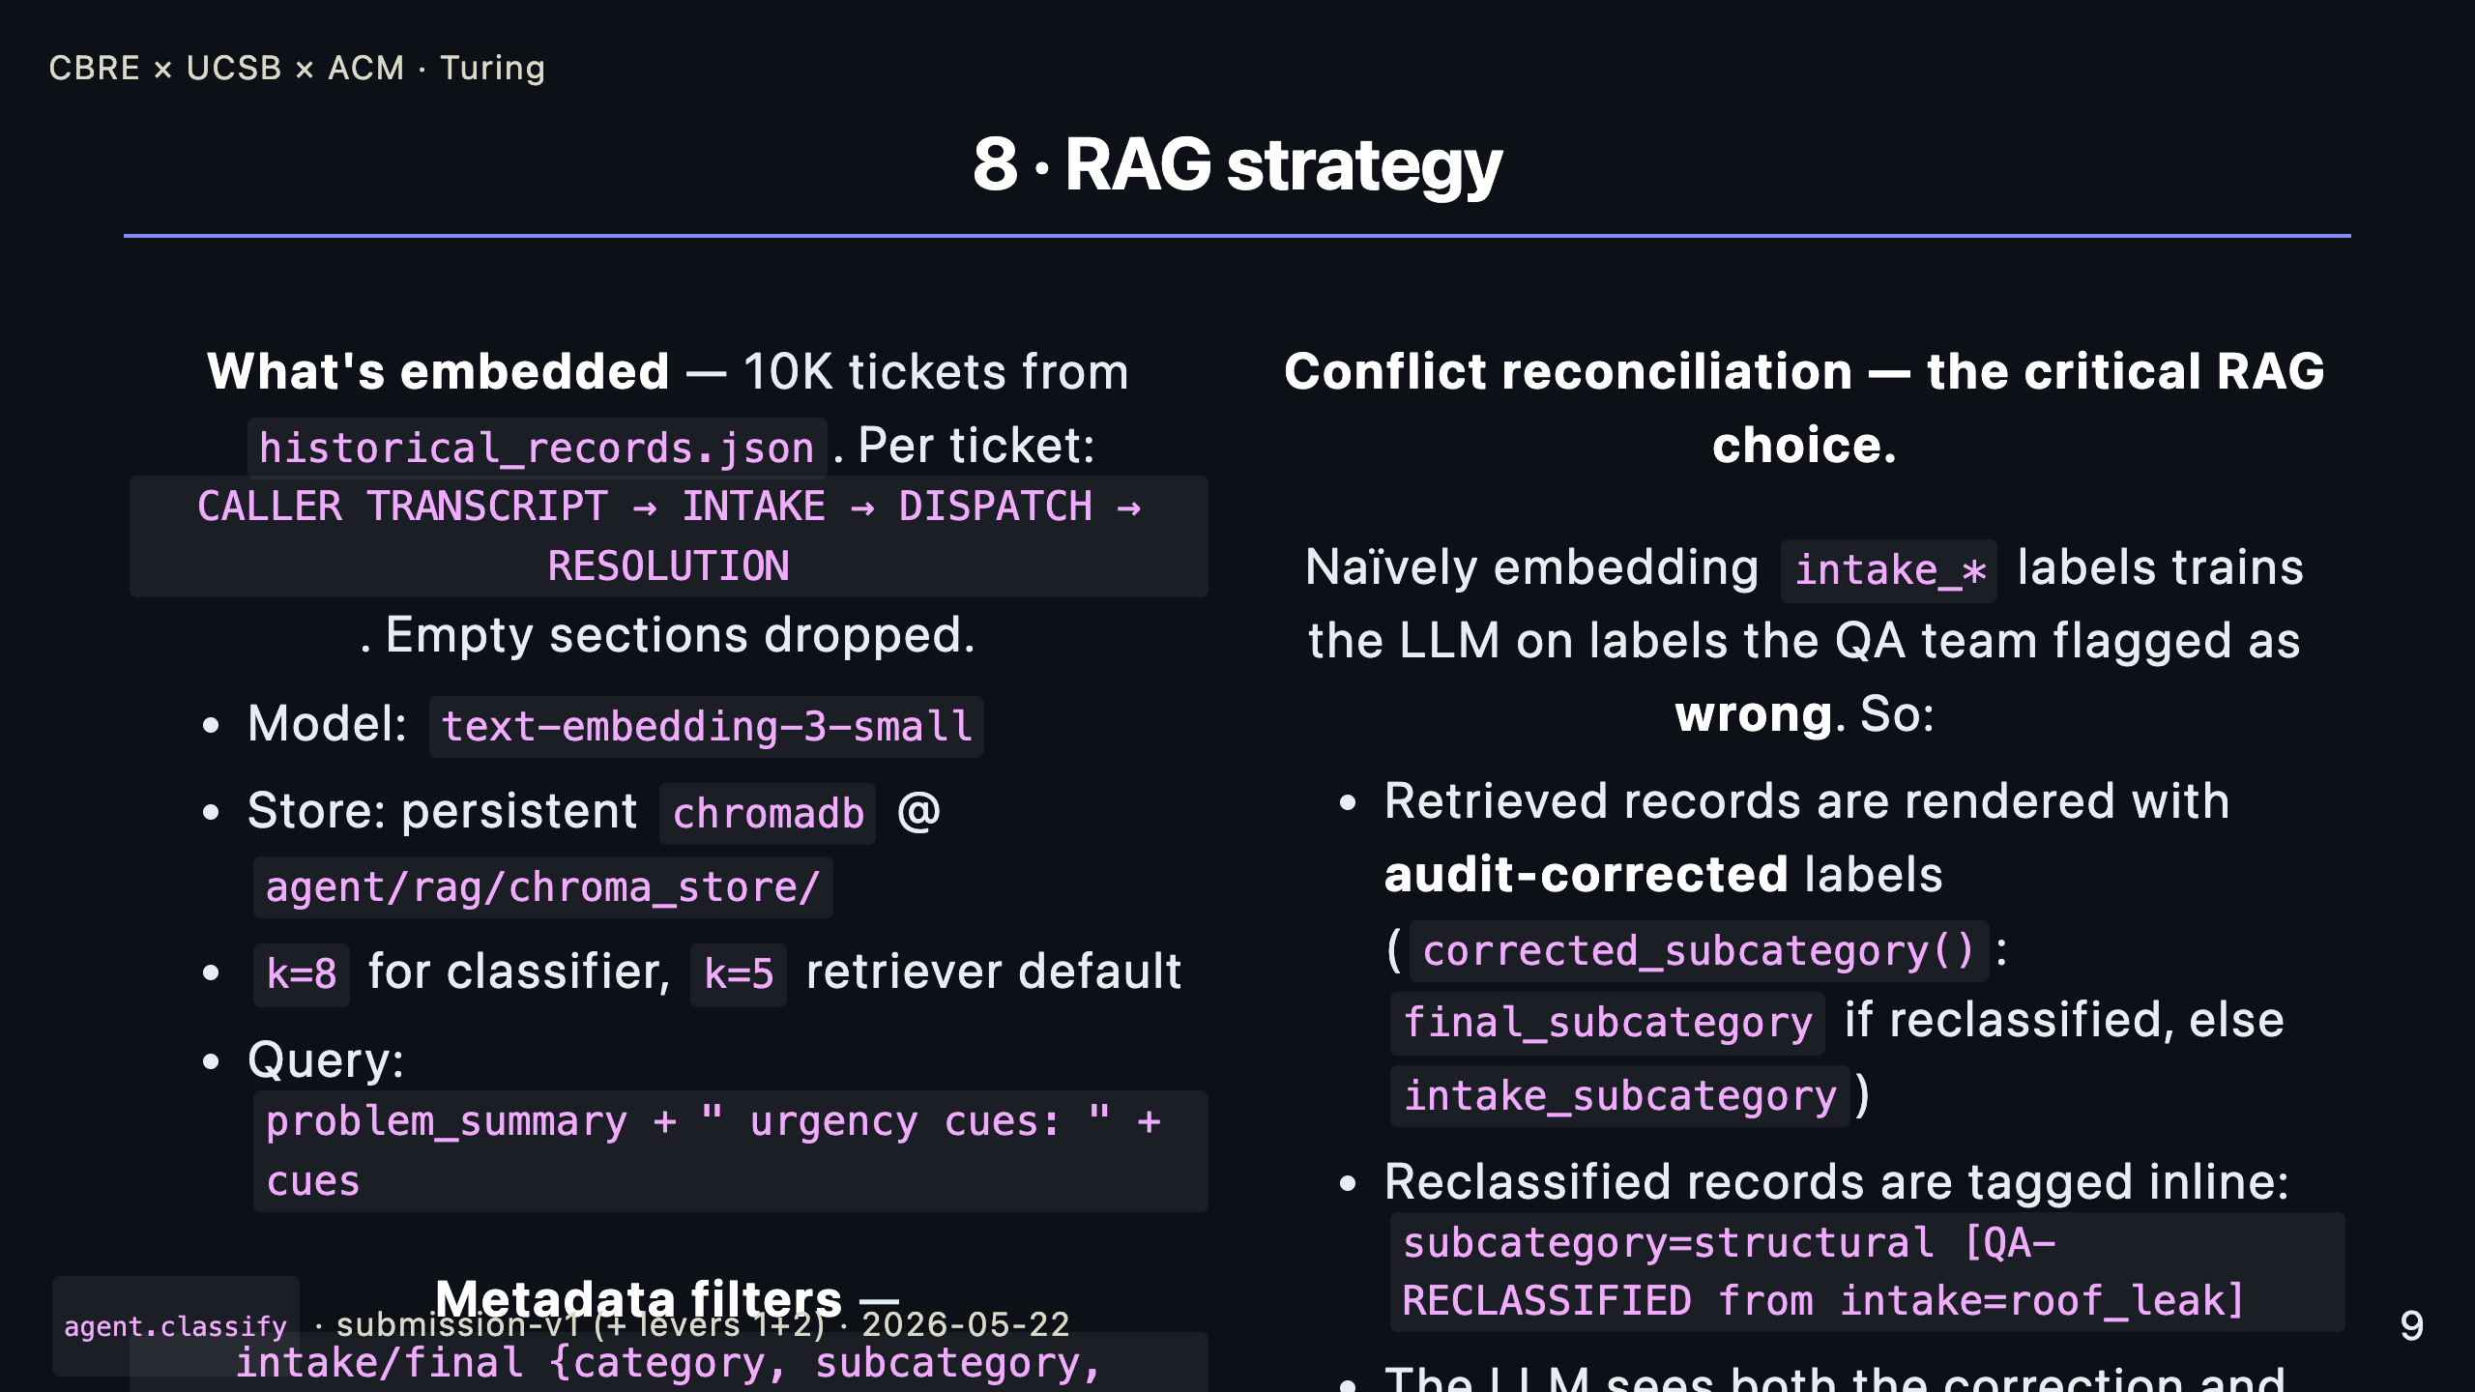
Notes:
_notes: RAG over the 10K historicals — text-embedding-3-small, persistent Chroma, k=8 for the classifier with query = problem_summary plus urgency cues. The choice that matters most isn't the model or the k — it's how we reconcile the QA audit. The audit file flags about a thousand historical tickets where intake got it wrong. If you naively embed the intake labels you train the classifier on data the QA team explicitly flagged as wrong. Our retriever renders every hit with audit-corrected labels — final when reclassified, intake otherwise — and inline-tags reclassified records so the LLM sees the correction PATTERN, not just the corrected label. Paired with five seeded boundary patterns in the classifier prompt, this is the largest single contributor to a 98% subcategory axis and zero false-911s.

Slide 10
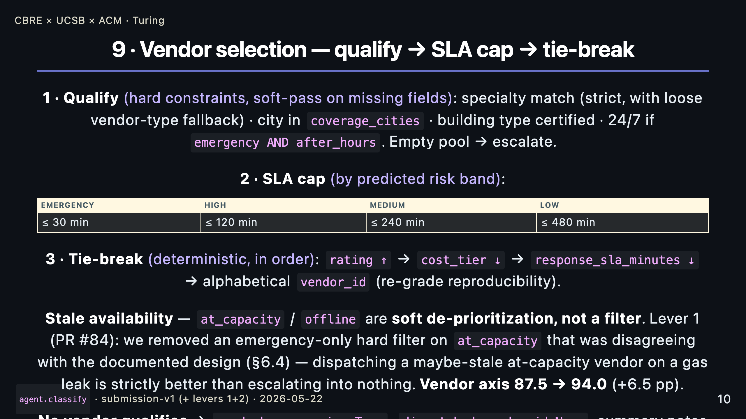
Notes:
_notes: Vendor selection is a three-stage funnel. First hard-qualify on specialty, city, building cert, and the 24/7 flag only if it's an emergency after hours. Then cap by risk-banded SLA — an EMERGENCY needs a vendor whose response SLA is under 30 minutes. Then break ties deterministically: rating, cost, SLA, alphabetical. Determinism matters — the test set gets re-graded and we want the same answer. Two important policies. First, when nothing qualifies we escalate, not dispatch wrong. Second — the at_capacity reconciliation from last week. The brief says the availability cache is intentionally stale. We were hard-filtering at_capacity vendors during emergencies, which both contradicted our design doc and meant a stale flag could turn a routable gas leak into nothing-dispatched. Lever 1 removed that filter; the vendor axis jumped 6.5 percentage points.

Slide 11
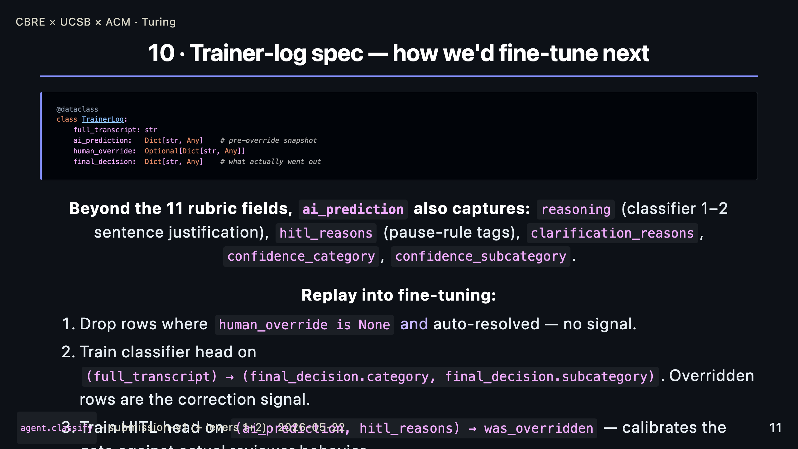
Notes:
_notes: The trainer log is the supervised data the next generation of this agent learns from. The dataclass is simple — transcript, AI prediction, override if any, final decision — but we capture more than the eleven scored fields. We log the classifier's reasoning, the pause-rule tags, the per-axis confidence. None of that is scored today; all of it is what you'd want to fine-tune against. The replay recipe is straightforward: drop rows with no signal, train the classifier head on the corrected labels, and crucially train a HITL head on whether a human ended up overriding — that's how you calibrate the gate against real reviewer behavior over time.

Slide 12
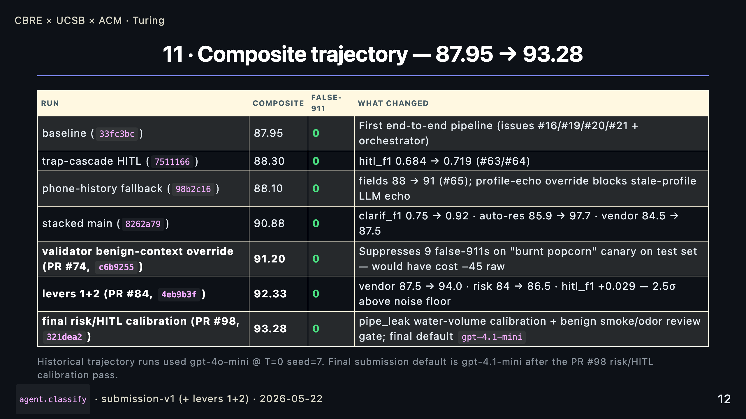
Notes:
_notes: The trajectory you see in numbers. We started at 87.95 from a clean end-to-end pipeline. Each row is a measurable iteration: trap-cascade tuning on the HITL rule, phone-history fallback for the location axis when the profile is inactive, then a stacked main with the clarification, auto-resolve and vendor improvements together. The submission-v1 cliff was PR #74 — a validator benign-context override that catches "smoke alarm but no actual fire" language and stops the false-911 from ever firing. Verified on the test set via dry-run audit: nine canary false-911s suppressed, all four verified-true emergencies preserved. Then last week, levers 1 and 2 from the deep analysis chat — vendor at_capacity reconciliation and the pipe_leak/power_outage demote. Plus 1.13 composite, 2.5 sigma above noise. Zero false-911 across every row.

Slide 13
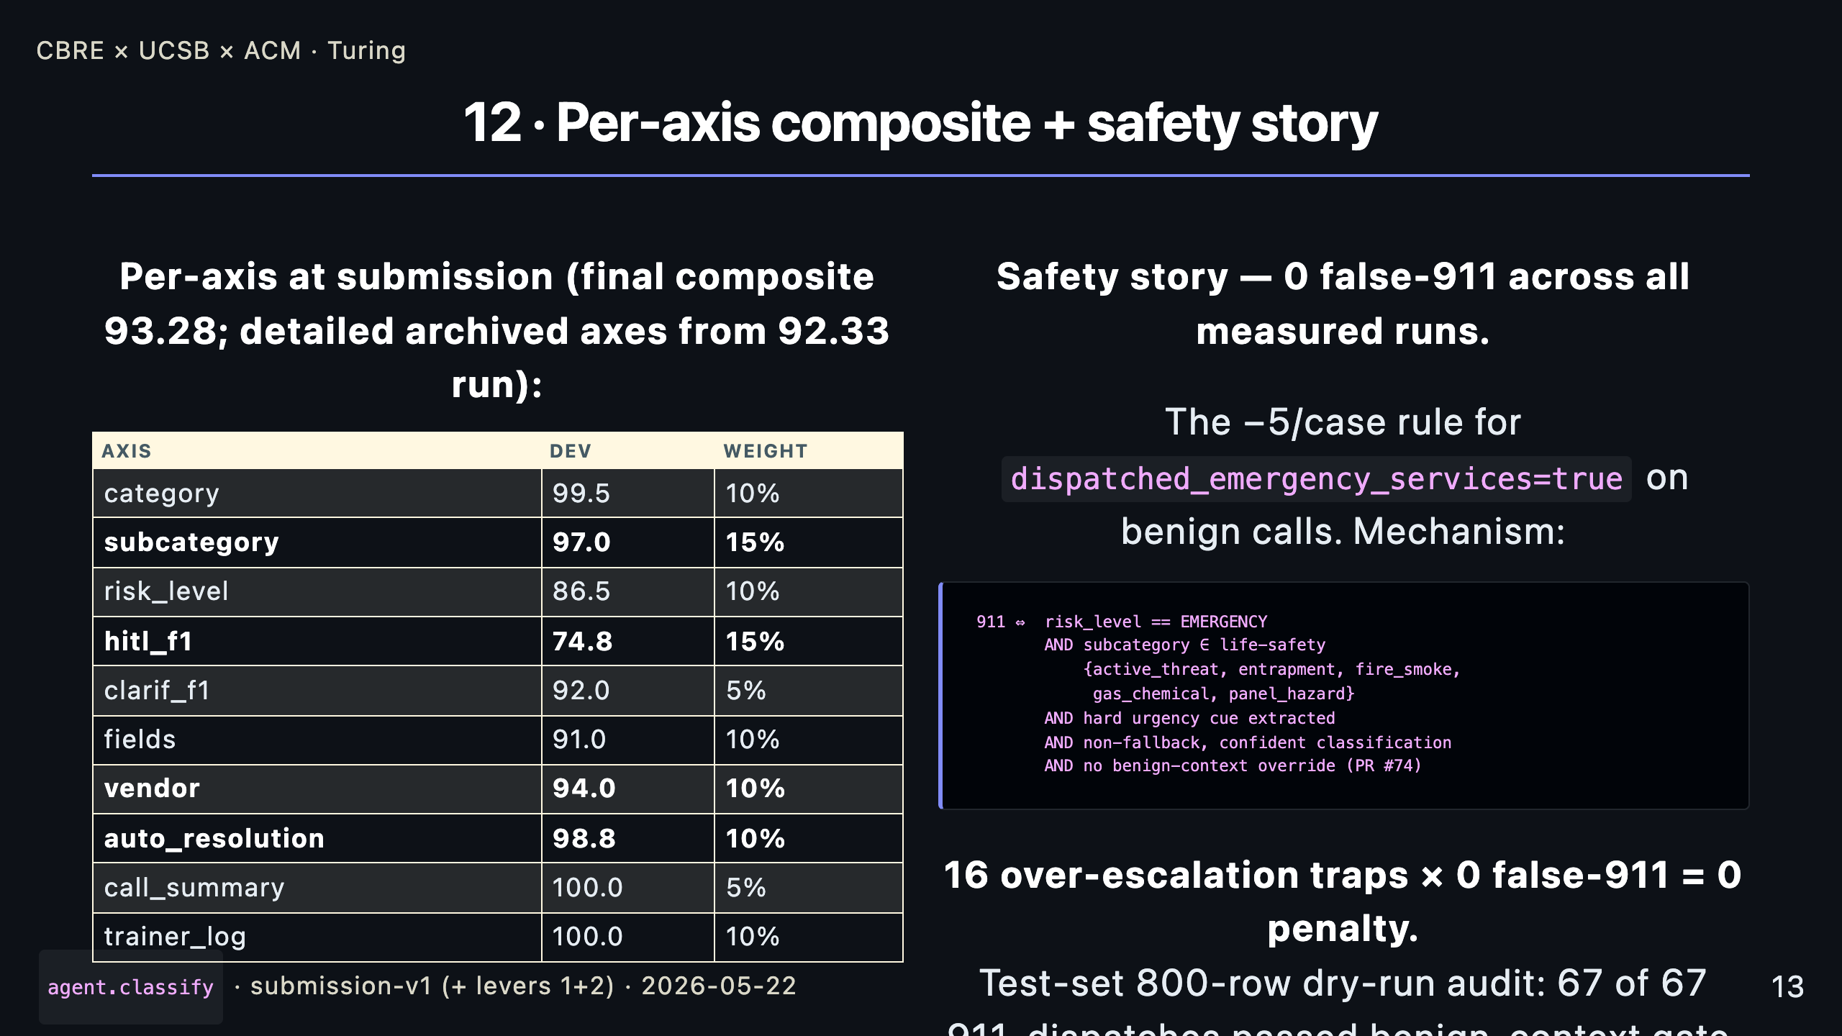
Notes:
_notes: Two views of where we are. On the left, per-axis. The big-weight axes — subcategory at 15%, HITL F1 at 15%, vendor at 10% — are all at or above 75% with vendor at 94%. The single biggest remaining lever is HITL F1, which is why it's been the focus of every iteration since baseline. On the right, the safety story — and this is the line we want the audience to remember. Zero false-911 across every measured run. That's not luck. The validator only flips dispatched_emergency_services to true when five conjoined conditions hold: EMERGENCY band, a life-safety subcategory from a five-item whitelist, an extracted hard urgency cue, a confident non-fallback classification, AND no benign-context override. The test-set audit on the 800 unlabeled transcripts shows 67 of 67 911-dispatches passed every gate.

Slide 14
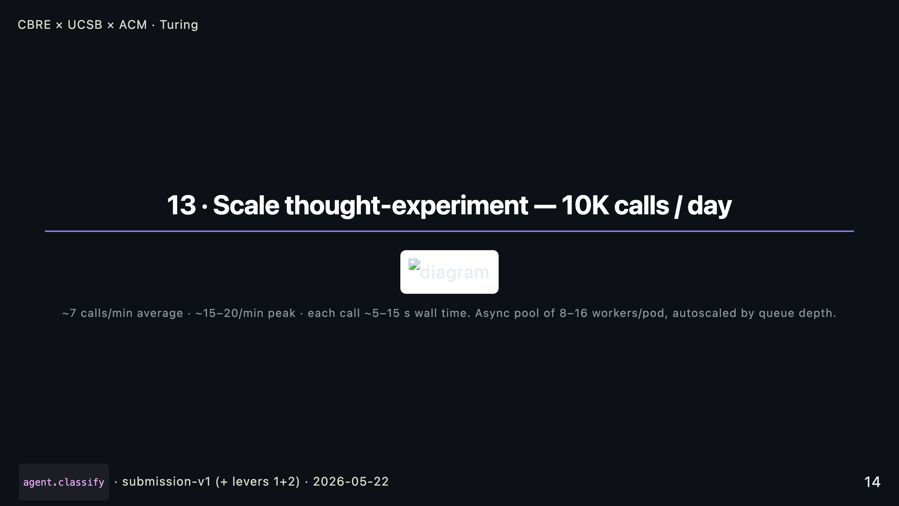
Notes:
_notes: At 10K calls a day you average about seven a minute with bursty intra-hour peaks. Each call is 5 to 15 seconds, almost all of it waiting on the LLM, so the bottleneck is concurrency. The shipped design moves to async worker pools per pod, autoscaled by queue depth. Five things change at scale.

Slide 15
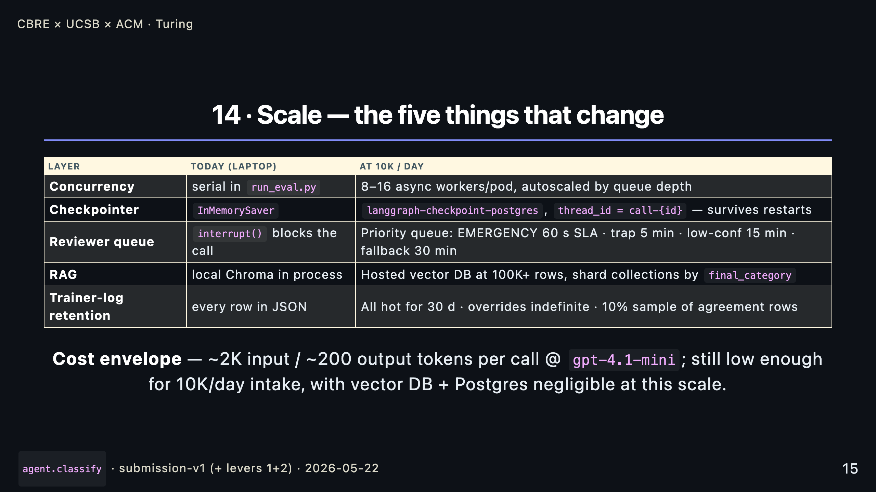
Notes:
_notes: Concurrency goes async — the classifier doesn't share state across calls, so no coordination needed. The checkpointer moves to Postgres so a pod restart doesn't lose an in-flight HITL pause. The reviewer queue gets SLA-driven priorities — an EMERGENCY pause has a one-minute SLA, a low-confidence pause has fifteen. RAG at 10K calls a day is fine on local Chroma; at 100K or a larger corpus you swap to hosted and shard by category. Trainer logs get a sampling policy — every override goes to the fine-tune corpus indefinitely, but only 10% of the agreement rows, because that's where the storage curve breaks. The cost envelope is honestly not the constraint here — ten to twenty dollars a day in LLM costs at 10K calls is dominated by every other cost center. The real cost is operator time, and that's exactly what we save.

Slide 16
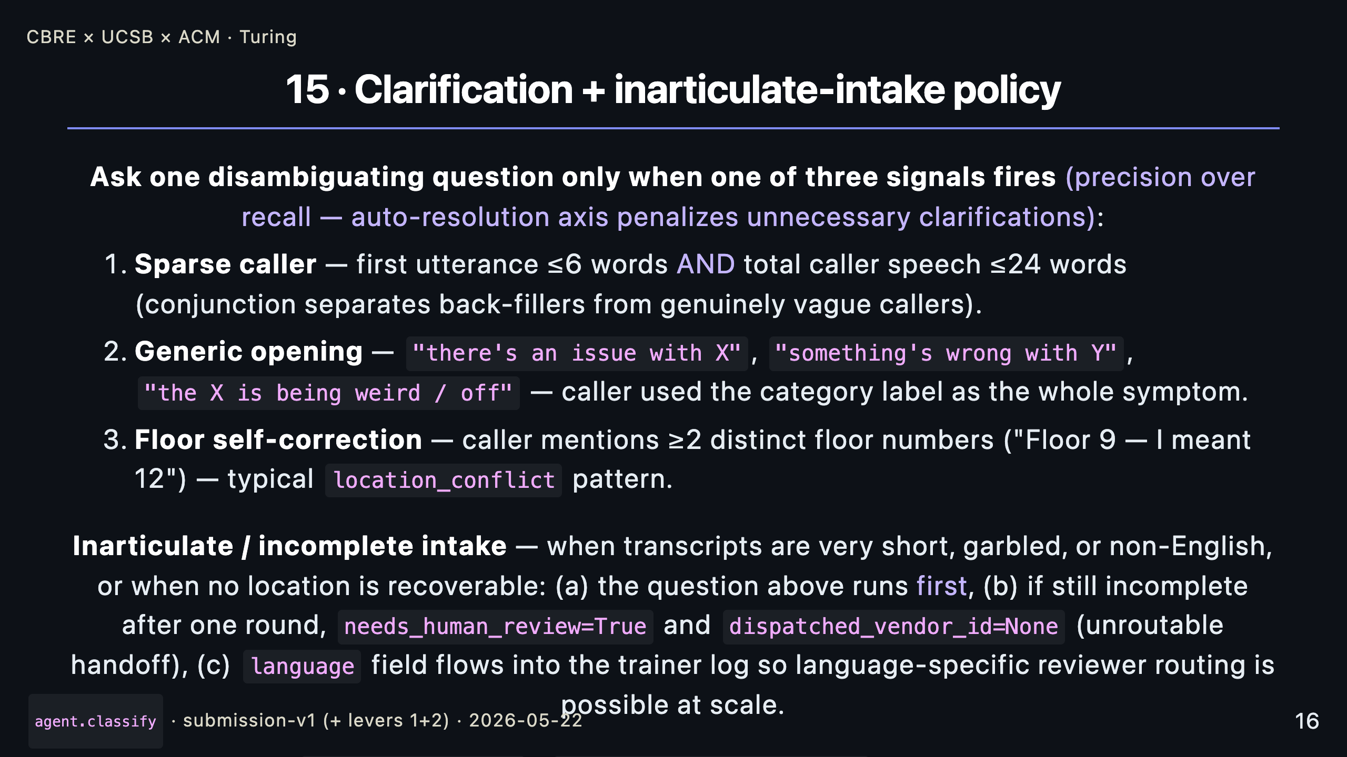
Notes:
_notes: The clarification policy and the inarticulate-intake path. We ask one question only — and only when one of three signals fires. Sparse caller, generic opening that just names the category, or self-correction on the floor number. We deliberately tuned for precision over recall because the auto-resolution axis punishes any unnecessary clarification. For genuinely garbled or non- English calls, the same clarification fires first; if a single round doesn't resolve, we mark needs_human_review and unroutable rather than guessing. Clarif F1 at 92, auto-resolution at 98.8 — both axes near ceiling.

Slide 17
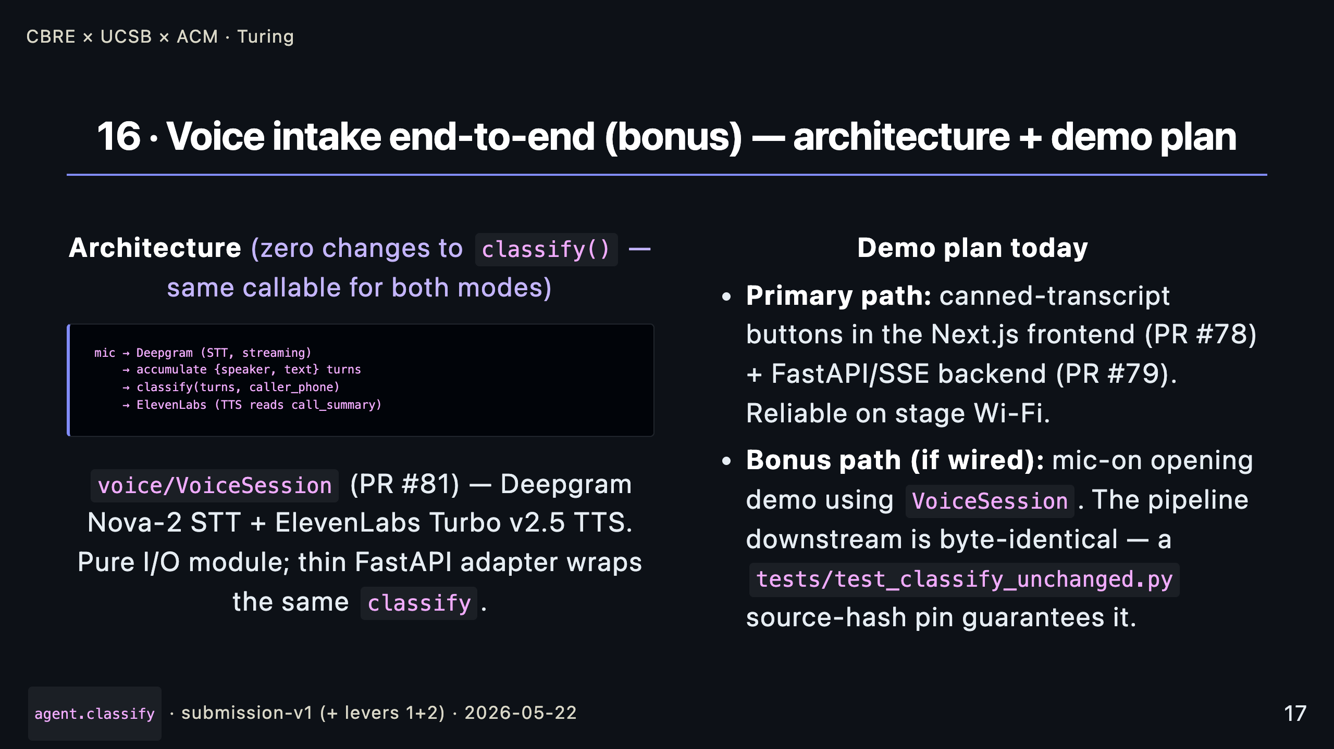
Notes:
_notes: Voice is the bonus. The architecture is the contract: STT accumulates turns, turns go into the exact same classify call we score against, TTS reads the call_summary back. PR #81 ships voice/VoiceSession — Deepgram for streaming STT and ElevenLabs for TTS — as a pure I/O module. The plan for today: the primary demo is the canned-transcript buttons because stage Wi-Fi is not something I want to bet a demo on. If the voice path is wired through the FastAPI backend by demo time, we'll do an opening voice call too. Either way the downstream pipeline is byte-identical — we have a source-hash pin in the tests that fails loudly if classify drifts from the submission tag.

Slide 18
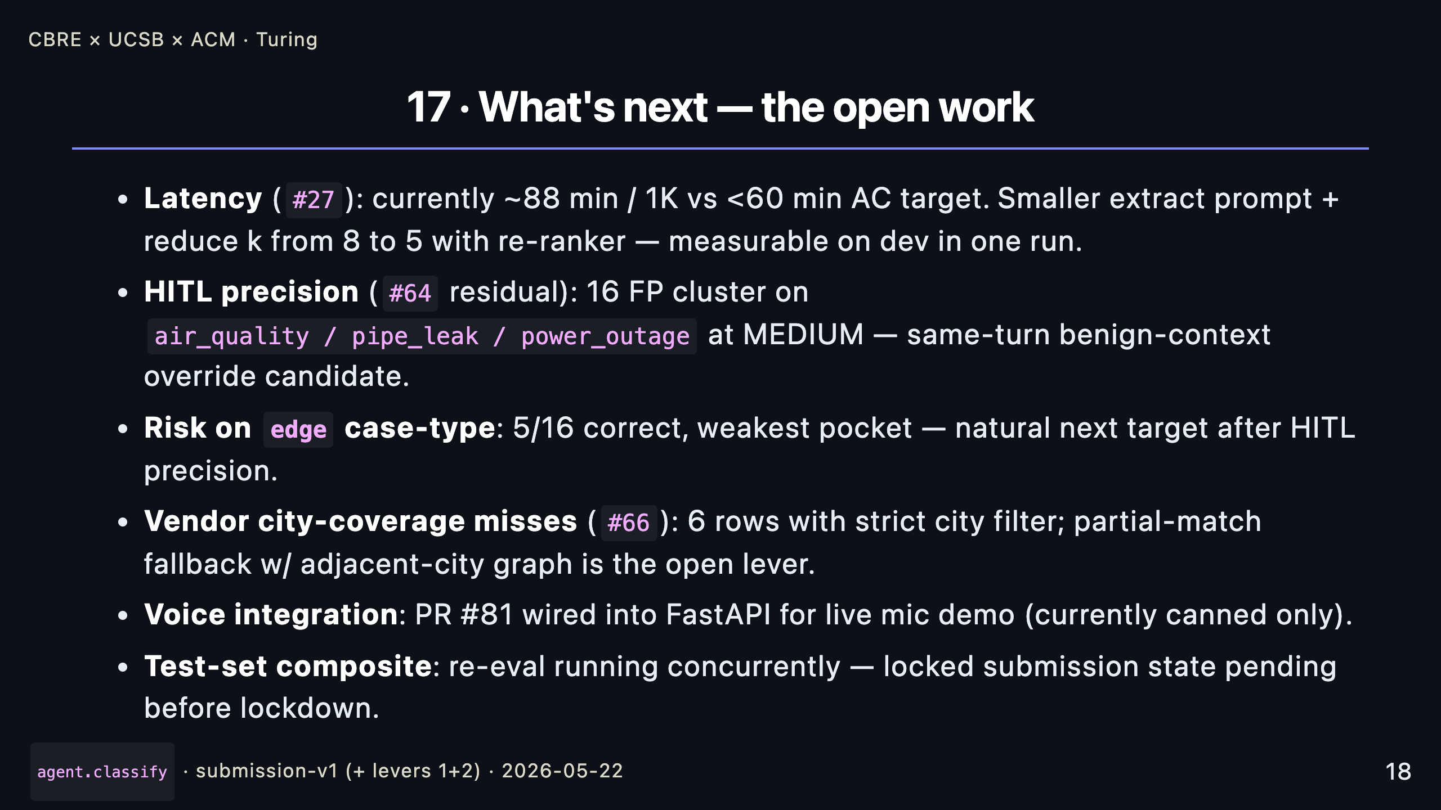
Notes:
_notes: What we'd do next, in priority order. Latency is the only operational AC we're not yet inside — we're at 88 minutes for the 1000-call eval against a 60-minute target. The fix is a smaller extract prompt and reducing k from 8 to 5 with a re-ranker. HITL precision still has 16 FPs clustered on a small set of MEDIUM-band subcategories — a benign-context override on the gate, mirroring PR #74's mechanism, is the natural lever. Risk on the edge case type is the remaining weak pocket. Vendor city coverage has six misses we could close with an adjacent-city graph. Voice integration is partially done — the module ships, the backend wiring is the open piece. And test-set re-eval is running right now; we'll have the final test composite before the deadline.

Slide 19
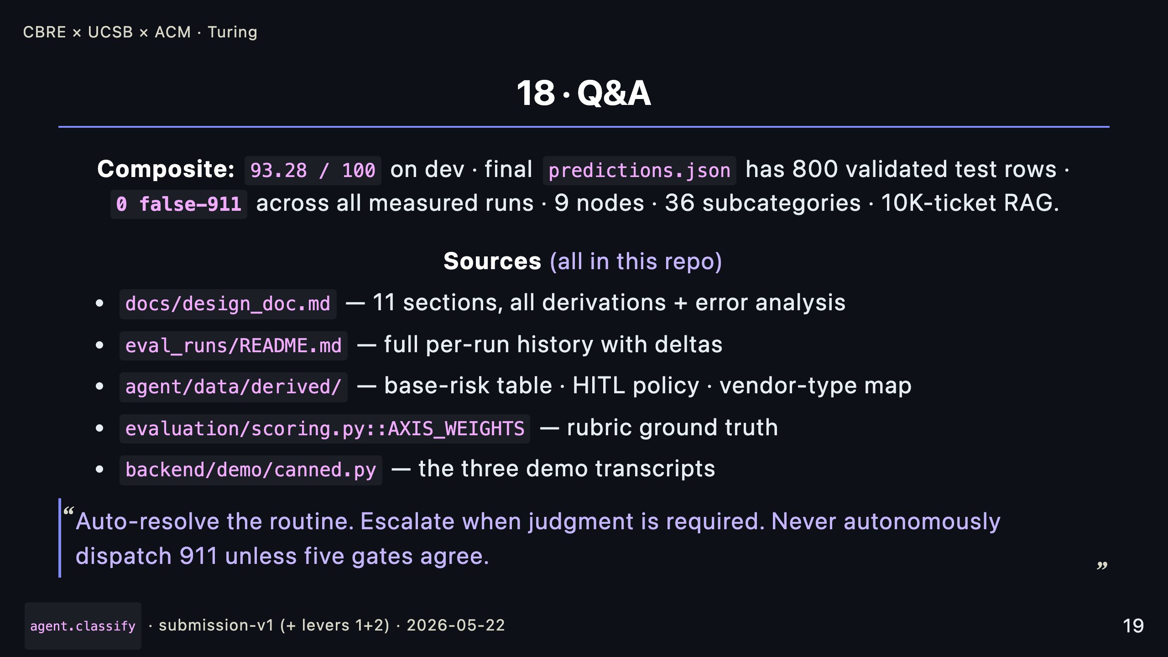
Notes:
_notes: Open for questions. The one-line we want the audience to walk away with is the closing italic — auto-resolve the routine, escalate when judgment is needed, and never autonomously dispatch 911 unless five gates agree. Happy to dig into any of the policy derivations, the HITL trigger sweep, the at_capacity reconciliation, the safety mechanism, or the scale story.

Slide 20
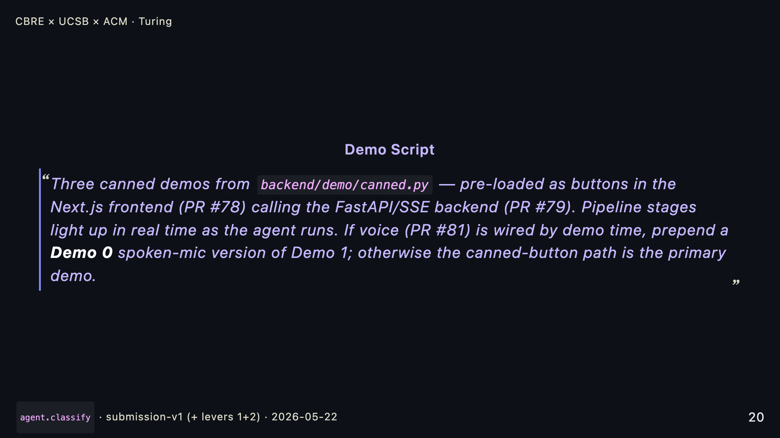

Slide 21
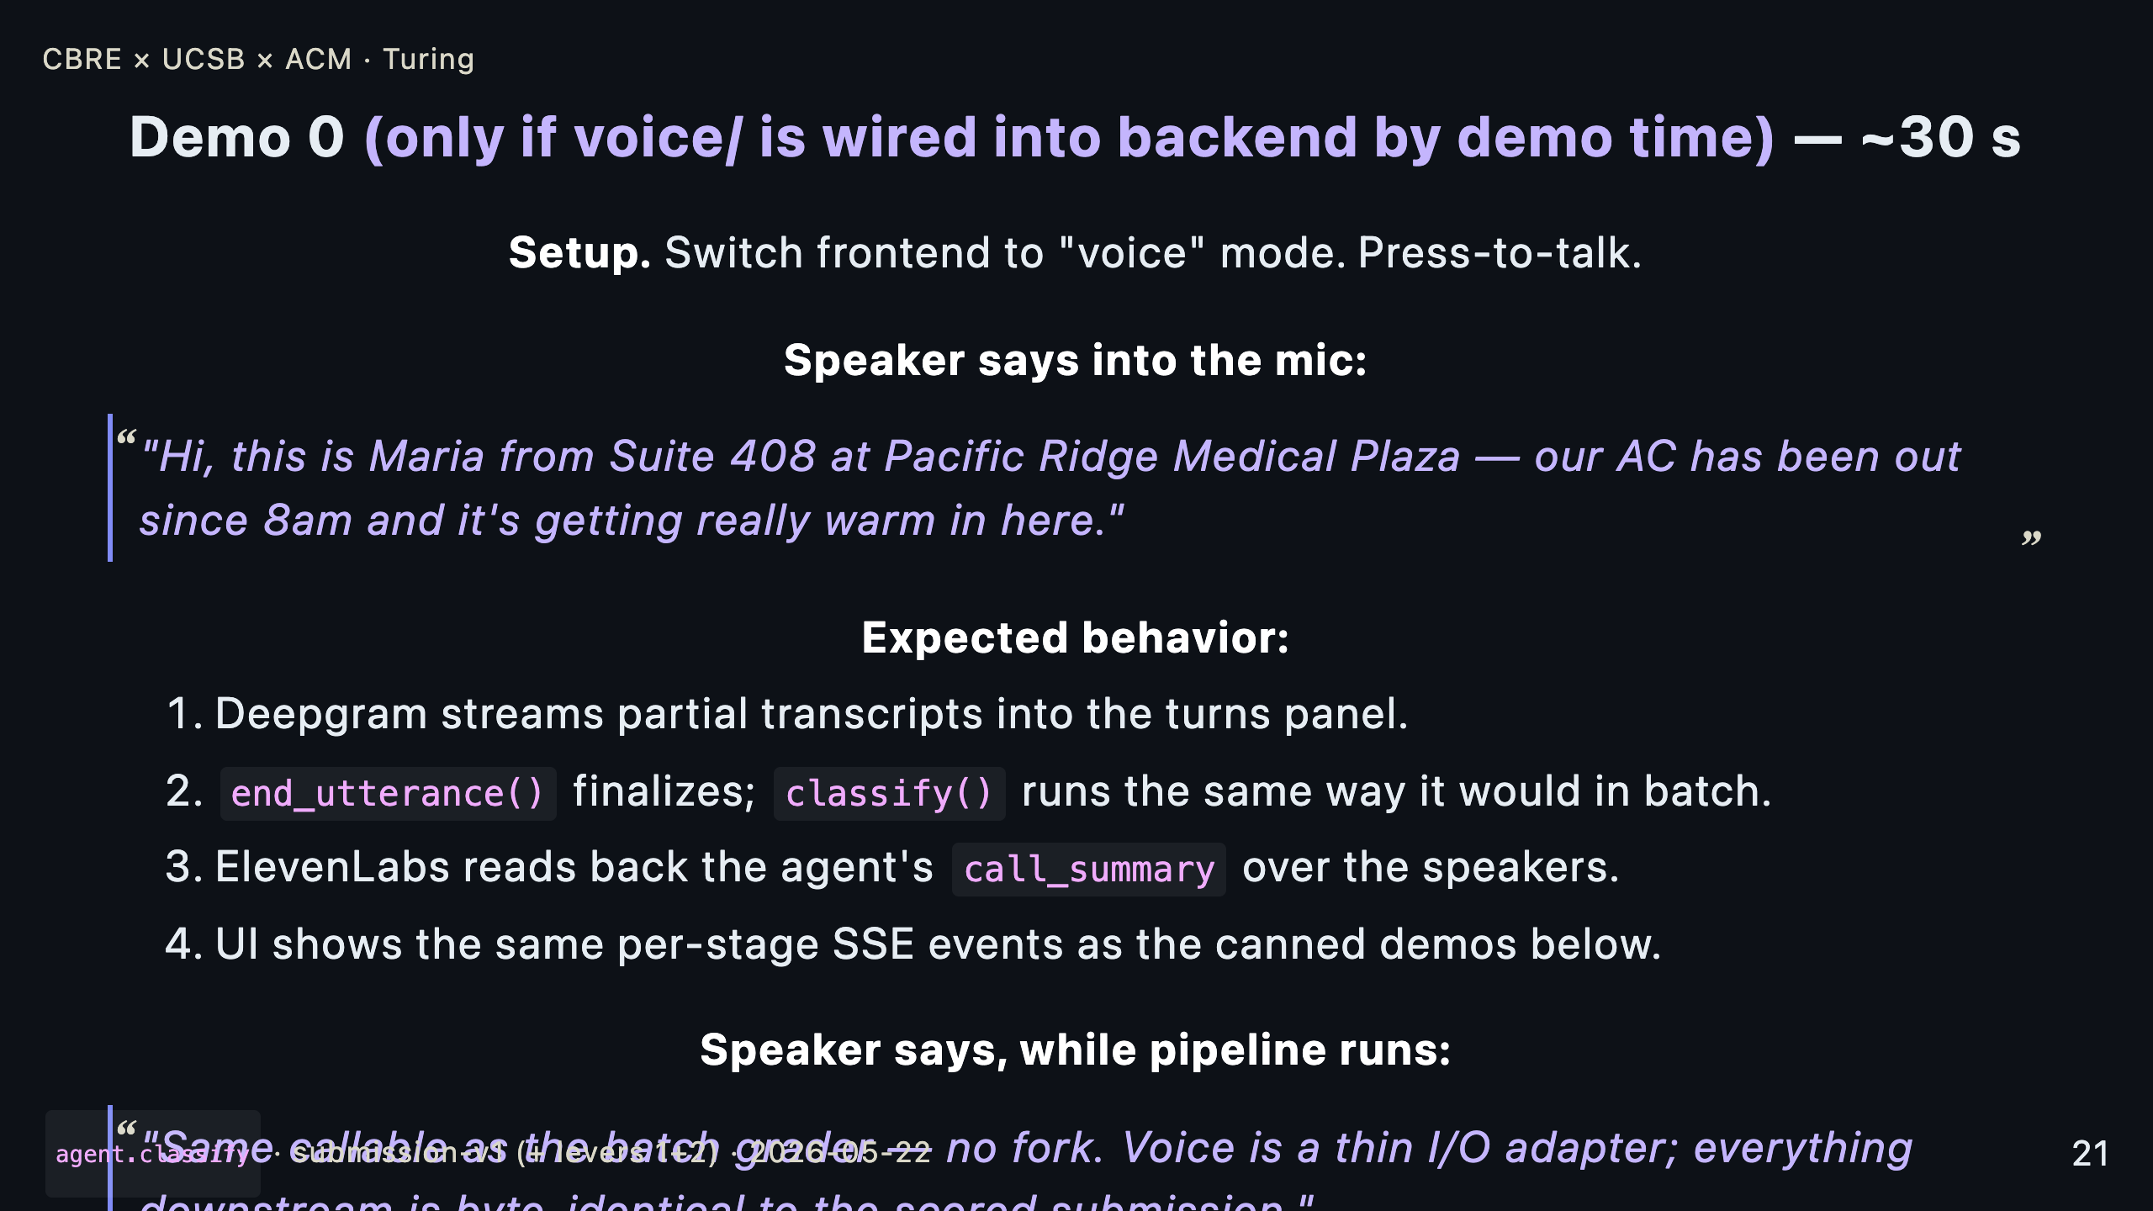

Slide 22
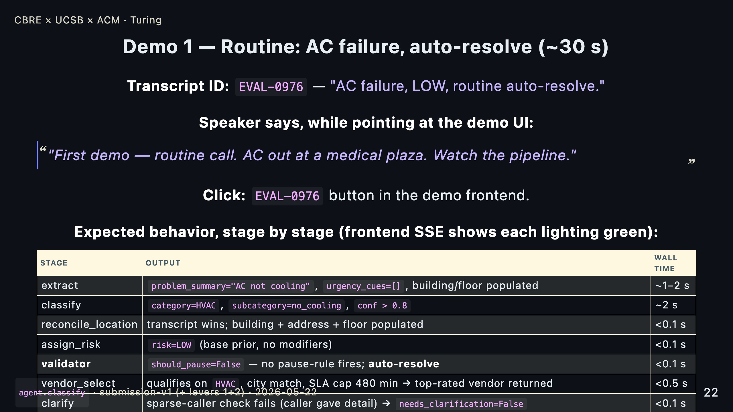

Slide 23
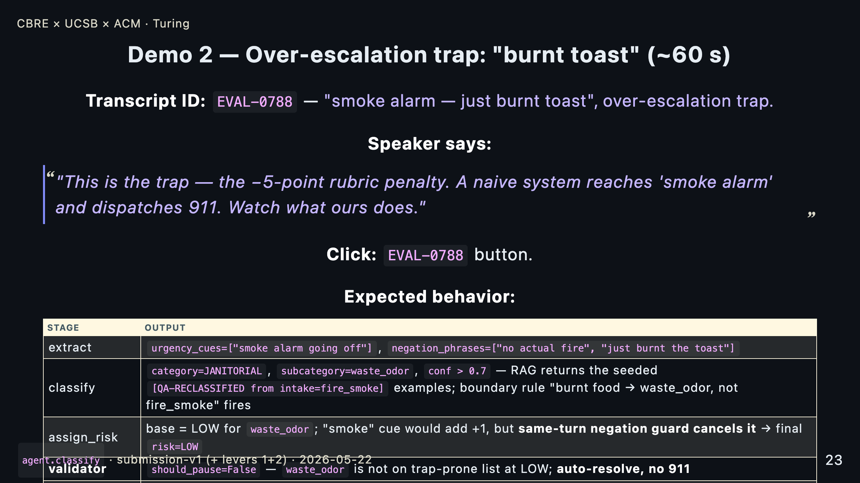

Slide 24
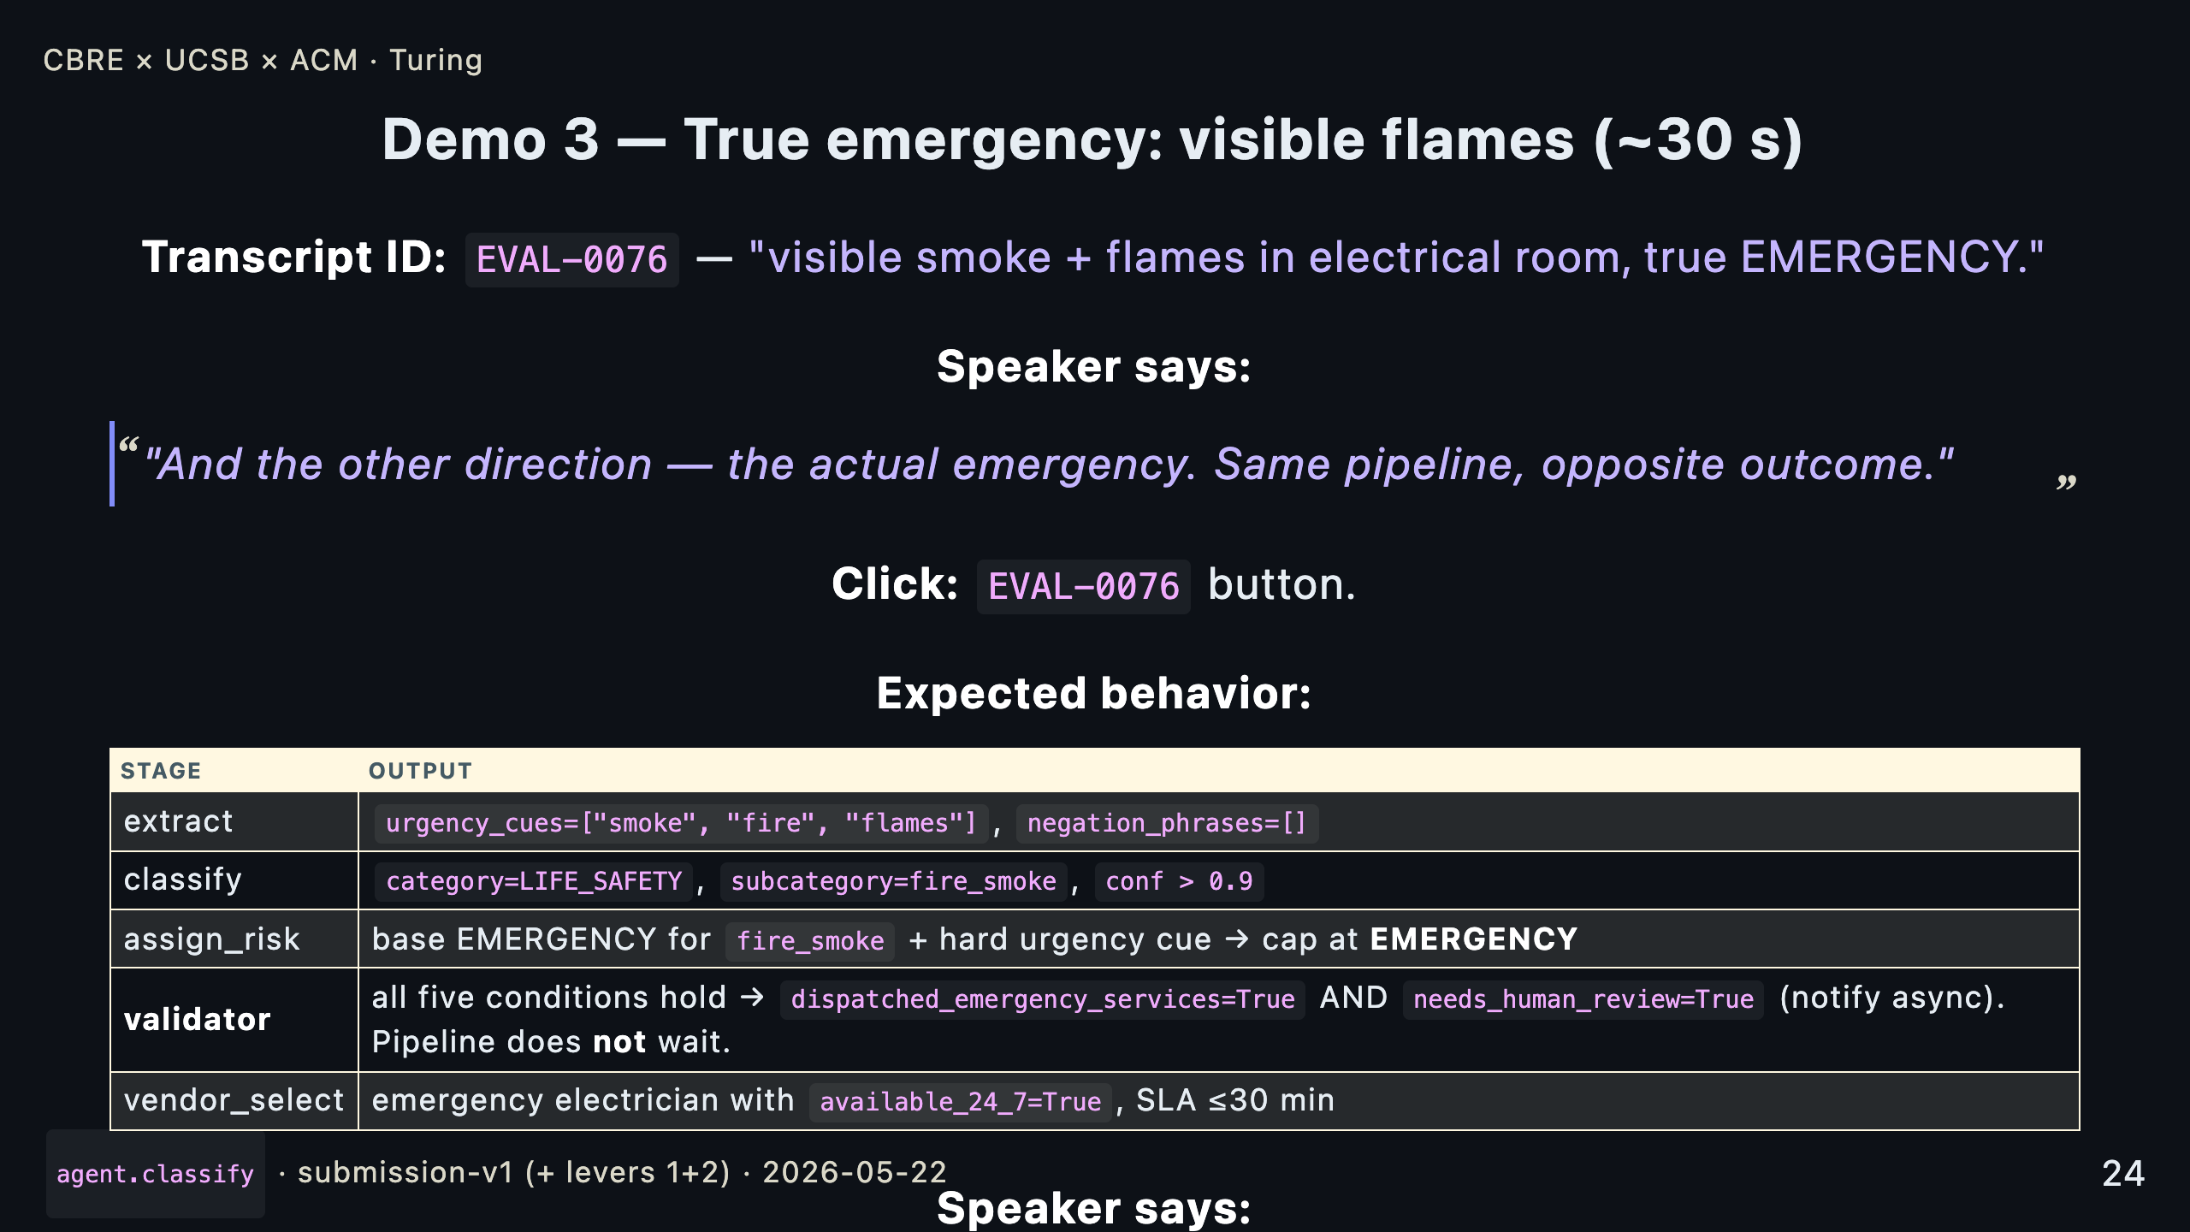

Slide 25
