Slide 1
Sig Web
January 31, 2014 @ 3PM

Slide 2
What is HTML5?
What it is:
What it isn’t:
Allows for better intergration of media consumption.
A new open standard
Provides new APIs to easily integrate and program into your applications.
Allows your browser applications to utilize your computer hardware.
In December 2012, W3C designated HTML5 as a Candidate Recommendation.
Not a replacement to Flash/Silverlight/Plugins… yet…

Slide 4
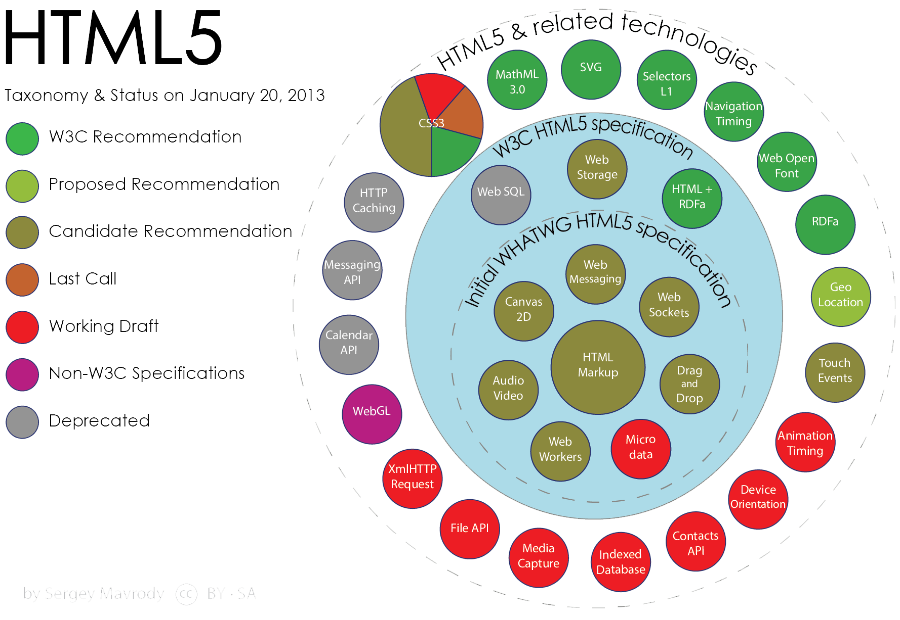

Slide 5
What is HTML5?
http://www.youtube.com/watch?v=mzPxo7Y6JyA
http://www.w3.org/html/logo/

Slide 6
Examples of the possibilities
http://ericrius1.github.io/ComeDownToUs/
http://auduno.github.io/clmtrackr/examples/facesubstitution.html
http://zya.github.io/granular/
http://www.play-create.com/id.php?034
http://www.cross-code.com/en/play

Slide 7
New Elements in HTML5
<canvas> | Defines graphic drawing using JavaScript
<audio> | Defines sound or music content
<video> | Defines video or movie content
<source> | Defines sources for <video> and <audio>
<track> | Defines tracks for <video> and <audio>
<embed> | Defines containers for external applications (like plug-ins)
<datalist> | Defines pre-defined options for input controls
<keygen> | Defines a key-pair generator field (for forms)
<output> | Defines the result of a calculation

Slide 8
New Elements in HTML5
<header> | Defines a header for the document or a section
<nav> | Defines navigation links in the document
<section> | Defines a section in the document
<article> | Defines an article in the document
<aside> | Defines content aside from the page content
<footer> | Defines a footer for the document or a section
<details> | Defines additional details that the user can view or hide
<summary> | Defines a visible heading for a <details> element
<figure> | Defines self-contained content, like illustrations, diagrams, photos, code listings, etc.
<figcaption> | Defines a caption for a <figure> element

Slide 9
New Element in HTML5
<mark> | Defines marked or highlighted text
<time> | Defines a date/time
<bdi> | Defines a part of text that might be formatted in a different direction from other text outside it
<wbr> | Defines a possible line-break
<dialog> | Defines a dialog box or window
<command> | Defines a command button that a user can invoke
<meter> | Defines a scalar measurement within a known range (a gauge)
<progress> | Defines the progress of a task
<ruby> | Defines a ruby annotation (for East Asian typography)
<rt> | Defines an explanation/pronunciation of characters (for East Asian typography)
<rp> | Defines what to show in browsers that do not support ruby annotations

Slide 10
Deprecated Elements in HTML5
<acronym>
<applet>
<basefont>
<big>
<center>
<dir>
<font>
<frame>
<frameset>
<noframes>
<strike>
<tt>

Slide 11
CSS3
Cascading Style Sheets 3
CSS3 is completely backwards-compatible with earlier versions of CSS.
CSS3 is split up into modules: http://www.w3.org/Style/CSS/current-work.en.html

Slide 12
Notable Use Cases for CSS3
General Styling
Simple Tweening Transitions
Simple Animations
Responsive Web Design (Media Queries)
Browser specific styling

Slide 13
CSS3 Hands On Demo

