Slide 1
Your friend, Bluestem

Slide 2
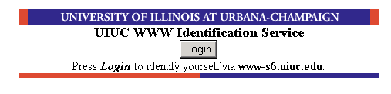
What is Bluestem?
“Bluestem is a software system which enables one or more high-security SSL HTTP servers in a domain (entrusted with handling user passwords) to provide reliable client identification for applications running on other authorized SSL HTTP servers within the domain. Bluestem provides client identification only. Decisions about whether an identified client is authorized to access a given application or resource are the responsibility of the applications.”

Slide 3
History
Bluestem was written in 1996 by CCSO (now CITES)
Began with the sole goal of providing secure access to Kerberos authentication for HTTP servers on the Urbana campus

Slide 4
History
Kerberos specific code was very small. The idea of bluestem can extend to any number of authentication methods. (TACACS, NTLM, system password files, etc.)
Bluestem did not have to be limited a single domain. Part of the system allows you to use a single id across domains. (uic.edu, uis.edu, uiuc.edu)

Slide 5
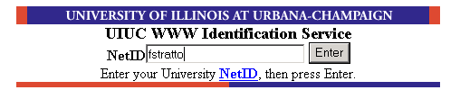
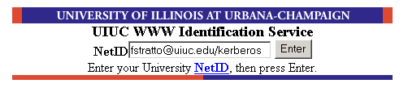
What is a Bluestem ID?
When you type your id:
You are really typing:
netid@domain/auth-method

Slide 6
Bluestem Components
Clients
  You are a client.
Application Servers
  Authorized (SSL enabled) servers
  Provide a service that requires authentication. (like CITES webstore)
ID Servers*
  High-security servers
  Actually perform authentication of clients.
  Communicates successful authentication to application servers
*(ego and superego servers not implemented)

Slide 7
How everything works….
1.
2.
2. Application server checks for client’s Bluestem cookie, and sets it when it doesn’t exist.
4.
3.
4.
1. Client requests page from Bluestem enabled site.
3. Application server redirects the client to an ID Server.
4. ID server asks for netid/password, send authentication information to the app. server, and then redirects the client back to the original page.

Slide 8
How everything works (without pictures)
Application Server Master Key
  256 bit secret
  Used to sign messages between the application server and ID server
  Can be created as often as you like / lasts as long as you like
ClientRandom
  64 bit secret
  Created by the application server for each new session.
  Protects from imposter attacks. (client to app. Server)

Slide 9
How everything works (without pictures)
Setting the cookie:
  Generate a unique CacheID and a 64 bit ClientRandom secret.
  Omit the expires keyword so that the cookie remains in memory.
  Omit the domain keyword, so the client will provide the cookie only to the application server that created it.
  Include the secure keyword, so the cookie will not be provided to a non-SSL HTTP server.
  Save the client's IP address and ClientRandom secret in the application server cache indexed by CacheID.

Slide 10
How everything works (without pictures)
ID server-side:
  Authenticate the user.
  For optional ‘prior authentication’, store the client's ID, IP address, and ClientRandom secret in a special persistent cache directory.
  Pass the following to the application server via an SSL-protected digitally signed XML-RPC request:
    CacheID
    Bluestem ID
    client IP address (for logging purposes, not authentication)
    current ID server cluster configuration (icluster.conf)

Slide 11
How everything works (without pictures)
The application server then:
  Verifies the XML-RPC request digital signature and content.
  Inserts the Bluestem ID in the appropriate cachefile.
  Updates its copy of the ID server cluster configuration file if it has changed.
  Verifies the redirected client based on the ClientRandom stored in its cache.

Slide 12
Security Concerns
Dumb clients…
Spoofed pages
Attacking ID servers
  ID servers are housed in a locked, limited access, 24-hour-attended machine room.
  Signons on the servers are limited to a small number of trusted long-time employees on a need-to-have basis. And logins are permitted from only a small set of trusted hosts.
  ASAP Policy for Security Patches
  TCP wrappers and real-time off-machine replication of system logs.
Breaking SSL
  “If a finesse attack on SSL turns up, chances are it'll be somewhere else, not here. And you'll learn about it in the New York Times, not your system logs. “
ClientRandom provides the only security mechanism to app servers.
XSS flaws (some detected and fixed in Sept. 2004/2005)

Slide 13
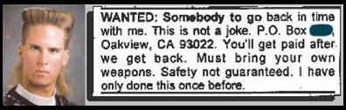

Demo Time?

