Slide 1
An Experimental Study of File Permission Vulnerabilities Caused by Single-Bit Errors in the SELinux Kernel Policy File
Tom Brown <tdbrown@uiuc.edu> and Michael Ihde <ihde@uiuc.edu>
December 10, 2004 at SIGMil

Slide 2
Project Goal
Determine if SELinux is vulnerable to single-bit errors
  Our study focuses on errors in policy file
  4Mbit DRAM suffers approx. 6000 FIT [1]
  A system with 1GB of standard ECC will still experience 3435 FIT [2]
    Equivalent to 900 errors in 10000 machines over 3 years
    Google uses at least 15,000 commodity machines
      1% fault vulnerability rate would create 13 vulnerabilites in 3 years

Slide 3
Quick Review of SELinux
Provides Mandatory Access Controls to Linux through the Linux Security Module framework
  SELinux MAC provides fine-grained access control lists applied to all system access
  SELinux restricts applications to the system resources they need
  Regular user/file permission is Discretionary Access Control
    Owner of file/process can grant permissions to others
    Root user is all powerful with Discretionary Access Control

Slide 4
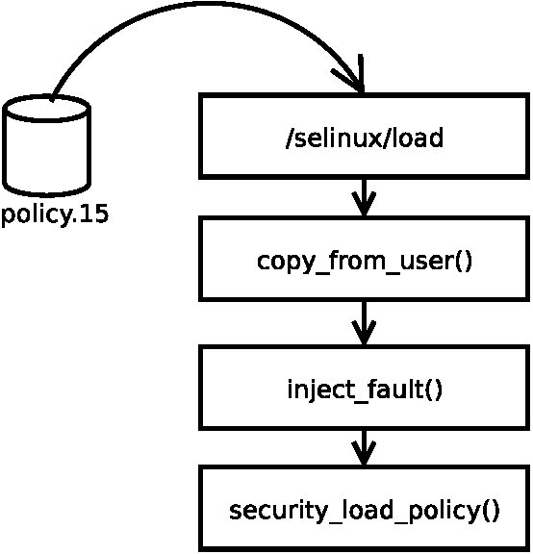
Error Injector Location
Implemented by adding code to selinuxfs.c
Injects error as the policy is being loaded, before any SELinux processing
  Most directly represents disk faults
  If the policy loads it can represent many other faults
Iteratively injected error into every bit of the policy

Slide 5

Test Framework
Host kernel
Need to find bug
Client (Tom)
(runs user-mode kernel, then checks for successful break-in)
User-mode kernel
Accepts fault location argument (Michael)
File System
LSM SELinux
?
Test application (Tom)
(violates SELinux policy)
Key:
Provided, hope to not modify
Our Work (Implementer)

Slide 6
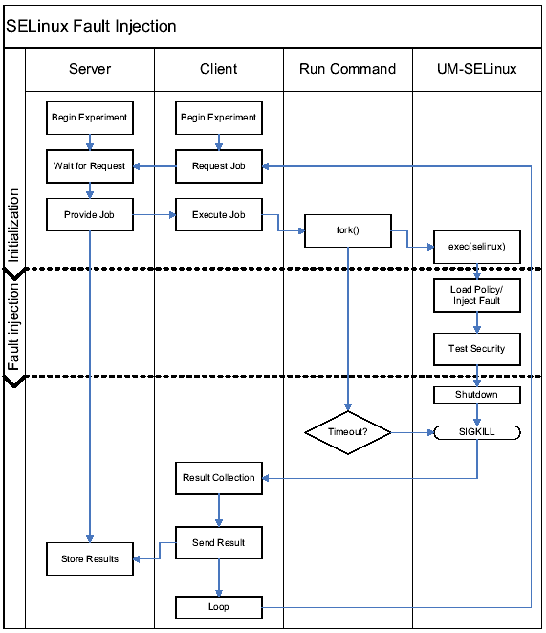
The New Fault Injector Framework
Allows for distributed processing
Simplified Injection Method
Robust recovery from faults and restarts

Slide 7
The Test Policy
Designed to reduce policy size and facilitate easier testing
  1 domain (kernel_t)
  1 user (system) / compared to 3 (system, sysadm, user)
  301 rules / compared to 19741
  18kB / compared to 500kB
  Specifically allow permissions needed to run, deny everything else
The million dollar question…does this represent a real policy?

Slide 8
The Short Answer
Yes
  Our security tests only concern the target file system, and thus a simple policy is representative of a portion of a complex policy
and No…
  A real policy would have far more rules with possible interactions
    Errors may have a greater or lesser effect.

Slide 9
Results
A majority of the errors had no measured security impact
Errors that failed policy load may create vulnerabilities if injected after load
  This is an artifact of our injection method
Errors That Cause Vulnerabilities | 8
Errors That Had No Measured Security Impact | 96770
Errors That Failed Policy Load | 48040
Total Errors Injected | 144818

Slide 10
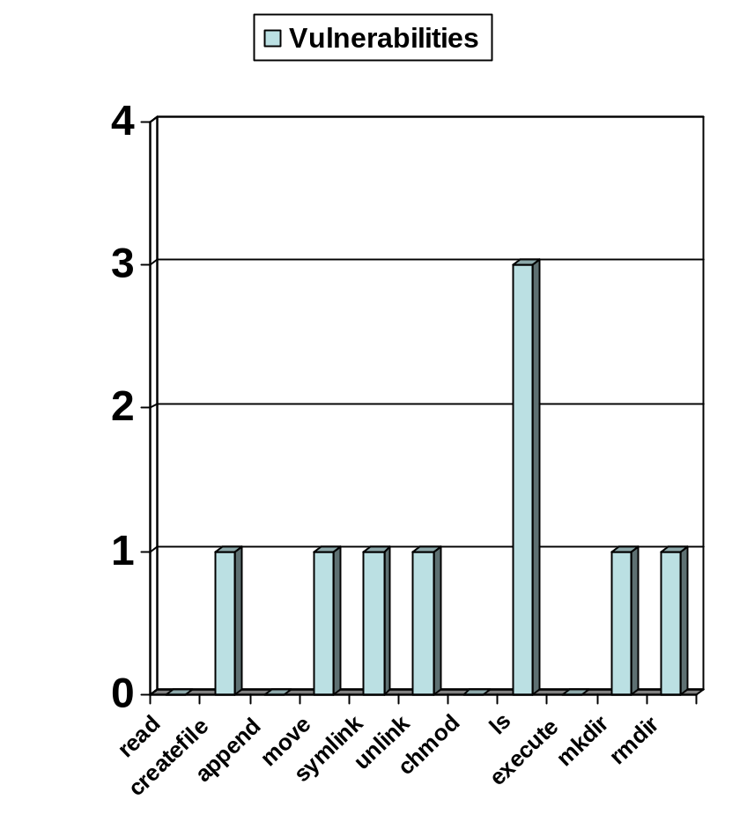
Results (cont.)
In most cases each vulnerability occurred only once
Some of the tests require multiple permissions
  Appending the output of date; file operations use stat and access to dir
Read and Execute were accidentally allowed in the fault free policy
  Injections actually denied read in over 1.3% of the errors

Slide 11
Other Difficulties and Problems
Every bit was injected with an error, but approx. 3.8% of the runs were lost due to possible UML crashes.
Memory Leak in UML forced reboot of machine every three hours
Enabling SELinux auditing would have allowed easier parsing, allowing for a more complete picture.

Slide 12
Future Work
Correct difficulties and problems and re-run experiments
Trace back vulnerabilities to their cause in source code.
Perform random error injection in a full policy
Perform error injection into the Text or Data segments using the ptrace interface
Independent inspection of source code to compare to our experimental study

Slide 13
References and Questions
[1] J. Ziegler et al. (2003, May) IBM experiments in soft fails in computer electronics
[2] T.J. Dell (1997, Nov) A white paper on the benefits of chipkill-correct ECC for pc server main memory

Slide 14
Source Code Investigation
The source code:
denied = requested & ~(allowed);
if ( !requested || denied)
if (enforcing)
DENY_ACCESS
else
ALLOW_ACCESS
Request an append to a file, in staff context
requested = 0x00000200
allowed = 0x00022053
enforcing = 0x01
Two single bit-errors which can cause a vulnerability:
allowed = 0x00022253
enforcing = 0x00000000

