Slide 1
Tor
Good + Evil

Slide 2
Introduction
“Tor is a network of virtual tunnels that allows people and groups to improve their privacy and security on the Internet. It also enables software developers to create new communication tools with built-in privacy features. Tor provides the foundation for a range of applications that allow organizations and individuals to share information over public networks without compromising their privacy.”

Slide 3
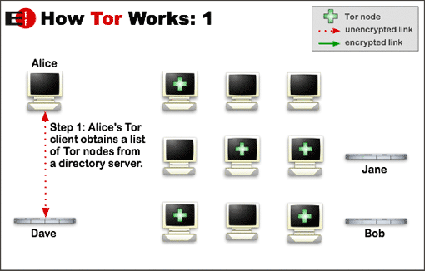
How Tor Works

Slide 4
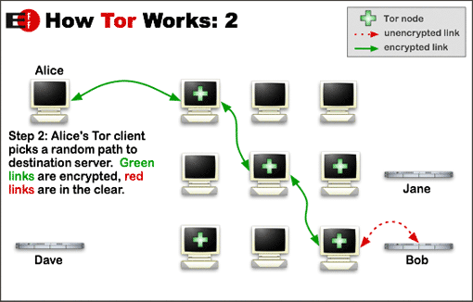
How Tor Works

Slide 5
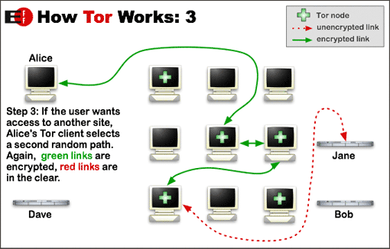
How Tor Works

Slide 6
What else can tor do?
Hidden Services
  Allows users of Tor to connect to servers without either side knowing each other’s ip address.
  Anonymous file/irc/web servers
  Made possible by “Introduction Points” and “Rendezvous Points”

Slide 7
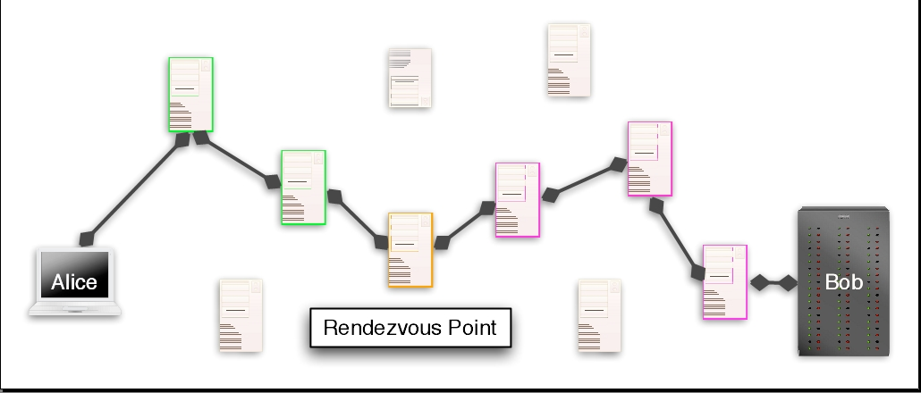
Hidden Services

Slide 8
Demo

Slide 9
Homework
Visit http://tor.eff.org
Download and Install Tor
Visit http://n4ez7vf37i2yvz5g.onion for other cool information

