Slide 1
Q-Learning
Dante Chavez | Miguel Angel Lama

Slide 2

Human Learning: Trial and Error
Achives Goal: Kid reaches the couch
Fail to achieve goal

Slide 3
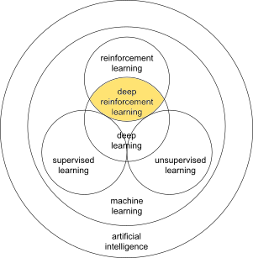
Learning based on trial and error.
Learning from interaction
Learning what to do (how to map situations to actions) as to maximize a numerical reward signal

Slide 4
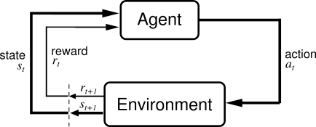
Problem Formulation
Environment: Where the agent operates
State: Actual situation of the agent
Action: interaction with the environment trough actions
Reward: Feedback from the environment
Policy: Method to map agent’s state to actions
Value: Future reward that an agent would receive bt taking an action in a particular state.

Slide 5
Example: Taxi Agent
How do we train an taxi agent to reach the end goal with the shortest path witout stepping on a mine.

Slide 6
TaxiV3 environment: Representation
WALL: You can’t pass through, Will remain in the same position
Yellow: Taxi current location
Blue: Pick up location
Purple: Drop-off location
Green: Taxi turn green once Passenger board.

Slide 7
TaxiV3 environment: Formulation
States: 500
Action Space:
0: Move South
1: Move North
2: Move East
3: Move West
4: Pickup Passenger
5.: Drop Off Passenger
Reward:
+20: Successfully pick up a Passenger and drop them off on a desired location.
-1 for each step.
-10 every time you incorrectly pick up or drop off a Passenger.

Slide 8
TaxiV3 environment: Q-Learning algorithm
Step 1: Set every Q-Value as 0.
Step 2: Choose an action.
Step 3: Perform an action.
Step 4: Measure reward
Step 5: Update Q-table
Update Q-Values:
Q[state, action] = Q[state, action] + lr * (reward + gamma * np.max(Q[new_state, :]) — Q[state, action])

