Slide 1
Deep Learning Project
Video Object Tracking

Slide 2
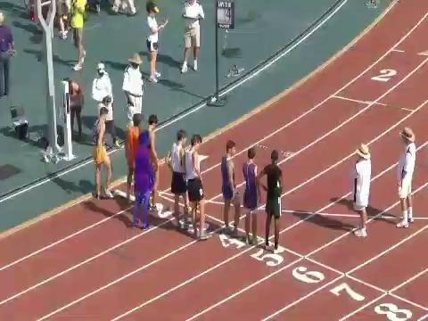
Demo

Slide 3
Content
Basic Concepts in Multi-Object Tracking & Segmentation (MOTS)
Assignment Overview
Data Preparation / Augmentation
Object Detection
Tracker / Similarity Model Training
Evaluation & Submission

Slide 4
MOTS Application
Autonomous driving: Tracking pedestrians, vehicles, and obstacles
Sports analytics: Following players and ball movement
Surveillance systems: Monitoring people and objects in security footage
Robotics: Tracking objects for manipulation or navigation
Retail analytics: Tracking customer movement in stores
Wildlife monitoring: Following animal movements in their habitats
Traffic management: Monitoring vehicle flow and pedestrian movement

Slide 5
Online vs offline tracking
Online tracking
Processes two frames at a time
For real-time applications
Hard to recover from errors or occlusions
Offline tracking
Processes a batch of frames
Good to recover from occlusions (short ones as we will see)
Not suitable for real-time applications
Suitable for video analysis

Slide 6
Off-line Tracking
Detect objects across frames in a video
Create a gallery for Re-ID
Identify a single object and assign it with the same id across frames
Output frames with bounding boxes, alongside the id

Slide 7
Assignment Overview
Goal:
Parse and prepare data.
Tune the pre-trained model using the training data. (4-6G VRAM, colab)
Implement the tracker and use it with the model.
Generate videos with boxes and ids for testing videos.

Slide 8
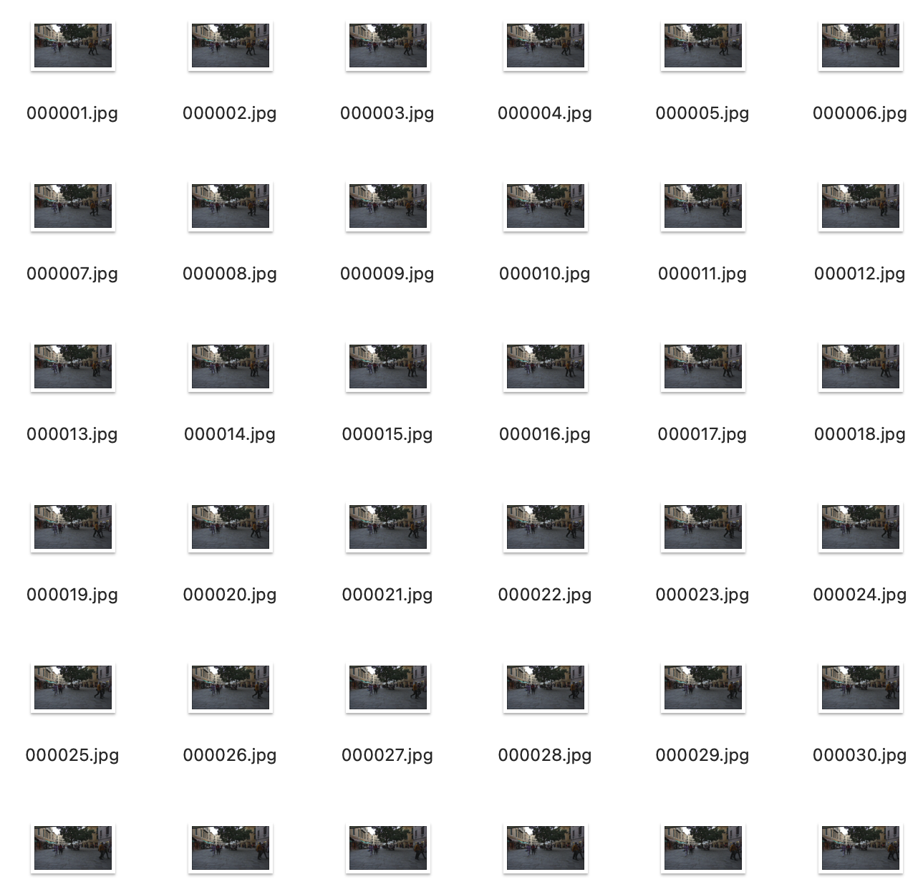
Data Preparation
Training dataset (MOTS):
1,3,586,447,85,263,1,1,1
Which means: (https://github.com/khalidw/MOT16_Annotator)
time frame 1
object id 3
bb_left 586
bb_top 447
bb_width 85
bb_height 263

Slide 9
Data Preparation
Parse the ground truth:
import numpy as np
def parse_gt_file(file_path):
data = []
with open(file_path, 'r') as f:
pass # do the preprocessing here
return data

Slide 10
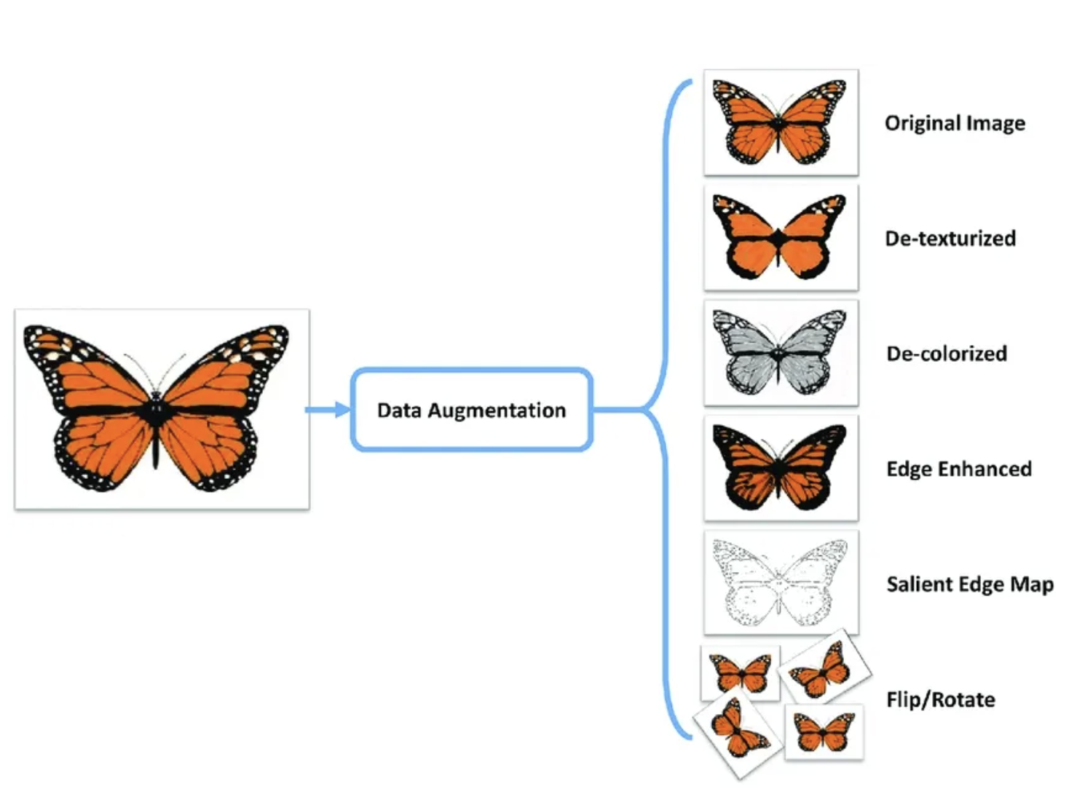
Data Augmentation
Data augmentation is the process of artificially generating new data from existing data, primarily to train new machine learning (ML) models.
Data augmentation artificially increases the dataset by making small changes to the original data.

Slide 11
Data Augmentation
from torchvision import transforms
color_aug = transforms.Compose([
transforms.ColorJitter(brightness=0.5, contrast=0.5, saturation=0.5),
transforms.GaussianBlur(kernel_size=(5, 9), sigma=(0.1, 5)),
])
augmented_image = color_aug(original_image)

Slide 12
Object Detection Models
Since it requires enormous training data and computational resources to fully train a model from scratch to perform well on MOTS task, in this assignment, you are highly encouraged to load pre-trained models from torchvision and fine-tune it on the provided training dataset.
Fast R-CNN / Faster R-CNN: Used for object detection (bounding box regression and classification)
Mask R-CNN: Used for instance segmentation (pixel-wise mask prediction)

Slide 13
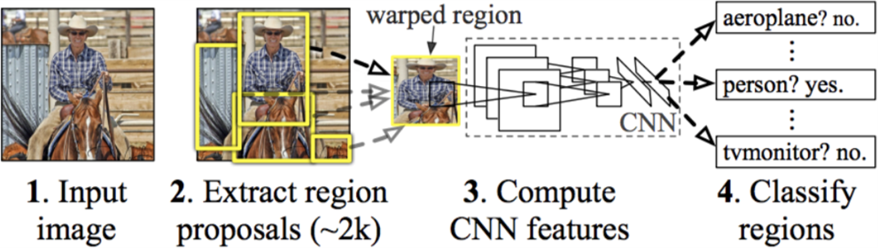
R-CNN
Girschick et al, “Rich feature hierarchies for accurate object detection and semantic segmentation”, CVPR 2014

Slide 14
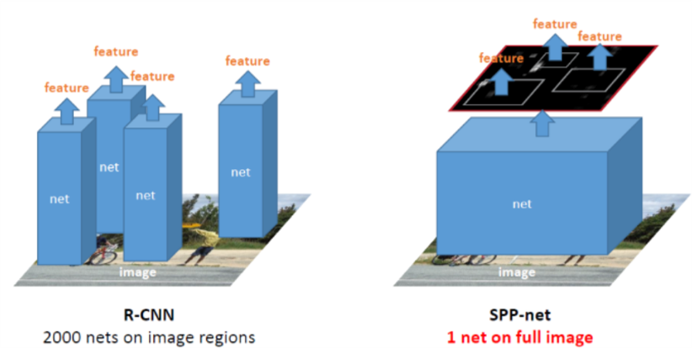
SPP-net
He et al. Spatial Pyramid Pooling in Deep Convolutional Networks for Visual Recognition. ECCV 2014.

Slide 15
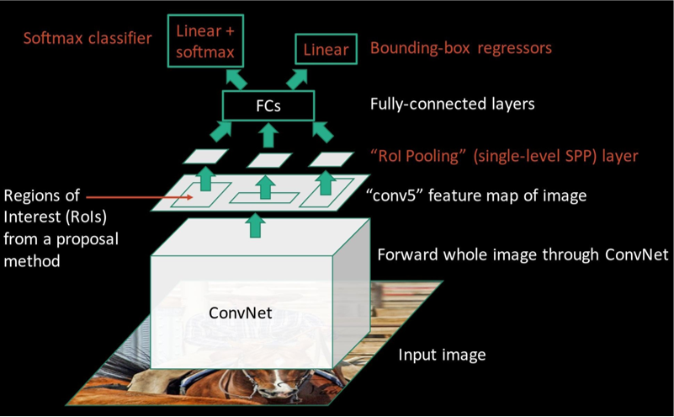
Fast R-CNN

Slide 16
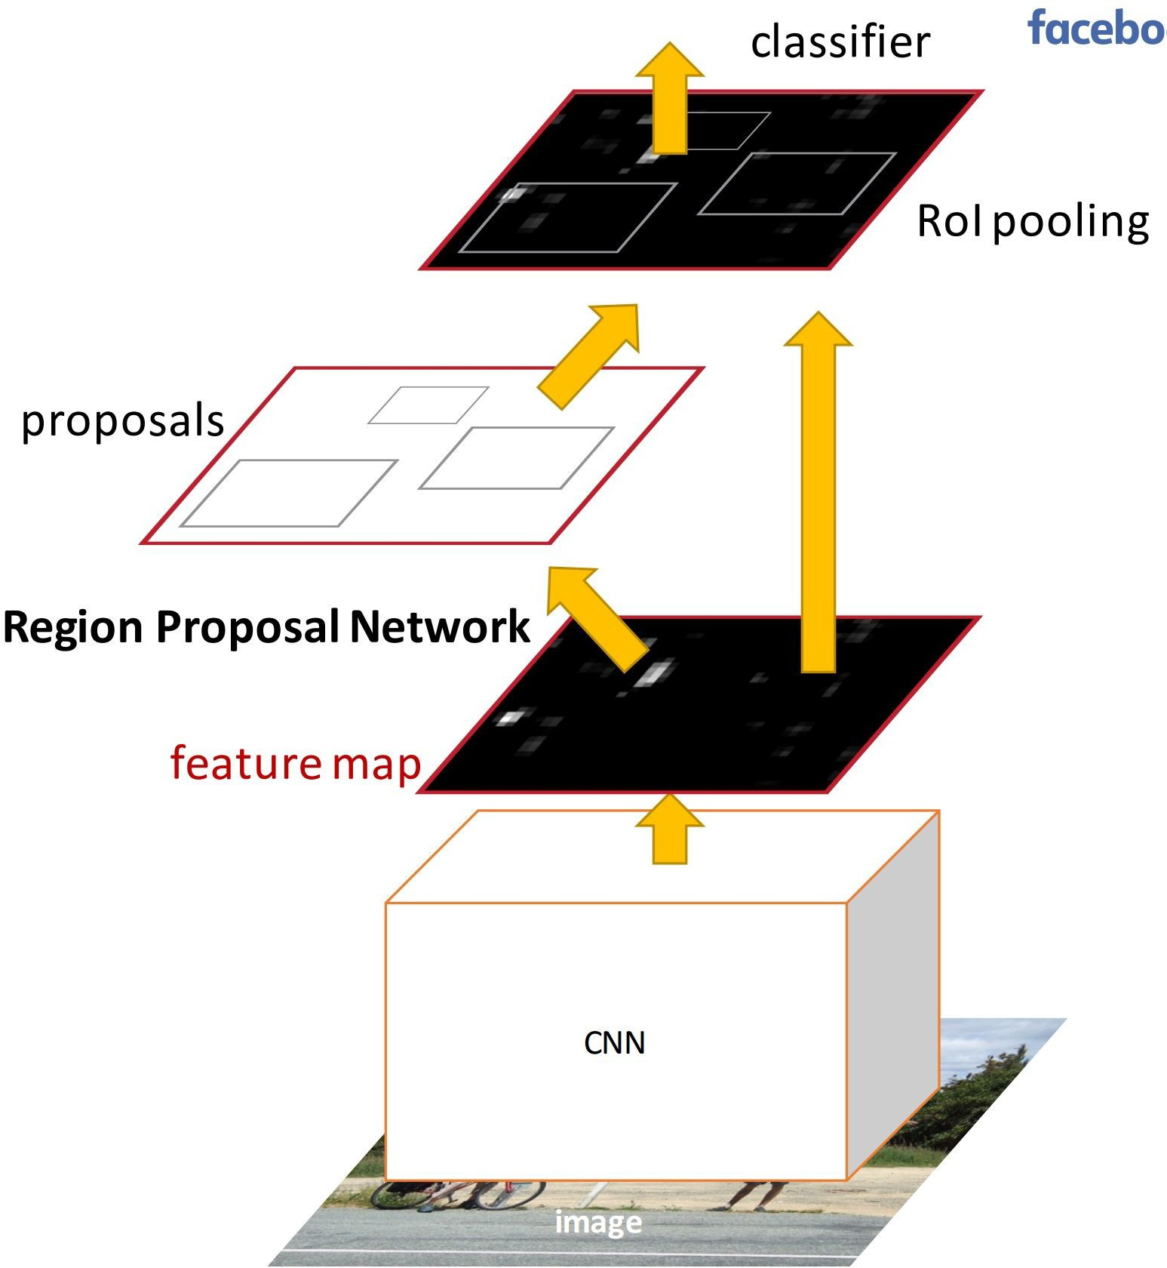
Faster R-CNN
Have the proposal generation integrated with the rest of the pipeline
Region Proposal Network (RPN) trained to produce region proposals directly.
Ren et al, “Faster R-CNN: Towards Real-Time Object Detection with Region Proposal Networks”, NIPS 2015

Slide 17
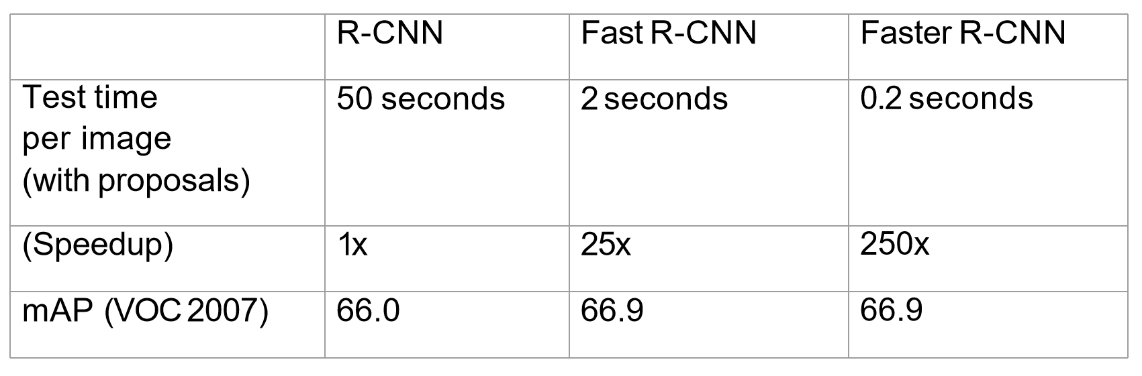
Comparison

Slide 18
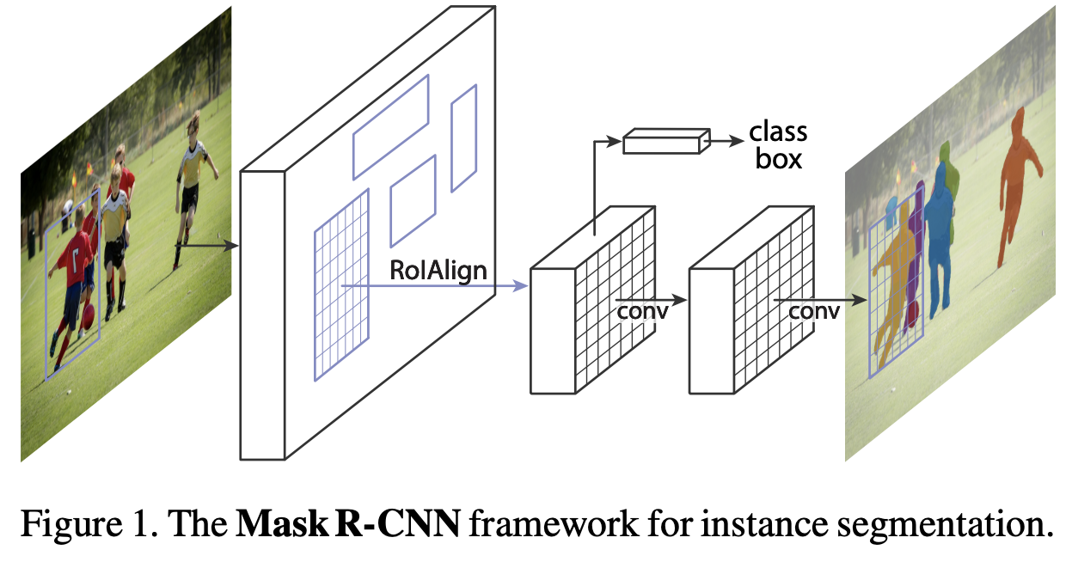
Mask R-CNN (optional, pixel-level seg)

Slide 19
Faster R-CNN
Since we will have limited amount of data to fully train a model from scratch, it’s a good approach to do few-shot fine-tuning which is a form of transfer learning.
Transfer learning is a machine learning technique in which knowledge gained through one task or dataset is used to improve model performance on another related task and/or different dataset.
Few-shot fine-tuning is to only tune a small portion of overall parameters in a large model.

Slide 20
Faster R-CNN
Since we will have limited amount of data to fully train a model from scratch, it’s a good approach to do few-shot fine-tuning which is a form of transfer learning.
Transfer learning is a machine learning technique in which knowledge gained through one task or dataset is used to improve model performance on another related task and/or different dataset.
Few-shot fine-tuning is to only tune a small portion of overall parameters in a large model.
Together with the data augmentation, we can simply tune a pre-trained model on our own small training dataset.

Slide 21
Fine-tune a pre-trained Faster R-CNN
import torchvision
from torchvision.models.detection import fasterrcnn_resnet50_fpn
from torchvision.models.detection.faster_rcnn import FastRCNNPredictor
# Freeze backbone layers
for param in model.backbone.parameters():
param.requires_grad = False
# Only fine-tune the heads for classification and mask prediction
params_to_optimize = [p for p in model.parameters() if p.requires_grad]

Slide 22
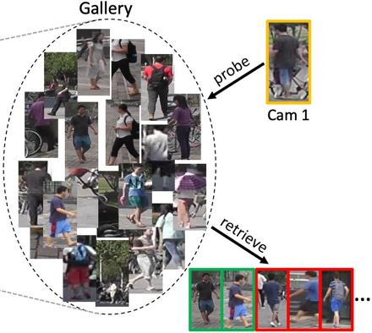
Re-ID
Basic idea: train a model to identify all detected objects.
Cons: We have to fine-tune the model once new objects join or detected object leave

Slide 23
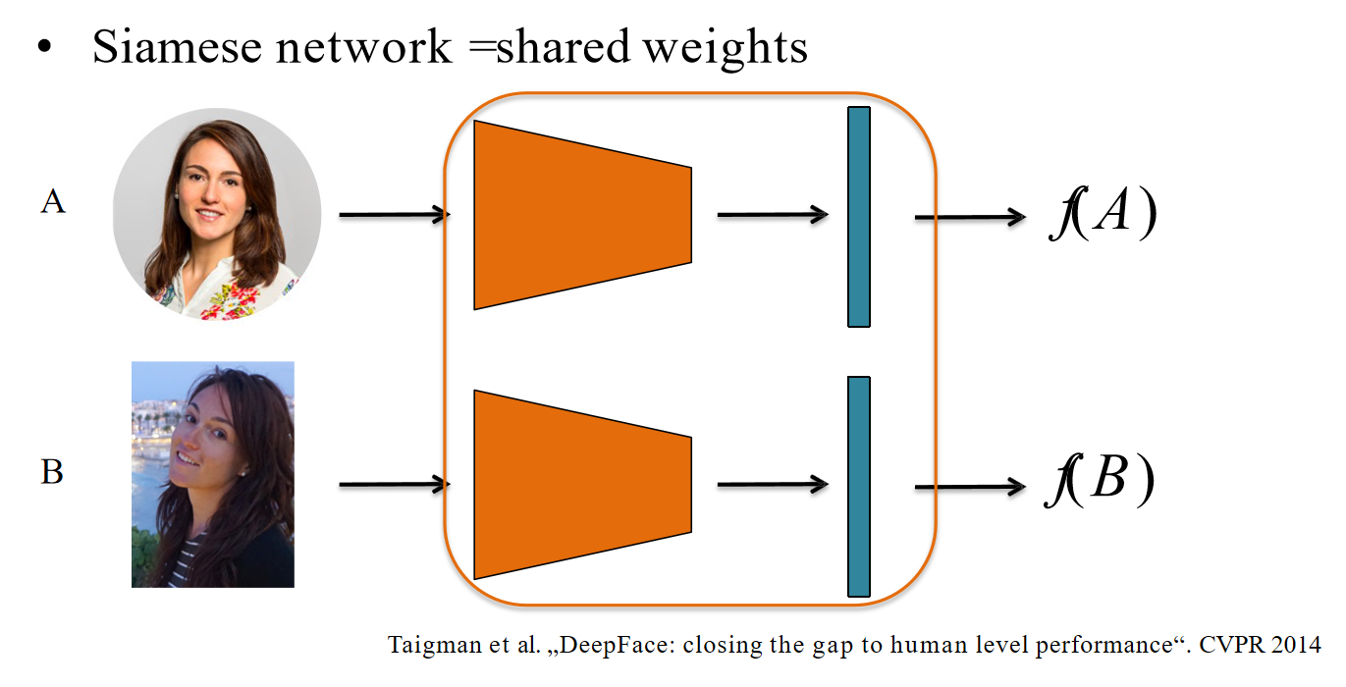
Tracker (Re-ID)
We do not need to identify any face, our model is trained to just tell the difference between them
Otherwise, we have to fine-tune the model frequently whenever there is new one here

Slide 24
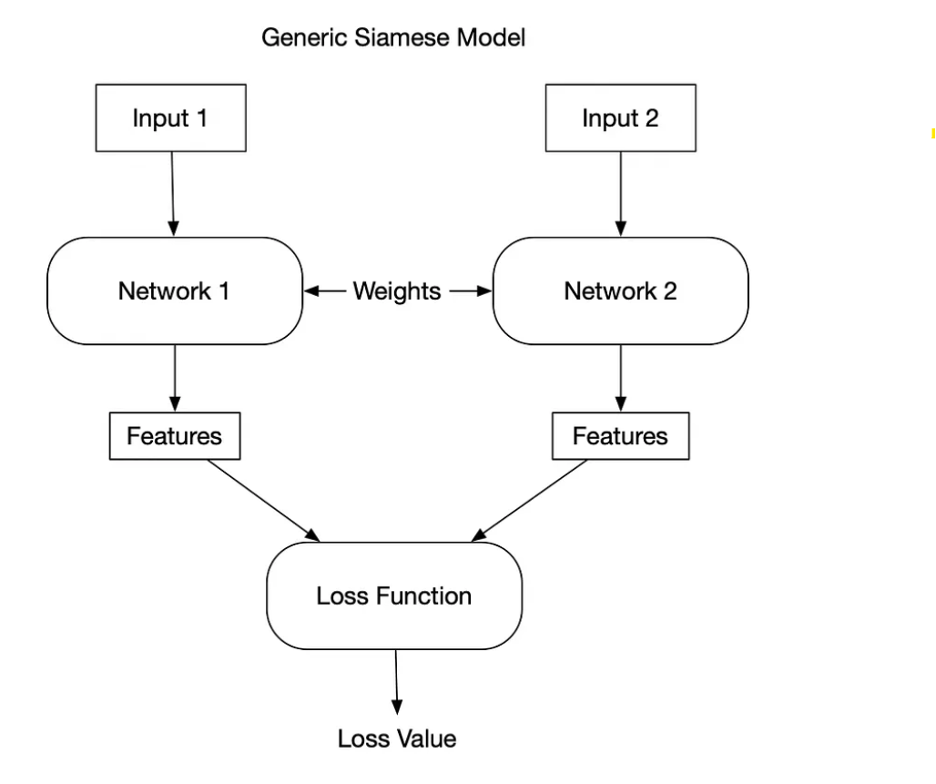
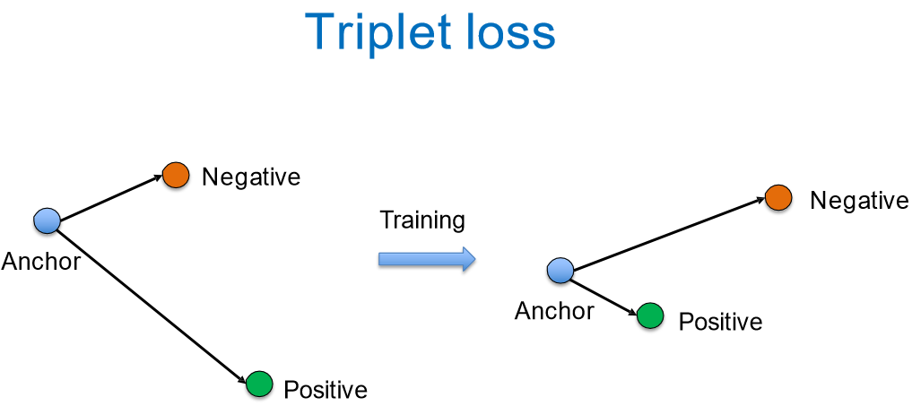
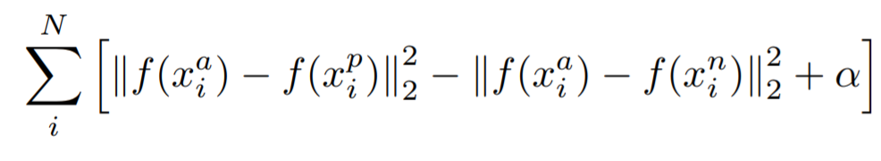
Tracker (Similarity Model)

Slide 25
Tracker (Similarity Model)
import torch
import torch.nn as nn
import torch.nn.functional as F
class Siamese_Network(nn.Module):
def __init__(self):
super(Siamese_Network, self).__init__()
# CNN layers for feature extraction
self.conv1 = nn.Conv2d(1, 64, kernel_size=3)
self.conv2 = nn.Conv2d(64, 128, kernel_size=3)
self.conv3 = nn.Conv2d(128, 128, kernel_size=3)
self.fc1 = nn.Linear(128 * 22 * 22, 256)
self.fc2 = nn.Linear(256, 256)
def forward_one(self, x):
x = F.relu(F.max_pool2d(self.conv1(x), 2))
x = F.relu(F.max_pool2d(self.conv2(x), 2))
x = F.relu(self.conv3(x))
x = x.view(-1, 128 * 22 * 22)
x = F.relu(self.fc1(x))
x = self.fc2(x)
return x
def forward(self, input1, input2):
output1 = self.forward_one(input1)
output2 = self.forward_one(input2)
return output1, output2

Slide 26
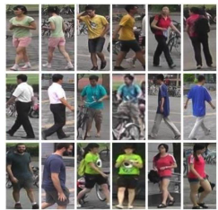
Tracker (Similarity Model)
Market-1501 Dataset

Slide 27
Implementation Pipeline
Data processing(decode gt (rle)) & Data augmentation
Faster R-CNN Object Detection and bounding box segmentation
Faster R-CNN few-shot fine-tuning
Train the Siamese Network for Re-ID
Re-ID
Tracking objects across frames
Perform Detection and Re-ID for tracking

Slide 28
Evaluation
Present your design, implementation details, challenges encountered and a result video in class.
Rubric:
A: Perfect tracking and bounding box across frames without missing the target.
B: Can track an object across a majority of frames but not all.
C: At least can detect the targeted object and assign a bounding box to it across some frames.

Slide 29
Submission
All of your source code (do not include any model weights)
A tracking video of at least one single target pedestrian on one MOT16 test data (video or link)
A pdf report that contains the following sections (recommend using Latex):
Abstract, Introduction
Methodology (System Design, Implementation Details)
Challenges encountered (how you solved them)
Self-evaluation and Proper Citations

Slide 30
Thank you!

Slide 31
This page is for guiding students who have even no idea about the implementation
Train the similarity network (input: raw images 16 * 16) -> output: 0, 1
Fine-tune the Faster RCNN (input: raw images) -> output: bbox of each object, class id ..
Inference of similarity network (24 * 24 images + gt) -> (1 , 0)
Get the bbox position from RCNN, retrieve images (30 * 16) (representing single object)
Resize the retrieved image for each object as the size of the image that you use to train the similarity network

