Slide 1

NO SQL and why?
Elastic scalability, because these databases are designed to be used with low-cost commodity hardware
Support for big data applications, with NoSQL databases able to handle massive volumes of data
Dynamic schemas, because NoSQL databases require no schemas to start working with data
Compatibility with cheap commodity hardware clusters as transaction and data volumes increase, allowing you to process and store more data at a lower cost
Notes:
Resources:
https://www.mongodb.com/scale/types-of-nosql-databases
https://www.dnsstuff.com/nosql-database-comparison

Slide 2
SQL vs NOSQL ?
SQL databases are relational, NoSQL are non-relational.
SQL databases use structured query language and have a predefined schema. NoSQL databases have dynamic schemas for unstructured data.
SQL databases are vertically scalable, NoSQL databases are horizontally scalable.
SQL databases are table based, while NoSQL databases are document, key-value, graph or wide-column stores.
SQL databases are better for multi-row transactions, NoSQL are better for unstructured data like documents or JSON.

Slide 3
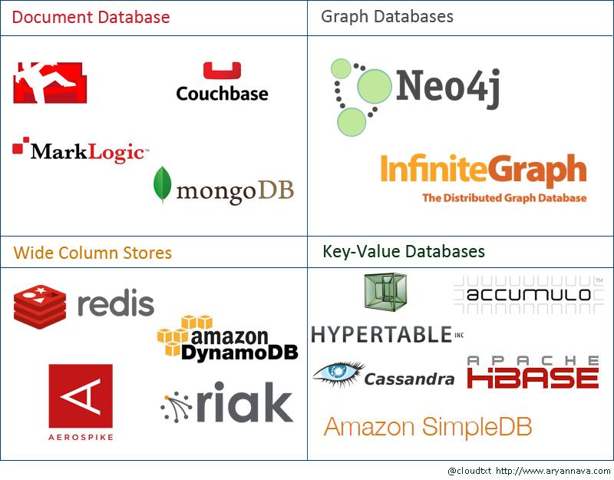
NO SQL Databases?

Slide 4
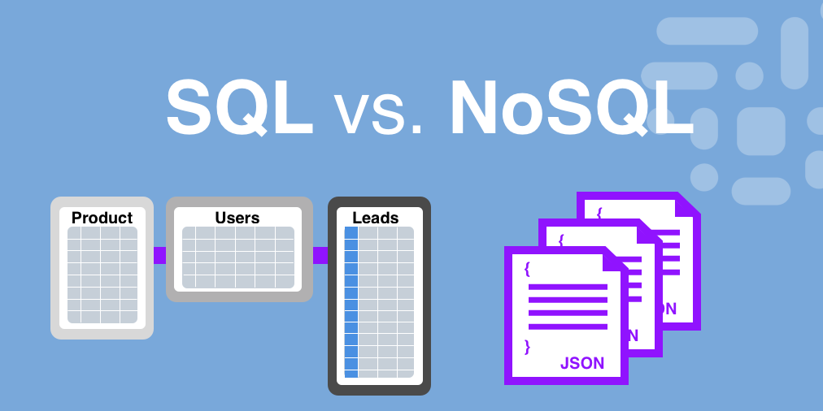
Notes:
Resources:
https://www.dnsstuff.com/nosql-database-comparison
https://www.xplenty.com/blog/the-sql-vs-nosql-difference/

Slide 5
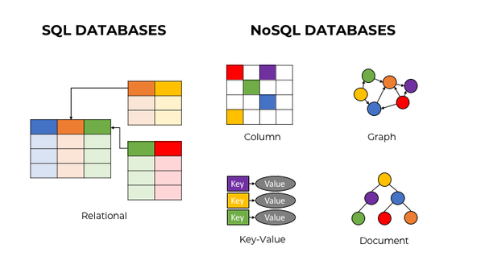

Slide 6
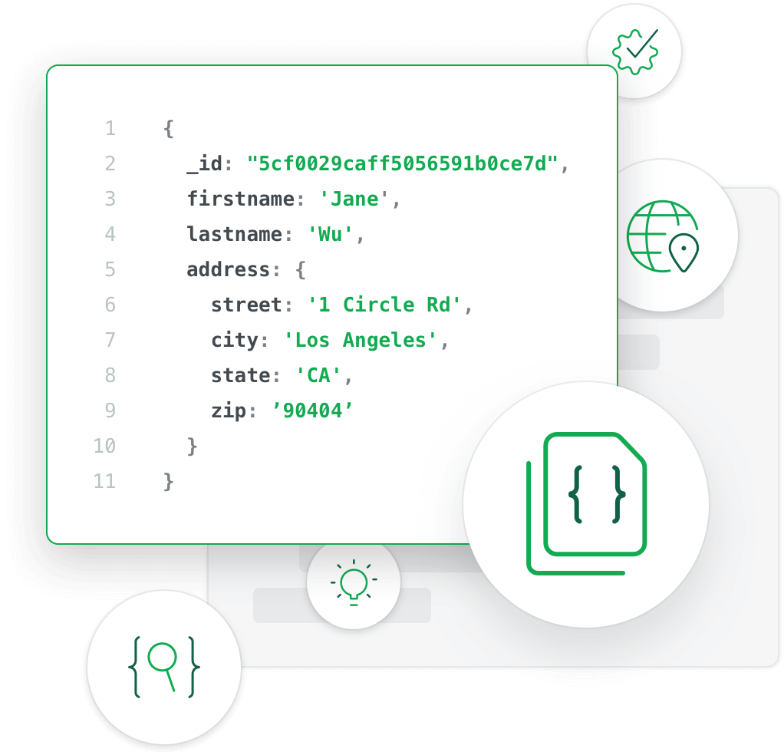

Notes:
Resources:
https://docs.mongodb.com/manual/crud/

Slide 7
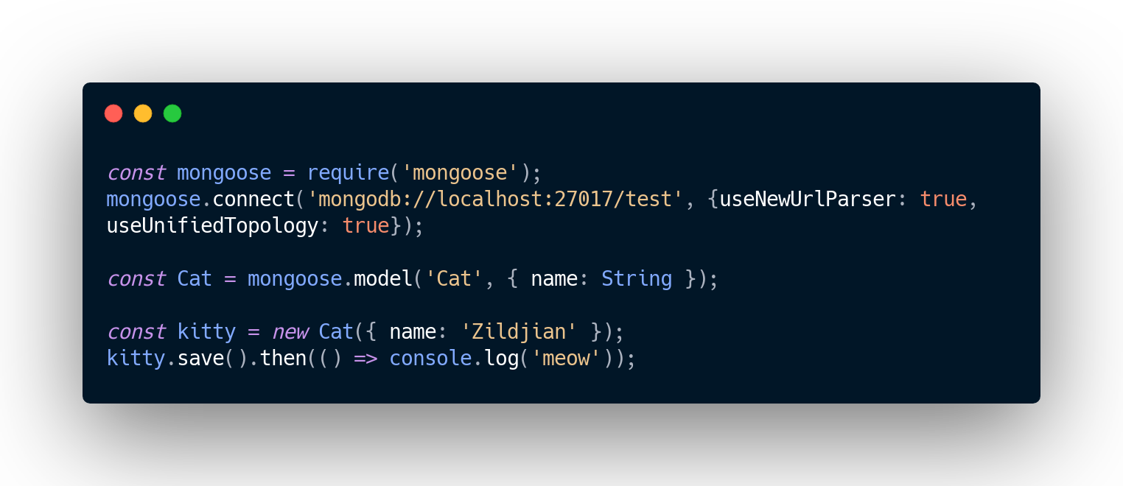
Mongoose (ODM)
Notes:
Resources:
https://mongoosejs.com

Slide 8
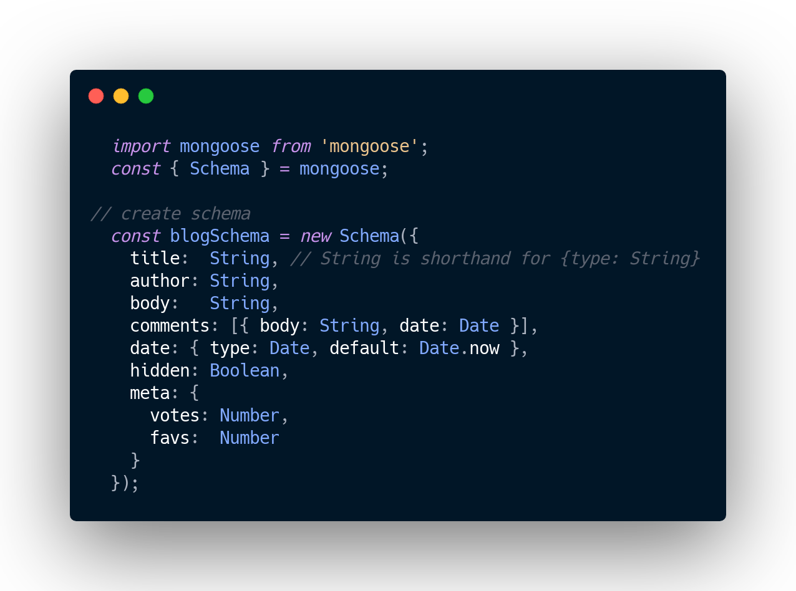
Mongoose Schema
Notes:
Resources:
https://mongoosejs.com/docs/guide.html#definition

Slide 9
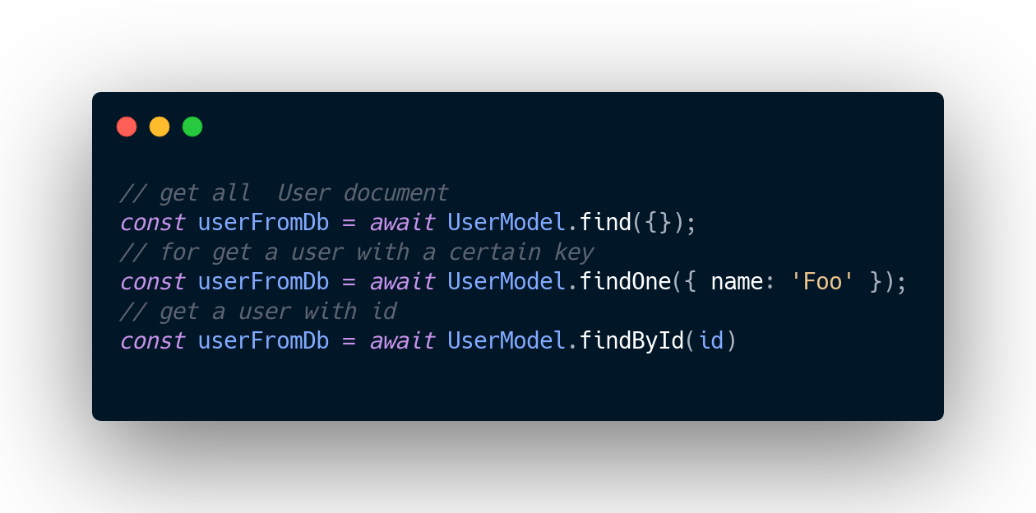
Mongoose Query
Notes:
Resources:
https://mongoosejs.com/docs/queries.html

Slide 10
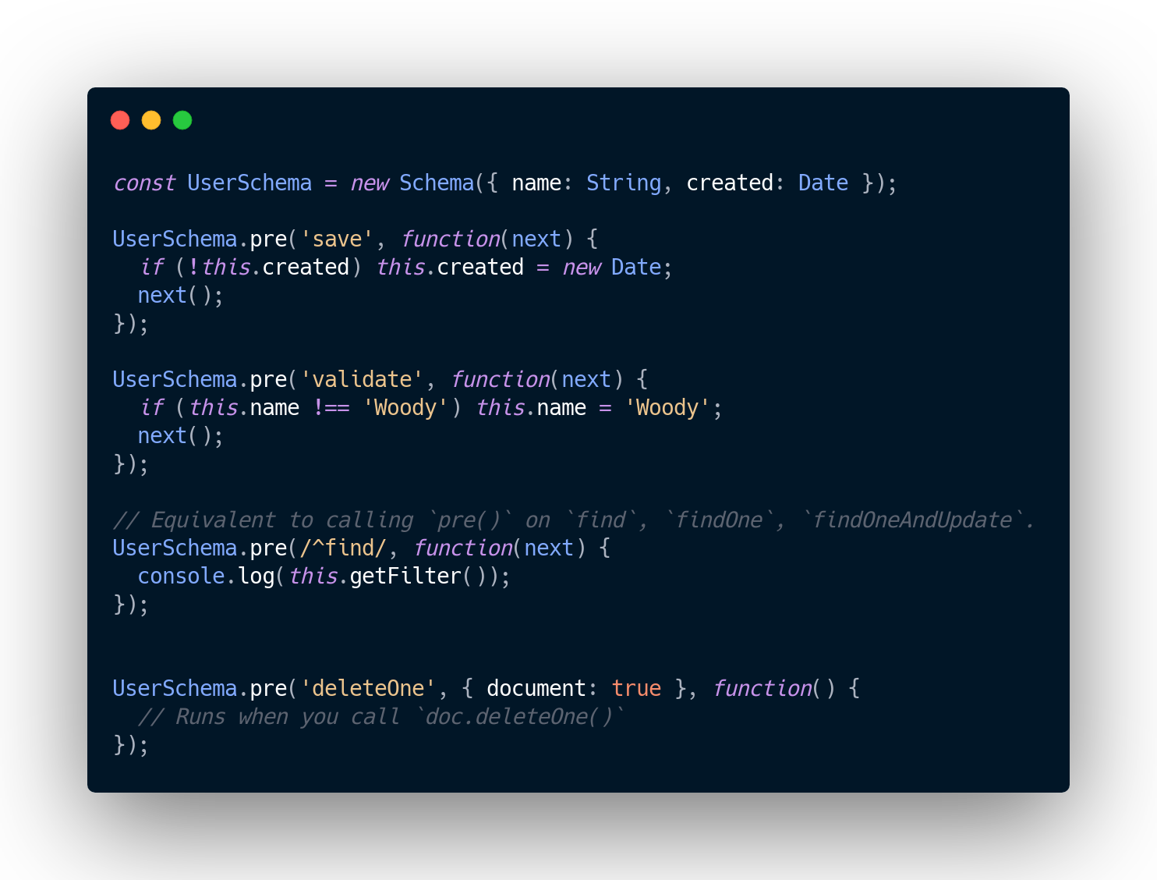
Pre Method vs virtual methods
Notes:
Resources:
https://mongoosejs.com/docs/api.html#schema_Schema-pre

Slide 11


Slide 12
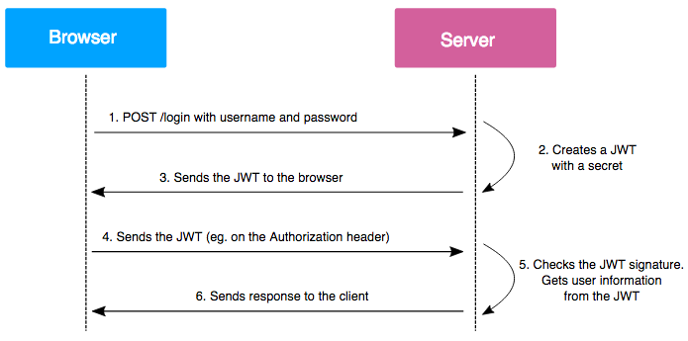
Auth Logic and how?

Slide 13
Demo Time!

Slide 14
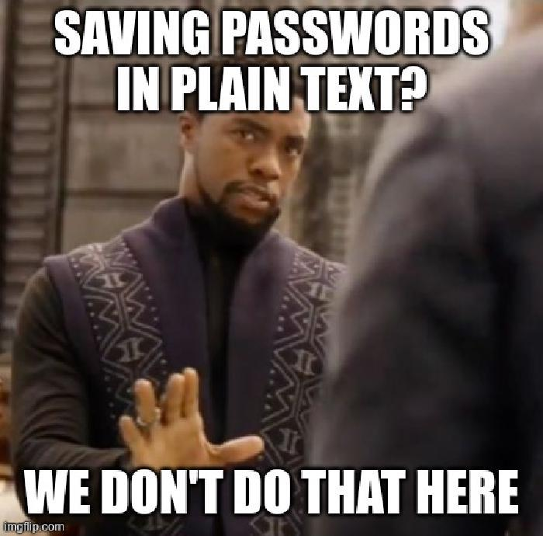

Slide 15
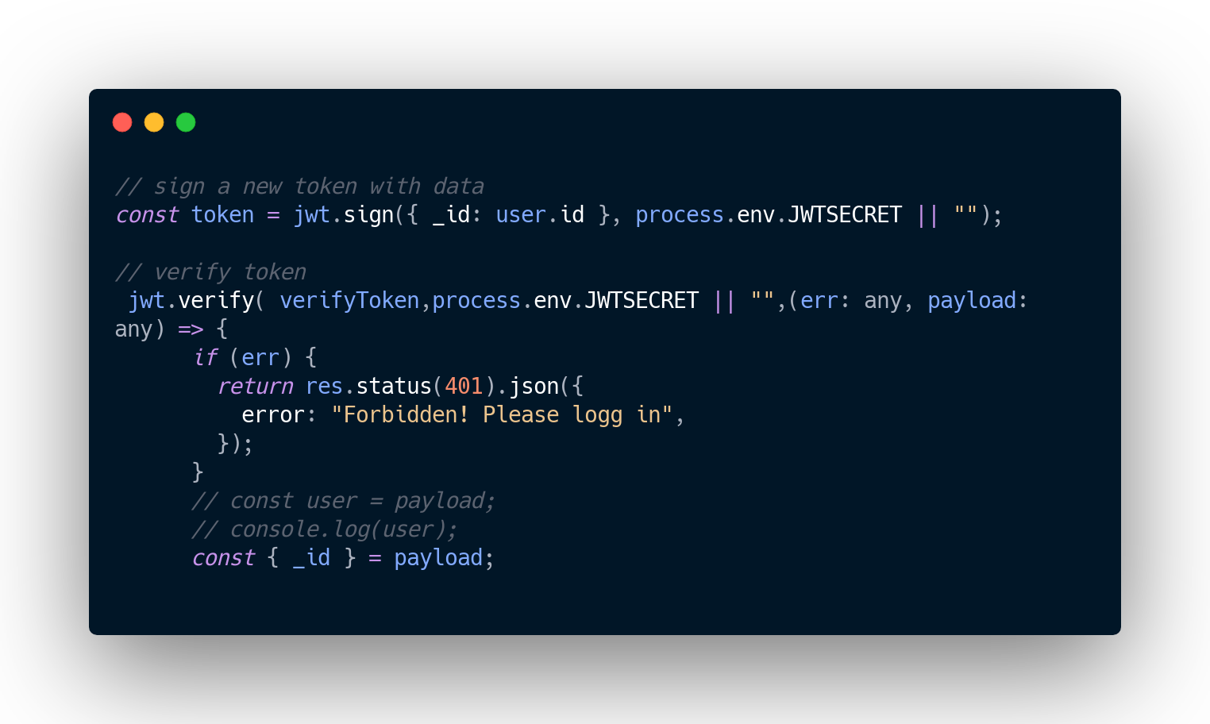
JWT (Json Web Token)
Notes:
Resources:
https://jwt.io

Slide 16
Private Routes ?

Slide 17
NoSql relations?

Slide 18
Notes:
Resources:
https://www.youtube.com/watch?v=2jqok-WgelI&feature=youtu.be
https://codeburst.io/to-handle-authentication-with-node-js-express-mongo-jwt-7e55f5818181?gi=2d8fcbd4d4fb

Slide 19
Thank You!

