Slide 1
Authentication and Authorization
passwords, encryption
and validation

Slide 2

Validation is a selected criteria which validates user credentials while registering at your site.

Slide 3
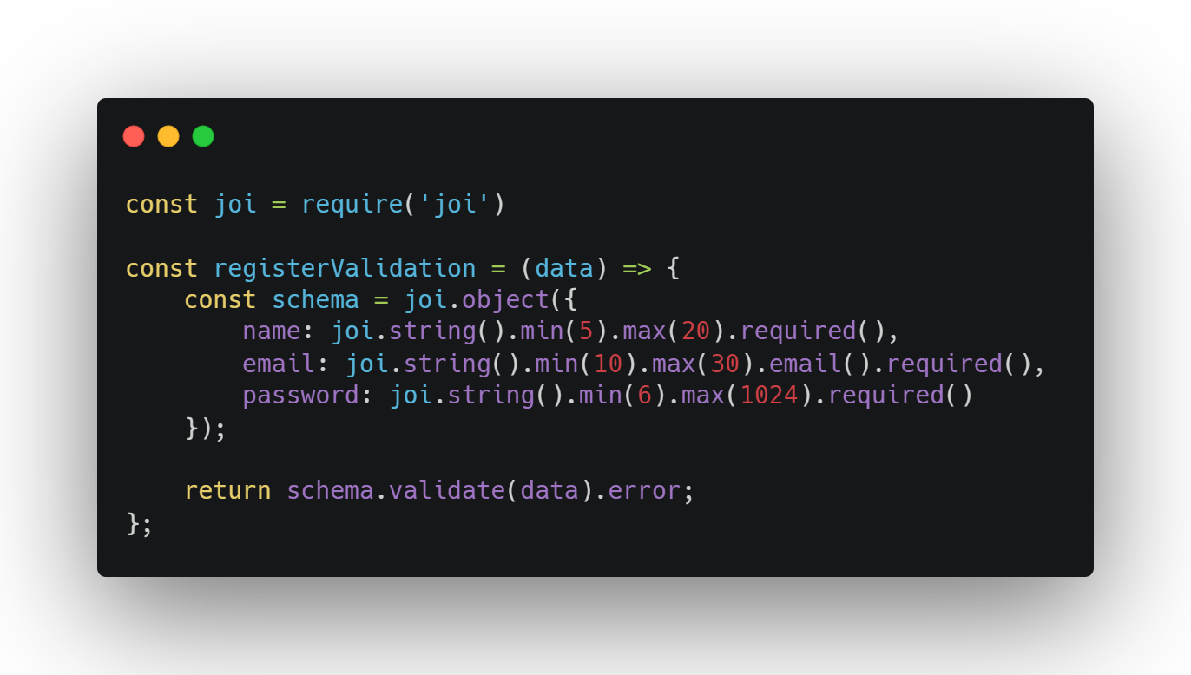

Slide 4
Storing passwords
Passwords provide the first line of defense against unauthorized access
to your personal information.
The stronger your password, the more protected your computer will be from hackers and malicious software.
Hint : Always select “never” when your Internet browser asks for your permission to remember your passwords.

Slide 5
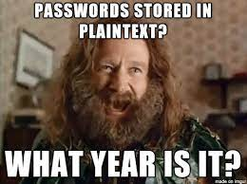
Plaintext Passwords
Notes:
https://youtu.be/8ZtInClXe1Q

Slide 6
ENCRYPTION vs HASHING
It has a problem, because the server authenticating the password must have the key to decrypt it.
An attacker who steals a file of encrypted passwords might also steal the key.
Hashing is a better option, especially with the use of salt.
Hashing, is a one-way function that scrambles plain text to produce a unique message, we can’t reverse the hashing process to reveal the original password.
An attacker who steals a file of hashed passwords must then guess the password.

Slide 7
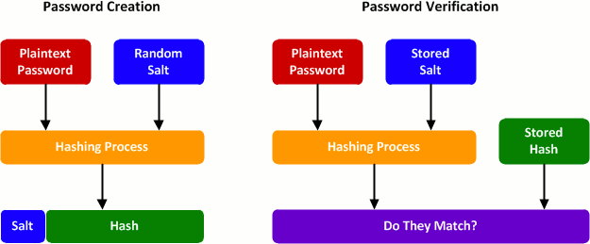
Password Hashing

Slide 8
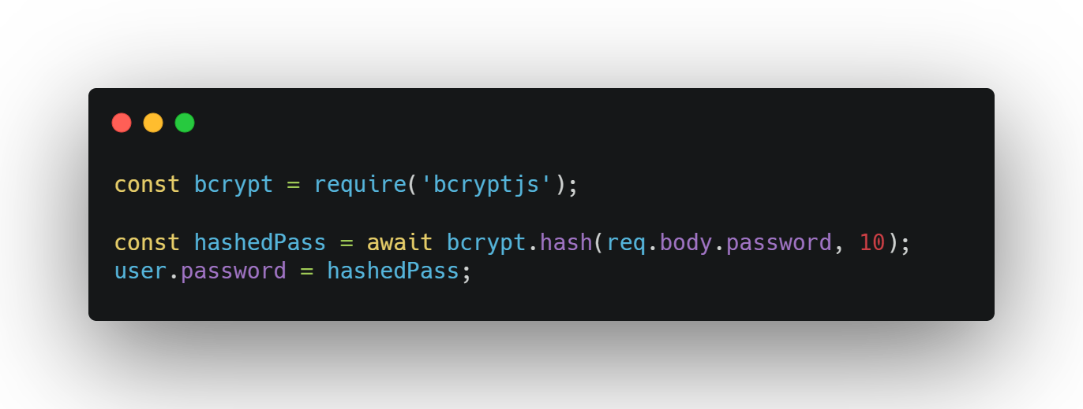

Slide 9
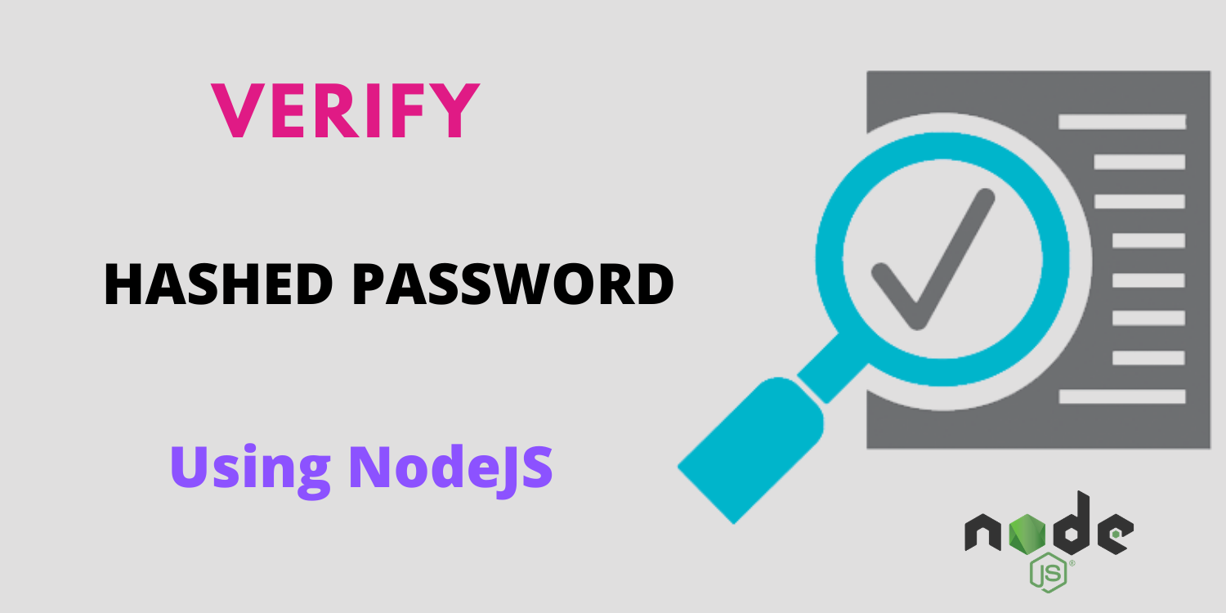
So how to verify it?

Slide 10
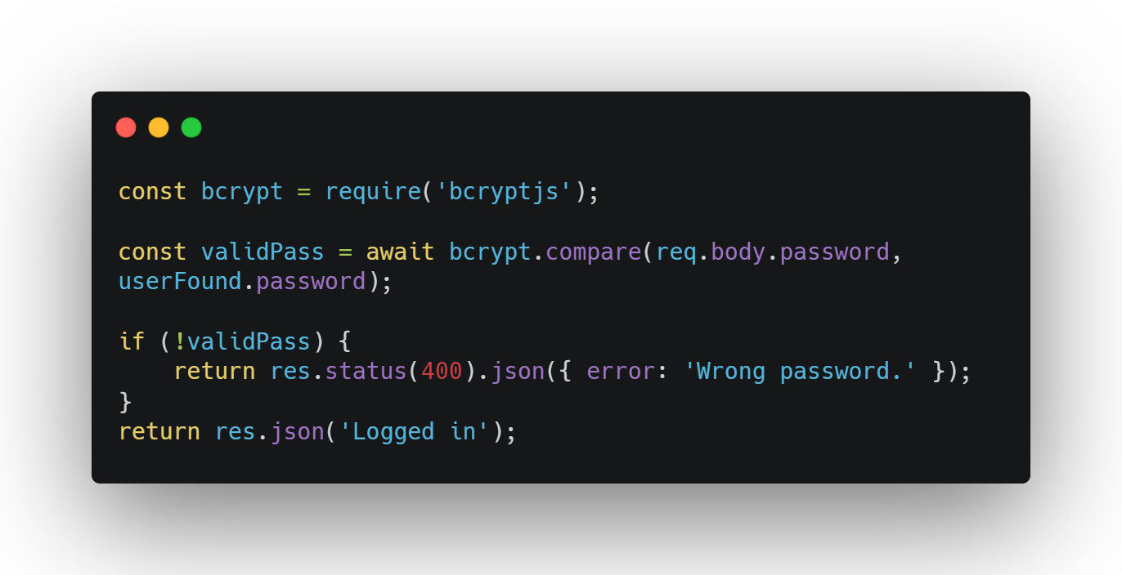

Slide 11
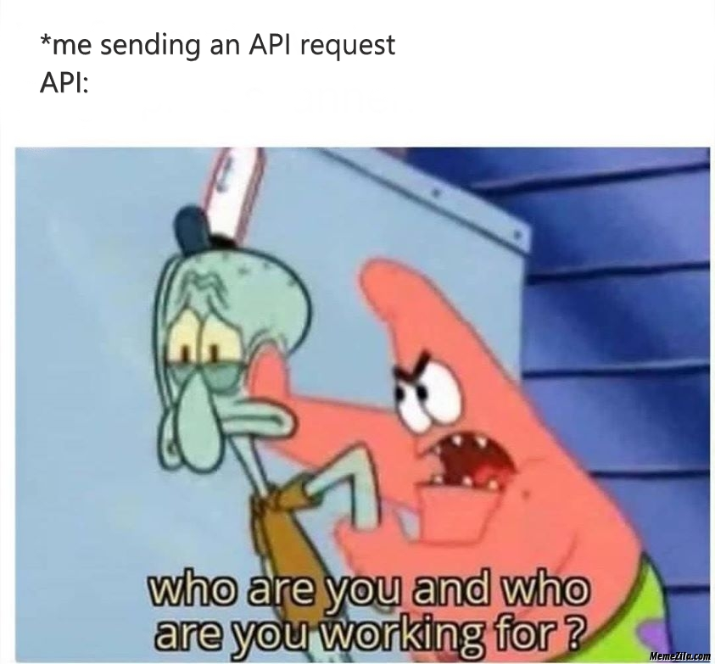
API Requests

Slide 12


Slide 13
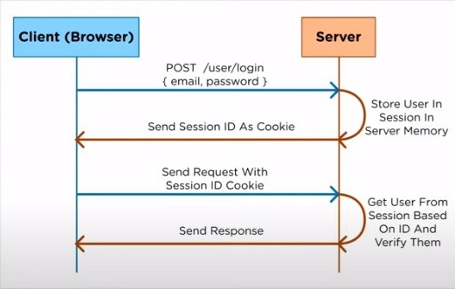
Session ID Cookie
First bad side, causes headache in the server side.
Second, login redundancy.
Wasting time and memory.

Slide 14

What’s JWT?
Notes:
https://youtu.be/7Q17ubqLfaM
https://jwt.io/

Slide 15
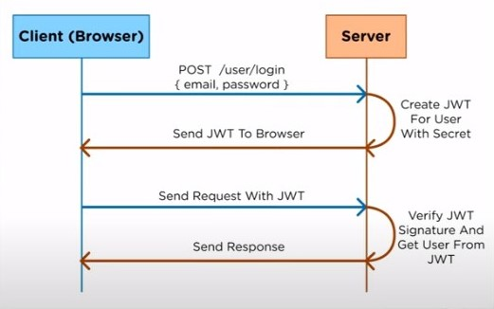
JWT Tokens

Slide 16
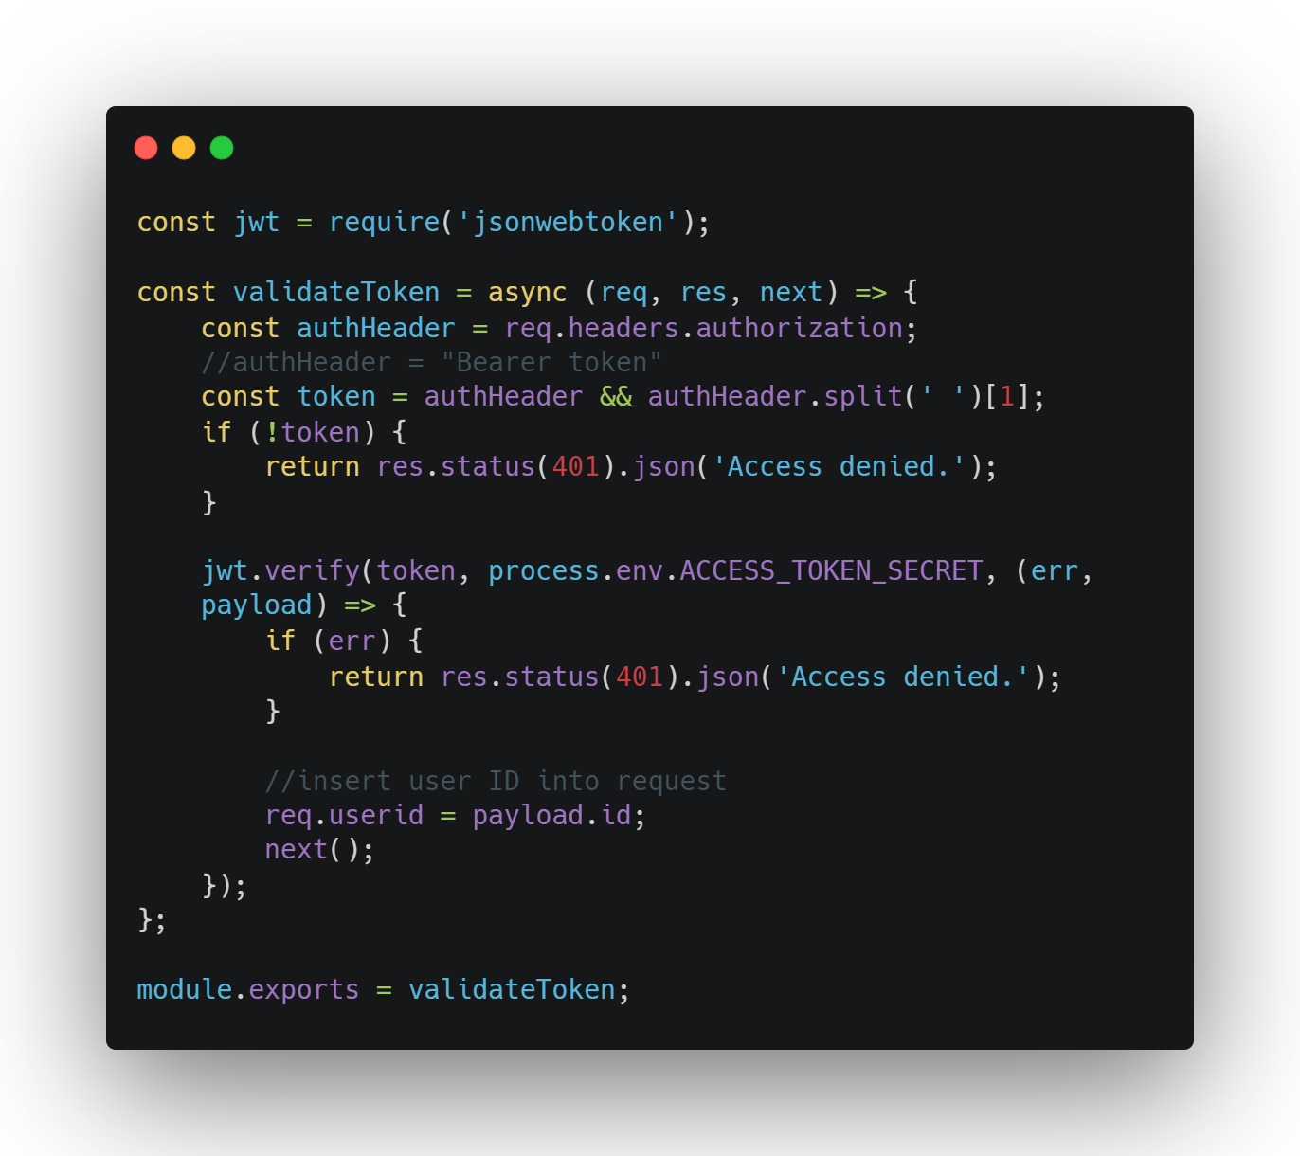

Slide 17
Thank you ...
Notes:
https://youtu.be/2jqok-WgelI
https://codeburst.io/to-handle-authentication-with-node-js-express-mongo-jwt-7e55f5818181

