Slide 1
The Comparison Between Microservice & Monolithic Architecture
Presented by :
Mahesh A C
Dept. of CSE
CIT, Gubbi

Slide 2
Contents
Introduction
Objectives
Architecture Using E-commerce website
Implementation & Development
Performance Testing
Pros and cons
Conclusion
Future Work
References

Slide 3

Introduction
In this day and age, people demand fast efficient
and reliable applications.
It is essential to choose an appropriate software
architecture for an application development.
To understand this let’s take two software
architecture. Monolithic and Microservice.
This two architecture are used to develop
commercial websites for better service.

Slide 4
Objectives
Choose more fast efficient and reliable software
System to improve application service.
Provide very good service to the user in time.
Improves the application for more responsive, scalable,
manageable to its envir0nment.

Slide 5
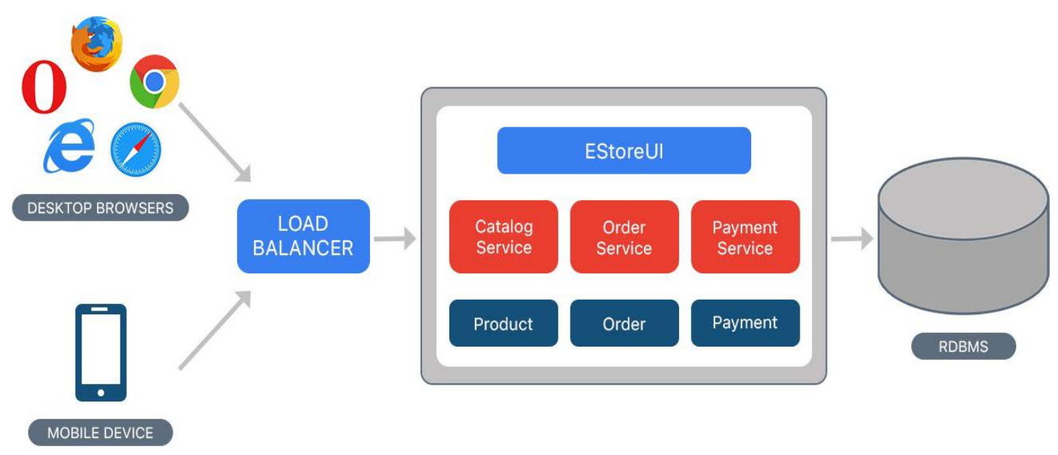
Monolithic architecture
Architecture:
E-commerce website using Monolithic architecture
Monolithic architecture is the traditional unified model for the design of a software program. Monolithic, means composed all in one piece.
The application is deployed as one single standalone program.

Slide 6
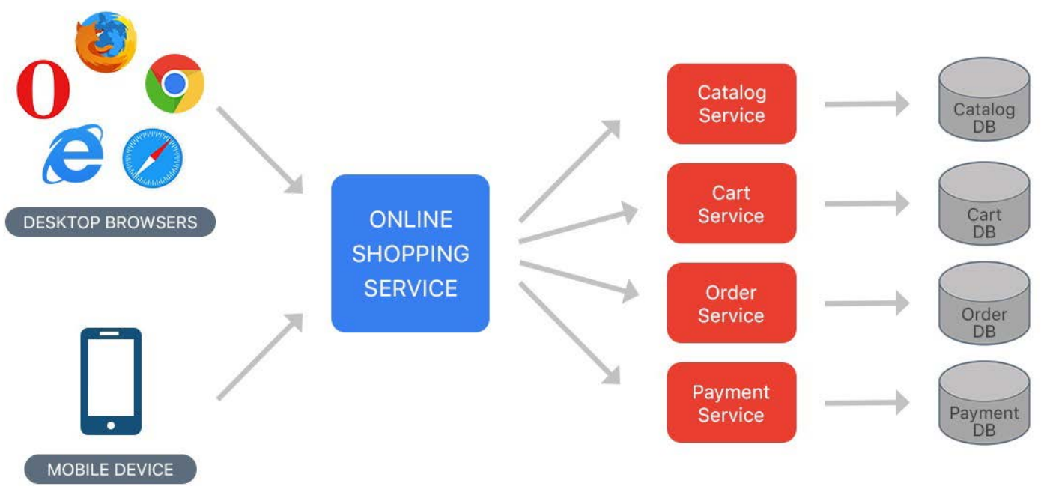
Microservice architecture
Architecture:
E-commerce website using Microservice architecture
Microservice is an architectural design for building distributed application using containers. Application operates as an independent service.
This architecture allows for each service to scale or update without disrupting other services in the application.

Slide 7
Technologies
Implementation &
Development
I. Java is a programming language used to develop
software applications.
II. Spring boot provide an easier and faster way to
set up, configure, run web-based applications.
Spring cloud supports quick develop cloud-based
allocation.
III. Docker provide deployment of applications with
containers that can run on the cloud.
IV. Gatling is a highly capable load testing tool.
Java along with Spring framework
Spring boot and Spring cloud
Docker
Gatling

Slide 8
Performance Testing
In order to compare the performance of the two presented
architectures, two cases of tests were performed:
1000 requests made at once by 30 users
(1000 * 30 = 30,000 requests)
10 000 requests made at once by 30 users
(10,000 * 30 = 3,00,000 requests)

Slide 9
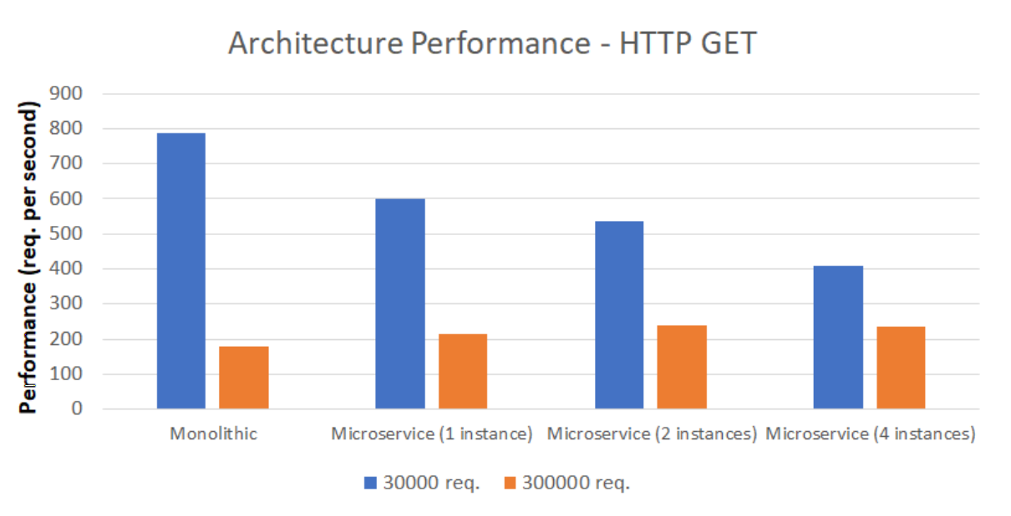
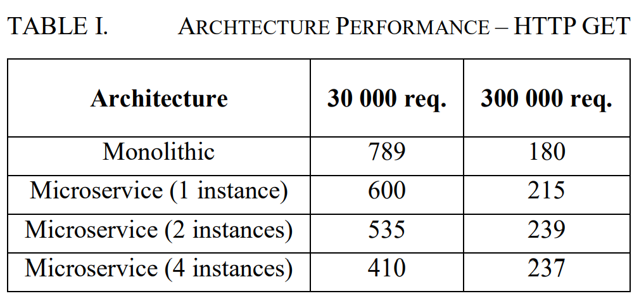
Performance testing – HTTP GET

Slide 10
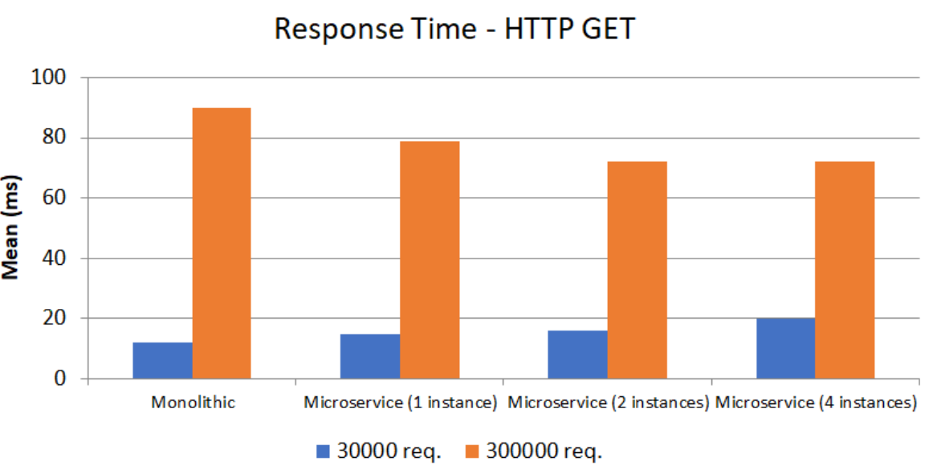
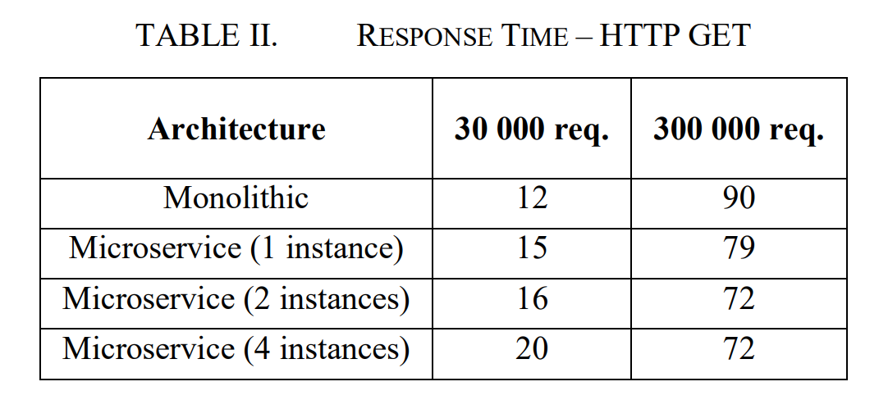
Response Time – HTTP GET

Slide 11

Pros & Cons
Monolithic
+Easy to develop
- Complex maintenance
- Reliability (one fault can down entire application)
- Availability (redeploy entire application on updates)
Microservice
+ Easy maintenance
+ Reliability (fault on only that microservice alone)
+ Availability (redeploy a new version of a microservice
requires little downtime)
- More complex deployment

Slide 12
Conclusion
The conducted tests have indicated that the Microservice
architecture is more efficient if an application has to handle a
bigger number of requests.
Monolithic architecture is not bad. It is more efficient during
lower load and is easy to develop.
The choice of the right architecture should be defined by
purposes of business so the investor will get the product
which will meet their expectations.

Slide 13

Future work
Microservices implemented as functions of service,
means serverless applications.
scalability of the cloud and the other benefits offered
by the cloud.
Improve the efficiency of Virtual Machines (VM)
and interconnect different service. (google colab)

Slide 14
References
https://www.techopedia.com/definition/24596/software-architecture
https://medium.com/koderlabs/introduction-to-monolithicarchitecture-and-microservices-architecture-b211a5955c63
https://www.oracle.com/technetwork/java/javase/8-whats-new2157071.html
https://spring.io/projects/
https://docs.docker.com/
https://gatling.io/docs/current

Slide 15
Thank you

