Slide 1
POPULATION PREDICTION USING MACHINE LEARNING
Under the guidance of:
Mr. Suhas K C M.Tech
Assistant Professor
Dept. of CSE
CIT, Gubbi.
Presented by:
Lokesh K
Mahesh A C
Manoj Kumar M
Narasimha swamy Prasad K L

Slide 2
CONTENTS
INTRODUCTION
OBJECTIVES
METHODOLOGY
IMPLEMENTATION
RESULTS
CONCLUSION
REFERENCES

Slide 3
INTRODUCTION
Population may be considered positive hindrance in the way of economic development of a country.
Population of India - According to latest United Nations data, India, with 1.36billion.
India is predicted to have more than (1.5022) billion people by the end of 2027.
By using machine learning algorithms and supported libraries we can predict the future population.

Slide 4
OBJECTIVES
Represent the given data in the form of pictorial representation, which is easy to understand and for future usage.
Develop a machine learning model to predict the future population with more accuracy.

Slide 5
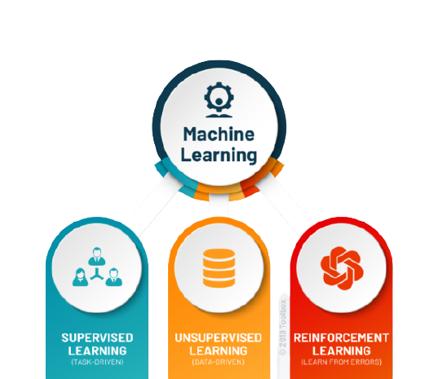
METHODOLOGY
Machine Learning:
Machine learning is a branch of artificial intelligence (AI) which focuses on the use of data and algorithms to imitate the way that humans learn, gradually improving its accuracy.
Types
Supervised learning
Unsupervised learning
Reinforcement learning

Slide 6
Supervised Learning:
Supervised learning is the types of machine learning in which model is trained using well "labelled" data, and on basis of that data, model predict the output.
Regression:
Regression analysis is a set of statistical analysis for estimating the relationship between dependent variable and one or more independent variables.
Types
Regression
Classification

Slide 7
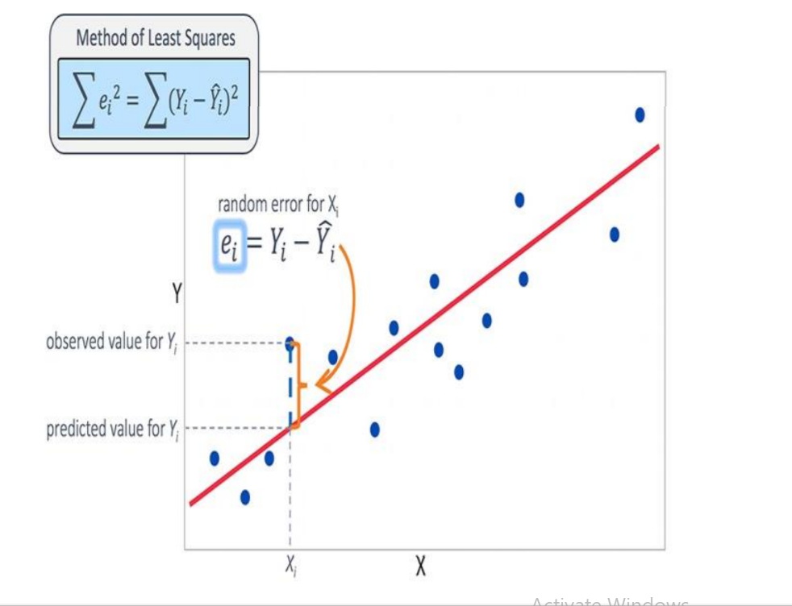
Linear Regression
Linear Regression attempt to model the relationship between two variables by fitting a linear equation to observed data.
Linear regression is useful for finding relationship between multiple continuous variables. There are multiple independent variables and single independent variable.
y=m1X1+m2X2+……+b

Slide 8
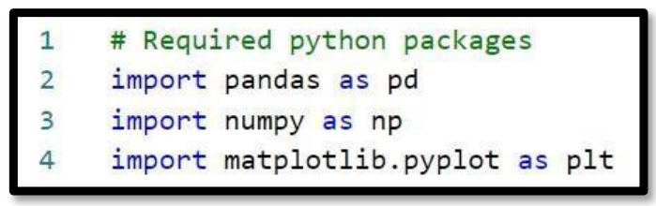
IMPLEMENTATION
Required libraries
NumPy: for numerical analysis
Pandas: for handling data files
Matplotlib: for Visualisation of data in the form of graphs

Slide 9
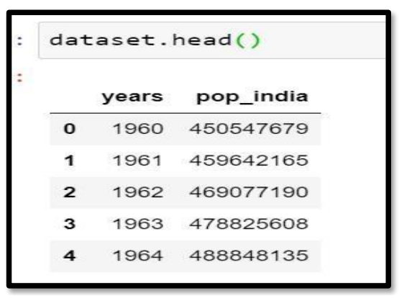
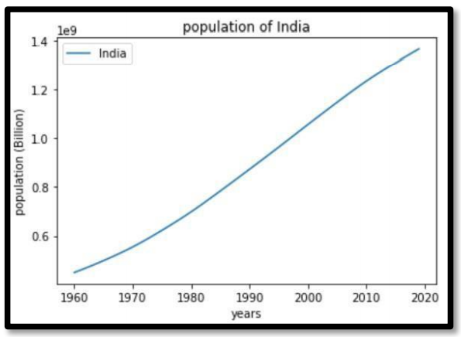
Sample Dataset
Representation of data and in the form of graph from 1960 – 2020.

Slide 10
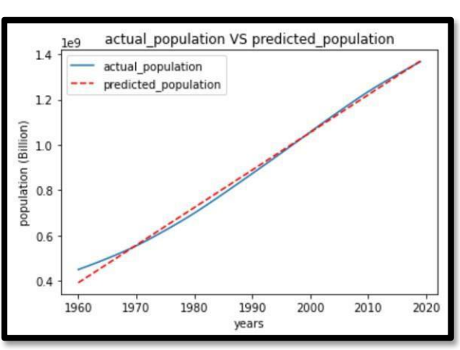
RESULT
Graph represents the actual and model
predicted values by using linear regression.

Slide 11
REFERENCES
https://worldpopulationreview.com/countries
https://population.un.org/wpp/
https://numpy.org/doc/stable/
https://scikit-learn.org/stable/
https://www.geeksforgeeks.org/machine-learning/
https://github.com/acmahesh10/population-dataset
https://towardsdatascience.com/linear-regression-detailed-viewea73175f6e86
https://matplotlib.org/stable/contents.html

Slide 12
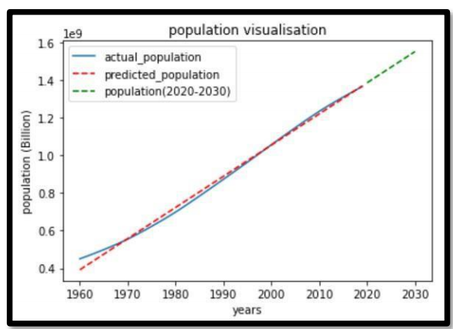
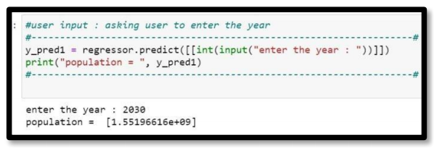
This graph represents the actual and model
predicted values and also give the future
predicted values for next ten years

Slide 13
CONCLUSION
As we observed in the above result our machine learning model is performing well with more accuracy when comparative actual data.
By using linear regression, we can predict the future population with good accuracy. With the help of analysis, it helps to take better decision to overcome the population problem in future.

Slide 14
THANK YOU

