Slide 1

GitHub
Bugsmashers

Slide 2

Git
Version Control System
Helps work collaboratively with others
Helps organize and keep track of changes

Slide 3
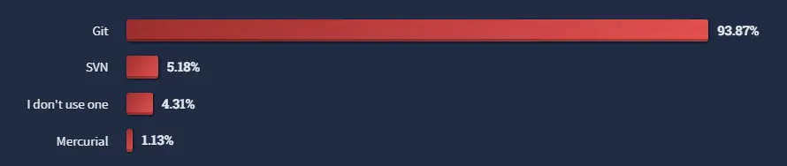
What is a version control system?
It lets you keep a complete history of your files
Allows you to rollback your files to previous saved versions
Allows for teams to work in sync with the same code
Allows for branching
What are the primary version control systems that Stack Overflow users use? (2022)

Slide 4
Important Git Commands
Add | Adds files to be staged for a commit
Commit | Records staged files into the local repository
Push | Pushes your previously committed changes into a remote repository (GitHub)
Fetch | Updates your local repository with code on the remote repository
Pull | Changes the local files to match those on the remote repository
Clone | Clones a repository into a new directory

Slide 5



Git in Command Line
Add
Commit
Push
Add files to staging area (ready to be committed)
Saves a “screenshot” of files in the staging area
Pushes all commits to the remote repository (to the website)

Slide 6
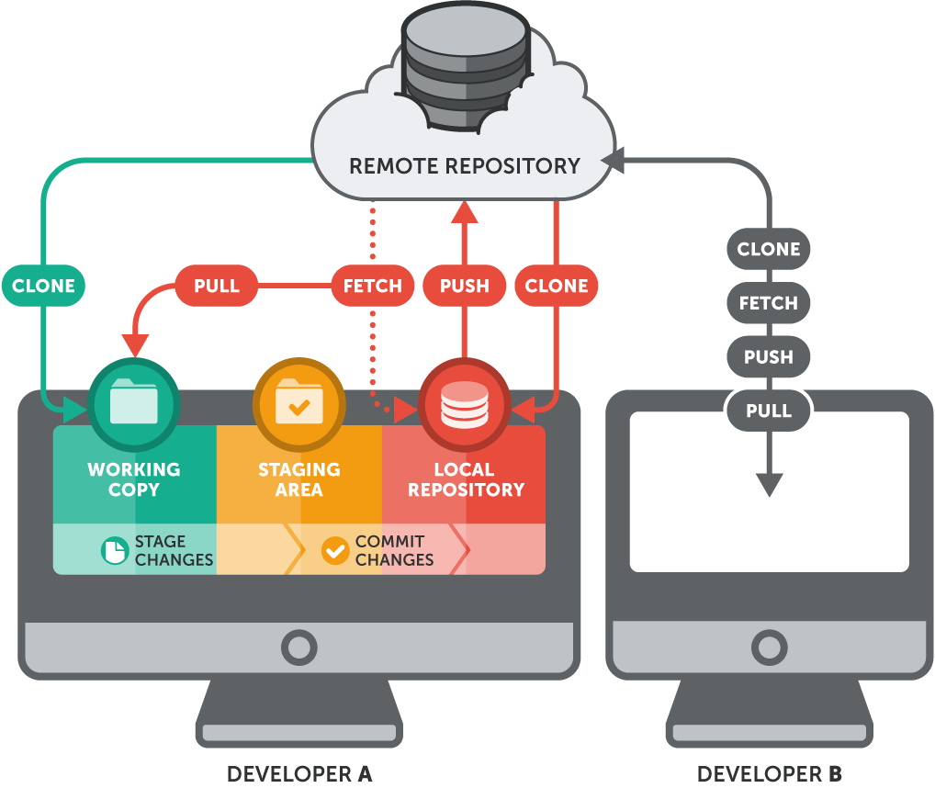
Git’s File System

Slide 7
Demo/Live

Slide 8
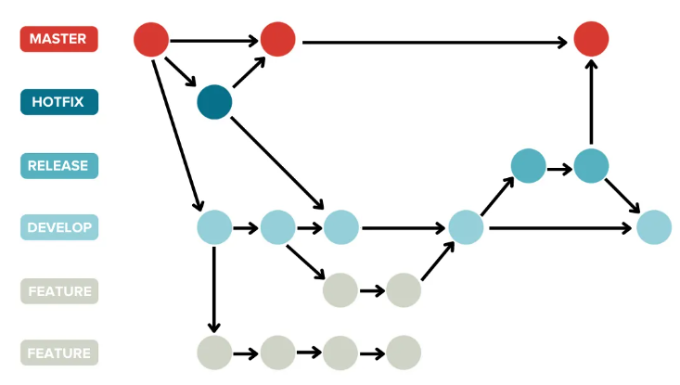
Branching

Slide 9
Branching Commands
Branch | Creates a new branch off of the main or current branch
Merge | Merges the commits from another branch with the commits on the current branch
Switch | Changes current branch to another branch
Stash | Saves commit changes into a log on the current branch (usually when switching branches)

Slide 10

GitHub
What is it?
Platform that can host git repositories
Features many different helpful tools for anything that a developer needs
Features Include:
Website hosting
Packaging files together for a release
Area to display product information

Slide 11

Github Desktop
Application with simple interface that lets the user more easily use git commands

Slide 12
.gitignore files
Allows you to keep files from being committed to git
This is especially helpful for storing things like API keys, or “messy” files automatically generated by your code.
Templates for .gitignore files can be found here:
https://github.com/github/gitignore

Slide 13
Demo/Live

Slide 14
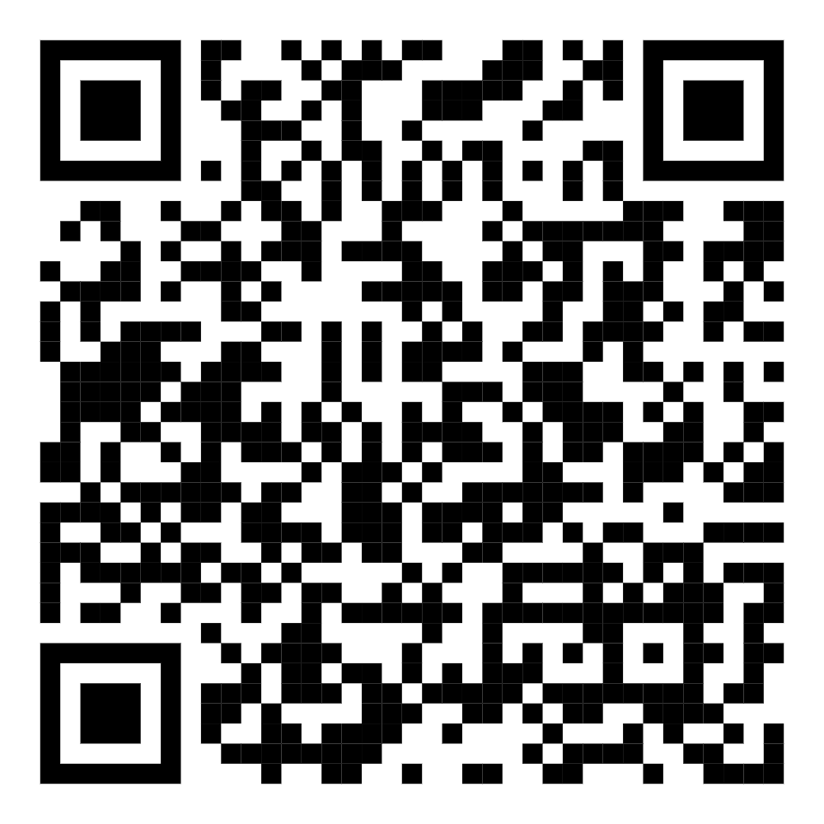
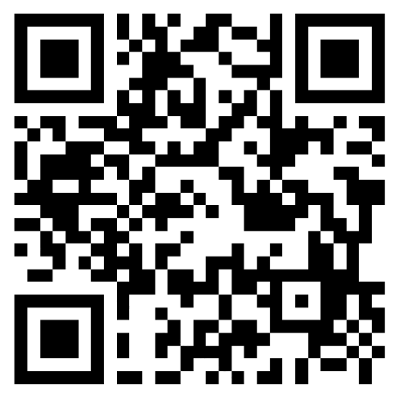
Feedback Form
Thanks!
ACM Discord
Do you have any questions?
@SwordPoro - Andrew’s Discord
@jarsnow - John’s Discord
Ask for help in the ACM Discord!
Resources used:
https://github.com/joshnh/Git-Commands

