Slide 1


Welcome to Hack Night!
Notes:
dk8

Slide 2

Command Line Tools & Git
BugSmashers 3/28 Hack Night!
Notes:
dk8

Slide 3
Campaign objectives
What is the CLI?
Why do Devs use it?
CLI - Command-Line Interface, it allows developers to interact with programs using text, and more importantly, their keyboard.
Developers use the CLI for its efficiency and flexibility - there are SO many tools written for the CLI.
Notes:
d3

Slide 4
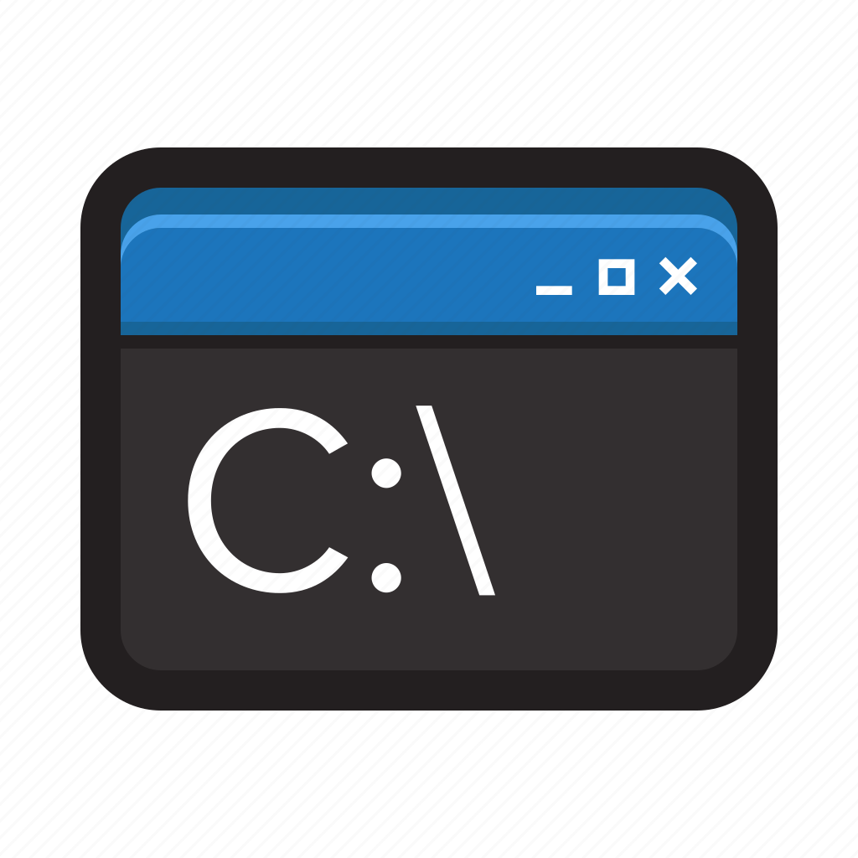
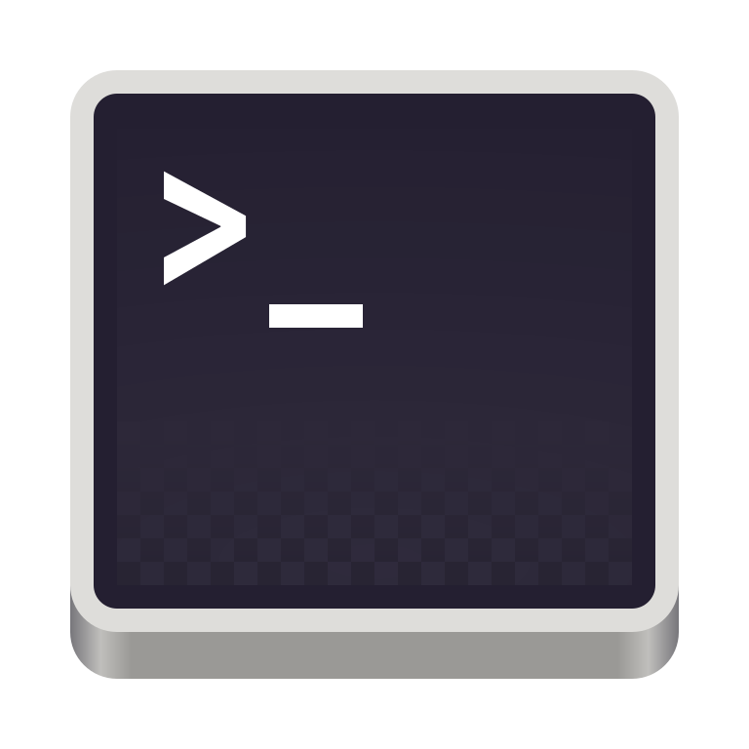
Why CLI?
📁 File navigation
💾 Version control
💻 Running programs
📝 Editing files
🛠 Tools
Notes:
dk8

Slide 5
Terminology
Terminal | Text-based interface for interaction
Shell | Program that interprets and executes terminal commands
Directory | Fancy word for folder
Path | Location of file or directory
Flag | Indicator to program, usually using ‘-flagname’ or ‘--flagname’
Notes:
dk8

Slide 6
Basic Unix Commands
cd <dir> | Change Directory
mkdir <dirname> | Make Directory
mv <src> <dest> | Move source to destination (can be directories or files!)
cp <src> <dest> | Copy source to destination
rm <filename> | Removes filename
touch <filename> | Creates filename
pwd | Print working directory
ls | List files in directory
cat <filename> | Print file contents
rm <filename> | Clear console
code/nano/vim/nvim <path> | Open corresponding editor in the given path
Notes:
d3

Slide 7
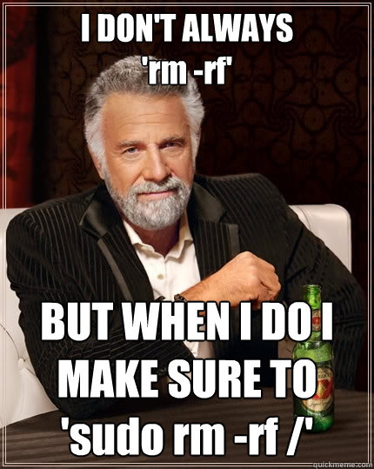
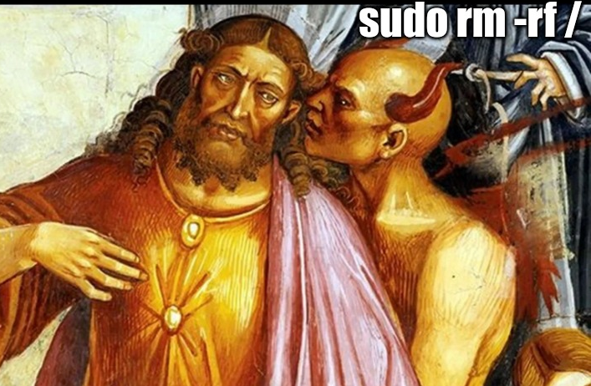
“Pro”tips
cd .. - navigates backwards a directory
./ - this refers to your current directory
-r - this flag makes things recursive, be careful!
man <command> - this provides the manual for a given command
history - this command shows the terminal’s command history
Notes:
dk8

Slide 8
How do we use terminal?
Notes:
bofa

Slide 9
A Problem.
We want to add these slides to our BugSmashers github!
Notes:
d3/dylan

Slide 10
A Version Control Tool: Git
One terminal and version control tool that y’all should all know is git.
This is just one example of how useful knowing the terminal and it’s tools is for devs
git is more than just a terminal tool!
Every popular programming language probably has a github repository
Quick Vocab!
Repository - Git’s project folder. Repositories store files and each file’s revision history.
Commit - A commit, or "revision", is an individual change to a file (or set of files).
Staged Changes - Local changes that have not been added to the repository.
Branch - A branch is a new/separate version of the main repository. Every repository has a default ‘main’ branch.
Notes:
visit rust’s github here

Slide 11
Git Commands - An Intro
Imagine you have a github repository you’d like to edit - let’s use the Rust Repository as an example again.
Clone - Creates a local copy of an existing repository.
Now, imagine you have edited a file and you’d like to add it back to the repository.
Add - Adds a file to a staged commit.
Commit - Creates a “commit” containing your staged changes.
Push - Pushes your commit to the repository, adding your code.
Finally, let’s imagine someone else has edited the Rust Repository, and we want to sync those changes to our copy of the repository.
Pull - Downloads and syncs an existing branch from a repository, usually the main branch.
Notes:
Probably gonna walkthrough adding these slides to our bugsmashers github as a wrap-up example

Slide 12
A Final Comment - Branching
Now, you’ve heard us discuss branches a bit throughout this presentation…
They’re one of the most useful tools in real development!
Branches allow developers to work on code without messing up other people
Hackathon Example
To learn how to use branches in the best example I’ve ever seen, check out this link!:
https://learngitbranching.js.org/
Notes:
Let’s pretend you’re a team at a hackathon working on a web app:
EX:
To split up development, each team member creates, and works on a specific branch
one for Database / backend integration,
one for the app’s main functionality
one for Frontend Integration
As the team works, these branches allow ppl to stay out of each other's way
As development continues, this allows them to stay out of each other’s way,
since their code isn’t very connected, they can each work without depending on each other
When they’ve all finished their features, they do some final tests to ensure compatibility, then merge back together
by working with branches, we’ve avoided all of the headaches that might arrive from out of sync pulls, commits, and pushes to the github
And by working in branches, we can sync individual parts of the code at any point, allowing teams to reduce conflicts and sync whenever they want
this allows us to try ideas in a sandboxed environment, and not worry about breaking the code base every time we push or pull

Slide 13


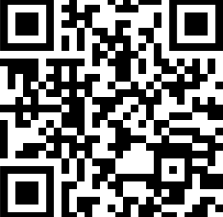
Thank you!
Any feedback or ideas for new topics? Please fill out the form below!

