Slide 1
Quick and Dirty
Machine Learning
K-Means Algorithm
Konstantin Itskov

Slide 2
The Plan!
Setup the development environment.
Theory behind K-means
K-means implementation

Slide 3
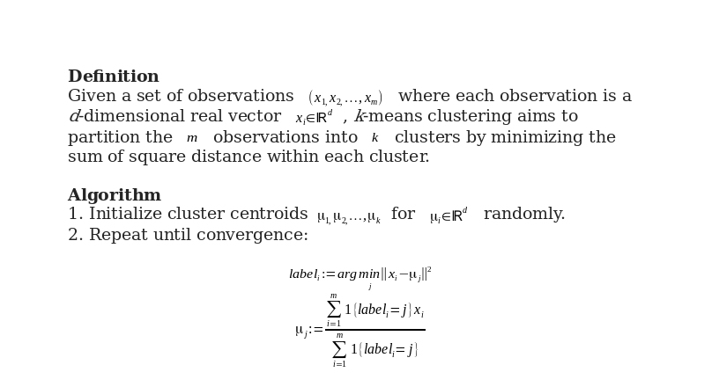
Theory

Slide 4
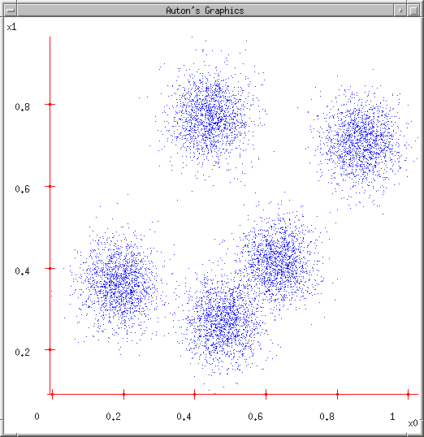
K-means Demo
User set up the number of clusters they’d like. (e.g. k=5)
https://courses.cs.washington.edu/courses/csep546/07sp/

Slide 5
K-means Demo
User set up the number of clusters they’d like. (e.g. K=5)
Randomly guess K cluster Center locations
https://courses.cs.washington.edu/courses/csep546/07sp/

Slide 6
K-means Demo
User set up the number of clusters they’d like. (e.g. K=5)
Randomly guess K cluster Center locations
Each data point finds out which Center it’s closest to. (Thus each Center “owns” a set of data points)
https://courses.cs.washington.edu/courses/csep546/07sp/

Slide 7
K-means Demo
User set up the number of clusters they’d like. (e.g. K=5)
Randomly guess K cluster centre locations
Each data point finds out which centre it’s closest to. (Thus each Center “owns” a set of data points)
Each centre finds the centroid of the points it owns
https://courses.cs.washington.edu/courses/csep546/07sp/

Slide 8
K-means Demo
User set up the number of clusters they’d like. (e.g. K=5)
Randomly guess K cluster centre locations
Each data point finds out which centre it’s closest to. (Thus each centre “owns” a set of data points)
Each centre finds the centroid of the points it owns
…and jumps there
https://courses.cs.washington.edu/courses/csep546/07sp/

Slide 9
K-means Demo
User set up the number of clusters they’d like. (e.g. K=5)
Randomly guess K cluster centre locations
Each data point finds out which centre it’s closest to. (Thus each centre “owns” a set of data points)
Each centre finds the centroid of the points it owns
…and jumps there
…Repeat until terminated!
https://courses.cs.washington.edu/courses/csep546/07sp/

