Slide 1




Slide 2

What is HTML ?
HTML is a language for describing web pages.
HTML stands for Hyper Text Markup Language
HTML is not a programming language, it is a markup language
A markup language is a set of markup tags
HTML uses markup tags to describe web pages

Slide 3

Where do we write a code in html?
Text Editor
1.Wordpad(In Windows OS)
2.Gedit Text Editor(Ubuntu in LINUX)
FrontPage or Dreamweaver.

Slide 4
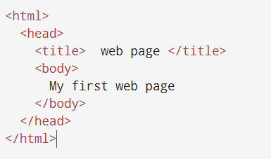

Simple Code – 1
Output

Slide 5
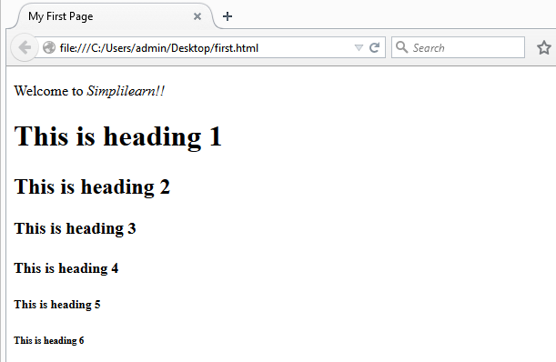
HTML TAG:

Slide 6

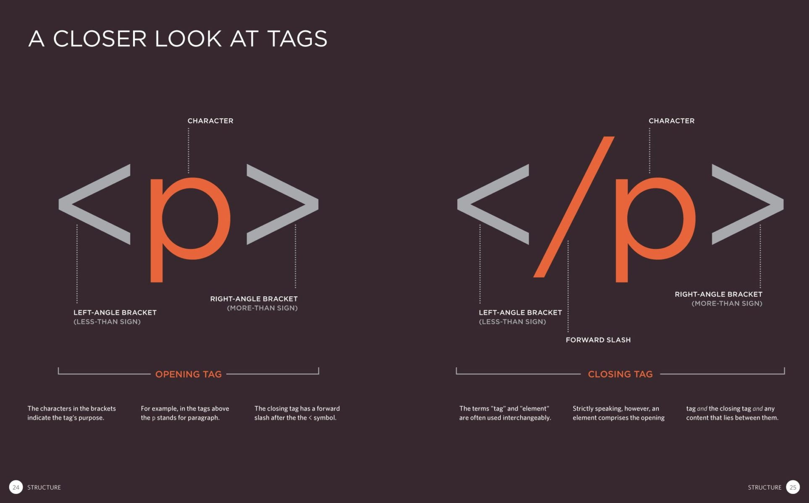
<p> TAG :
The <p> tag defines a paragraph. Browsers automatically add a single blank line before and after each <p> element. Tip: Use CSS to style paragraphs.

Slide 7
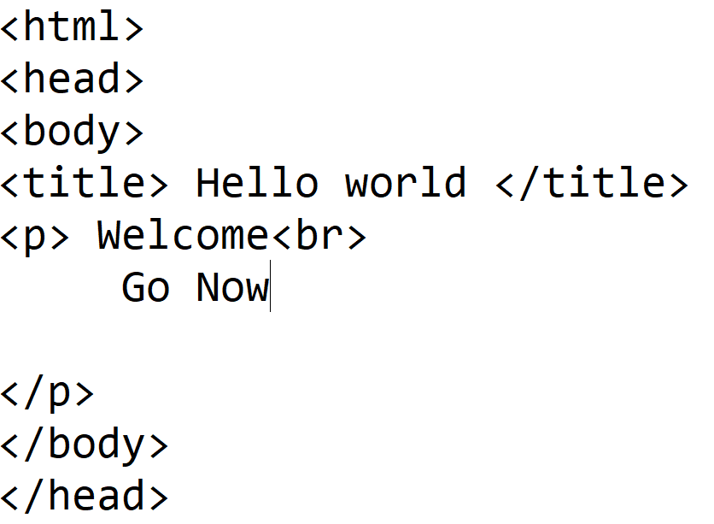

<br> tag :
Definition and Usage. The <br> tag inserts a single line break. The <br> tag is useful for writing addresses or poems. The <br> tag is an empty tag which means that it has no end tag.

Slide 8
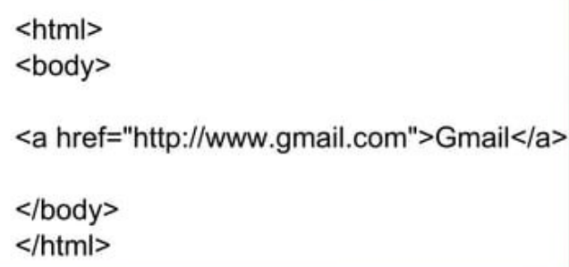

Link Tags
Html links:
Html links are defined with the <a> tag
Syntax: < href=“https”//www.gmail.com”>Gmail</a>
Example:
O/P:

Slide 9
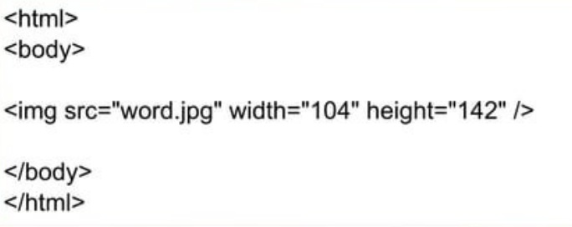

Image Tags
HTML images: Html images are defined with the <img> tag.
Syntax: <img src “123.jpg”width =“104”height = “”142”/>
Example:
Output:

Slide 10
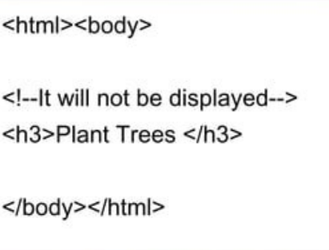

HTML Comments : Comments can be inserted in the HTML code to make more readable and understandable .Comments are ignored by the browser and are not displayed.
Syntax: <! – sometext ->
Example:
Output:

Slide 11
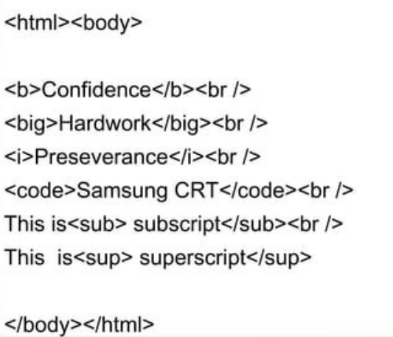
HTML Text Formatting : Some formatting tags are 1.b-Bold ,2.i-Italic ,3.code-Computer,4.sub-Subscript &5.sup-Superscript

Slide 12
HTML Style Attributes
Tags Description
<center> Defines centered content
<font> Defines HTML fonts
<s> and <strike> Defines strikeout text
<u> Defines underlined text
Tags Description
Align Defines alignment of the text
Bgcolor Defines background color
Color Defines the color of text

Slide 13
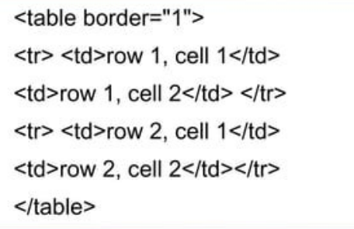
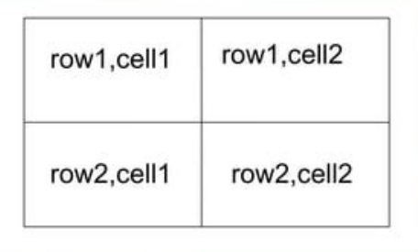
HTML Tables
Table are defined with the <table>tag.
A table is divided into rows (with <tr> tag).
Each row is divided into data cells (with <td> tag).
Heading in a table are defined with the <th> tag.

Slide 14
Html List:
Ordered List:
An ordered list is also a list of items.The items are marked with number.
An ordered list starts with the <ol> tag.Each list item starts with the <li> tag.
Unordered list:
An unordered list is a list of items.The list items are marked with bullets (typically small black circles).
An unordered list starts with the <ul> tag.

Slide 15


