Slide 1

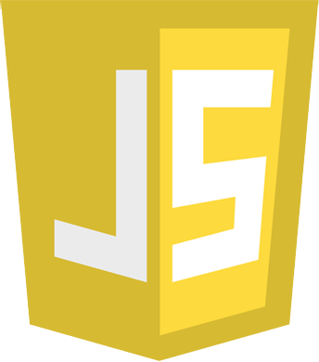
JavaScript Basics

Slide 2
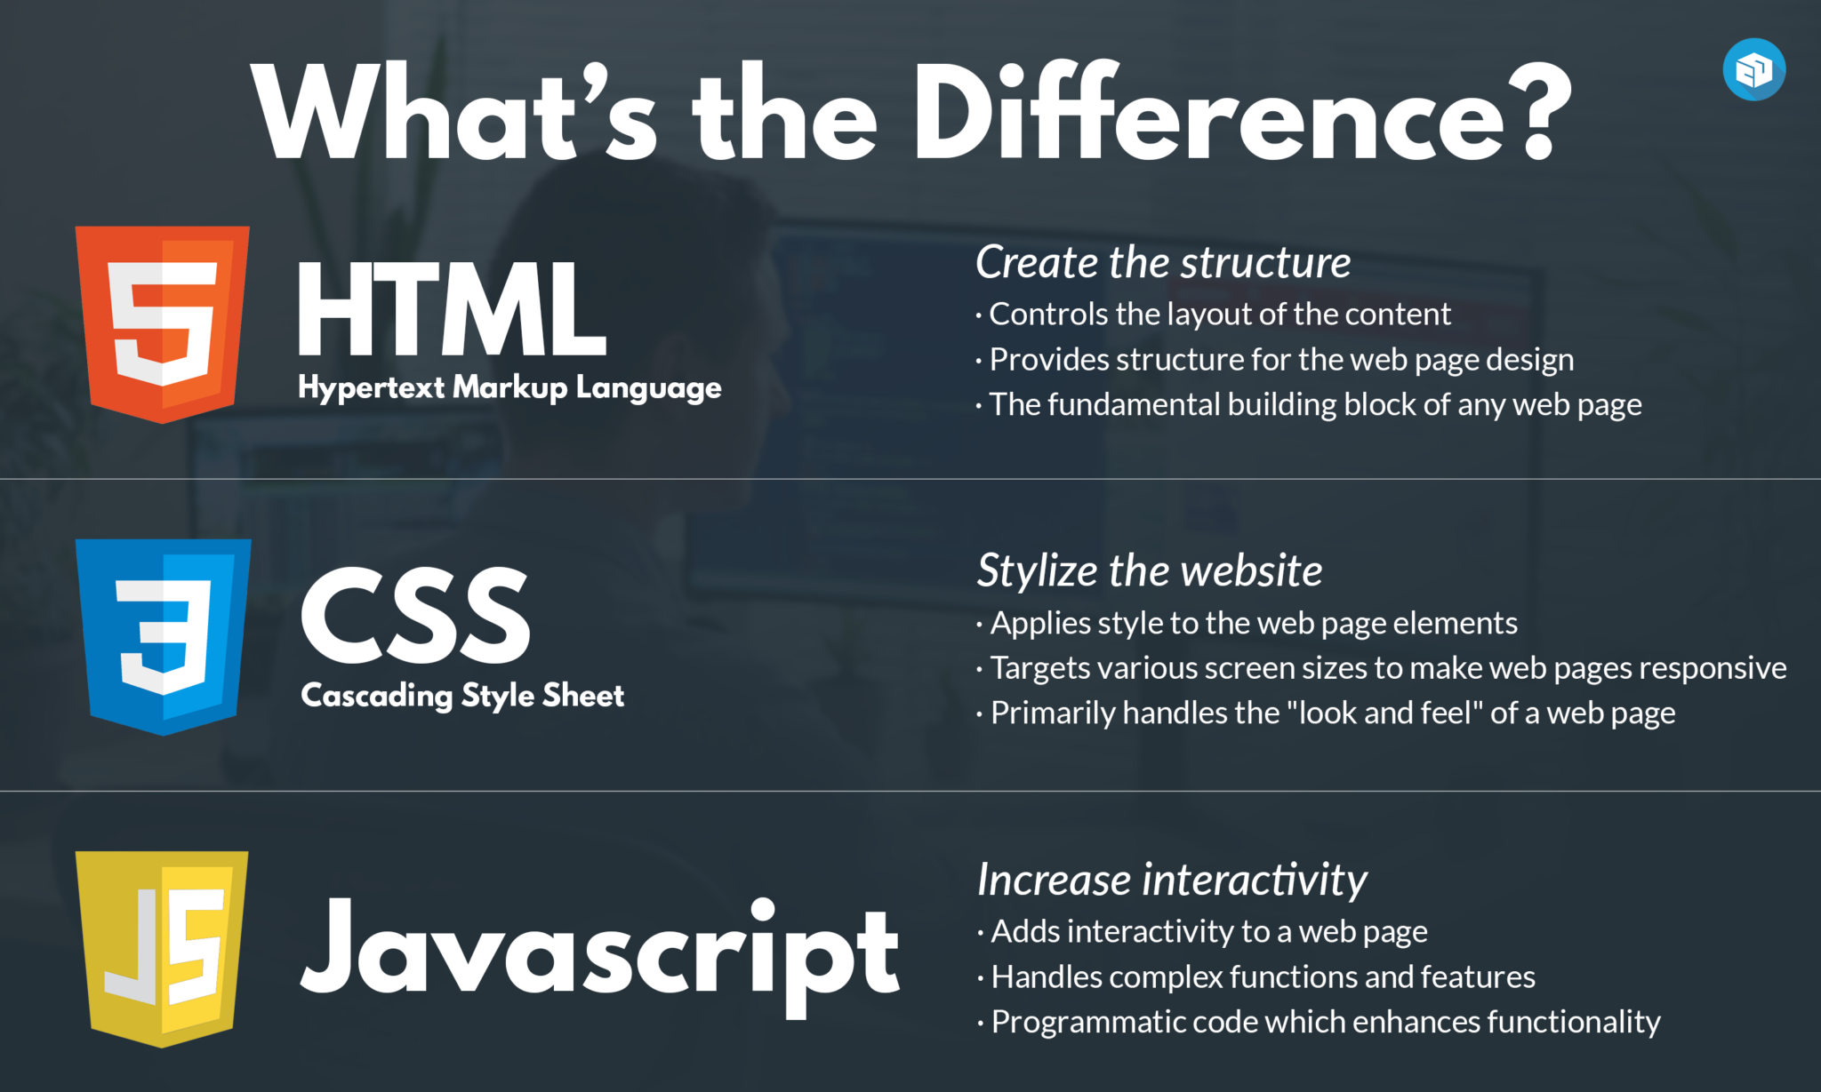
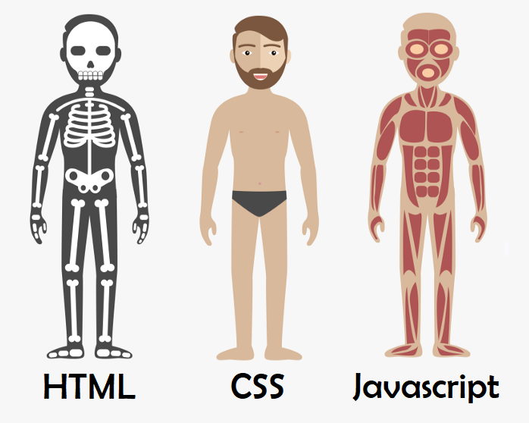

02

Slide 3
JavaScript: The Brain of A Website!!🧠🧠
0303
JavaScript is the programming language of the Web.
JavaScript (JS) is a lightweight, interpreted, or just-in-time compiled programming language with first-class functions.
It can be used for both Client-side as well as Server- side developments.
JavaScript version we use is ES6, launched in 2015.
Notes:
JavaScript does not require to be converted into machine language due its interpreted nature and can be compiled in browser directly.

Slide 4
04
Client Side
Server Side
It is the program that runs on the client machine (browser) and deals with the user interface/display and any other processing that can happen on client machine.
Interact with temporary storage.
Make interactive web pages.
Interact with local storage.
Interact with local storage.
The Programming languages for client-side programming are : JavaScript, HTML, CSS, XML, etc...
It is the program that runs on server dealing with the generation of content of web page.
Querying the database.
Operations over database.
Interact with other servers.
Structure web applications.
The programming languages for server-side programming are:
JavaScript, Java, PHP, Python, etc…

Slide 5
Why JavaScript?
0505
No need for compilers.
Used on both Client and Server side.
Used everywhere.
Huge Community Support (Over 1.4M Libraries).
Also, major tech companies like Microsoft, Uber , Google, Netflix, and Meta use JavaScript in their projects.

Slide 6
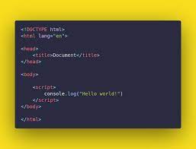
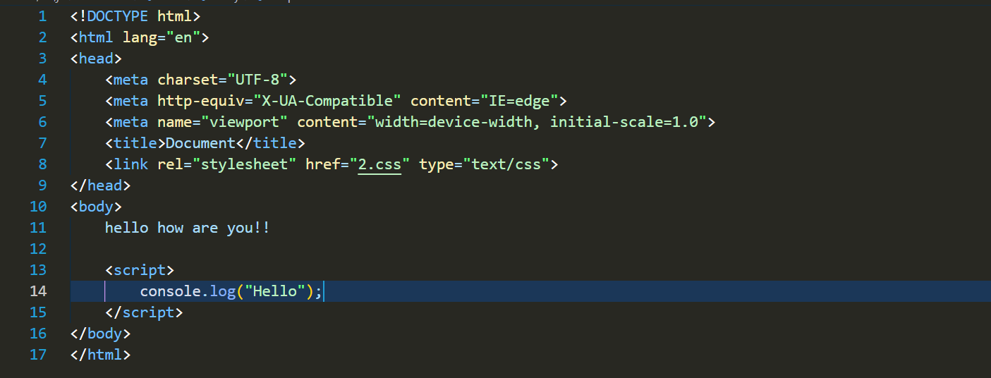
Internal And External JavaScript.
0606
JavaScript can be added to our HTML file in two ways:
Internal JavaScript:
We can add JS code directly to our HTML file by writing the code inside the <script> & </script>. The <script> tag can either be placed inside the <head> or the <body> tag according to the requirement.
Example:

Slide 7
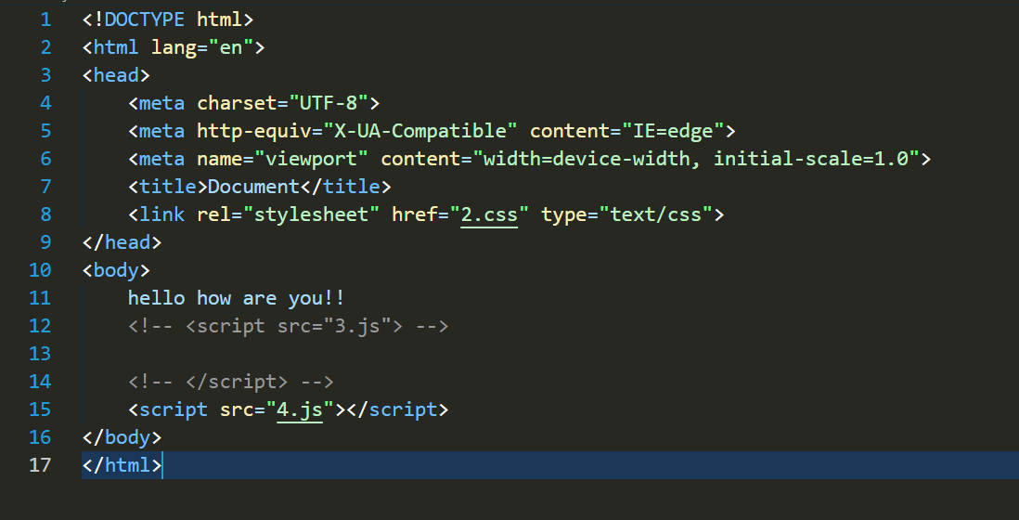
07
External JavaScript
We can create the file with a .js extension and paste the JS code inside of it. After creating the file, add this file in <script src=”file_name.js”> tag, and this <script> can import inside <head> or <body> tag of the HTML file.
Example:

Slide 8
JavaScript Outputs!!
08
Console.log() method: For debugging purposes we can call console.log() method in browser to display data.
Example:
1.Console.log(“Hello World!!”);
2.let a=4;
Console.log(a);

Slide 9
JavaScript Message Boxes:
109
alert(message): Display a popup box with the specified message with the OK button.
confirm(message): Display a popup box with the specified message with OK and Cancel buttons.
prompt(message, default value): Display a popup box to take the user's input with the OK and Cancel buttons.

Slide 10
LET US VISUALIZE!!
10

Slide 11
JavaScript Variables:
11
3 ways to declare a JavaScript Variable:
Using var :The var statement declares a function-scoped or globally-scoped variable.
Using let: The let keyword is generally used in block scope or where the value can be changed.
Using const: Declare a variable with const when we know that value of variable will not be changed.

Slide 12
Identifiers:
12
All JavaScript variables must be identified with unique names. These unique names are called identifiers.
Rules:
Name can contain letter, digits, underscore(_) or dollar sign($).
Name can begin with letters, underscore, and dollar signs.
Keywords cannot be used as the identifiers.
Names are case-sensitive(ditu and Ditu are different identifiers).

Slide 13
JavaScript Operators:
13
JavaScript operators are symbols that are used to perform operations on operands.
There are following types of operators in JavaScript.
Arithmetic Operators
Comparison (Relational) Operators
Bitwise Operators
Logical Operators
Assignment Operators

Slide 14
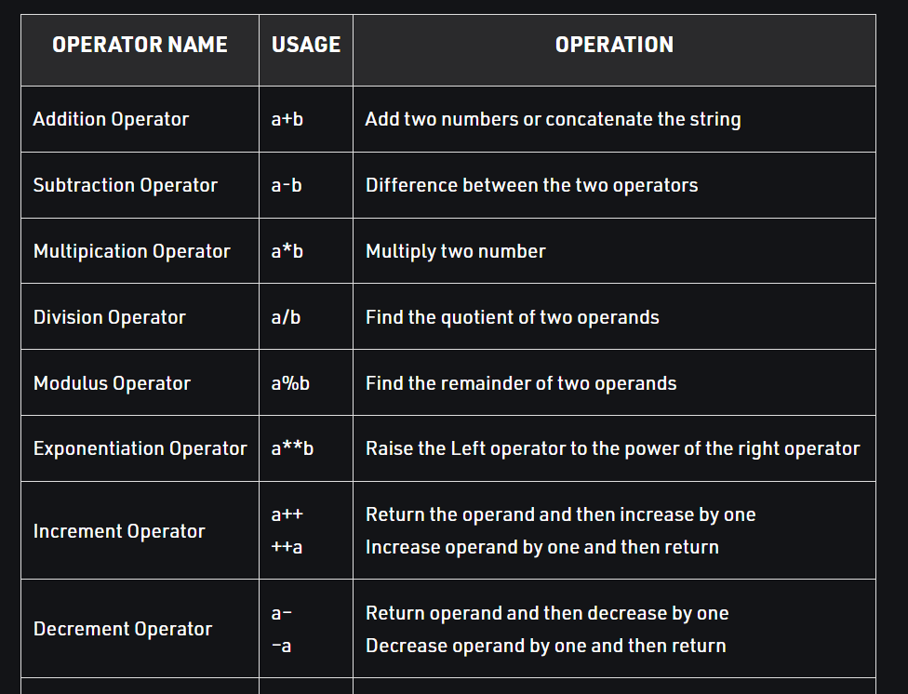
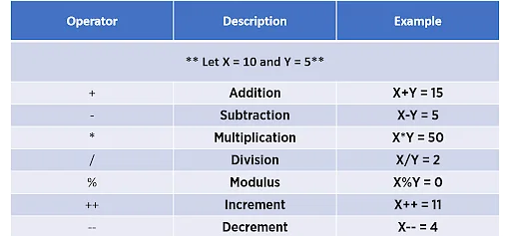
JavaScript Arithmetic Operators
14

Slide 15
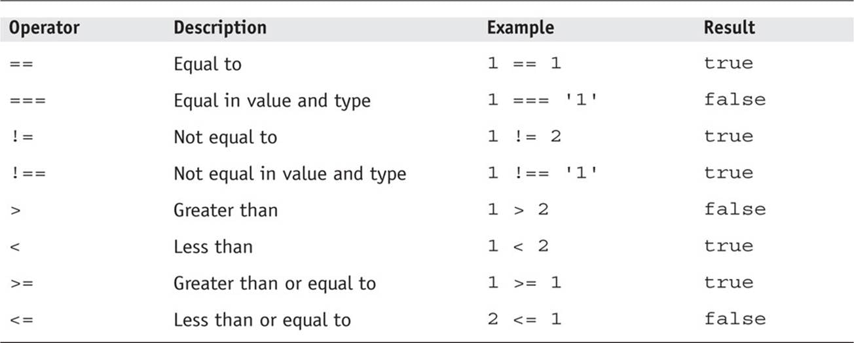
JavaScript Comparison Operators
15

Slide 16
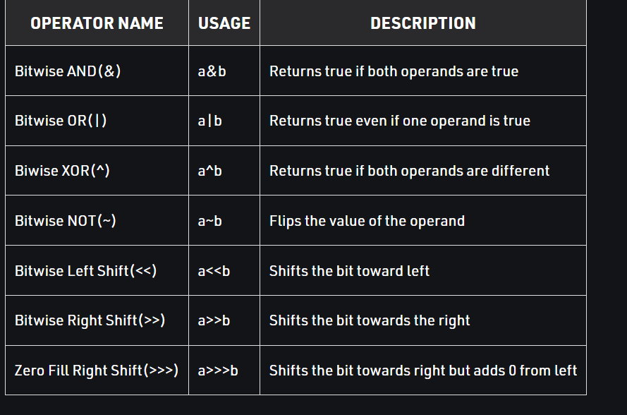
JavaScript Bitwise Operators
16

Slide 17
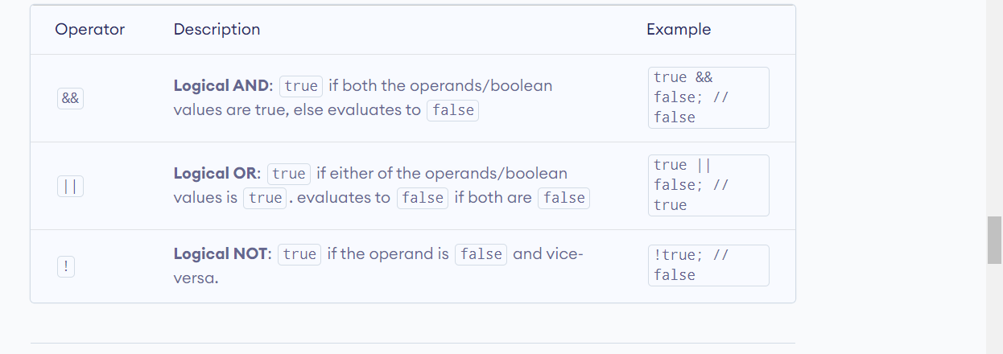
JavaScript Logical Operators
17

Slide 18
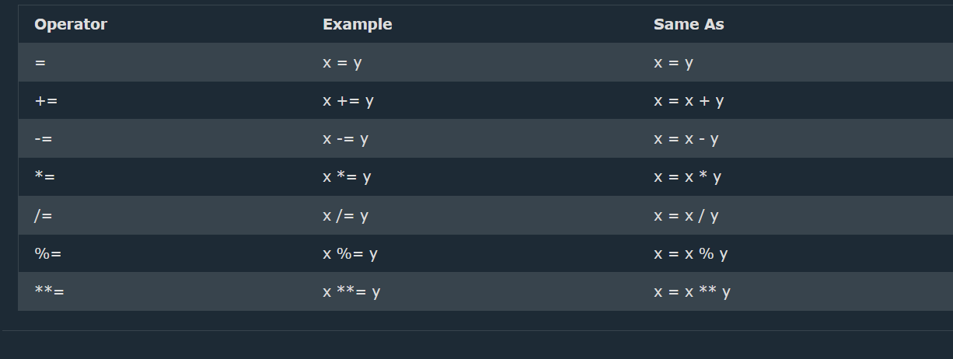
JavaScript Assignment Operators
18

Slide 19
JavaScript Data Types
19
JavaScript primitive datatype:
String
Number
Boolean
Undefined
Null
JavaScript non-primitive datatype:
Objects
Arrays
Date

Slide 20
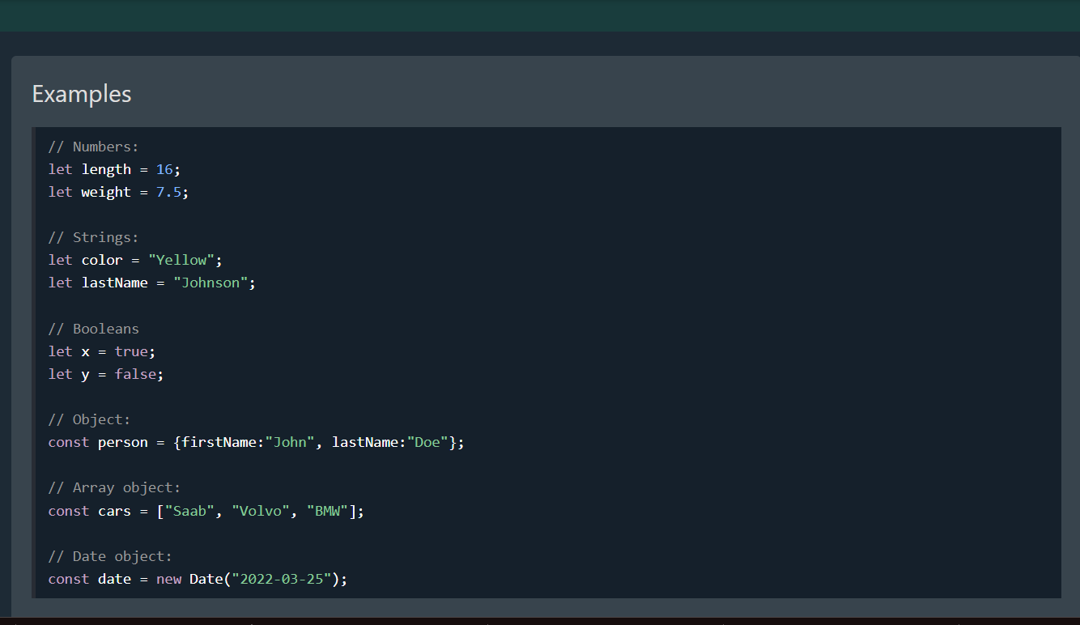
20

Slide 21
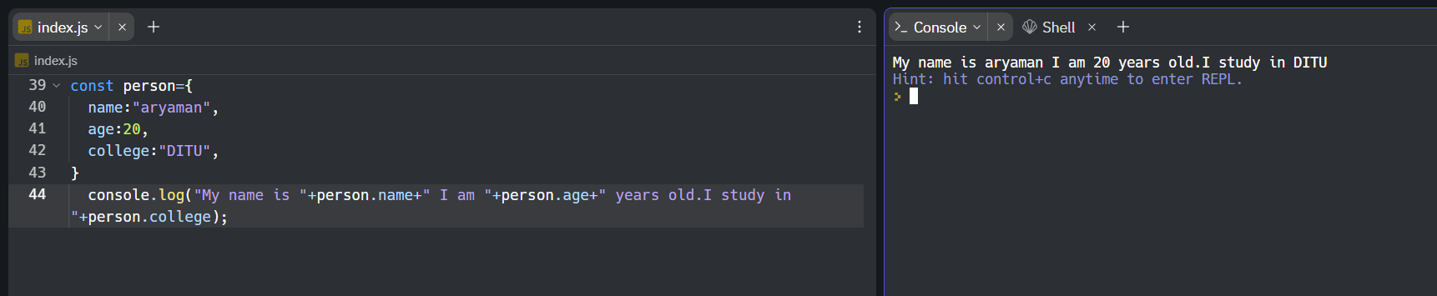
JavaScript Objects:
21
JavaScript variables can also contain many values.
Objects are variables too. But objects can contain many values.
Object values are written as name : value pairs (name and value separated by a colon).

Slide 22
JavaScript Functions:
22
A JavaScript function is a block of code designed to perform a particular task.
A JavaScript function is executed when "something" invokes it (calls it).
Syntax:
function function_name(parameter1,parameter2…){
//code to be executed
}
Function return:
When JavaScript reaches a return statement, the function will stop executing.
If the function was invoked from a statement, JavaScript will "return" to execute the code after the invoking statement.
Functions often compute a return value. The return value is "returned" back to the "caller“.

Slide 23
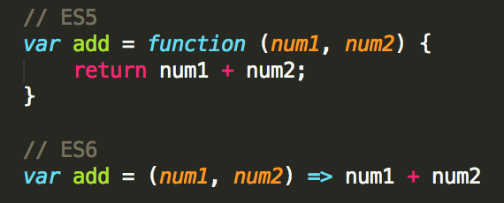
Arrow Function:
23
Arrow function allow us to write shorter function syntax.

Slide 24
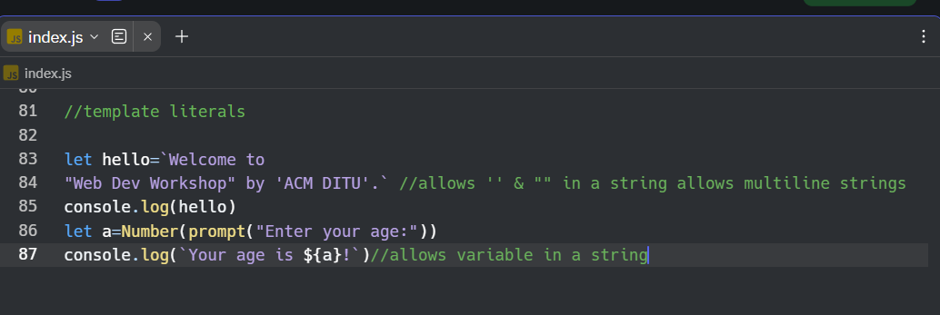
Template Literals:
24
Template Literals use back-ticks (``) rather than the quotes (“ ") to define a string.
With template literals, you can use both single and double quotes inside a string.
Template Literals allow multiline strings.
Template literals allow variables in strings.

Slide 25
LET’S LEARN BY PRACTICE!!
25

Slide 26
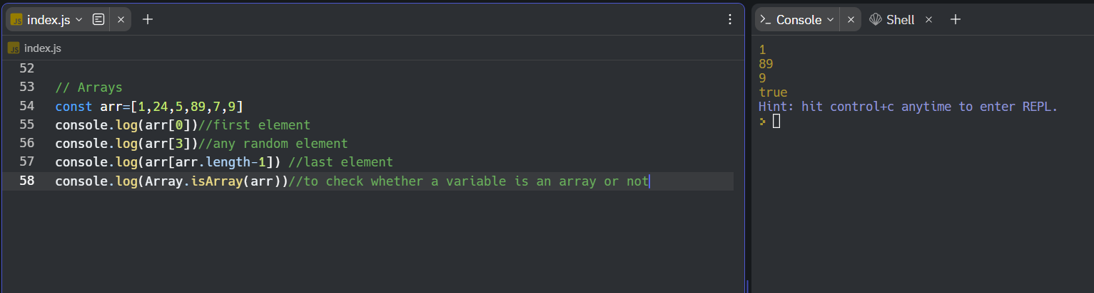
JavaScript Arrays:
26
An array is a non-primitive datatype that can hold more than one value.
Arrays are the special types of objects.
const array_name = [item1, item2, ...];

Slide 27
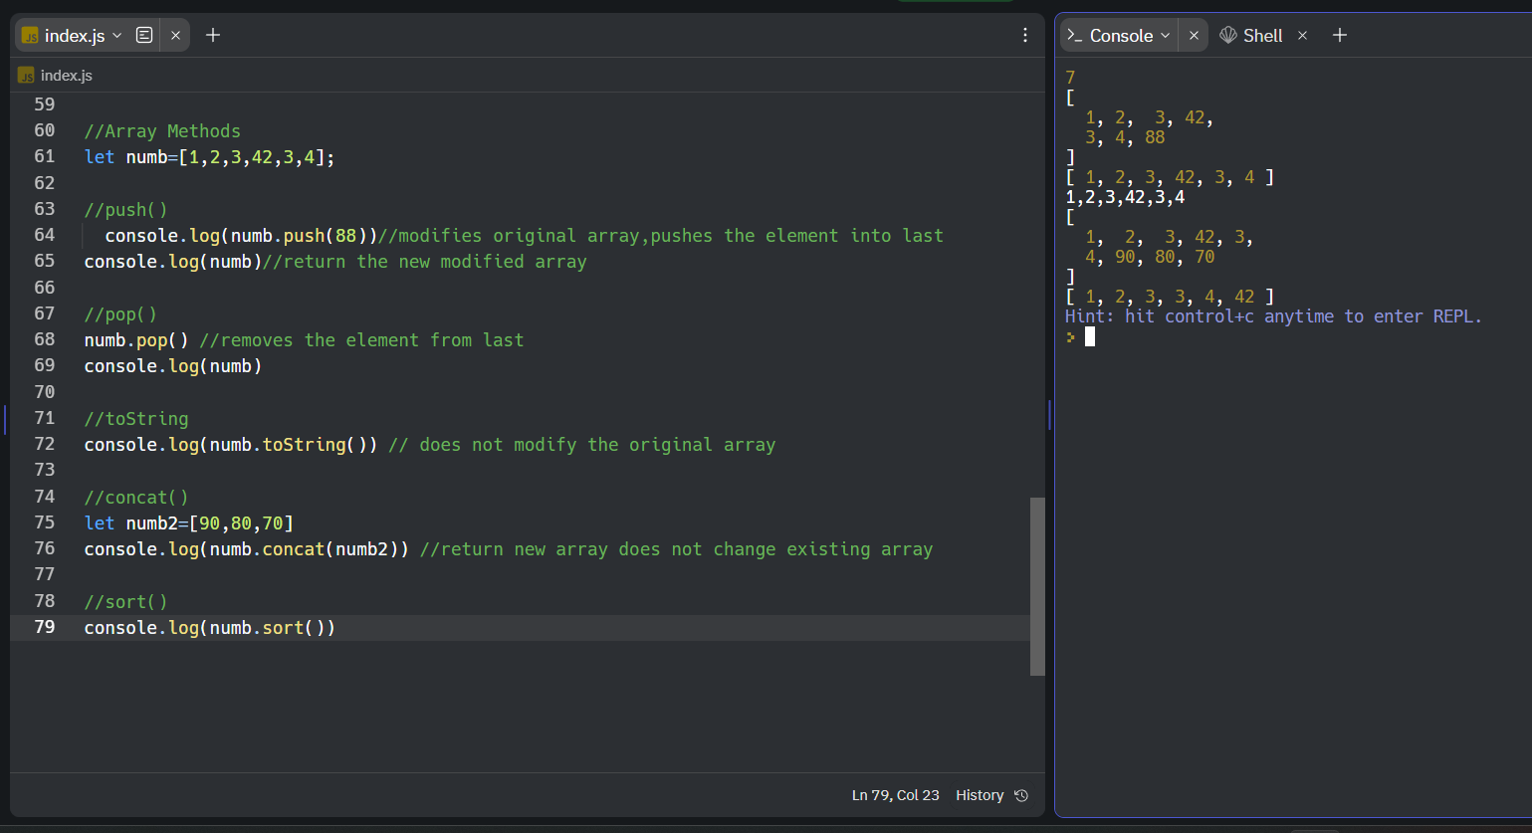
Array Methods:
27

Slide 28
JavaScript Loops🔁
28
There are 5 types of loop in JavaScript:
for loop: loops through a block of code a number of times
Syntax:
for (initialization; condition; increment)
{
// code to be executed
}
while loop: loops through a block of code while a specified condition is true
while (condition)
{
//code to be executed
}

Slide 29
29
do-while loop: same as while loop
do {
//code to be executed
}while (condition);
for/in loop: loops through the properties of an object.
for(key in Object){
//code to be executed
}
for/of loop: loops through the values of an iterable object
for (variable of iterable) { // code block to be executed }

Slide 30
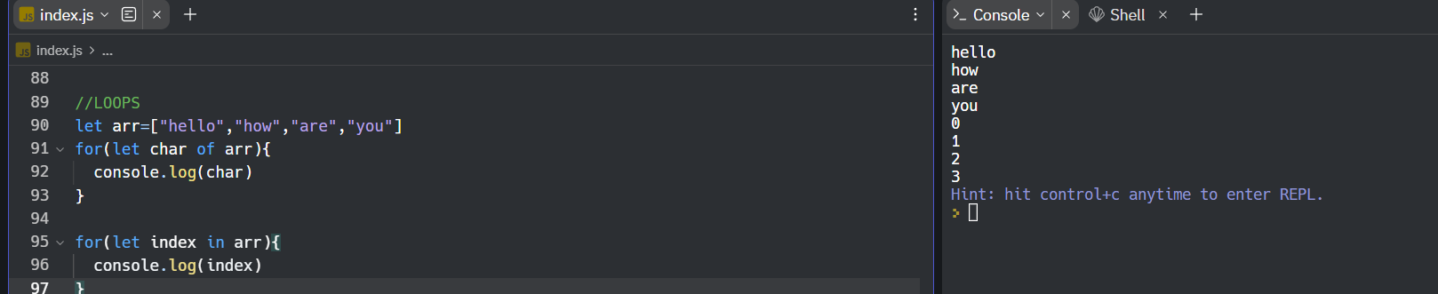
30

Slide 31
LET’S LEARN BY PRACTICE!!
31

Slide 32
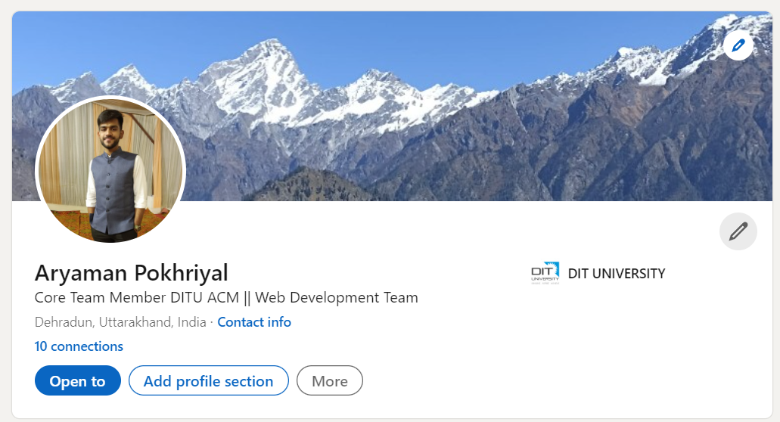

About Me!!
32
@aaryaman_20

