Slide 1
Energy A.I. Hackathon 2023
Team Drillpy
April 11th, 2023
Abraham Montes, Çınar Turhan, Mohammad Abdullah, Ethan Litchauer
Petroleum and Geosystems Engineering, Electrical and Computer Engineering

Slide 2
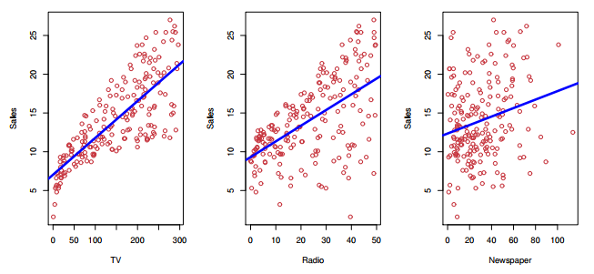
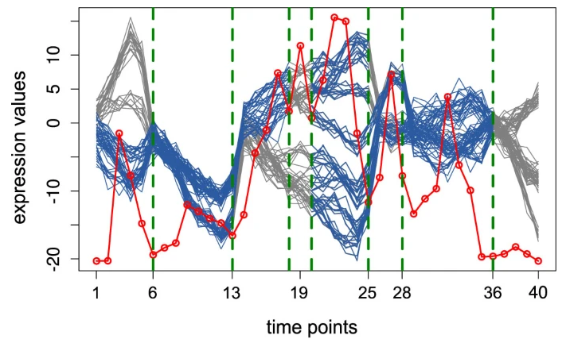
Agenda
Introduction
Why does it matter?
Work breakdown
Data is gold, right?
How we would hack it again
Wrap up
[James et al 2017]
[Omranian et al 2015]

Slide 3
Introduction

Slide 4
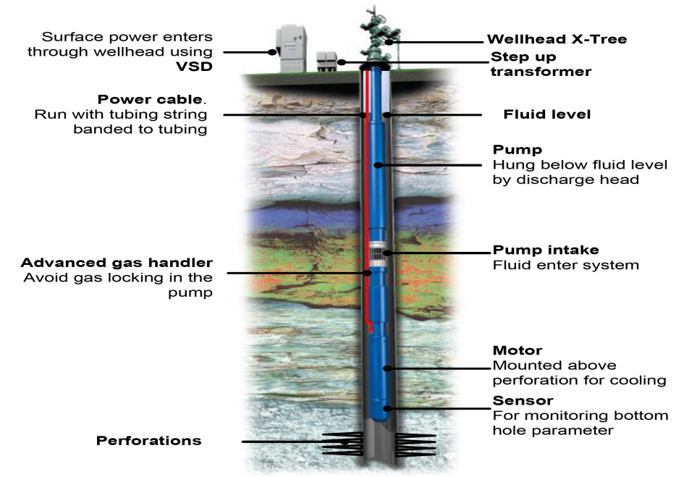
Why does it matter?
Logistics
Preventive maintenance
Aid design enhancement: RCA
Rig job scheduling
[Nuñez et al 2014]

Slide 5
Work breakdown

Slide 6
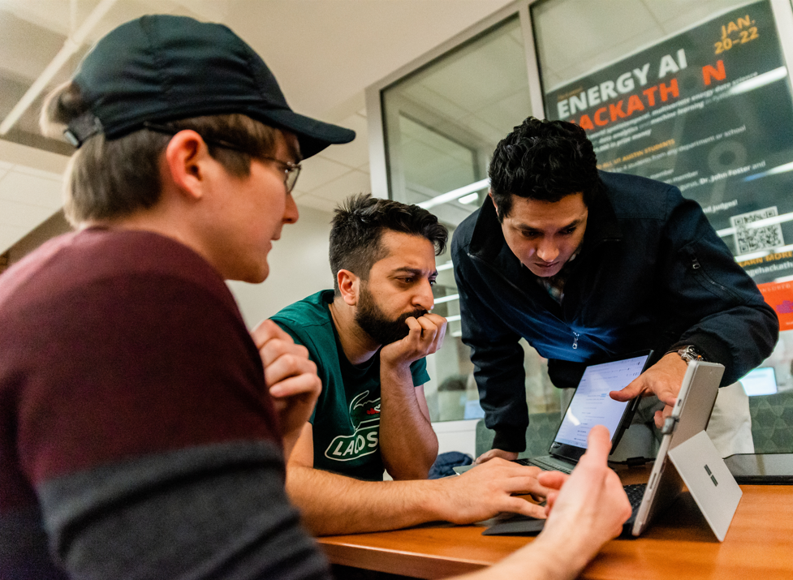
Work breakdown

Slide 7
Data is gold, right?

Slide 8
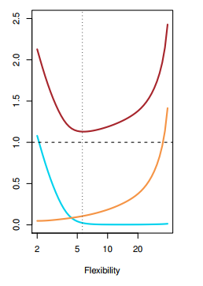
How we would hack it again
Increase the search space
$$E{\left[y_{0}−\hat{f}\left(x_{0}\right)\right]}^{2}=Var\left(\hat{f}\left(x_{0}\right)\right)+{\left[Bias\left(\hat{f}\left(x_{0}\right)\right)\right]}^{2}+Var\left(ε\right)$$
Model space: There is no free lunch.
Parameters and Hyperparameters: Informed search, instead of brute force.
Is the irreducible really irreducible?
The covariogram (what about the
window size?)
[James et al 2017]

Slide 9
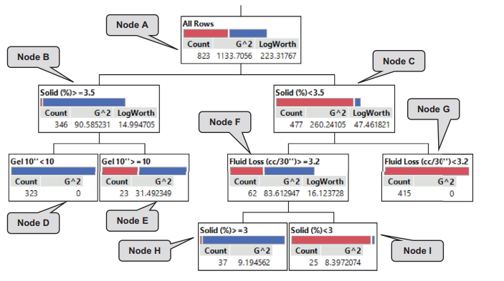
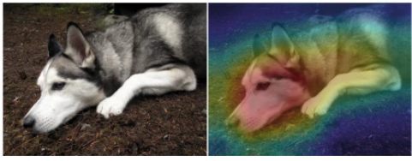
How we would hack it again
High-stakes decisions require interpretability
Explainable ML
Inherently Interpretable ML
[Rudin, et al 2019]
[Al Dushaishi, et al 2019]

Slide 10
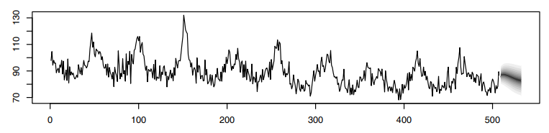

How we would hack it again
High-stakes decisions require to go beyond binary setting
$$z_{t}\sim N\left(α z_{t−1}, σ^{2}\right)$$
$$α\sim N\left(μ_{α},σ_{α}^{2}\right)$$
$$σ^{2}\sim IG\left(μ_{α},σ_{α}^{2}\right)$$
[Shumway & Stoffer 2011]

Slide 11
Wrap up

Slide 12
Feature selection :
36 + 14 to 10 only
WOR
GOR
Frequency
ESP Current E
ESP Voltage
Gas intake
Gas through Annulus
Pump dp
Power difference
ESP Temp.
Filter Data/Feature Selection
Sliding Window/SVM
Iteration Updates/K-Folds

Slide 13
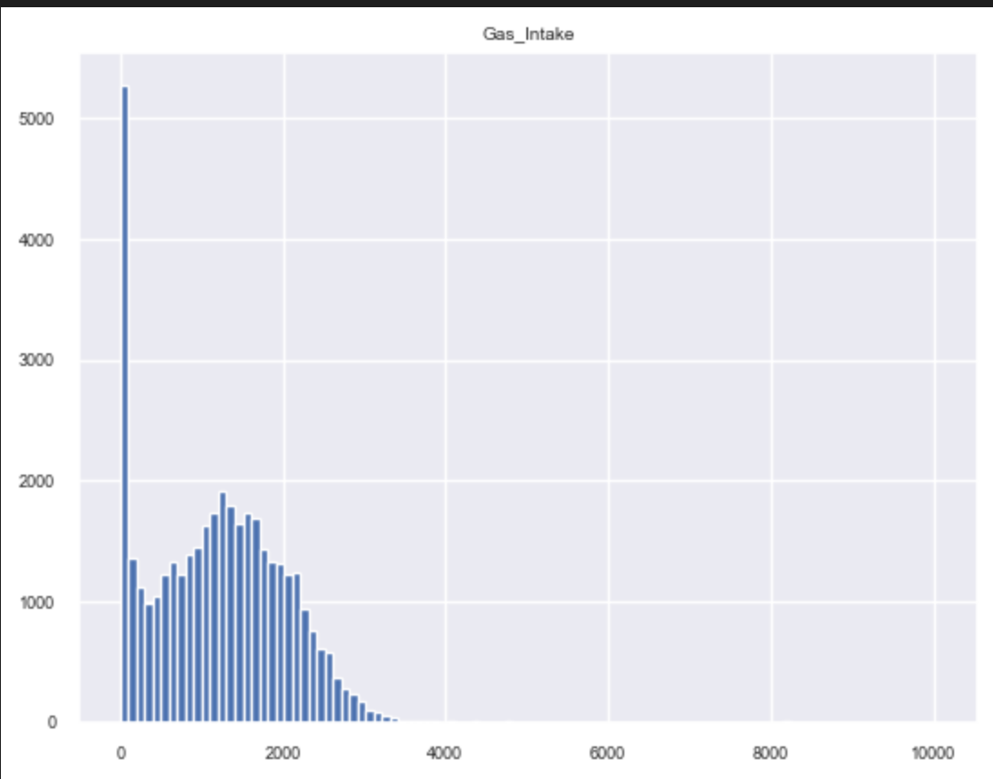
Workflow
How to handle histogram as a PE?
Filter Data/Feature Selection
Sliding Window/SVM
Iteration Updates/K-Folds
Gas Intake

Slide 14
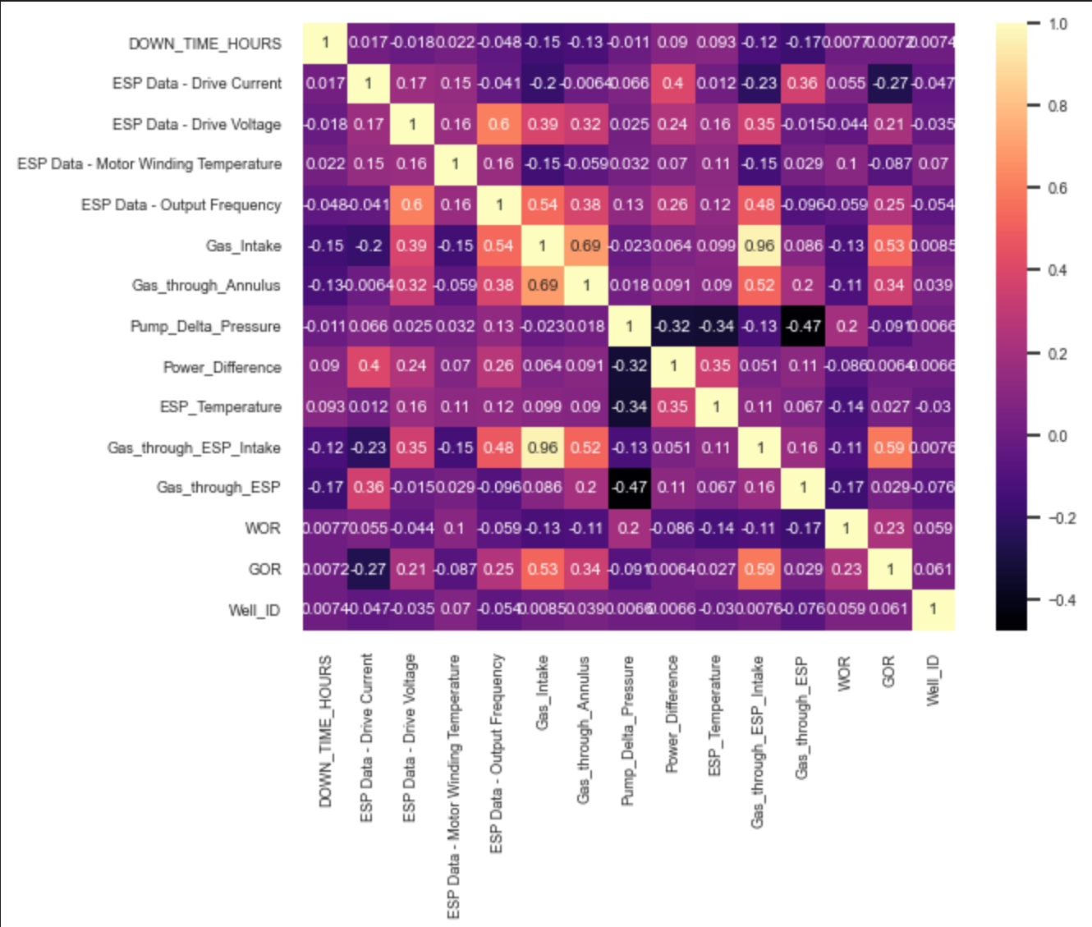
What if your PE knowledge is not sufficient?
Filter Data/Feature Selection
Sliding Window/SVM
Iteration Updates/K-Folds

Slide 15
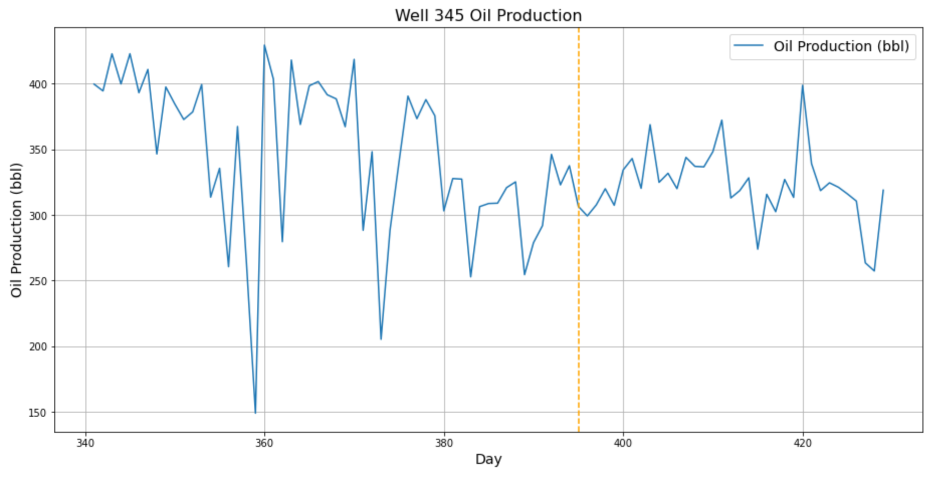
Filter Data/Feature Selection
Sliding Window/SVM
Iteration Updates/K-Folds
30 Days

Slide 16
Workflow
Filter Data/Feature Selection
Sliding Window/SVM
Iteration Updates/K-Folds
How to deal with imbalanced dataset?
What if the testing wells were out of the dat processing?
Undersampling- RF – Kfold - GridSearch

Slide 17
Results and Discussions
We got lower accuracy with under sampling but less variance
RF overperformed SVM
Gridsearch was very efficient tool

Slide 18
Feedback
Very great exercise and challenging.

