Slide 1
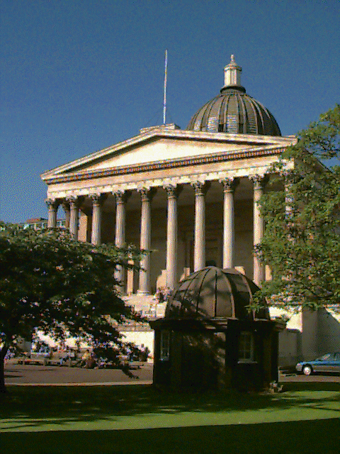
Impact of Research on
Middleware Technology
Wolfgang Emmerich, Mikio Aoyama &
Joe Sventek

Slide 2

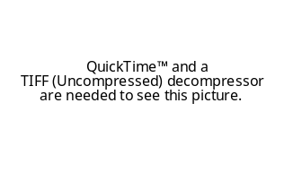

About the Impact Project
http://www.acm.org/sigsoft/impact
History of Science project funded by
Aim: document impact that research has had on practice
Areas of investigation:
  Software configuration management
  Programming languages
  Middleware
  Assertions
  Testing
  Software development environments
  Design methods
  …

Slide 3
Impact Middleware Report
Detailed investigation into the research origins of successful middleware technology
  Web services
  Application Servers
  Transaction Monitors
  Distributed Object Systems
  Message Queues
  Remote Procedure Call Systems
We have documented a dozen impact traces (existence proof)
To be published in
  ACM SIGSOFT Software Engineering Notes in Q4 06
  ACM SIGOPS Operating Systems Review in Q1 07
  ACM Transactions on Software Engineering Methodology in 07

Slide 4
Research Method
Evidence for impact
  Market analysis reports
  Articles in journals & proceedings
  PhD Theses
  Technical Reports
  Software
  Standards documents
  Minutes of standards meetings
  Interviews
  People movement
Impact traces
[A Vendor, 2006]
A Product
[Standards Body, 2004]
Standard
[Author, 2002]
A Paper
[Author, 2000]
Prototype
[Another Author, 1998]
PhD Thesis

Slide 5
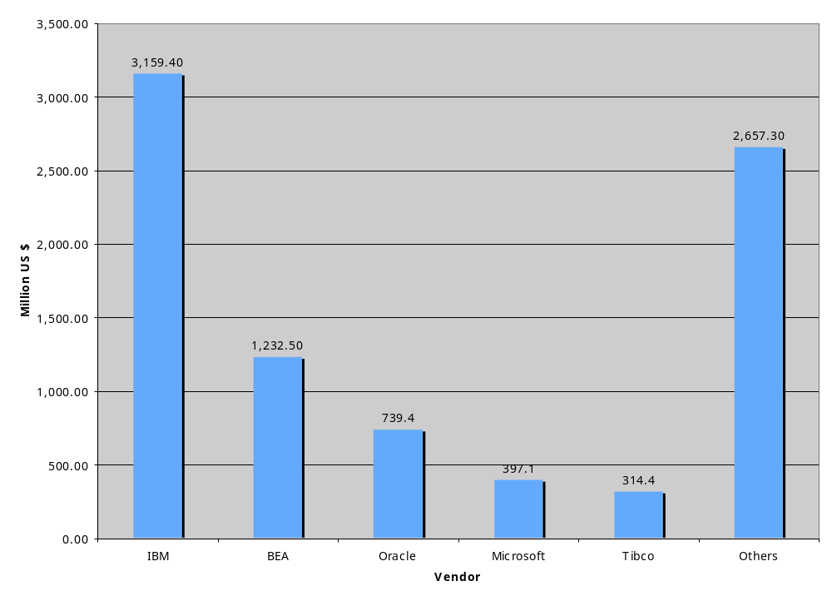
Middleware License Market in 2005 [Gartner 06]

Slide 6
Impact on Middleware: Overview
Application
Servers
RPC
Systems
Web Services
Middleware
TPMs
MOMs
Distributed
Objects
[Sun 2001]
EJB & JTA
[Sun 2003] RMI
[W3C 2-03]
SOAP, WSDL
[Sun 2001] JMS
[BEA 1999]
BEA MQ
[TIBCO 1999]
TIB
[Waldo 1998] RMI
[OMG 1994]
OTS
[Birrel&Nelson 1993]
Network Objects
[DEC 1995] FUSE
[OMG 1991]
CORBA
[W3C 1998]
XML
[Skeen 1992]
InformationBus
[Dixon et al 1989]
Arjuna
[IETF 1988] ONC
[APM 1989]
ANSA
[Dixon 1988]
Recoverability
[Reiss 1987]
Field
[ISO 1986]
SGML
[Birrel&Nelson 1984]
RPC
[Moss 1980]
Nested
Transactions
[Goldfarb 1981]
GML
Market Segment
[Nelson 1981]
RPC
[Lauer 1979]
Mesa
Standard
Article
[Reid 1976]
Scribe
PhD Thesis
[DeRemer&Kron1976] MIL

Slide 7
Trace: Simple Object Access Protocol
[IBM 2004]
WebSphere
[Microsoft 2004]
BizTalkServer
[Apache 2004]
Axis
[BEA 2004]
WebLogicServer
[Gudgin et al, 2003]
SOAP 1.2
[Box, 2001]
Soap History
[Box et al, 2001]
SOAP 1.1
[Winer, 1999]
XML RPC
[Bray, 1998]
XML
[OpenGroup, 1995]
DCE & NDR
[OMG, 1995]
CDR, IIOP, & GIOP
[SUN, 1988]
XDR & ONC
[ISO, 1986]
SGML
[Reid, 1981]
Scribe
[Goldfarb, 1981]
Document Markup
[Jones, 1980
Rigorous SW Engineering
[Reid, 1981]
Scribe
Notes:
Box: SOAP History: “For that reason, we looked at the existing serialization formats (ASN.1 BER, NDR, XDR, CDR, JRMP) and RPC protocols (GIOP/IIOP, DCE/DCOM, RMI, ONC) and tried to hit the sweet spot that would satisfy the 80% case elegantly but could be bent to adapt to the remaining 20% case.”
Box: “Unwilling to let the slow process of getting MS to act on SOAP beyond a press release, Dave Winer went out on his own and shipped the XML-RPC specification based on subsetting the original SOAP type system.”
Goldfarb acknowledges Reid’s Scribe system to be the first to avoid using procedural markup and focussing on descriptive markup only.

Slide 8
Trace: Web Services Description Language
[Eclipse 2006]
BPEL Designer
[Eclipse 2006]
WebToolsProject
[Microsoft 2004]
BizTalkServer
[IBM 2004]
WebSphere
[Apache 2004]
Axis
[BEA 2004]
WebLogicServer
[Chinnici et al, 2004]
WSDL 2.0
[Christensen et al, 2001]
WSDL 1.1
[Curbera et al, 2000]
NASSL
[Microsoft, 1999]
SDL
[Microsoft 1995]
DCOM
[Bray et al, 1998]
XML
[Microsoft 1992]
MS-RPCs
[OMG 1991]
CORBA
Notes:
Christensen et al: This draft represents the current thinking with regard to descriptions of services within Ariba, IBM and Microsoft.
It consolidates concepts found in NASSL, SCL, and SDL (earlier proposals in this space).
Curbera: Defining the interface provided by a service is a well understood problem, particularly in the
remote procedure call paradigm. Languages suchas MS IDL and OMG IDL are popular industry
standards used to describe RPC interfaces. Instead of inventing yet another language,
NASSL borrows key concepts from some of these languages and adapts them to cover non
RPC types of services.

Slide 9
Trace: Business Process Execution Language
[IBM 2004]
WebSphere
[Microsoft 2004]
BizTalkServer
[Eclipse 2006]
BPEL Designer
[Oracle 2004]
BPEL Process Mgr
[ActiveEndpoints 2004]
ActiveBPEL
[Andrews et al, 2003]
BPEL 1.1
[Christensen et al, 2001]
WSDL 1.1
[Thatte 2001]
XLANG
[Bray et al, 1998]
XML
[Leyman et al, 1997]
WSFL
[Alonso et al 1995]
Advanced Transactions
[Hollingsworth 1994]
WfMC Reference Model
[Leyman & Altenhuber, 1994]
FlowMark
[Barghouti, 1992]
PDSEs
Notes:
Altenhuber was on the WfMC Standards Committee.
WfMC: Software to handle complex IT application project development (eg IPSEs - "Integrated Project Support
Environments") has often provided a form of workflow functionality within the project environment, for
"transferring" development tasks between individuals and routing information between individuals to support
these tasks.
XLANG semantics defined in Pi Calculus.

Slide 10
Trace: Transactions in Application Servers
[Fleury et al 2003]
JBoss
[IBM 2001]
WebSphere
[HP 2001]
Arjuna AS_x0004_
[BEA 2000]
WebLogicServer
[Sun 2001]
iPlanet
[Arjuna 2000]
JTS Arjuna_x0004_
[Sun, 1999]
JTS
[BEA 1996]
Tuxedo
[Arjuna 1998]
OTS Arjuna_x0004_
[OMG, 1994]
CORBA OTS
[OMG, 1994]
CORBA CCS
[OMG, 1993]
IBM/Tandem Transarc
OTS Proposal
[OMG, 1993]
Bull/Iona/Novell
OTS Proposal
[OMG, 1993]
Transarc CCS
[Gray, 1993]
Transaction
Processing
[X/Open, 1991]
ODTP XA
[ISO, 1992]
ISO 10026
[Dixon et al, 1989]
Persistent Objects
[Dixon, 1988]
Object Mgmnt for
Recoverability
[ISO, 1988]
ISO 9804/05
[Moss, 1981]
Nested Transactions
[Gray, 1978]
Database OSs

Slide 11
Trace: Messaging in Application Servers
[IBM 2005]
Websphere MQ
[Sonic 2005]
Sonic MQ
[JBoss 2005]
JBoss MQ
[BEA 2005]
WebLogicServer
[Sun, 2001]
JMS
[BEA 2000]
WebLogicEnterprise
[Tibco 1999]
TIB
[BEA 1999]
BEA MessageQ
[OMG, 1999]
CORBA Notification
[DEC 1998]
DEC Message Queue
[IBM 1995]
MQ Series
[Hart et al 1995]
DEC FUSE
[Teknekron 1995]
Information Bus
[SSI 1994]
EzBridge
[OMG, 1994]
CORBA Events
[IBM 1992]
Networking
Blueprint
[Oki et al 1993]
Information Bus
[X/Open, 1991]
ODTP XA
[Skeen 1992]
Information Bus
[Cagan 1990]
HP Softbench
[Reiss 1990]
Message Passing
[Rothermel&Mohan 1989]
Aries
[Birman&Thomas 1989]
Replication
[Reiss 1987]
Field
[Cheriton&Deering 1985]
Network Multicasts

Slide 12
Trace: Distributed Objects in Application Servers
[Sun, 2003]
J2SE 1.3 RMI
[Waldo 1998]
RPC and RMI
[Wollrath et al 1996]
RMI
[OMG, 1995]
CORBA 2.0
[Microsoft, 1995]
DCOM 1.0
[Birrel et al 1993]
Network Objects
[OMG, 1991]
CORBA 1.0
[Dixon et al 1989]
Arjuna
[Bal 1989]
Shared Objects
[Jul et al 1988]
Emerald
[Liskov 1988]
Arden
[Bal et al 1988]
Orca
[Hutchinson 1988]
Emerald
[Black et al 1987]
Emerald
[Shapiro et al 1985]
SOS
[Almes et al 1985]
Eden
[Birrel&Nelson 1984]
Implementing RPC

Slide 13
Trace: Distributed Objects in CORBA
[OMG 1992]
Object Management Architecture
[OMG 1991]
CORBA 1.0
[Booch 1991]
OO Design
[Sventek&Andreas 1991]
Joint Submission
[Atkinson et al 1989]
OODB Manifesto
[Sventek 1991]
HP CORBA Submission
[Snyder 1990b]
Draft OMG Object Model
[Snyder 1990a]
Glossary
[ANSA 1989]
ANSA Reference Manual
[Snyder 1986]
Encapsulation &
Inheritance
[Meyer 1988]
OO SW Construction
[Liskov&Snyder 1979]
CLU Exceptions
[Liskov et al, 1977]
CLU

Slide 14
Trace: Remote Procedure Calls
[Microsoft, 1995]
DCOM
[Microsoft, 1992]
RPCs
[ANSA 1989]
ANSA Reference Manual
[OSF, 1991]
OSF/DCE
[IETF, 1988]
ONC RPCs
[Dineen et al 1987]
NCA
[Birrel&Nelson 1984]
Implementing RPC
[Leach et al 1982]
UIDs
[Nelson 1981]
RPC
[Liskov 1980]
Distributed Systems
Primitives
[Goldberg 1980]
Smalltalk
[Lauer et al 1979]
Mesa
[Liskov 1977]
CLU
[DeRemer & Kron 1976]
Module Interconnection Languages
[Stroustrup 1977]
C++
[Parnas 1972]
Software Module Specification

Slide 15
Key findings
Technology Transfer takes time: 15-20 years between first publication of an idea and widespread availability in products
Inter-disciplinarity: Industry does not care about the ACM CS classification
On the importance of PhD students: Almost all impact traces lead back to somebody’s PhD
Technology transfer: Most successful form is people movement
Standardization: Without wide-spread agreements on ideas there is no wide-spread adoption

Slide 16

Tech transfer needs time
RPCs: Key ideas of Module Interconnection Languages in mid 70s, basic research on RPC systems in early 80s, release of RPC into Sun and Apollo OS in late 80s, standardization by IETF and OSF in early 90s.
Distributed Transactions: Early research into non-standard transactions in early-mid 80s, standardization in mid 90s at OSF and OMG, wide spread use in application servers in late 90s.
Distributed Objects (RMI): Basic research in mid 80s (Argus, Eden, Emerald), Consolidation in “network objects” in mid 90s, standardization through JCP in late 90s, widespread use in Java and .NET remoting at turn of millenium

Slide 17
Interdisciplinarity
Impact traces frequently cross boundaries between different CS disciplines.
For middleware study:
  Software Engineering
  Networking
  Programming Languages
  Distributed Systems
  Databases
Impact sometimes larger in area other than that of first publication (e.g. MQs)
Example 1: RPC IDLs
  Information Hiding [CACM 15(5), 1972]
  MIL [IEEE TSE SE-2(2), 1976],
  Mesa [ICSE-4, 1977]
  Cedar RPCs [ACM ToCS (2(1), 1984]
  Sun RPC [IETF RFC 1057, 1987]
Example 2: Transactions
  OS - Gray 1976
  Nested Transactions, Moss 1981
  Concurrency Ctrl Bernstein et al 1987
  Arjuna Dixon, 1989
  OSF ODTP/XA, 1991
  CORBA CCS, OTS 1994
  J2EE JTS, JTA, 2001

Slide 18

Traces often lead back to PhDs
RPCs:
  Failure semantics & architecture: Nelson, (CMU 1981)
  Orphan detection: Panzieri (Newcastle University 1985)
Distributed Transactions:
  Nested transactions: Moss (MIT 1981)
  Object transactions: Dixon (Newcastle University, 1987)
Object Models for distributed computing:
  CORBA object model: Snyder (MIT, 1978)
  RMI object model: Bal (Vrije, 1989) & Hutchinson (Washington 1987)
Web services:
  Scribe: Reid (CMU, 1981)

Slide 19

People movement: The real enabler of technology transfer
A. Herbert from U Cambridge to APM where he devised ANSA
B. Nelson from CMU to Xerox PARC where he wrote the definitive paper on RPCs with A. Birrel
B. Nelson and A. Birrel to DEC Research where they wrote the Network Object paper providing the basis for Java RMI.
A. Watson from APM to OMG where he controlled CORBA standardization
J. Waldo from UMass to HP and J. Sventek from APM to HP where they wrote CORBA 1.0 spec
J. Waldo from HP to Sun where he wrote RMI specification
G. Dixon from NCL to Transarc where he wrote OMG CORBA OTS and CCS service specs

Slide 20
Conclusions
Be patient about exploitation of results!
Support PhD students!
Fund mobility not just between member states but between academia and industry!
Facilitate out of area dissemination!
Find ways to incentivize software engineering academics to take part in standardization!

