Slide 1
Basics of NLP

Slide 2
Code: cla$$ification

Slide 3
Outline
Basics of NLP Slides
What is NLP?
What is it used for?
Why should you care?
Interactive Notebook
Dataset Exploration
Rule-Based Classifier
Bag of Words + ML Models

Slide 4
What is Natural Language Processing?
Developing systems for processing and understanding human language
Automated manipulation of natural (human spoken) languages (compared to machine automata).
Notes:
So what is the deal with NLP? Natural language processing deals with how computers interpret what we say and write, and potentially mimic the way we communicate. The end goal of the field is to create systems that are capable of “understanding” natural language like humans can, including the little nuances that make language so strange.
(If we are speaking purely about deep learning based NLP, say the following line:
“In this presentation, we’re going to focus more on the deep learning components of NLP, but there is a whole group of purely statistical NLP that is very cool!”)
Essentially, getting a computer to understand the difference between “Let’s eat, grandma” and “Let’s eat grandma!”.

Slide 5
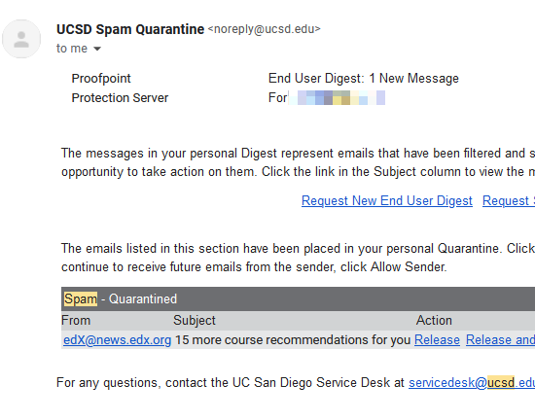




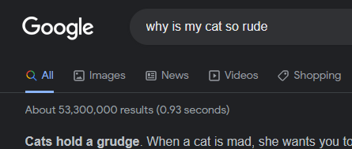
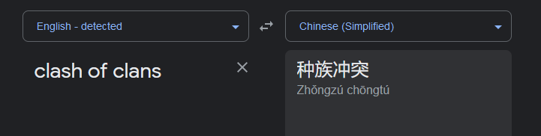
What can we use NLP for?
Notes:
On a more basic level, we can use NLP for some pretty ubiquitous and standard technologies, like spell check and autocomplete.
However, we can also look into a deeper level (with or without some deep learning) and find some other practical uses, like spam filters, search engines, recommender systems, and machine translation.
As well as this, we can analyze text using NLP, using sentiment analysis, keyword extraction, and name entity recognition.

Slide 6
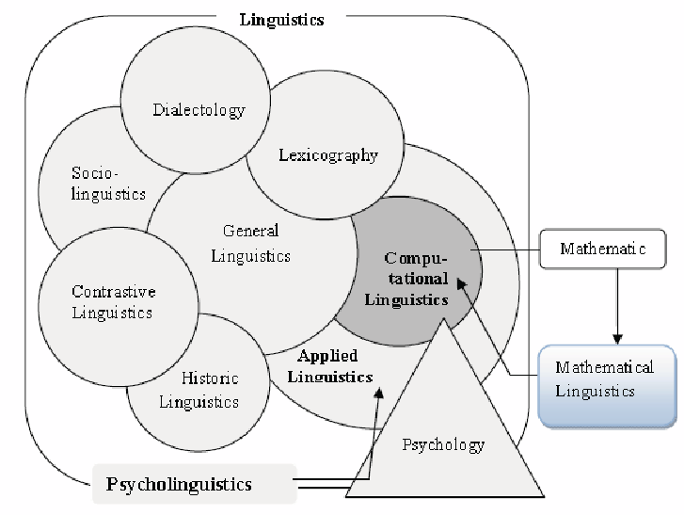
NLP vs Computational Linguistics?
NLP ⊆ CL
Both are very cool fields!
Notes:
You may have also heard about computational linguistics, and thought about how they were different. Essentially:
Computational Linguistics
The science of computers dealing with languages
Some interest in modeling what people do
Natural Language Processing
Developing systems for processing and understanding human language

Slide 7
Why should YOU be interested?
You speak in a natural language
Lots of available data (anything and everything that has ever been written)
Large research field (has many NLP specific conferences)
Notes:
ACL: Association for Computational Linguistics
EMNLP: Empirical Methods in Natural Language Processing
NAACL: North American Chapter of the Association for Computational Linguistics
EACL: European Chapter of the Association for Computational Linguistics
COLING: International Conference on Computational Linguistics
CoNLL: Conference on Natural Language Learning
SIGIR: Special Interest Group on Information Retrieval
AAAI: Association for the Advancement of Artificial Intelligence
ICML: International Conference on Machine Learning
ICDM: International Conference on Data Mining
Journal of Computational Linguistics
Transactions of the Association for Computational Linguistics
Journal of Information Retrieval
Journal of Machine Learning
LREC: Language Resources and Evaluation*
NeurIPS: Neural Information Processing Systems*

Slide 8
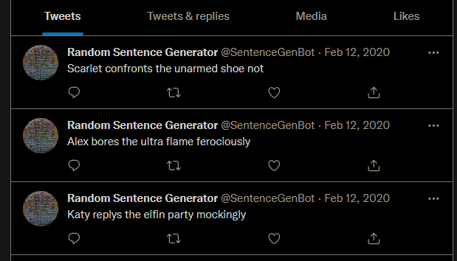
Why should YOU be interested?
Lots of resources to learn from!
Well supported (NLTK, Sci-kit Learn)
Bad outputs are funny
Notes:
Like every other hot field in AI, there are plenty of resources for you to learn and work on projects.

Slide 9
Colab Notebooks
Interactive Notebook: https://acmurl.com/nlp-interactive-1

Slide 10
Colab Notebooks
Main Notebook: https://acmurl.com/nlp-main-1
Interactive Notebook: https://acmurl.com/nlp-interactive-1
Summary Graphic: https://acmurl.com/nlp-summary-1

