Slide 1
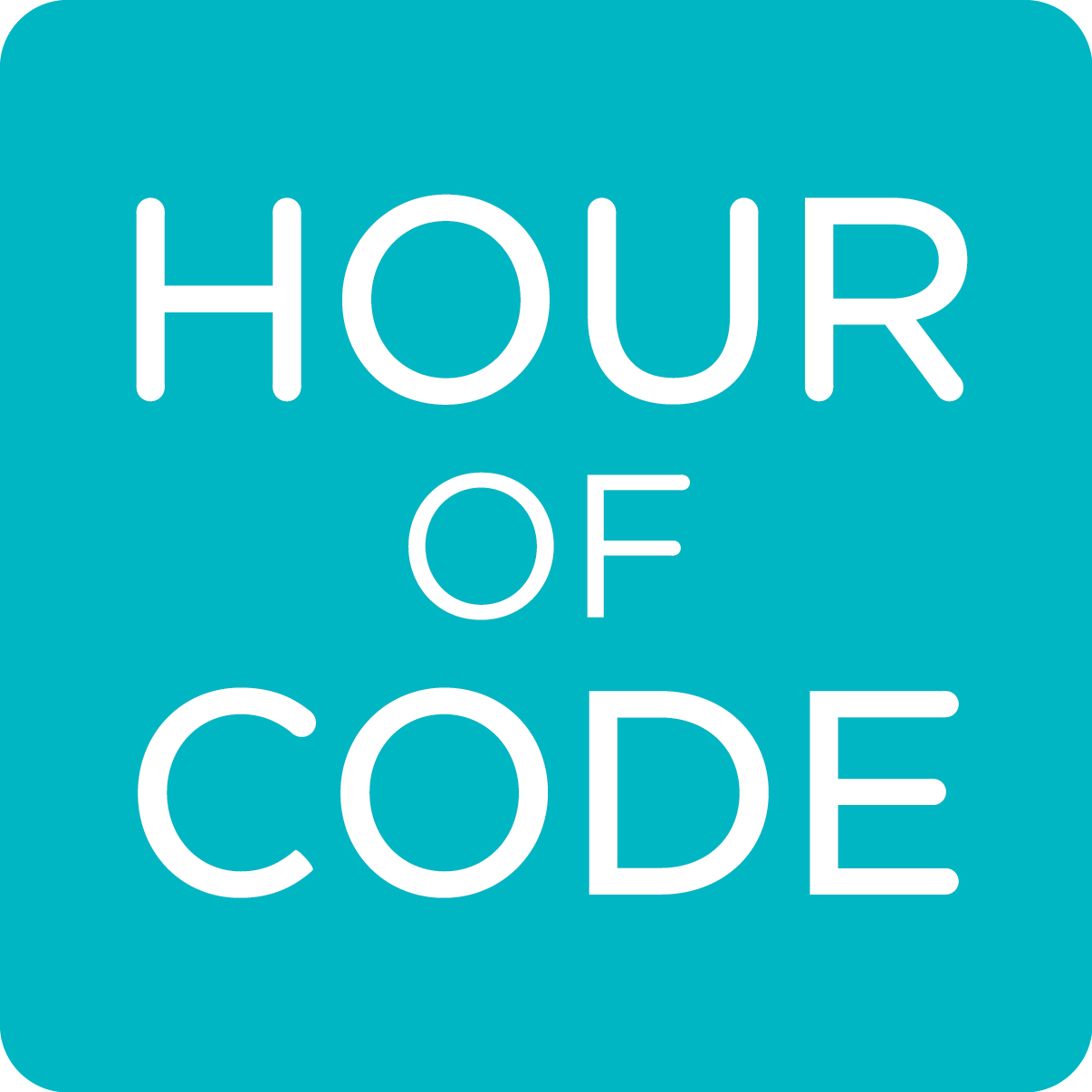
arduinos and piezo buzzers

Slide 2

What is an Arduino?
Electronics platform based on easy to use software and hardware
The board is a microcontroller
It reads input (force, light, temperature, twitter messages) and creates output (light, sound, motors)
Arduino programs are written in something similar to C++

Slide 3
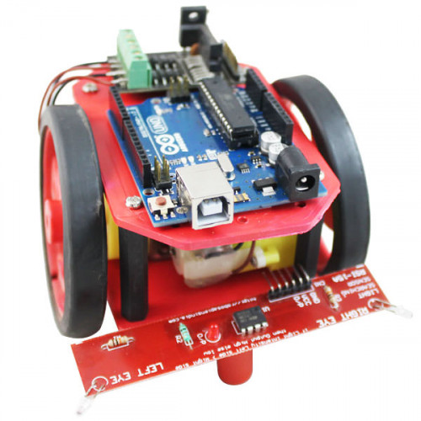
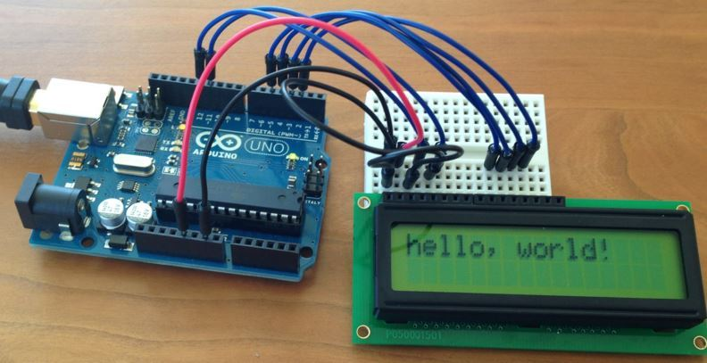
What can i do with arduino?

Slide 4
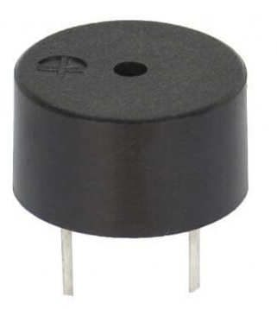
What is a piezo speaker?
Sending voltage to the speaker/buzzer will produce a sound
It is polarized which means one leg is negative and one is positive and can only be hooked up in one direction. (the dimple denotes the positive side)

Slide 5
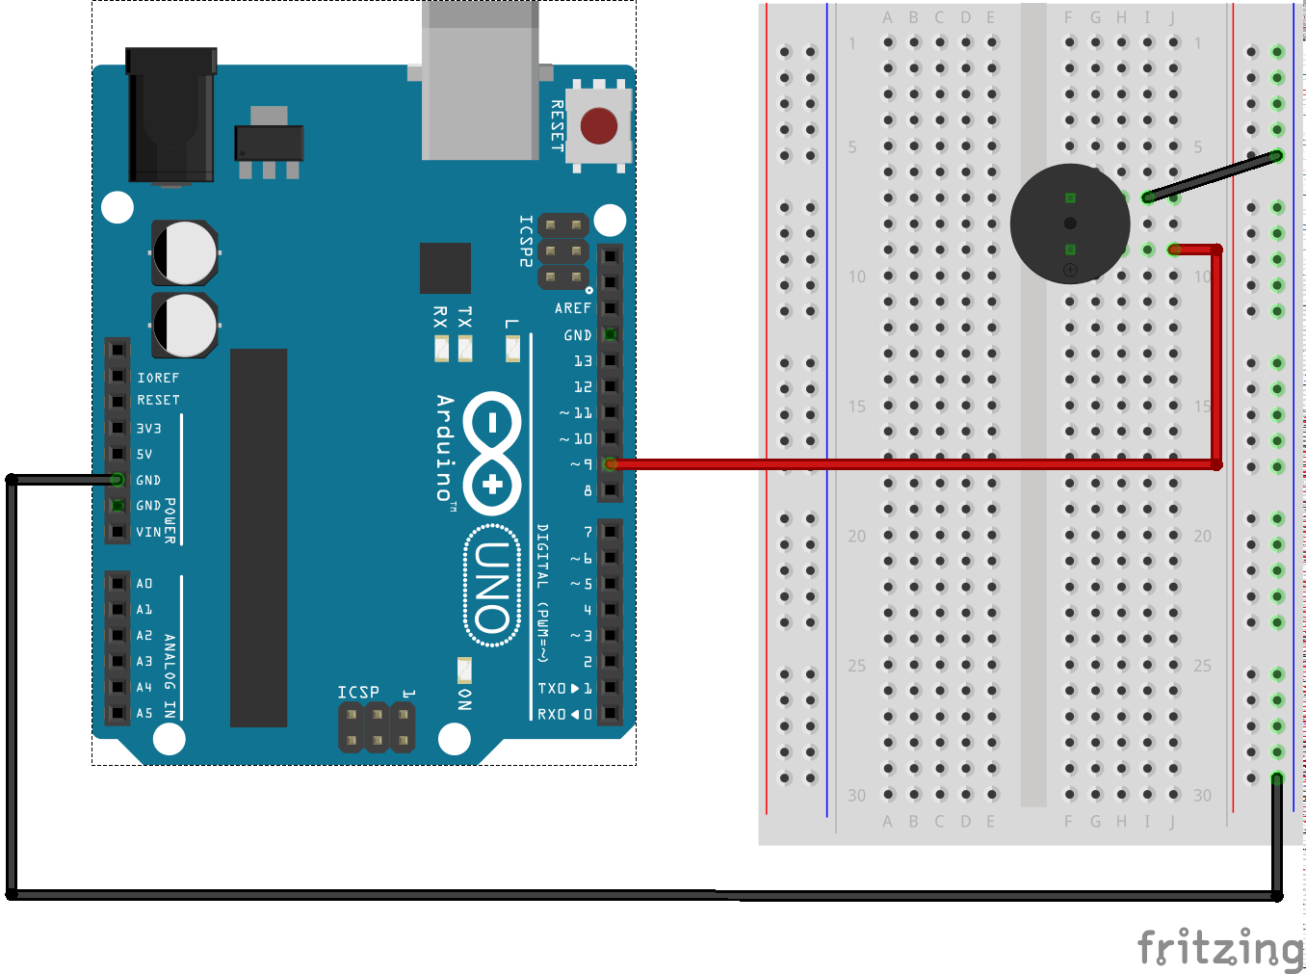
How to Hook up the speaker
Positive side goes to digital pin 9
Negative side goes to ground

Slide 6
How to program speaker
Arduino has 2 built in functions for the buzzer
Tone() This function can be programmed 2 ways
Tone(pin, frequency)
Tone(pin, frequency, duration)
noTone() This function can be programmed 1 way
noTone(pin)
Pin is the pin the buzzer is connected to, frequency is the freq of the note you want to play, and duration is the time in milliseconds

Slide 7
How an Arduino program works
Arduino code has two main sections: the setup function and the loop function
The set up function runs once. This is where you can configure the pin mode as input/output, set the data rate for serial data transmission.
The loop function will run repeatedly until you unplug the board. This is where we will put our code

Slide 8
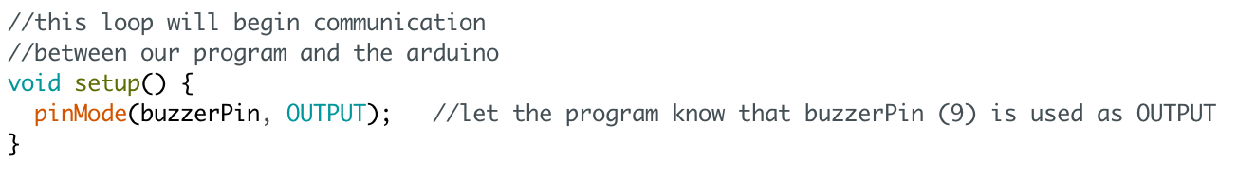
setup() function

Slide 9
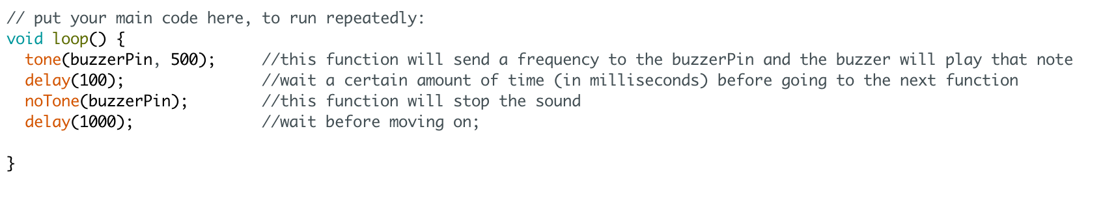
Loop() function

Slide 10
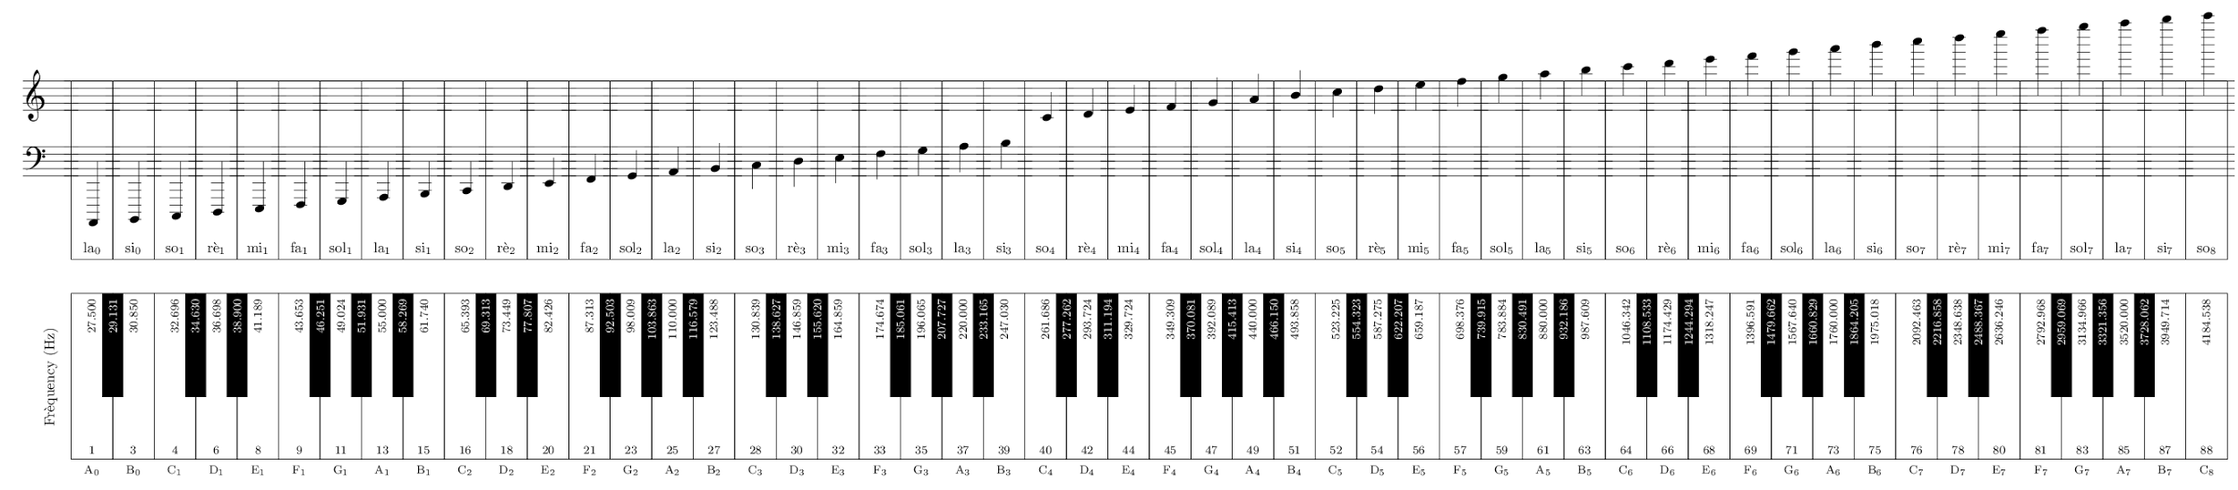
Frequencies of notes

Slide 11
More about loops
-Loops are a very important concept in computer science, it’s how we can efficiently make things happen in our code!
-A for loop is a special kind of loop that will run our instructions for a specific number of times.

Slide 12
For loop syntax
for (init; condition; increment) {
//write your code here!
}
init is where you initialize your loop control variable
We will use i as an iterator which will keep track of how many times our for loop has run
condition defines the condition your control variable needs to fulfill to run the loop
increment will change your control variable at the end of each loop run

Slide 13
WRite a for loop to play 5 tones

Slide 14
Now let’s make music!

