Slide 1
Modal Analysis
2021/12/25

Slide 2
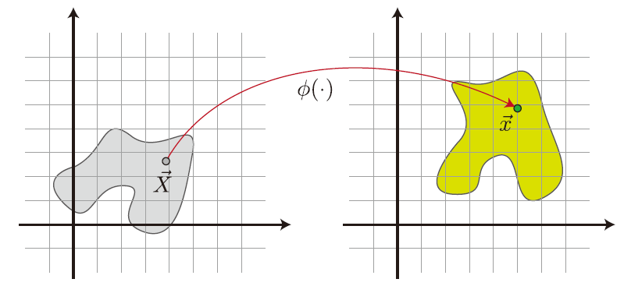
$$φ$$
Deformation map
$$E[φ]$$
Strain energy
$$x$$
$$X$$
$$Ψ(F)$$
Energy density
Constitutive
Models
(chap 3)
$$f$$
Elastic force
$$F$$
Deformation gradient
$$P(F)$$
Stress tensor

Slide 3
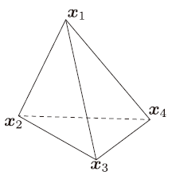

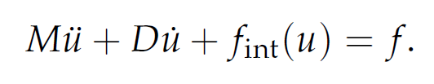





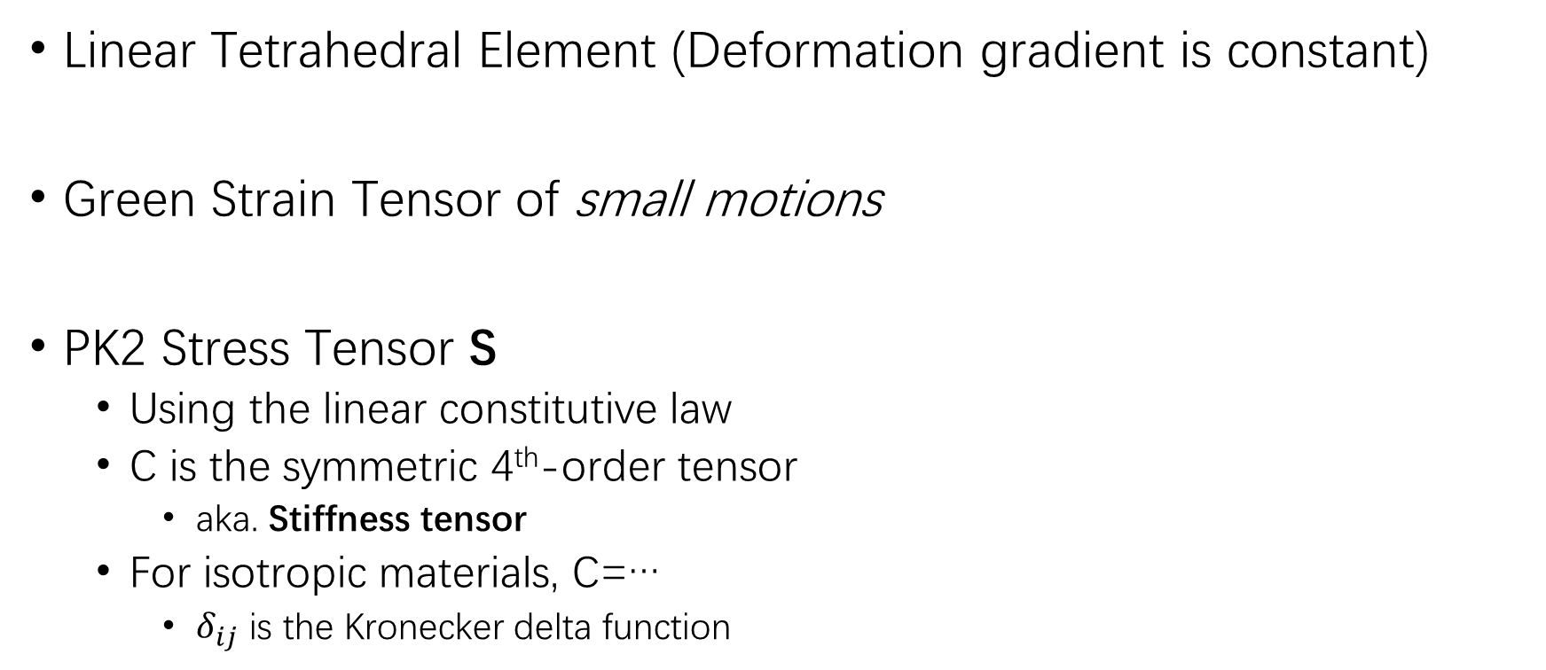

Elastic Vibration How to compute $f_{int}\left(u\right)$ ?
Linear Tetrahedral Element (Deformation gradient is constant)
Green Strain Tensor of small motions
PK2 Stress Tensor S
Using the linear constitutive law
C is the symmetric 4th-order tensor
aka. Stiffness tensor
For isotropic materials, C=…
$δ_{ij}$ is the Kronecker delta function
Notes:
目标：算出u
目前已经写出了牛顿第二定律等式：把u和内力、外力联系起来
Stiffness: stress对strain求导

Slide 4
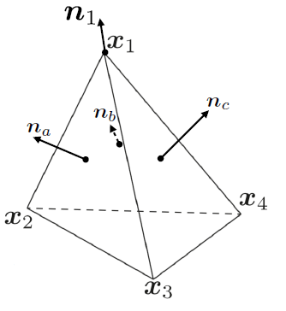


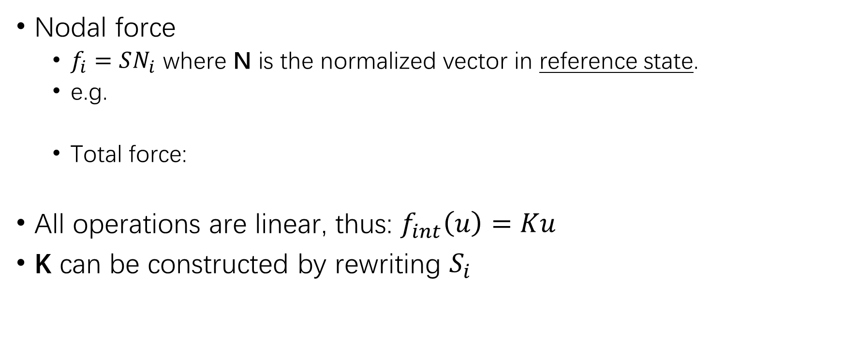
Elastic Vibration How to compute $f_{int}\left(u\right)$ ?
Nodal force
$f_{i}=SN_{i}$ where N is the normalized vector in reference state.
e.g.
Total force:
All operations are linear, thus: $f_{int}\left(u\right)=Ku$
K can be constructed by rewriting $S_{i}$

Slide 5


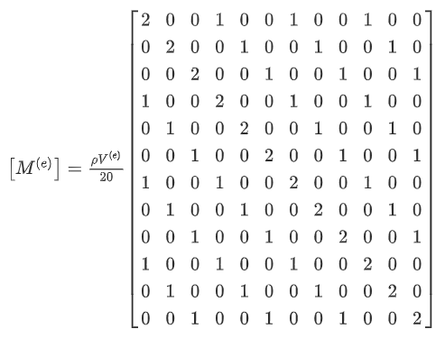

Elastic Vibration How to compute M and D?
Mass matrix
By taking the 2nd partial derivative of the kinetic energy w.r.t. nodal velocity
For a single tet element, M is a 12*12 matrix
Damping matrix
Rayleigh damping model

Slide 6





Decouple
Generalized eigenvalue decomposition of (K, M)
U: Modal shape
S: Diagonal eigenvalue
Let
On the left side, all pre-multiplied matrices are diagonal -> individual modes
Notes:
u=Uq
只取人耳可感知频率范围内的模态
-> model reduction

Slide 7



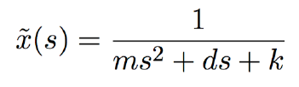

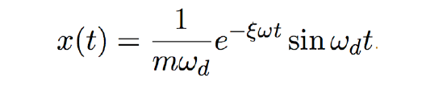




1D Solution
If f(t) = δ(t):
Laplace Transform:
Inverse Laplace:
According to the property of Laplace Transform,
the solution of is a time convolution with the impulse response:
Notes:
ms^2+ds+k的逆变换
如果没有ds，那么逆变换得到的结果中就只有sin(wt)，也就是说不会随着时间衰减
如果有了ds，相当于对s进行了平移 = m(s+p)^2+k’，那么逆变换之后也要在频域上进行平移，也就是乘上一个e^-t即随时间衰减

Slide 8

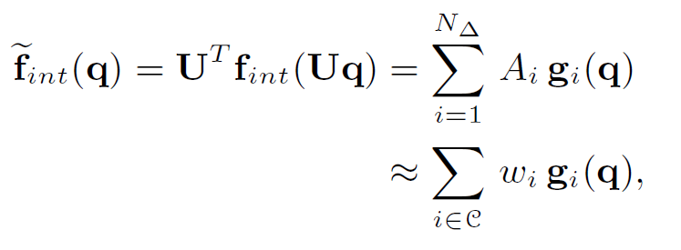

Nonlinear vibration How to compute $f_{int}\left(u\right)$ ?
From FEM Course:
Paper1(2007): For geometrically nonlinear, materially linear
f_int(u) is a cubic polynomial of u, we can precompute the coefficients
Paper2(2008): For general material
There is a fast approximation scheme
Paper3(2016)
Component Mode Synthesis
We amortize the cost of the linear modal analysis by dynamically partitioning the mesh into nearly rigid pieces: the modal analysis of a rigidly moving piece is retained over time.
Notes:
[1] J. Barbiˇc. Real-time Reduced Large-Deformation Models and Distributed Contact for Computer Graphics and
Haptics. PhD thesis, Carnegie Mellon University, Aug. 2007.
[2] S. S. An, T. Kim, and D. L. James. Optimizing cubature for efficient integration of subspace deformations.
ACM Trans. on Graphics, 27(5):165:1–165:10, 2008.

Slide 9
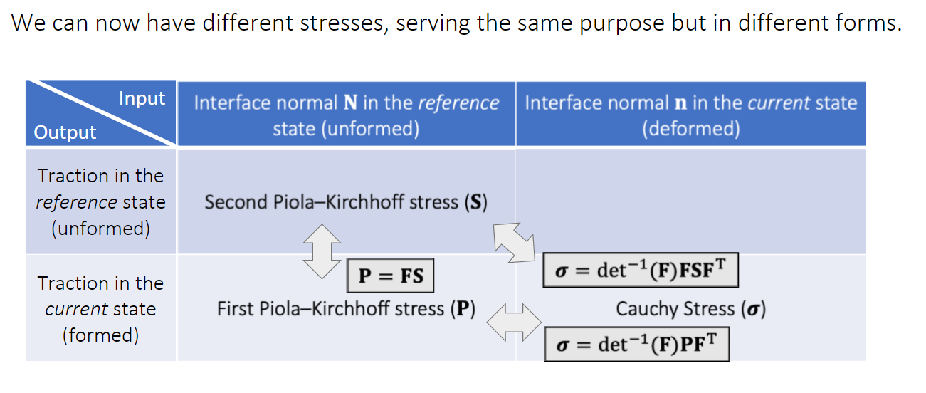
Stress tensors

Slide 10
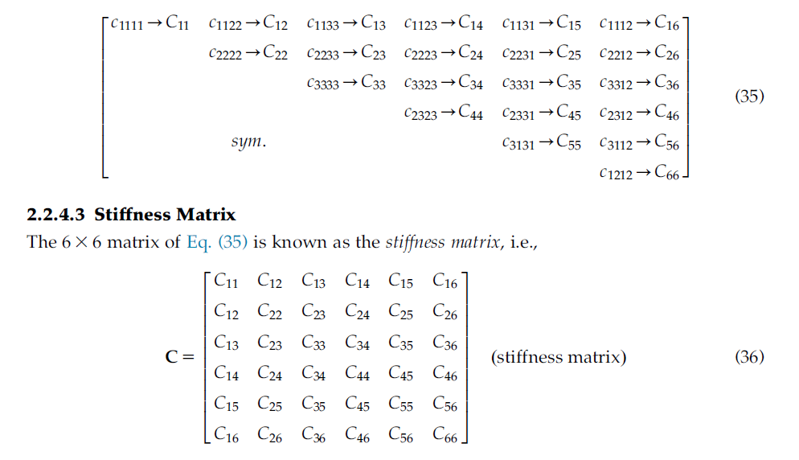
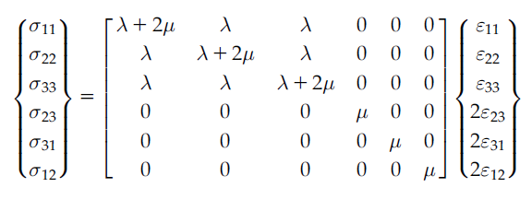
Stiffness tensor C_ijkl
Notes:
V Giurgiutiu
Structural Health Monitoring of Aerospace Composites
P42

Slide 11
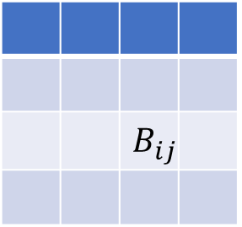
Mass matrix
 |  | $$B_{ij}$$
Notes:
Singiresu S
The Finite Element Method in Engineering 5th edition
(12.55)
P456

Slide 12



Transfer……
Modes: q_j(t) =
Transfer: a_j(x) i.e. p(x)
a_j(x)为什么和频率有关？
Helmholtz方程的Neumann边界条件和频率有关

Slide 13
求解Helmholtz方程的几种方法
Equivalent sources
在物体内部放置n个点声源，使这些点声源的组合声场满足Neumann条件 -> 得到一个Ac=b的线性系统，使用最小二乘法求解
Boundary
在物体表面放置n个点声源，使用BEM求解多级源系数c_n^m
每个c_n^m是一个边界积分式
Spatial Discretizations
空间离散化，计算量大
Precomputed Acoustic Transfer文章使用的方法
使用BEM求解Helmholtz方程的边界解
找到enclosing surface包含原物体，可以使用BEM求解surface内部每一处的声压值
在surface外部，使用Equivalent sources方法求解

