Slide 1
Review
ComputerArchitecture_Review

Slide 2
Final examination
Close-text, with a handwritten A4 memo sheet
Selections 26%
Calculation 10%
Storage 10%
Cache /Memory 20%
Pipeline 34%

Slide 3
Chapter1: Fundamentals
What’s Computer architecture ?
What’s a computer architect’s task ?
What should a computer architect need to know ?
Feb.2008_jxh_Introduction

Slide 4
What’s Computer architecture ?
Computer Architecture is the science and art of selecting and interconnecting hardware components to create computers that meet functional, performance, cost and power goals.
Computer architecture is the conceptual design and fundamental operational structure of a computer system. Computer architecture is a blueprint and functional description of requirements (especially speeds and interconnections) and design implementations for the various parts of a computer — focusing largely on the way by which the central processing unit (CPU) performs internally and accesses addresses in memory.
Tradeoff
Feb.2008_jxh_Introduction

Slide 5
What’s Computer Architect’s task ?
Define the requirements
  Application field, computer market(1.2)
  Functional requirement
  non-functional requirements
Architecture design ( blueprint )
  ISA
  Organization
  Hardware
Optimization
Supercomputer
PC, workstation
Embedded system
Server

Slide 6
Computer Design Engineering life cycle
Using benchmark to Evaluat Existing
Systems for
Bottleneck(1.8)
User requirement
Analysis(1.2)
Quantitative Principles
1.9
Technology Trend 1.4
Power Trend 1,5
Cost Trend 1.6
Implement Next
Generation System
Simulate New
Designs and
Organizations
Workloads
Evaluating for price performance or watt perf.(1.8)
Notes:
Requirement Analysis:
Market analysis: who you will sell 4-1.2
desktop, server, embedded system, HPC
Different markets has different driven motivations.
When design a desktop, it aims to obtain best price-performance.
For the servers, dependability is critical, then the scalability, and throughput.
For the embedded computer systems, price is a key factor, while real-time performance is important . And power efficiency and memory size is always under consideration.
2. Functional requirement: 4-1.3
3. Performance requirement:
4. Power
5. Unfuntional requirements: availability, dependibility 1.7
7. Cost/price

Slide 7
1.4 Technology Trends
Designers often design for the next technology.
Technology improves continuously, an impact of this improvements can be in discrete leaps.
Moore Law
  In 1965 , number of components the industry would be able to place on a computer chip would double every year.
  In 1975, he updated his prediction to once every two years.
Rule of thumb
  Bandwidth grow rate ~ improvement in latency2
  transistor perf. Improves linearly with decreasing feature size.
  signal delay for a wire increase in proportion to the product of its resistance and capacitance.
Feb.2008_jxh_Introduction

Slide 8
1.5 Trends in Power
Power also provide challenges as device scaled
  first microprocessor: 1/10watt --> 2GHz P4: 135watt
Challenges:
  distributing the power
  removing the heat
  preventing hot spot
What to do? power-aware design

Slide 9
1.6 Cost trend
Understanding cost trends of component is important, since we design for tomorrow !
How to learn ? Learning curve.
The impact factors for cost:
  Time, Volume, modification
Rules of Thumb
  Twice the yield will have half the cost.
  Cost decrease about 10% for each doubling of volume.

Slide 10
Cost vs. Price
Component costs
  Raw material cost.
Direct cost:
  Costs incurred to make a single item. Adds 20% to 40% to component cost.
Gross margin ( Indirect cost):
  Overhead not associated with a single item, i.e. R&D, marketing, manufacturing equipment, taxes, etc.
Average Selling Price (ASP):
  Component cost + direct cost + indirect cost.
List price :
  Not ASP. Stores add to the ASP to get their cut. Want 50% to 75% of list price.
Small changes in cost can have an unexpected
large increase in price.

Slide 11
1.7 Dependability
Dependability is a deliberately broad term to encompass many facets including reliability, security and availability.
Service level Agreements(SLA)/Service level objectives (SLO)
  Service accomplishment
  Service interruption
Failures: S_{accomplishment} →S_{interruption}
Restorations: S_{interruption} →S_{accomplishment}
Redundancy:
  Time redundancy: repeat the operation again to see if it is still in erroneous.
  Resource redundancy: have other components to take over from the one that failed.

Slide 12
Measurements of Dependability
Module reliability: continuous service accomplishment
  MTTF: Mean Time To Failure
  MTTR: Mean Time To Repair
  FIT: Failure In Time = 1/MTTR
  MTBF: Mean Time Between Failure = MTTF+MTTR
Module availability
  MTTF = MTTF
  MTTF + MTTR MTBF

Slide 13
1.8 Measuring and Reporting Perf.
Performance Metrics
  response time or elapsed time – user perception
  Throughput --administrator perception
  User CPU time – computer architect
  MIPS - millions of instructions per second
Comparing Machines Using Sets of Programs
  Choosing which program to evaluate performance
    Benchmark Suites
  Different Means: Arithmetic, Harmonic, and Geometric Means

Slide 14
Summary of performance metrics
Response (Execution) time
  user perception
  system performance
  the only unimpeachable measure of performance
CPU time
  designer perception
  CPU performance
Throughput
  administrator perception
MIPS
  merchant perception

Slide 15
1.9 Quantitative Principles
Take Advantage of Parallelism
Focus on the common case
Principle of Locality
Amdahl's Law
CPU Performance Equation
Where the principles are used ?
Could you give some examples ?

Slide 16
Exploiting the Parallelism
Taking advantage of parallelism is one of the most important methods for improving performance.
Many example
  system level: multiple processors / multiple disk,
  individual processor: pipelining
  digital design level: set-associative caches

Slide 17
What the Amdahl’s Law imply ?
If an enhancement is only usable for a fraction of task, then the total speedup will be no more than 1/ (1-F).
Serve the guide
  to how much an enhancement will improve performance
  to how to distribute resource to improve cost-performance
Useful for comparing
  the overall system performance of two alternatives,
  two CPU design alternatives
We can improve the performance by
  increasing the Fraction_{enhanced}
  or, increasing the Speedup_{enhanced}

Slide 18

The CPU Performance Equation
The “Iron Law” of processor performance:
  Often it is difficult to measure the improvement in time using a new enhancement directly.
CPU Performance Equation

Slide 19

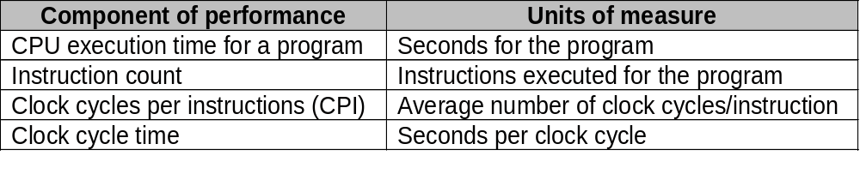
Calculation of CPU Time
CPU time = Instruction count × CPI × Clock cycle time
Or
Architecture --> Implementation --> Realization
Compiler Designer Processor Designer Chip Designer

Slide 20
Related technologies
CPU performance is dependent upon 3 characteristics:
  clock cycle (or rate) ( CC )
  clock cycles per instruction ( CPI )
  instruction count. ( IC )
One difficulty: It is difficult to change one in isolation of the others.
Inst Count CPI Clock Rate
Program X
Compiler X (X)
Inst. Set. X X
Organization X X
Technology X

Slide 21
Principle of Locality
Programs tend to reuse data and instructions they have used recently.
a program spends 90% of its execution time in only 10% of the code.
Temporal locality
  Recently accessed items are likely to be accessed in the near future.
Spatial locality
  Items whose addresses are near one another tend to be referenced close together in time.

Slide 22
ChapterB Outline of ISA

Slide 23
Seven dimensions of ISA
Class of ISA
Memory addressing
Addressing modes
Types and sizes of operands
Operations
Control flow instructions
Encoding an ISA
The impact of compiler

Slide 24
Important step for ISA design
To analyze and evaluate the existing machines with a large collection of programs before making architectural decisions.

Slide 25
Classifying Instruction Set Architectures
The type of internal storage in CPU
  Stack, accumulator, GPR(General-Purpose Register) architecture
Max number of operands in ALU instruction.
  R-R, R-M, M-M
  What’s Load/Store architecture ?

Slide 26
Other Taxonomy of Computer Architecture
1989 IEEE taxonomy：
  ．Personal Computer (PC)
  ．WorkStation (WS)
  ．Mini Computer
  ．Mainframe
  ．Minisupercomputer
  ．Supercomputer
  Server
  Embedded systme
  Cluster、Grid Computer

Slide 27
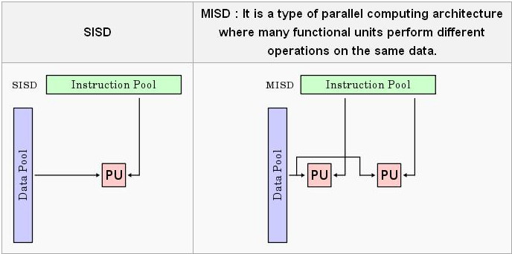
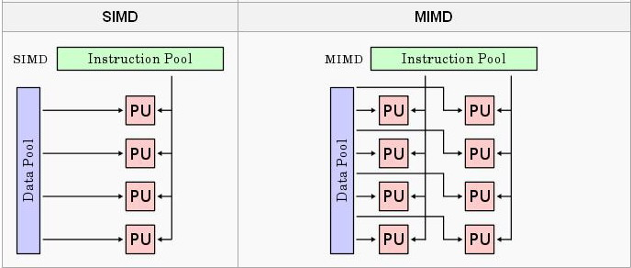
Flynn taxonomy
based on the number of streams of instructions and data on bottleneck

Slide 28
CSIC & RISC
What’s a RISC ?
What are a RISC machine’s characteristics ?
Could you compare RISC & CISC ? From which viewpoint?

Slide 29
How you make decision when design ISA ?
Measure the existing ISA
Make the common case fast
  Memory addressing mode:
    aligned memory access
  Oprand
  Operation
  Ecoding
    Fixed, variable, Hybrid

Slide 30
Basic pipeline

Slide 31
What is Pipelining ?
Pipelining:
  is a set of data processing elements connected in series, so that the output of one element is the input of the next one. The elements of a pipeline are often executed in parallel or in time-sliced fashion; in that case, some amount of buffer storage is often inserted between elements.

Slide 32
Instruction Pipeline
An instruction pipeline is a technique used in the design of computers and other digital electronic devices to increase their instruction throughput (the number of instructions that can be executed in a unit of time).
  implementation technique whereby different instructions are overlapped in execution at the same time.
  implementation technique to make fast CPUs

Slide 33
Why pipelining : conclusion
The key implementation technique used to Make fast CPU: decrease CPUtime.
Improving of Throughput ( rather than individual execution time)
Improving of efficiency for resources (functional unit)

Slide 34
Multi-cycle implementation vs. pipelining
Multip-Cycle Implementation: CPI=5,
Cycle 1
Cycle 2
Cycle 3
Cycle 4
Cycle 5
Cycle 6
Cycle 7
Cycle 8
Cycle 9
Cycle 10
Clk
Load
Store
R-type
IF
ID
EX
MEM
WB
IF
ID
EX
MEM
WB
Pipeline Implementation: CPI=1,
Cycle 1
Cycle 2
Cycle 3
Cycle 4
Cycle 5
Cycle 6
Cycle 7
Cycle 8
Cycle 9
Cycle 10
Clk
Load
IF
ID
EX
MEM
WB
Store
IF
ID
EX
MEM
WB
R-type
IF
ID
EX
MEM
WB

Slide 35
Ideal Performance for Pipelining
If the stages are perfectly balanced, The time per instruction on the pipelined processor equal to:
Time per instruction on unpipelined machine
Number of pipe stages
So, Ideal speedup equal to
Number of pipe stages.

Slide 36
Pipeline hazard: the major hurdle
A hazard is a condition that prevents an instruction in the pipe from executing its next scheduled pipe stage
Taxonomy of hazard
  Structural hazards
    These are conflicts over hardware resources.
  Data hazards
    Instruction depends on result of prior computation which is not ready (computed or stored) yet
  Control hazards
    branch condition and the branch PC are not available in time to fetch an instruction on the next clock

Slide 37
What we need to know ?
What results in the various hazards ?
  The causes
  How to judge whether there is hazard ?
The approaches to solve the hazards.
How to evaluate the performance considering the hazards ?

Slide 38
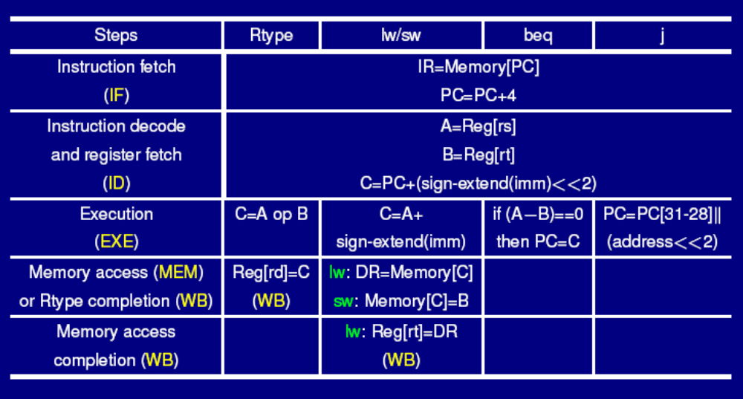
5-cycle MIPS CPU

Slide 39
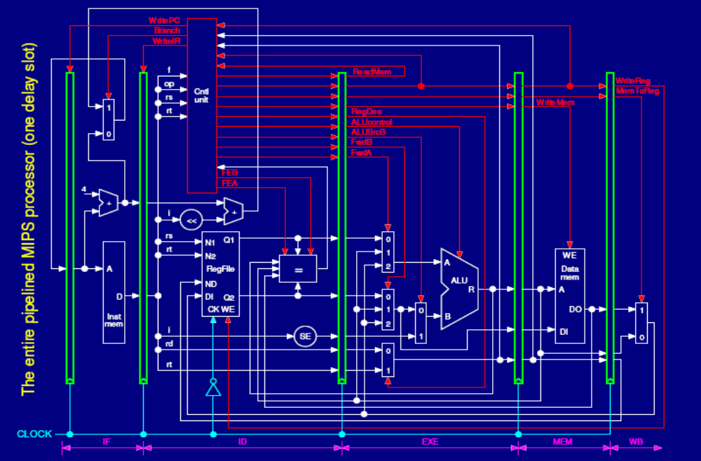
Pipeline with 1 delay slot and forwarding path and load stall

Slide 40
Could you write the logic expression ?
LoadStall ?
FowardA ?
FowardB ?
BranchStall ?
When and How many stalls ? Examples ?
Which Forwarding path will be used ?
How to implement “stall” ?
What if give an 7-stage pipeline ?

Slide 41
Structural hazard: Pipe Stage Contention
Structural hazards
  Occurs when two or more instructions want to use the same hardware resource in the same cycle
  Causes bubble (stall) in pipelined machines
  Overcome by replicating hardware resources
    Multiple accesses to the register file
    Multiple accesses to memory
    some functional unit is not fully pipelined.
    Not fully pipelined functional units

Slide 42
Split instruction and data memory
Time (clock cycles)
I
n
s
t
r.
O
r
d
e
r
Ld/St
IM
Reg
ALU
DM
Reg
Instr 1
IM
Reg
ALU
DM
Reg
Instr 2
IM
Reg
ALU
DM
Reg
Instr 3
IM
Reg
ALU
DM
Reg
Split instruction and data memory / multiple memory port / instruction buffer means:
fetch the instruction and data inference using different hardware resources.

Slide 43
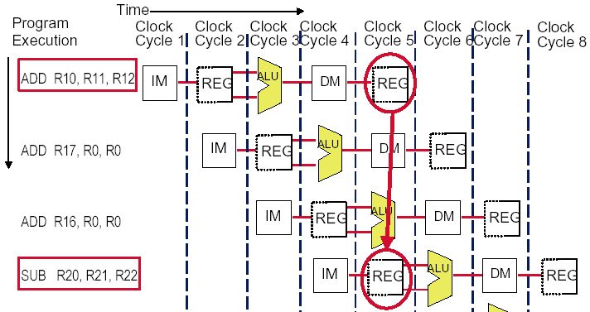
Multi access to the register file
Simply insert a stall , speedup will be decreased.
We can resolve it with “ double bump”

Slide 44
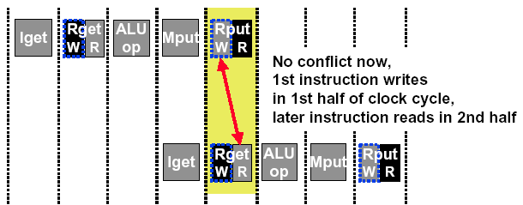
Double Bump Works !
allow WRITE-then-READ in one clock cycle (double bump)

Slide 45
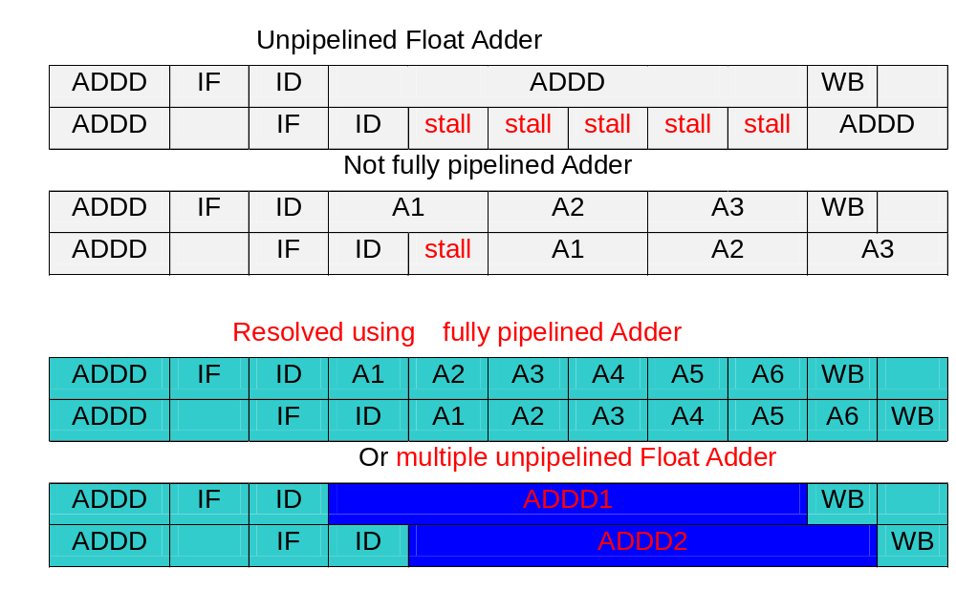
Not fully pipelined function unit : may cause structural hazard

Slide 46
Data hazard
Data dependence = Data hazard ?
  RAW, WAR, WAW
How to resolve ?
  Double bump
  Forwarding path
  Load stall
  Compiler scheduling
  Dynamic scheduling, Register renaming

Slide 47
Data hazard
Data hazards occur when the pipeline changes the order of read/write accesses to operands comparing with that in sequential executing .
Let’s see an Example
  DADD R1, R1, R3
  DSUB R4, R1, R5
  AND R6, R1, R7
  OR R8, R1, R9
  XOR R10, R1, R11

Slide 48
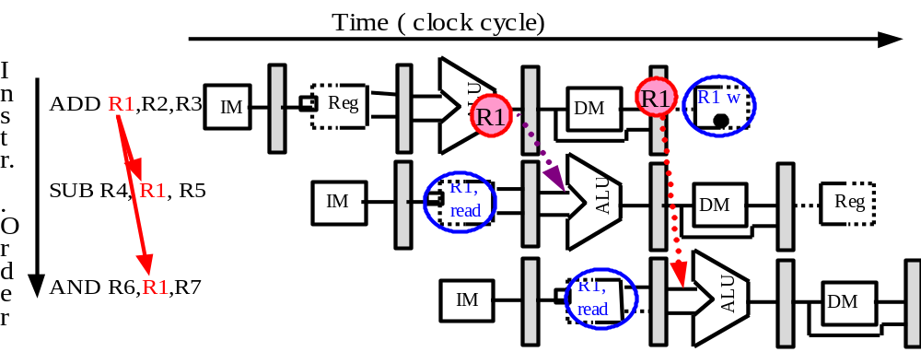
Forwarding:reduce data hazard stalls
Data may be already computed - just not in the Register File
EX/MEM.ALUoutput → ALU input port
MEM/WB.ALUoutput → ALU input port

Slide 49
Hardware Change for Forwarding
NextPC
ID/EX
EX/MEM
MEM/WR
Registers
mux
ALU
Data
Memory
mux
mux
Immediate
EX/Mem.ALUoutput → ALU input
MEM/WB.ALUoutput → ALU input
MEM/WB.LMD → ALU input

Slide 50
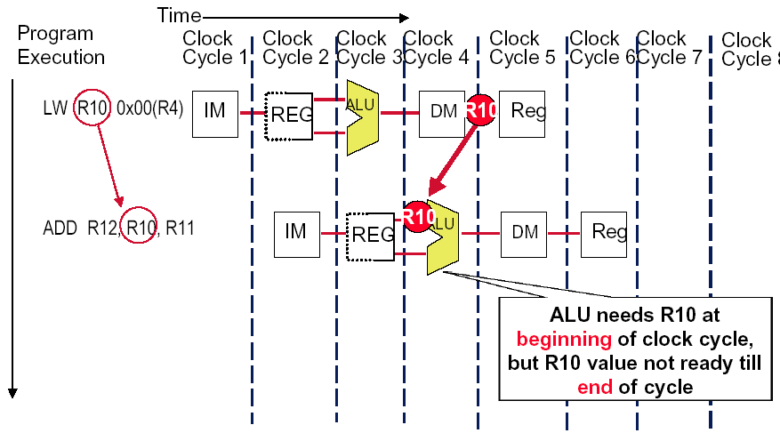
Forwarding Doesn’t Always Work

Slide 51
So we have to insert stall: Load stall
Time (clock cycles)
I
n
s
t
r.
O
r
d
e
r
lw r1, 0(r2)
Ifetch
Reg
ALU
DMem
Reg
Bubble
sub r4,r1,r6
Ifetch
Reg
ALU
DMem
Reg
Bubble
and r6,r1,r7
Ifetch
Reg
ALU
DMem
Reg
or r8,r1,r9
Bubble
Ifetch
Reg
ALU
DMem

Slide 52
Example of
Forwarding and Load Delay
Why forwarding?
  ADD R4, R5, R2
  LW R15, 0(R4)
  SW R15, 4(R2)
Why load delay?
  ADD R4, R5, R2
  LW R15, 0(R4)
  SW R15, 4(R2)

Slide 53
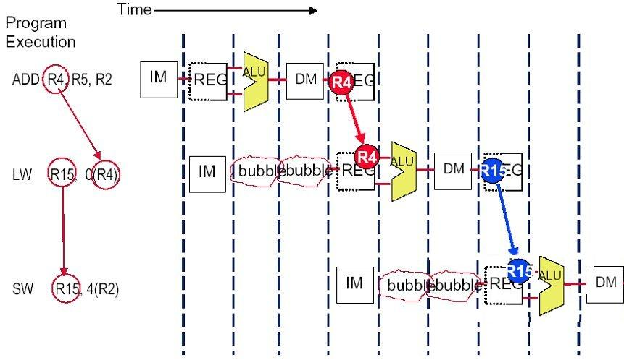
Solution (without forwarding)

Slide 54
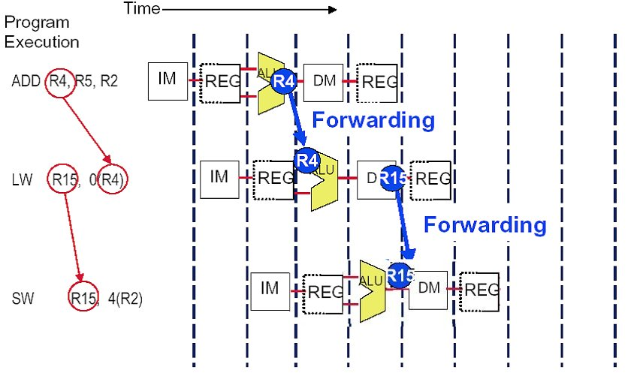
Solution (with forwarding)
EX/MEM.ALUoutput → ALU input port
MEM/WB.ALUoutput → DM data write port

Slide 55
Instruction reordering by compiler to avoid load stall
Try producing fast code for
a = b + c;
d = e – f;
assuming a, b, c, d ,e, and f in memory.
Slow code:
LW Rb,b
LW Rc,c
ADD Ra,Rb,Rc
SW a,Ra
LW Re,e
LW Rf,f
SUB Rd,Re,Rf
SW d,Rd
Fast code:
LW Rb,b
LW Rc,c
LW Re,e
ADD Ra,Rb,Rc
LW Rf,f
SW a,Ra
SUB Rd,Re,Rf
SW d,Rd

Slide 56
Deal with Control Hazards
Flushing the pipeline
Predict-taken
Predict-not-taken
Delayed branch
Resolve the branch as earlier as possible
Branch predict , Specluation

Slide 57
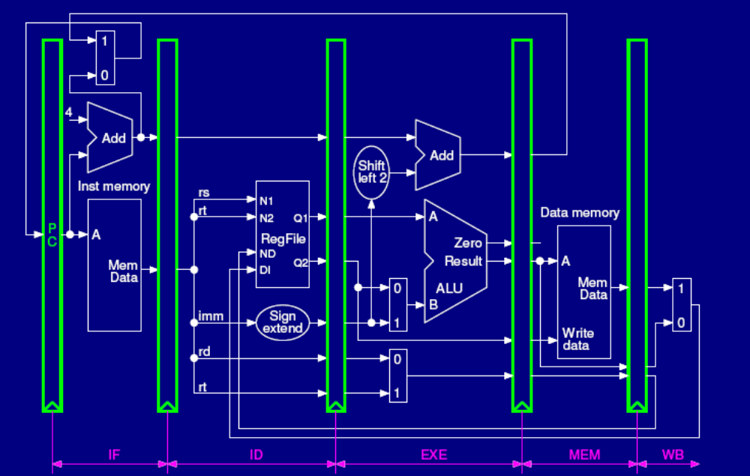
Deal with Control Hazards

Slide 58
Flushing the pipeline
Simplest hardware:
  Holding or deleting any instruction after branch until the branch destination is know.
  Penalty is fixed.
  Can not be reduced by software.

Slide 59
The pipeline status --flushing
Branch instruction | IF | ID | EX | MEM | WB
Branch Successor |  | IF | stall | stall | idle | idle
Branch successor+1 |  |  |  |  | IF | ID | EX
Branch successor+2 |  |  |  |  |  | IF | ID
Branch successor+3 |  |  |  |  |  |  | IF

Slide 60
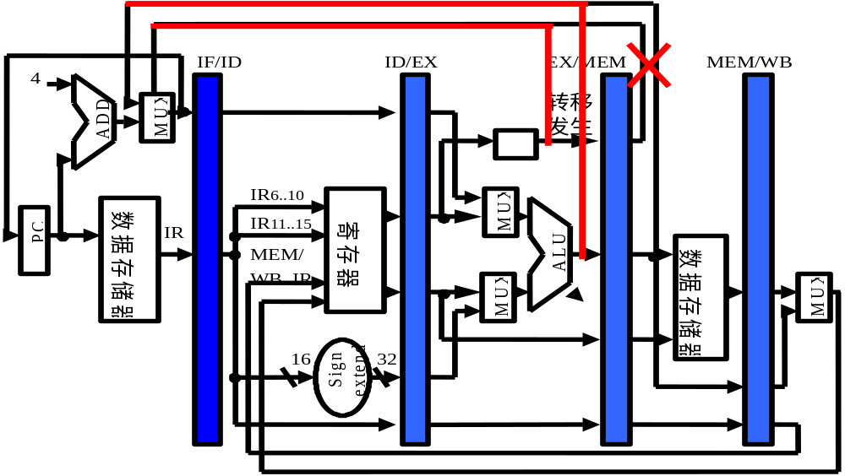
Move the Branch Computation Forward

Slide 61
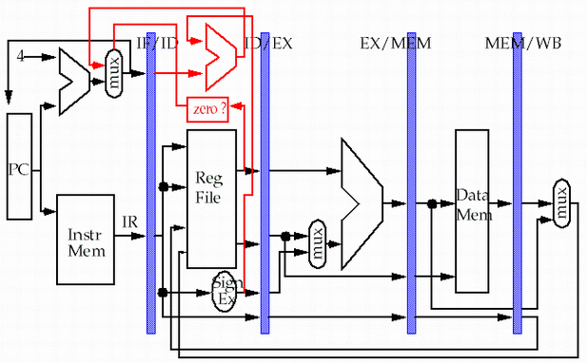
Move the Branch Computation more Forward
store
load

Slide 62
Why “waste” the fetched instruction ?
Branch instruction | IF | ID | EX | MEM | WB
Branch Successor |  | IF | idle | idle | idle | idle
Branch successor+1 |  |  | ID | EX | MEM | WB | ID
Branch successor+2 |  |  |  | ID | EX | MEM | WB
Branch successor+3 |  |  |  |  | ID | EX | MEM
We have fetched the instruction 48, why should we waste the delay slot ?

Slide 63
Delayed branch
Good news
  Just 1 cycle to figure out what the right branch address is
  So, not 2 or 3 cycles of potential NOP or stall
Strange news
  OK, it’s always 1 cycle, and we always have to wait
  And on MIPS, this instruction always executes, no matter whether the branch taken or not taken. (hardware scheme)

Slide 64
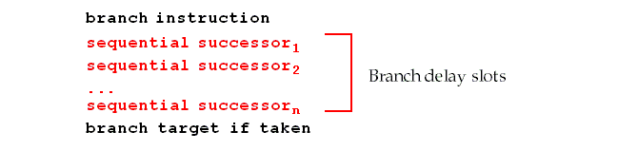
Branch delay slot
Hence the name: branch delay slot
  The instruction cycle after the branch is used for address calculation , 1 cycle delay necessary
  SO…we regard this as a free instruction cycle, and we just DO IT
Consequence
  You (or your compiler) will need to adjust your code to put some useful work in that “slot”, since just putting in a NOP is wasteful (compiler scheme)

Slide 65
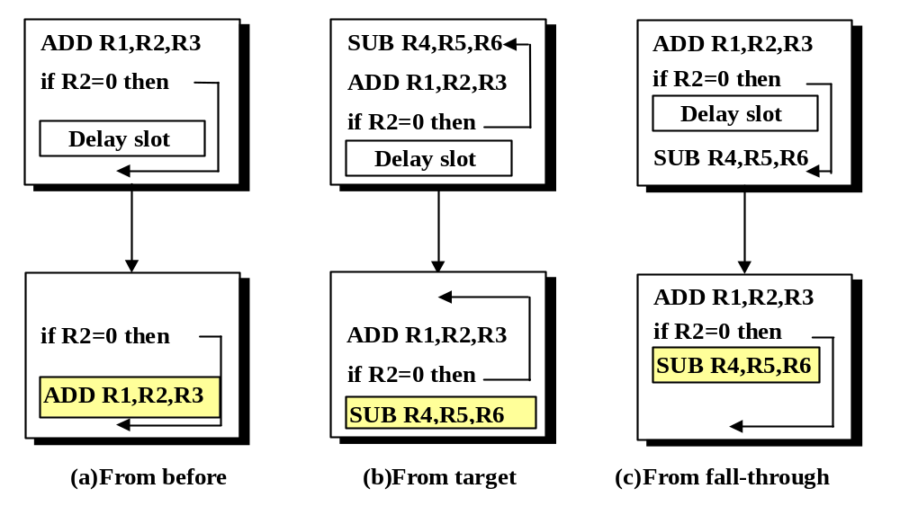
How to adjust the codes?

Slide 66
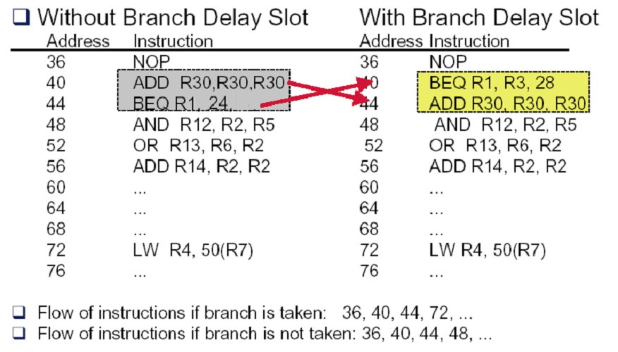
Example: rewrite the code (a)

Slide 67
Example: rewrite the code (b-1)
Loop: LW R2, 0(R1)
ADD R3, R2, R4
SW R3, 0(R1)
……
SUB R1, R1, #4
BNEZ R1, Loop
LW R2, 0(R1)
Loop: ADD R3, R2, R4
SW R3, 0(R1)
……
SUB R1,R1, #4
BNEZ R1, Loop
LW R2, 0(R1)

Slide 68
Example: rewrite the code (b-2)
Loop: LW R2, 0(R1)
ADD R3, R2, R4
SW R3, 0(R1)
DIV …..
……
SUB R1, R1, #4
BNEZ R1, Loop
Loop: LW R2, 0(R1)
ADD R3, R2, R4
DIV …...
…...
SUB R1, R1, #4
BNEZ R1, Loop
SW R3, +4(R1)

Slide 69
MIPS Pipeline

Slide 70
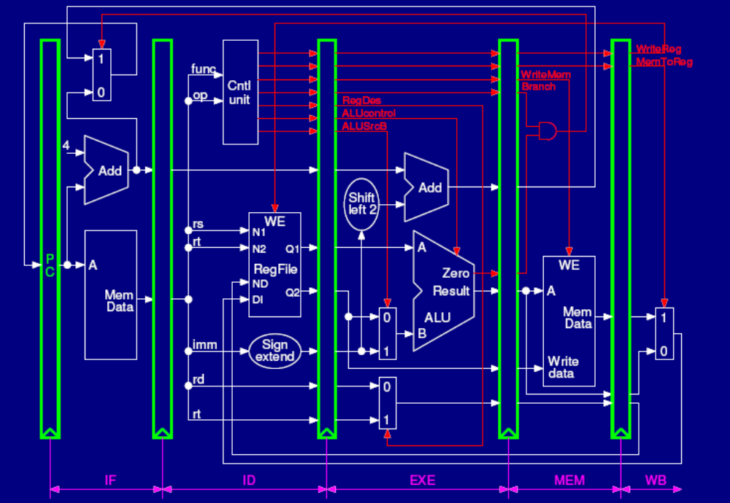

Slide 71
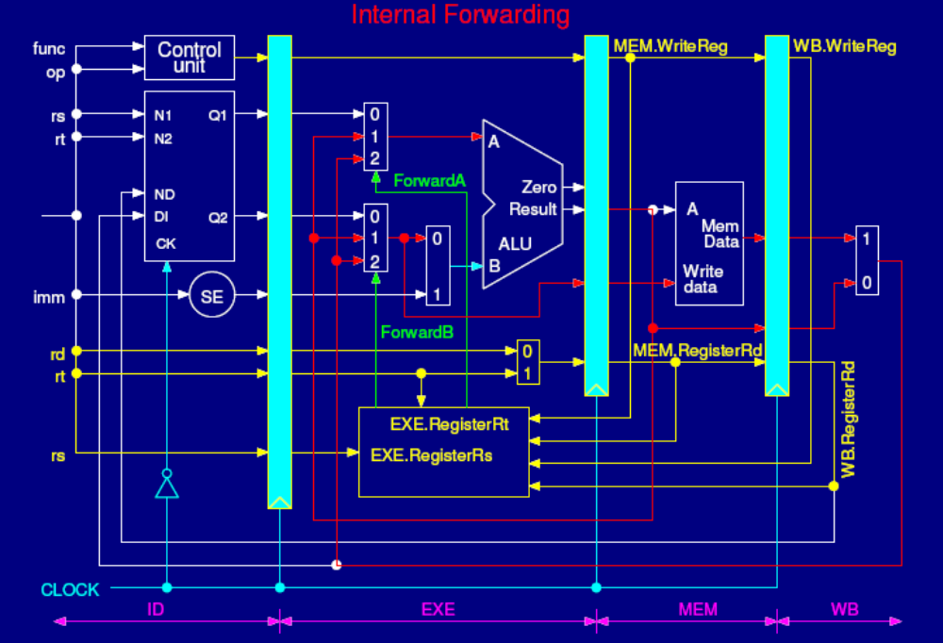

Slide 72
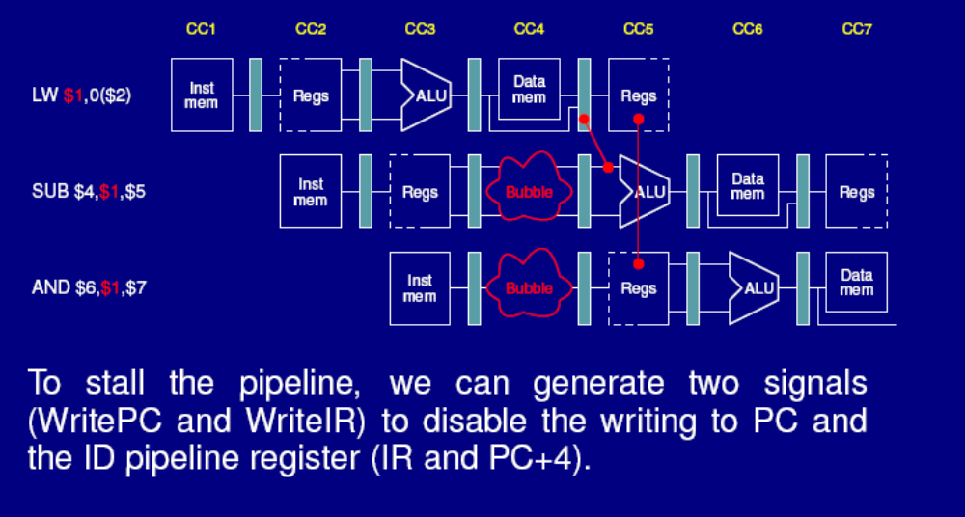
Load stall even with forwarding path

Slide 73
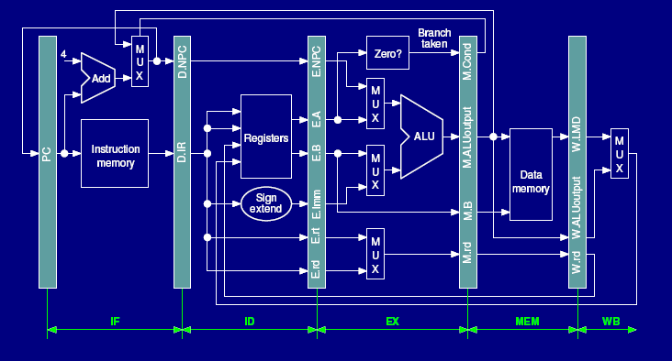
Pipeline with 3 branch delay slot

Slide 74
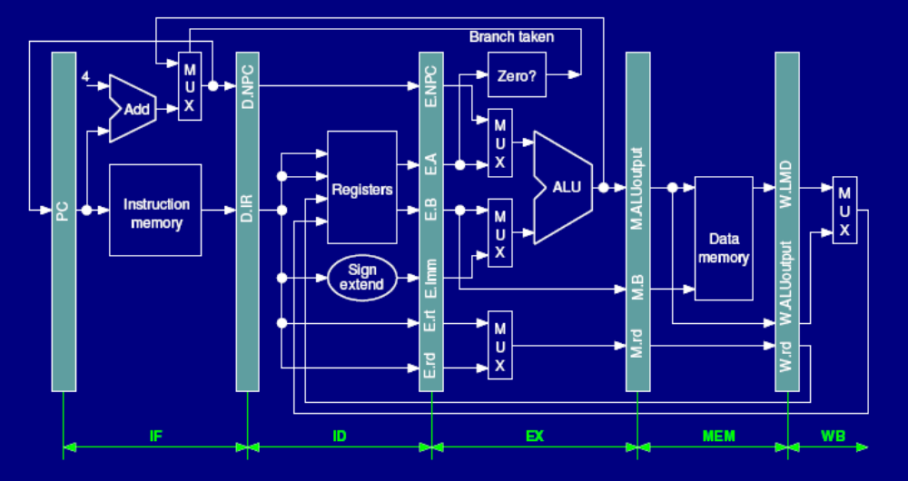
Pipeline with 2 branch delay slot

Slide 75
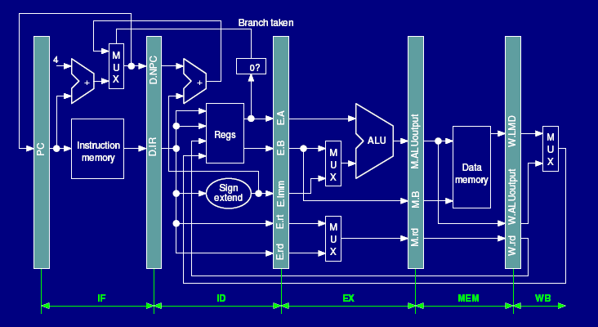
Pipeline with 1 branch delay slot

Slide 76
Pipeline with 1 delay slot and forwarding path and load stall

Slide 77
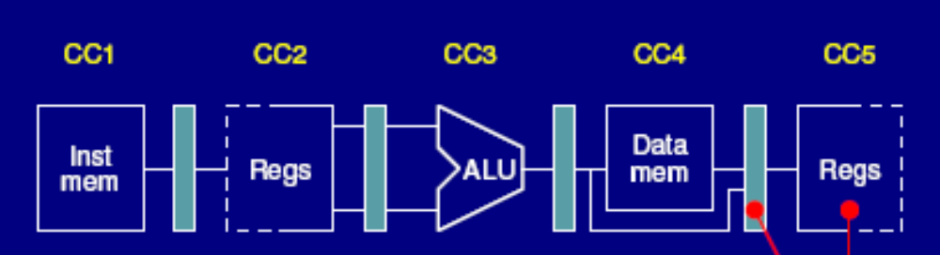

Still need to stall sometime
SUB $4, $1, $5
BEQ $4, $2, L1

Slide 78
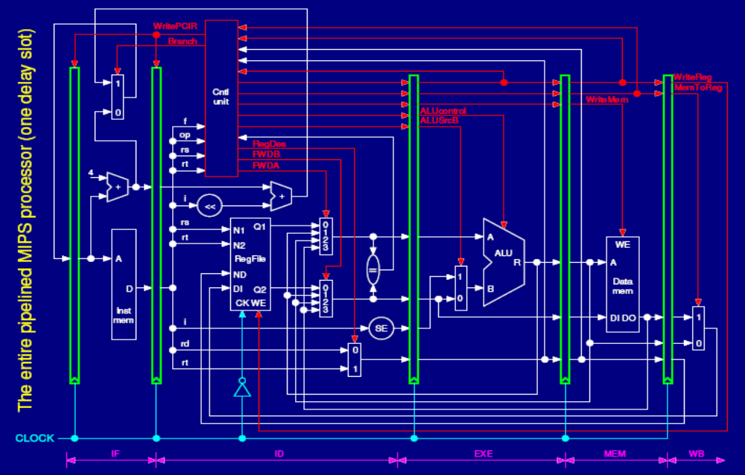
Move forwarding to ID

Slide 79
Extending 5-MIPS pipeline to deal with multi-cycle operations
Is there WAR hazard or WAW hazard ?
Could you judge when and what hazard ?

Slide 80
Are you clear about these terms ?
36 terms of Cache
Cache Virtual memory
data cache Instruction cache unified cache
block page tag field
Block address index field block offset
full associative set associative direct mapped
n-way set associative set address trace
misses per instruction Memory stall cycles miss penalty
Valid bit dirty bit locality
cache hit hit time
cache miss miss rate page fault
Write through write back write allocate
random replacememt least-recently used no-write allocate
Average memory access time write buffer write stall

Slide 81
Memory Hierarchy (C.1)
What’s Memory hierarchy ? Why ?
Basic four questions for Memory Hierarchy
  Block placement
    Relations among direct mapped, set associate, full associate
  Block identification
    Structure description ←→ graph ?
    Could you break the Physical Address down to Tag/ Index / block offset ?
  Replacement
    RAND, LRU, FIFO
  Write strategy
    Write through / write back
    Write allocate / No write allocate

Slide 82
Memory Hierarchy (cont.)
What’s the difference between cache and Virtual memory ?
Cache ← L2 cache, memory
Line( block)
Direct mapped/set/full associate
Pseudo RAND/ LRU / FIFO
Write through / write back
Hardware
CPU Stall waiting for miss
Aim at Memory Speed
……
Physical Memory ←VM
Page / segment
Full associate
LRU
Write back
TLB & software ( page table )
Interrupt while page fault
Aim at Memory Size
……
What’s TLB ? Can we call it a cache ? What are included in a TLB entry ?

Slide 83
Cache Performance
What metric is used to evaluate cache performance ?
  Miss Rate? AMAT ? CPU time ?
How to calculate AMAT ? (examples )
How to calculate CPUtime taking into account of memory system ?
What’s the difference between Miss Rate and Misses
per instruction ?

Slide 84
How to Improve Cache Performance?
3C model (C.3)
  Compulsory
  Capacity
  Conflict
4th C –Coherency (4.3)
  Truth sharing miss
  False sharing miss

Slide 85
How to Improve Cache Performance? ( C.3, 5.2)
1. Reduce the time to hit in the cache.--4
——small and simple caches, avoiding address translation, way prediction , and trace caches
2. Increase cache bandwidth .--3
—— pipelined cache access, multibanked caches, non-blocking caches,
3. Reduce the miss penalty--4
——multilevel caches, critical word first, read miss prior to writes, merging write buffers, and victim caches
4. Reduce the miss rate--4
——larger block size, large cache size, higher associativity,and compiler optimizations
5. Reduce the miss penalty and miss rate via parallelism--2
——hardware prefetching, and compiler prefetching

Slide 86
Memory Technology
What’s difference between DRAM & SRAM ?
Memory organization
  Wider memory
  Simple interleaved memory
  Independent memory banks
  Avoiding Memory Bank Conflicts ( complier / Hardware )
Memory chip
  FPM ( Fast Page Mode DRAM )
  Synchronize DRAM
  DDR ( Double Date Rate )
  RDRAM

Slide 87
Multiprocessor
Catalogue the Parallel (MIMD) processors
  Centralized shared memory / Distributed memory multi-processor
  Pros vs. Cons
concepts
  SMP / DSM / CSM / Multiple computer
  UMA / NUMA
  SPP / MPP
Communication Model
  Share memory
  Message passing

Slide 88
Cache coherence
What’s cache coherence ?
  Write serialization
Snooping protocol
  Write Invalidate / Write update
  What’s the difference between them ?
  State machine
Directory-based protocol
  Status machine ( cache block, directory )

