Slide 1

Computer Architecture ----A Quantitative Approach
陈文智
浙江大学计算机学院
chenwz@zju.edu.cn

Slide 2
TOC
5.8 Main Memory and Organizations for Improving Performance
5.9 Memory Technology
5.10 Virtual Memory

Slide 3
5.8 Main Memory and Organizations for Improving Performance
Main memory is the next level down in the hierarchy.
We usually call it inter-memory(EMS memory)
Main memory is usually made from DRAM while caches use SRAM.
Performance of main memory
Latency: harder to reduce latency
Important for caches.
Bandwidth: easier to improve bandwidth with new organizations
Important for I/O.
Also for cache with second-level and larger block sizes.
The previous sections describe cache organization to reduce CPU-DRAM performance gap
This section we analyze techniques for organizing memory to improve bandwidth.

Slide 4

Performance basic memory organization
First-level caches are often organized with a physical width of 1 word because most CPU accesses are that size
Assume
4 clock cycles to send the address
56 clock cycles for the access time per word
4 clock cycles to send a word of data
Block size is 4 words
Every word is 8 bytes
The miss penalty:
4×(4+56+4)＝256 CLKs
Bandwidth :
4×8
1
Memory
＝
256
8

Slide 5
First Technique for Higher Bandwidth: Wider Main Memory
Amdahl’law suggested that memory capacity should grow linearly with CPU speed.
Retrospecting
Memory capacity grows four-fold every three years to supply this demand.
The CPU-DRAM performance gap is a problem, however, since DRAM performance improvement is only about 7% per year.
We will now look at innovations in main memory organizations that are more cost effective.
Wider Main Memory
Doubling or quadrupling the width of the cache and the memory
It will therefore double or quadruple the memory bandwidth.

Slide 6
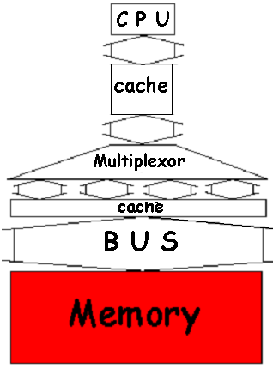
Many words in Single bank
Widening memory:
Doubles /quadruples
Memory and Bandwidth
Disadvantages: bus
MUX required on critical path to allow word access.
Increase minimum memory increment purchased by customer.
Complicates error correction
Memory

Slide 7
Performance in the Technique
With a main memory width of 2 words
The miss penalty: 4words/Block
2×(4+56+4)＝128 CLKs
Bandwidth :
With a main memory width of 4 words
The miss penalty: 4words/Block
1×(4+56+4)＝64 CLKs
Bandwidth :
4×8
1
＝
128
4
4×8
1
＝
64
2

Slide 8
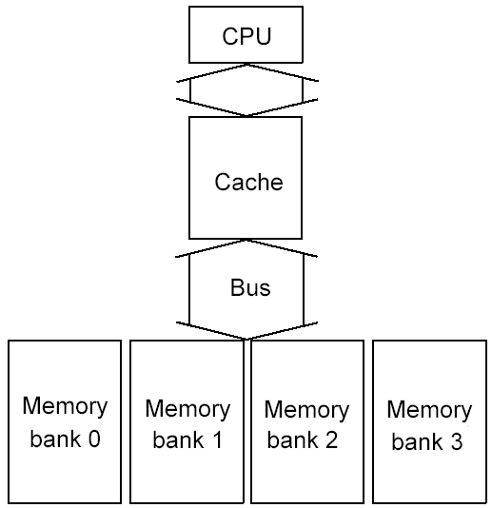
Second Technique for Higher Bandwidth: simple Interleaved Memory
Advantages:
Take advantage of the potential parallelism of having many DRAMs in a memory system.
Such a memory organization is especially important for write through with accessing sequentially
Memory chips can be organized in banks to read or write multiple words at a time
The banks are often 1 word wide so that width of the bus and cache need not change.
But sending addresses to several banks permits them all to read simultaneously.
Memory

Slide 9
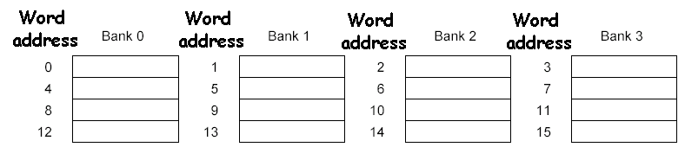
Performance in the Technique
With 4 banks Interleaved Memory
The miss penalty: 4words/Block
4+56 +(4 × 4)＝76
Bandwidth :
Four-way interleaved memory
4×8
＝
0.4
76
Parallel access
Optimizes sequential address access patterns
Notes:
为什么第一个4不用×4？
因为第一个下行带宽是够的

Slide 10
Example 14-1 Interleaved Memory
Assume:
Block size = 1 word
Memory bus width = 1 word
Miss rate = 3%
Memory accesses per instruction = 1.2
Cache miss penalty = 64 cycles (as above)
Average cycles per instruction (ignoring cache misses) = 2
What can interleaving and wide memory buy?
Answer: The CPI for the base computer using 1-word blocks:
CPI = 2 + (1.2 × 3% × 64) = 4.30
We can calculate performance improvement by just comparing CPI.

Slide 11
Example 14-2 Interleaved Memory
Answer:
Increasing the block size to two words gives the following options(miss rate is 2%):
64-bit bus and memory, no interleaving
CPI＝ 2 + (1.2 × 2% ×2 × 64) = 5.07
64-bit bus and memory, interleaving
CPI＝ 2 + (1.2 × 2% ×(4 + 56 + 8)) = 3.63
128-bit bus and memory, no interleaving
CPI＝ 2 + (1.2 × 2% × 1 × 64) = 3.54
Thus, doubling the block size slows down the straightforward implementation (5.07 versus 4.30), while interleaving or wider memory is 1.19 or 1.22 times faster, respectively.
If we increase the block size to four, How about performance?

Slide 12
Example 14-４ Interleaved Memory
Answer:
Assume: miss rate is 1.2%
Increasing the block size to four words gives the following options:
64-bit bus and memory, no interleaving
CPI＝ 2 + (1.2 × 1.2% × 4 × 64) = 5.69
64-bit bus and memory, interleaving
CPI＝ 2 + (1.2 × 1.2% × (4 + 56 + 16)) = 3.09
128-bit bus and memory, no interleaving
CPI＝ 2 + (1.2 × 1.2% × 2 × 64) = 3.84
Again, the larger block hurts performance for the simple case(5.69 versus 4.30), although the interleaved 64-bit memory is now fastest—1.39 times faster versus 1.12 for the wider memory and bus.
How many banks should be included? One metric, used in vector computers, is as follows:
Number of banks ≥ Number of clock cycles to access word in bank

Slide 13
Third Technique for Higher Bandwidth: Independent Memory Banks
Independent memory banks
The interleaved memory concept can be extended to remove all restrictions on memory access.
Independent memory controller was present for every bank.
Using separate address line and data bus
This allowed the interleaving of sequential access patterns.

Slide 14
Example 15 Avoiding Memory Bank Conflicts
Assume: Memory banks 128（总共有128个bank）, interleaved on a word basis, and execute following code:
int x[256][512];
for (j = 0; j < 512; j = j+1)
for (i = 0; i < 256; i = i+1)
x[i][j] = 2 * x[i][j];
Solutions There are both software and hardware solutions
The compiler :
Loop interchange optimization to avoid accessing the same bank.
For the programmer or the compiler to expand the size of the array so that it is not a power of 2, thereby forcing the addresses above to go to different banks.
The hardware: Using a prime number of memory banks 2^{n}-1
How are Memory Bank Conflicts and does it solve ?
Answer:
Conflicts: Since the 512 is an even multiple of 128, all the elements of a column will be in the same memory bank and code will stall on data cache misses no matter how sophisticated a CPU or memory system.

Slide 15
5.9 Memory Technology
This section describes the technology inside the memory chips.
Two measures—access time and cycle time.
Access time ----- time between when a read is requested and when the desired word arrives,
Cycle time ----- minimum time between requests to memory.
One reason that cycle time is greater than access time is that the memory needs the address lines to be stable between accesses.

Slide 16
Main Memory Background
Random Access Memory (vs. Serial Access Memory)
Different flavors at different levels
Physical Makeup (CMOS, DRAM)
Low Level Architectures (FPM,EDO,BEDO,SDRAM)
Cache uses SRAM: Static Random Access Memory
No refresh (6 transistors/bit vs. 1 transistor Size: DRAM/SRAM ­ 4-8, Cost/Cycle time: SRAM/DRAM ­ 8-16
Main Memory is DRAM: Dynamic Random Access Memory
Dynamic since needs to be refreshed periodically (8 ms, 1% time)
Addresses divided into 2 halves (Memory as a 2D matrix):
RAS or Row Access Strobe
CAS or Column Access Strobe

Slide 17
Embedded Processor Memory Technology: ROM and Flash
Embedded computers usually have small memories, and most do not have a disk to act as non-volatile storage.
Two memory technologies are found in embedded computers to address this problem.
The first is Read-Only Memory (ROM).
ROM is programmed at time of manufacture, nothing the computer can do can modify the contents of this memory.
The second is Flash memory.
Allows the embedded device to alter nonvolatile memory after the system is manufactured,
Allows reading at almost DRAM speeds but writing flash is 10 to 100 times slower.

Slide 18
ROM (掩膜式)
PROM(熔丝或二极管)
EPROM
EEPROM
FLASH MEMORY
Notes:
ROM：只读储存器；PROM：可以写一次，通过专用的设备； ERPOM：可以写，而且写的条件略有放松，也可以多次写，断电后不丢失；EEPROM，可在计算机上直接擦除，不易挥发；flash memory，实际上是RAM（断点后数据丢失。）范畴，flash可以做到随机访问，而且断点不丢失，进一步可以分为必须按顺序读写课不需要按顺序读写

Slide 19
5.10 Virtual Memory
What is virtual memory?
Technique that allows execution of a program that
can reside in discontinuous memory locations
does not have to completely reside in memory
Allows the computer to “fake” a program into believing that its
memory is contiguous
memory space is larger than physical memory, Provides illusion of very large memory
Why is VM important?
Cheap - no longer have to buy lots of RAM
Removes burden of memory resource management from the programmer
Enables multiprogramming, time-sharing, protection

Slide 20
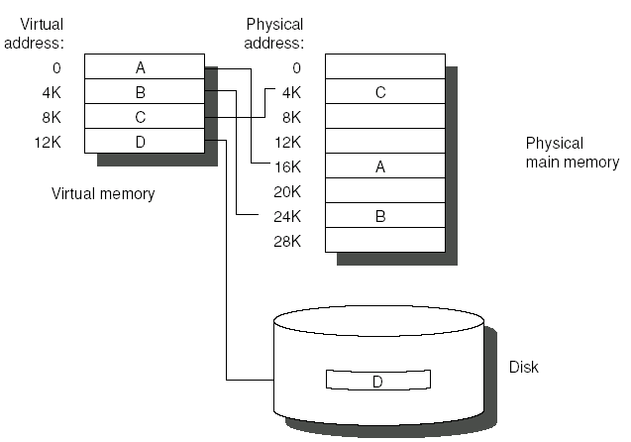
Advantages
Main memory (physical memory) can act as a cache for the secondary storage (disk)
illusion of having more and contiguous physical memory
program relocation by “pages” or “segment”
protection in multiprogramming
Virtual Address :
address used by the programmer
Virtual Address Space:
collection of such addresses
Memory Address:
address of word in physical memory
also known as “physical address”
or “real address”

Slide 21
How Does VM Work
Two memory “spaces”
Virtual memory space - what the program “sees”
Physical memory space - what the program runs in (size of RAM)
On program startup
OS copies program into RAM
If there is not enough RAM, OS stops copying program & starts running the program with some portion of the program loaded in RAM
When the program touches a part of the program not in physical memory, OS copies that part of the program from disk into RAM
In order to copy some of the program from disk to RAM, OS must evict parts of the program already in RAM
OS copies the evicted parts of the program back to disk if the pages are dirty (ie, if they have been written into, and changed)

Slide 22
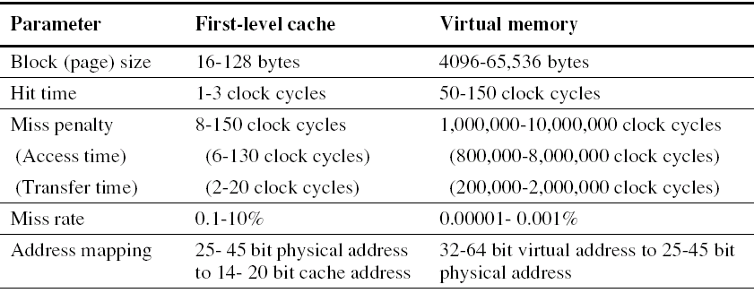
Memory Hierarchy Parameters for Virtual Memory.
Terms are different
Block ----Page or segment
Miss ---- page fault or address fault
Memory mapping or address translation ---- With virtual memory, the CPU produces virtual addresses that are translated by a combination of hardware and software to physical addresses, which access main memory.
The two memory-hierarchy levels controlled by virtual memory are DRAMs and magnetic disks.

Slide 23
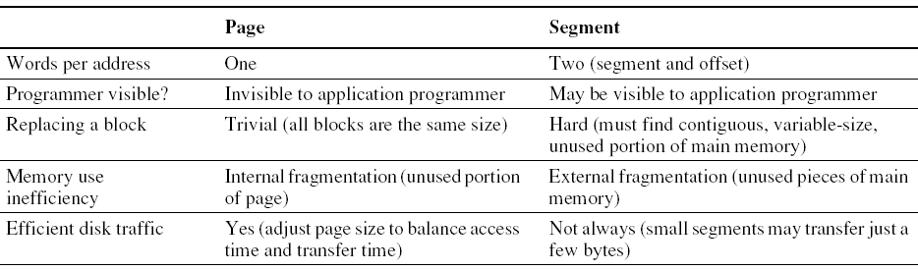
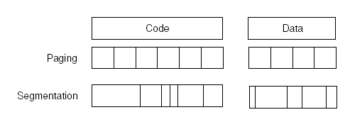
Paging versus segmentation
Virtual memory systems can be categorized into two classes
Pages---- fixed-size blocks,
segments---- variable-size blocks

Slide 24
Four Memory Hierarchy Questions Revisited
Q1: Where can a block be placed in main memory?
The high miss penalty
Quite high
access to a rotating magnetic storage device and
Must be lower miss rates
choosing a simpler placement algorithm
operating systems designers normally pick lower miss rates because of the exorbitant miss penalty.
Fully associative strategy.
Thus, operating systems allow blocks to be placed anywhere in main memory.

Slide 25
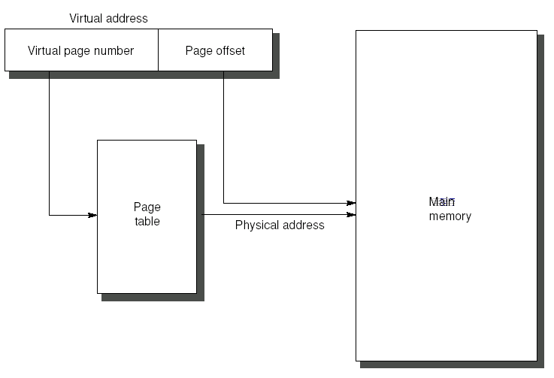
Q2: How is a block found if it is in main memory?
Both paging and segmentation data structure table
The data structure contains the physical address of the block.
That is indexed by the page or segment number
For segmentation:
The offset is added to the segment’s physical address to obtain the final physical address.
For paging:
the offset is simply concatenated to this physical page address
The size of the table
The number of pages in the virtual address space.
Assume: 32-bit virtual address, 4-KB pages, and 4 bytes per page table entry; the size of the page table:
To reduce the size table
-Apply a hashing function to the virtual address.
-The hash allows the data structure to be the length of the number of physical pages in main memory. Such a structure is called an inverted page table.
To reduce address translation time
-Computers use a cache dedicated to these address translations, called a translation look-aside buffer, or simply translation buffer.
2³²
×2² ＝2²²B＝4 MB
2¹²

Slide 26
Q3: Which block should be replaced on a virtual memory miss?
For minimizing page faults
Almost all operating systems try to replace the least-recently used (LRU) block
Because if the past predicts the future, that is the one less likely to be needed.
Mechanism
Many processors provide a use bit or reference bit
which is logically set whenever a page is accessed.
The operating system periodically clears the use bits and later records them
By keeping track in this way, the operating system can select a page that is among the least-recently referenced.

Slide 27
Q4: What happens on a write?
Write strategy
The level below main memory contains rotating magnetic disks that take millions of clock cycles to access.
Thus, the write strategy is always write back.
Dirty bit
cost of an unnecessary access Disk is so high, it allows blocks to be written to disk only if they have been altered since being read from the disk.

Slide 28

THANK YOU
THANK YOU

