Slide 1

Computer Architecture ----A Quantitative Approach
陈文智
浙江大学计算机学院
chenwz@zju.edu.cn

Slide 2
6.1 Introduction
Three opinions:
Advances in uniprocessor architecture were nearing an end
Processor performance growth was at its highest rate
Parallel processors will definitely have a bigger role in the future
Which is right ?

Slide 3
6.2 A Taxonomy of Parallel Architectures
Single instruction stream, single data stream (SISD) —This category is the uniprocessor.
Single instruction stream, multiple data streams (SIMD) —Vector architectures are the largest class of processors of this type.（GPU）

Slide 4
Multiple instruction streams, single data stream (MISD) —No commercial multiprocessor of this type has been built to date, but may be in the future.
Multiple instruction streams, multiple data streams (MIMD) —Each processor fetches its own instructions and operates on its own data. The processors are often off-the-shelf microprocessors.

Slide 5
6.3 Two classes of MIMD
Depend On:
the number of processors
memory organization
Interconnect strategy

Slide 6
6.3.1 Centralized shared-memory architecture
Notes:
集中共享存储器 SMP，对称式的（对称多处理器），也叫UMA
Cache里面可以存放私有数据。

Slide 7
With small processor counts
With large caches
Called symmetric (shared-memory) multiprocessors (SMPs)
Called UMA for uniform memory access
Notes:
Centralized Shared-memory = SMP = UMA
总线的结构，导致规模无法太大（总线带宽的限制）

Slide 8
6.3.2 Distributed-memory architecture
Notes:
链接通过一个复杂的互联网络链接，支持大规模和超大规模的节点数目
Cache当中存有的数据不一定是本家的Memory中的数据，也可以是别家的。

Slide 9
With large processor counts
the need for a high bandwidth interconnect
Advantage:
cost-effective way to scale the memory bandwidth, if most of accesses are to local memory in the node.
It reduces the latency for access to the local memory.

Slide 10
6.4 Models for Communication and Memory Architecture

Slide 11
6.4.1 Models for memory Architecture
Distributed shared memory (DSM or scalable shared memory)
logical uniform address space but physical distributed memory, so any one of the processors can access any one of the memories.
Shared memory means sharing the address space, which is different from centralized shared memory.
UMA( uniform memory access) ---- centralized share memory.
NUMA( non-uniform memory access) ---- distributed shared memory.

Slide 12
Multiple computers
Address space consists of multiple private address spaces。cannot be addressed by a remote processor.
Each processor-memory module is essentially a separate computer (multicomputers).

Slide 13
6.4.2 Models for Communication
Shared memory
Message passing
Synchronous message passing (RPC)
Asynchronous message passing(MPI)

Slide 14
For Shared memory
compatibility with mechanism used in centralized multiprocessors
easy programming, simplify compiler design
lower overhead for communication and better use of bandwidth, due to implicit nature of communication and implement memory protection in hardware instead of in OS.
The ability to use hardware-controlled caching to reduce the frequency of remote communication by supporting automatic caching of both shared and private data.

Slide 15
For Message passing
The hardware can be simpler
communication is explicit, simpler to understand
forcing programmers and compilers to pay attention to communication.
….

Slide 16
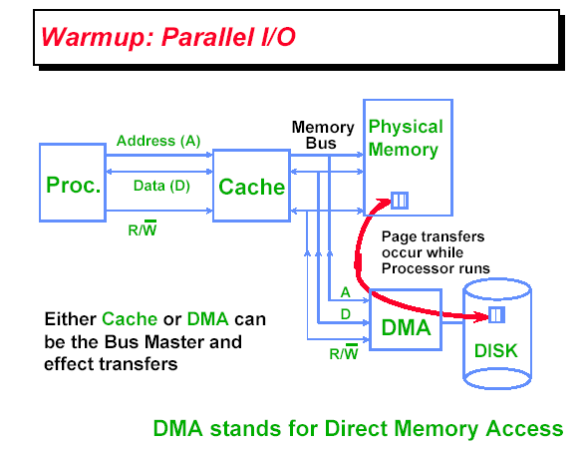
6.5 What Is Multiprocessor Cache Coherence?

Slide 17
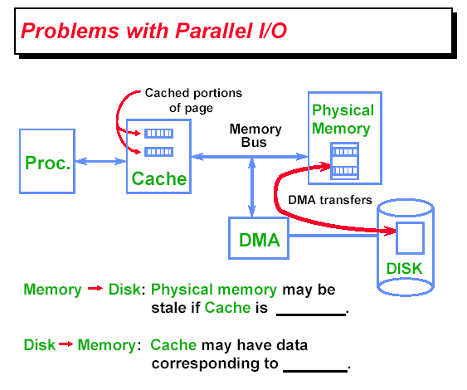
Physical memory may be stale of Cache is modified by CPU
Cache may be stale if cached data in Memory is updated by Disk

Slide 18
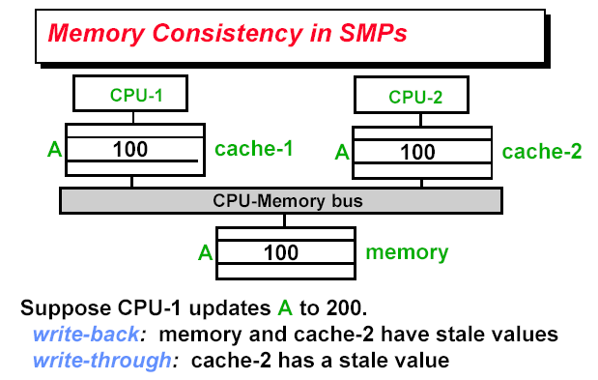

Slide 19
Example1: read

Slide 20
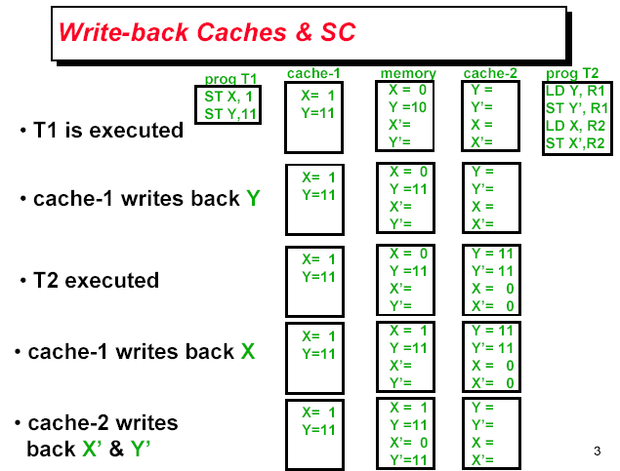
Example2: Write

Slide 21
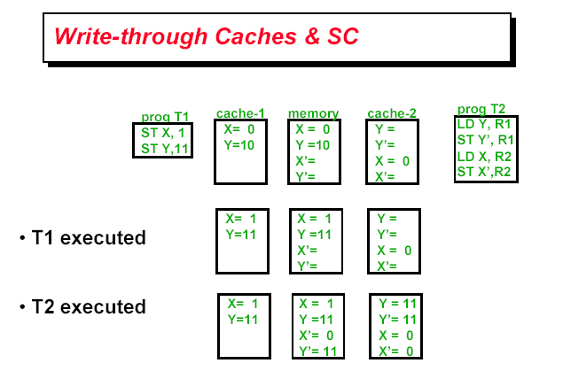

Slide 22
6.6 Snooping

Slide 23
6.6.1 Write invalidate protocol
Notes:
写时无效的侦听协议

Slide 24
6.6.2 Write update or write broadcast protocol
Notes:
写实更新的侦听协议

Slide 25
Notes:
蓝色：侦听总线的操作
黑线：本地操作

Slide 26
6.7 Directory protocol
Notes:
目录协议：家节点、本地节点、远程节点

Slide 29

THANK YOU
THANK YOU

