Slide 1

Computer Architecture ----A Quantitative Approach
陈文智
浙江大学计算机学院
chenwz@zju.edu.cn

Slide 2
Topics in Chapter
1.1 Why take this course ?
1.2 Classes of computers in current computer market
1.3 Defining computer architecture and What’s the task of computer design?
1.4 Trends in Technology
1.5 Trends in power in Integrated circuits
1.6 Trends in Cost
1.7 Dependability
1.8 Measuring, Reporting and summerizing Perf.
1.9 Quantitative Principles of computer Design
1.10 Putting it altogether

Slide 3
Cost trends
Cost Trend
Understanding cost trends of component is important for designers.
The impact factors for cost:
Time: Component prices drop over time without major improvements in manufacturing technology
Volume: Volume decreases cost due to increases in manufacturing efficiency.
Commodification: The competition among the suppliers of the components will decrease overall product cost.

Slide 4
Microelectronics Process
Notes:
1、电迁移特性。2、单晶硅。3、单晶硅锭。4、二氧化硅层 。5、感光层。6、光烛刻

Slide 5
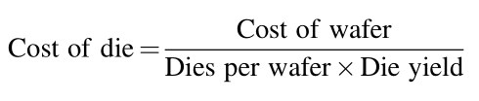
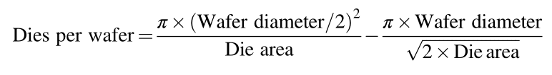
Cost of an Integrated Circuit

Slide 6
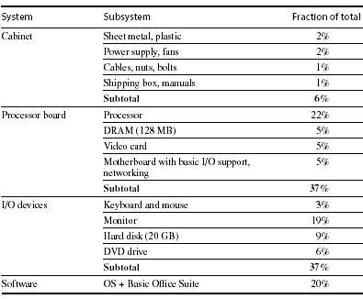
Distribution of Cost in a System

Slide 7
Cost vs. Price
Component costs
Raw material cost.
Direct cost:
Costs incurred to make a single item. Adds 20% to 40% to component cost.
Gross margin (Indirect cost):
Overhead not associated with a single item, i.e. R&D, marketing, manufacturing equipment, taxes, etc.
Only 4%-12% of income are spent on R&D
Average Selling Price (ASP):
Component cost + direct cost + indirect cost.
List price

Slide 8
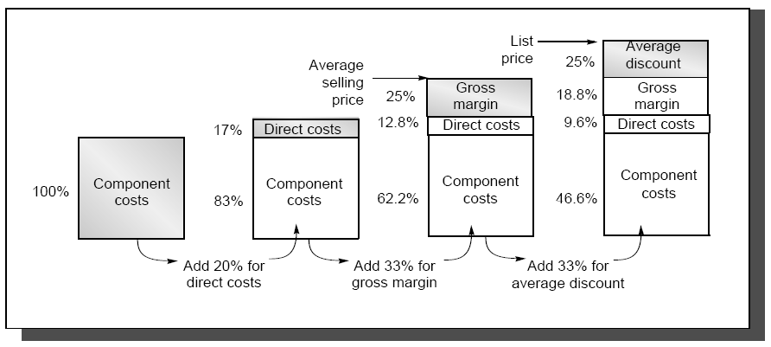
The components of price for a $1000 PC

Slide 9
Cost vs. Price
This gives you insight on how a design decision will affect selling price,
i.e. changing cost by $1,000 increases selling price by $3,000 to $4,000.
Also, consider volume and price relationship:
In general, the fewer computers that are sold, the higher the price.
Also, a decrease in volume causes cost to increase, further increasing price.
Therefore, small changes in cost can have an unexpected large increase in price.

Slide 10
Topics in Chapter
1.1 Why take this course ?
1.2 Classes of computers in current computer market
1.3 Defining computer architecture and What’s the task of computer design?
1.4 Trends in Technology
1.5 Trends in power in Integrated circuits
1.6 Trends in Cost
1.7 Dependability
1.8 Measuring, Reporting and summerizing Perf.
1.9 Quantitative Principles of computer Design
1.10 Putting it altogether

Slide 11
Dependability
Dependability is a deliberately broad term to encompass many facets including reliability, security and availability.

Slide 12
Dependability vs. Reliability
Dependability. A measure of the degree to which an item is operable and capable of performing its required function at any (random) time during a specified mission profile, given item availability at the start of the mission.
Its use is restricted to general descriptions in non-quantitative terms.
Dependability is related to reliability; the intention was that dependability would be a more general concept then reliability.

Slide 13
Two Main Measures of Dependability
Module Reliability
Continuous service accomplishment
(or, equivalently, of the time to failure)
MTTF: Mean Time To Failure
MTTR: Mean Time To Repair
FIT : Failure In Time = 1/MTTF
MTBF: Mean Time Between Failure = MTTF+MTTR
Module Availability
Service accomplishment with respect to the alternation between accomplishment and interruption
For a nonredundant system with repair:
Module Availability= MTTF / (MTTF + MTTR)

Slide 14
Topics in Chapter
1.1 Why take this course ?
1.2 Classes of computers in current computer market
1.3 Defining computer architecture and What’s the task of computer design?
1.4 Trends in Technology
1.5 Trends in power in Integrated circuits
1.6 Trends in Cost
1.7 Dependability
1.8 Measuring, Reporting and summarizing Performance
1.9 Quantitative Principles of computer Design
1.10 Putting it altogether

Slide 15
Measuring and Reporting Performance
Performance Metrics
Response Time (or execution time)
Time between start and end of an event
Throughput
Total amount of work done in a given time
Comparing Machines Using Sets of Programs
Choosing which program to evaluate performance
Benchmark Suites
Different Means: Arithmetic, Harmonic, and Geometric Means

Slide 16
Defining performance
Performance means different things to different people, therefore its assessment is subtle
Criteria of performance evaluation differs among users and designers

Slide 17

Performance Metrics: Response Time
Wall-clock time
Start the program and watch the clock -
when the program ends, that’s the total wall-clock time
Also called response time or elapsed time or
Measures user perception of the system speed
Problems with wall-clock time
What if more than one program is running on the same machine ?
What if the program asks for user input ?

Slide 18
Performance Metrics: CPU Time
Measures the time the CPU is computing, (not waiting for I/O)
Measures designer perception of the CPU speed
CPU time is further divided into:
User CPU time - time spent in user mode
System CPU time - time spent in the operating system (OS)
Unix time command reports CPU time as:
90.7u 12.9s 2:39 65%
90.7 user CPU seconds (in the user’s program)
12.9 system CPU seconds (in the system calls e.g. printf)
2 minutes, 39 seconds wall-clock time
65% of the wall clock time was spent running on the CPU

Slide 19
Performance Metrics: Throughput
Amount of work done in a given time
Measure administrator perception of the system perf.
We often use throughput to measure
Number of lines of code per day
Number bits per second transmitted over a wire
Number of web pages served
In contrast to latency
amount of time to produce 1 line of code
amount of time to send 1 bit over a wire
Amount of time spent waiting to receive web page
Often, processor performance is only quoted in terms of relative latency
Program A ran 10 times faster than program B
But, for many apps, throughput much more important than latency
Financial markets, government statistics (census)

Slide 20
Response time vs. Throughput
If you improve response time, you usually improve throughput
Replacing the processor of a computer with a faster version
You can also improve throughput without improving response time
Adding additional processors to a system that uses multiple processors for separate tasks
e.g. handling of airline reservations system

Slide 21
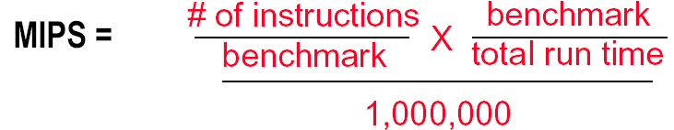
Another industry Metric: MIPS
MIPS - Millions of Instructions per Second
When comparing two machines (A, B) with the same instruction set, MIPS is a fair comparison(sometimes…)
But, MIPS can be a “meaningless indicator of performance” when comparing different architectures
Difference in instruction sets/ accelerators

Slide 22
Another view: Power consumption and Efficiency
Critical factors for embedded systems:
Cost
Physical size
Memory
Power consumption

Slide 23
Choose Programs to Evaluate Performance
Ideal performance evaluation:
A random sample of users running their programs and OS commands.
Many different types of benchmarks
Real applications--- Scientific and engineering
Modified (or scripted) applications--- focus on specific features
Kernels --- critical program fragments
Toy --- small programs, often measure very little
Synthetic -- created to represent some aspects of a program (e.g., mix of instruction types)
Database -- a world unto itself
What really matters is how YOUR application performs

Slide 24
Something about Synthetic
Synthetic benchmarks :
Programs that try to "exercise" the system in the same way to match the average frequency of operations and operands of a large set of programs.
Whetstone and Dhrystone.
Similar to kernels but are NOT real programs !
Compiler and hardware optimizations can artificially inflate performance of these benchmarks but not of real programs.
These benchmarks don’t reward optimizations!
For example, SQRT(EXP(x)) = EXP(X/2)

Slide 25
Notes on performance benchmark
Benchmarks can focus on specific aspects of a system
floating point & integer ALU, memory system, I/O, OS
Universal benchmarks can be misleading since hardware and compiler vendors might optimize their design for ONLY these programs
The best types of benchmarks are real applications since they reflect the end-user interest
Architectures might perform well for some applications and poorly for others
Compilation can boost performance by taking advantage of architecture-specific features. Application-specific compiler optimization are becoming more popular.

Slide 26
SPEC
SPEC - The System Performance Evaluation Cooperative
founded in 1988 by a small number of workstation vendors who realized that the marketplace was in desperate need of realistic, standardize performance tests.
Grown to become successful performance standardization bodies with more than 40 member companies.
http://www.spec.org
SPEC's Philosophy
The goal of SPEC is to ensure that the marketplace has a fair and useful set of metrics to differentiate candidate systems.
The basic SPEC methodology is to provide the benchmarker with a standardized suite of source code based upon existing applications

Slide 27
SPEC benchmarks Desktop Benchmarks
CPU-intensive benchmarks
SPEC89
SPEC92
SPEC95
SPEC2000
SPEC CPU2006 ( 12 CINT2006, 17 CFP2006)
SPEC CPU2017
Graphics-intensive benchmarks
SPECviewperf
is used for benchmarking systems supporting the OpenGL graphics library
SPECapc
consists of applications that make extensive use of graphics.

Slide 28
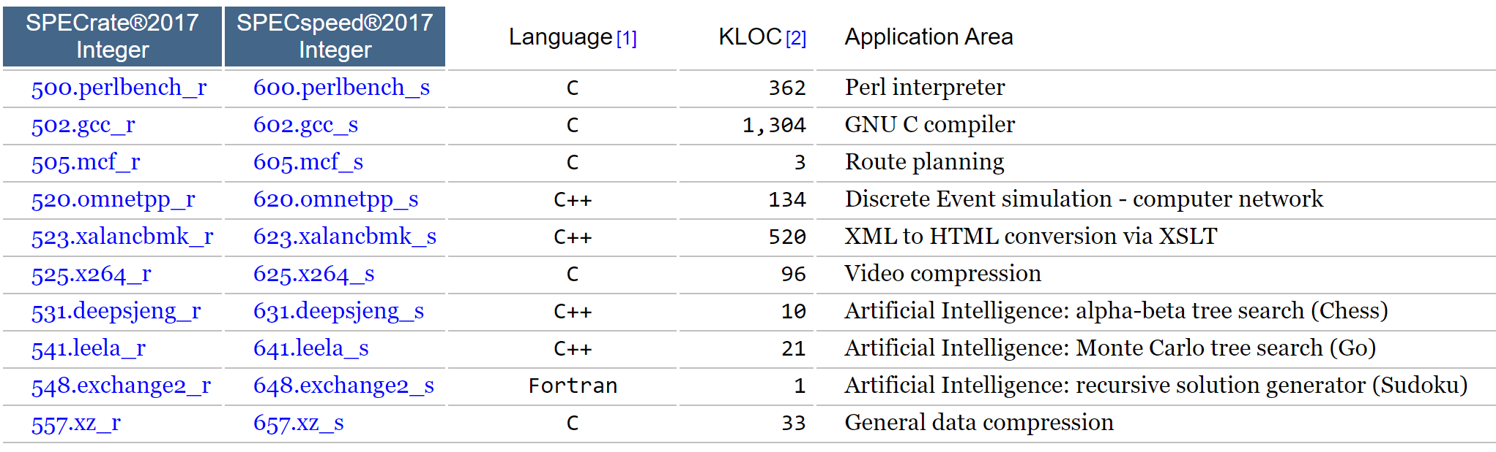
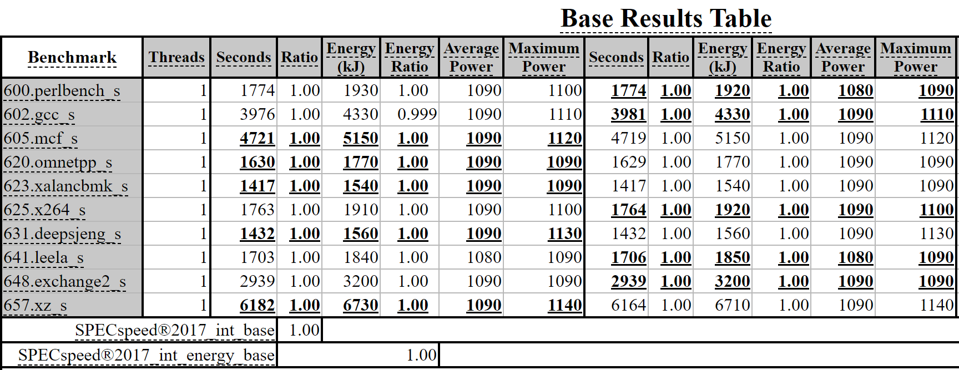
SPEC INT 2017 Benchmark descriptions
SPECspeed is a time-based metric; SPECrate is a throughput metric.
Notes:
SPECspeed is a time-based metric; SPECrate is a throughput metric.

Slide 29
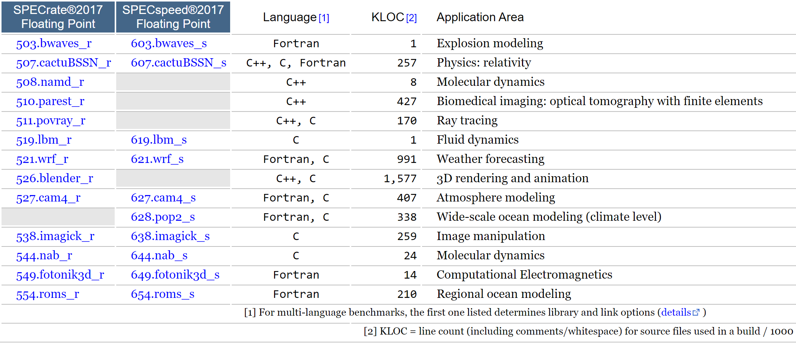
SPEC FP 2017 Benchmark Descriptions
Notes:
https://www.spec.org/cpu2017/Docs/overview.html#klocNote

Slide 30
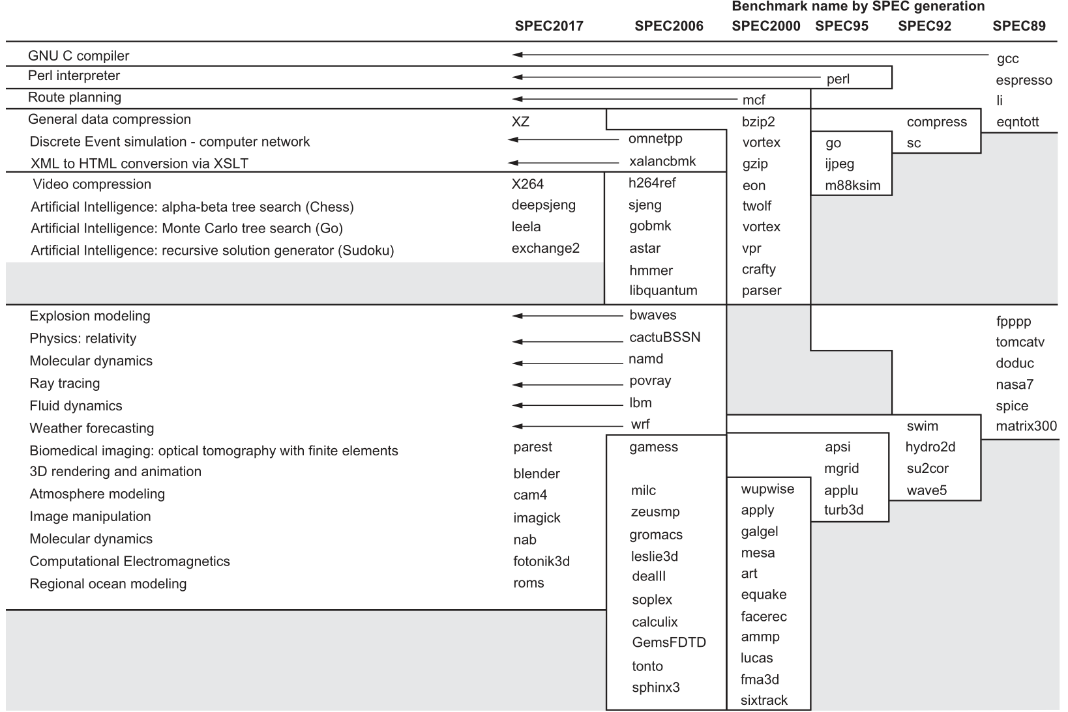
the evolution of the SPEC benchmarks over time

Slide 31
Running Benchmarks
Key factor: Reproducibility by other experimenters.
Details: List all assumptions and conditions of your experiments.
i.e. program input, version of the program, version of the compiler, optimization level, OS version, main memory size, disk types, etc.
A system’s software configuration can significantly affect the performance results for a benchmark.

Slide 32

Comparing Performance
Why we want to compare the performance of different machines or different programs.
To help engineers understand which is “better”
To give marketing a “silver bullet” for the press release
To help customers understand why they should buy <my machine>
Performance and Execution time are reciprocals
Maximizing performance means minimizing response (execution) time

Slide 33

Common used phrases
“Performance of P1 is better than P2 ” is, for a given work load L, P1 takes less time to execute L than P2 does
performance(P1) > Performance(P2)
⇒ Execution Time(P1, L) < Execution Time(P1, L)
“Processor X is n times fast than Y” is

Slide 34
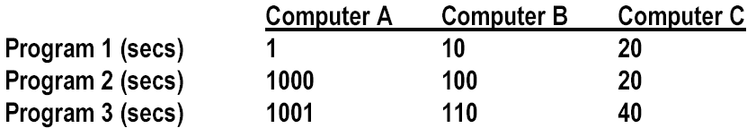
Comparing Performance Across Multiple Programs
A is 10 times faster than B for program 1
B is 10 times faster than A for program 2
A is 20 times faster than C for program 1
C is 50 times faster than A for program 2
B is 2 times faster than C for program 1
C is 5 times faster than B for program 2
Each statement above is correct…,
…but we want to know which machine is the best?

Slide 35
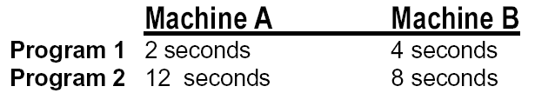
Let’s Try a Simpler Example
Two machines timed on two benchmarks
How much faster is Machine A than Machine B?
Attempt 1: ratio of run times, normalized to Machine A times
program1: 4/2 program2 : 8/12
Machine A ran 2 times faster on program 1, 2/3 times faster on program 2
On average, Machine A is (2 + 2/3) /2 = 4/3 times faster than Machine B
It turns this “averaging” stuff can fool us

Slide 36
Example: Second answer
Two machines timed on two benchmarks
How much faster is Machine A than Machine B?
Attempt 2: ratio of run times, normalized to Machine B times
program 1: 2/4 program 2 : 12/8
Machine A ran program 1 in 1/2 the time and program 2 in 3/2 the time
On average, (1/2 + 3/2) / 2 = 1
Put another way, Machine A is 1.0 times faster than Machine B

Slide 37
Example: Third answer
Two machines timed on two benchmarks
How much faster is Machine A than Machine B?
Attempt 3: ratio of run times, aggregate (total sum) times,
Machine A took 14 seconds for both programs
Machine B took 12 seconds for both programs
Therefore, Machine A takes 14/12 of the time of Machine B
Put another way, Machine A is 6/7 faster than Machine B

Slide 38
Which is Right?
Question:
How can we get three different answers?
Solution
Because, while they are all reasonable calculations…
…each answers a different question
We need to be more precise in understanding and posing these performance & metric questions

Slide 39
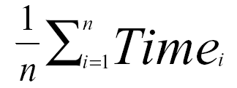
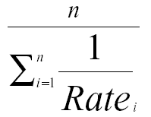
Arithmetic and Harmonic Mean
Total Execution Time: A Consistent Summary Measure
Arithmetic mean is the average of the execution time that tracks total execution time.
If performance is expressed as a rate, then the average that tracks total execution time is the harmonic mean

Slide 40
Problems with Arithmetic Mean
Applications do not have the same probability of being run
Longer programs weigh more heavily in the average
For example, two machines timed on two benchmarks
Machine A Machine B
Program 1 2 seconds (20%) 4 seconds (20%)
Program 2 12 seconds (80%) 8 seconds (80%)
If we do arithmetic mean, Program 2 “counts more” than Program 1
an improvement in Program 2 changes the average more than a proportional improvement in Program 1
But perhaps Program 2 is 4 times more likely to run than Program 1

Slide 41

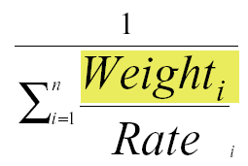
Weighted Execution Time
Often, one runs some programs more often than others. Therefore, we should weight the more frequently used programs’ execution time
Weighted Harmonic Mean

Slide 42
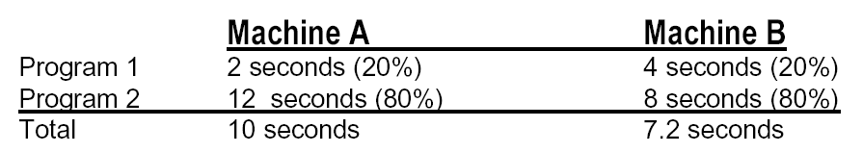
Using a Weighted Sum (or weighted average)
Allows us to determine relative performance 10/7.2 = 1.38
--> Machine B is 1.38 times faster than Machine A

Slide 43
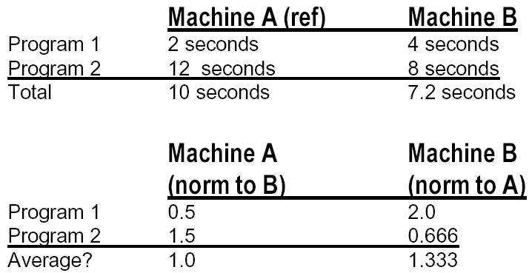
Another Solution
Normalize run time of each program to a reference
So when we normalize A to B, and average, it looks like A & B are the same.
But when we normalize B to A, it looks like B is 33% better!

Slide 44
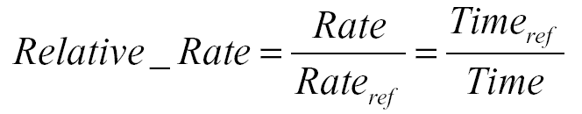
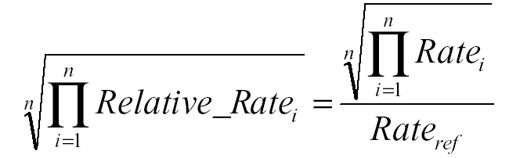
Geometric Mean
Used for relative rate or performance numbers
Geometric mean

Slide 45
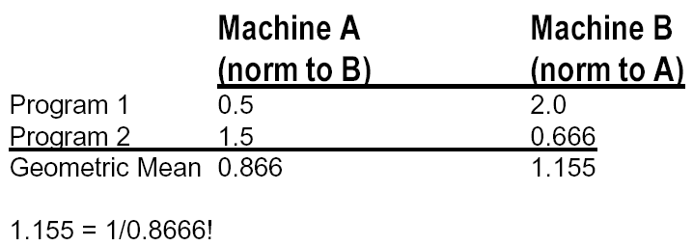
Using Geometric Mean
Drawback:
Geometric mean does NOT predict run time because it automatically
normalizes.
Each application now counts equally.
Irrelevance of the reference computer in relative performance

Slide 46
Summary of comparing performance
Total execution time or arithmetic mean
consistent result
programs in the workload are NOT always run an equal number of times
Weighted arithmetic mean
take into account the frequency of use in the workload
solution depends on which machine is the reference.
Normalized Geometric Mean
consistent result, no matter which machine is the reference.
Geometric mean does NOT predict run time
Ideal solution : Measure a real workload and weight the programs according to their frequency of execution.
What really matters is how your application performs

Slide 47
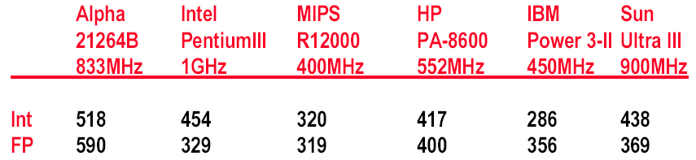
New SPEC Performance Numbers
Geometric Mean of 12 (SpecInt) and 14 (SpecFP) Benchmarks
Performance measured against SPARC 10/40
2000 Performance Numbers (Microprocessor Report, Dec. 2000)

Slide 48
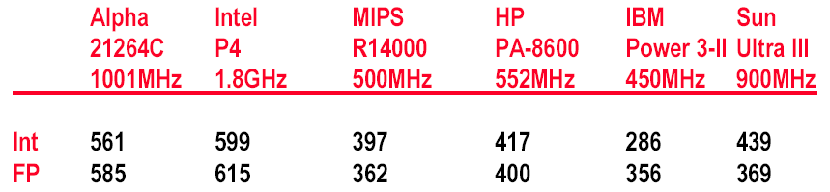
New SPEC Performance Numbers
Geometric Mean of 12 (SpecInt) and 14 (SpecFP) Benchmarks
Performance measured against SPARC 10/40
2001 Performance Numbers (Microprocessor Report, Aug. 2001)

Slide 49
Topics in Chapter
1.1 Why take this course ?
1.2 Classes of computers in current computer market
1.3 Defining computer architecture and What’s the task of computer design?
1.4 Trends in Technology
1.5 Trends in power in Integrated circuits
1.6 Trends in Cost
1.7 Dependability
1.8 Measuring, Reporting and summarizing Perf.
1.9 Quantitative Principles of computer Design
1.10 Putting it altogether

Slide 50
1.9 Quantitative Principles
Take advantage of parallelism
Principle of Locality
Focus on the common case
Amdahl's Law
CPU Performance Equation

Slide 51
Take advantage of parallelism
Most important methods of improving performance
Parallelism levels
System level: use multiple processors
Instruction level:
Pipelining
Operation level:
set-associate cache
Pipelined function unit
Any other examples ?

Slide 52
Principle of Locality
Program Property: Programs tend to reuse data and instructions they have used recently.
Rule of thumb:
a program spends 90% of its execution time in only 10% of the code.
Temporal locality
Recently accessed items are likely to be accessed in the near future.
Spatial locality
Items whose addresses are near one another tend to be referenced close together in time.
Any example ?

Slide 53
Focus on the common case
The most important and pervasive principle of computer design.
Power, resource allocation, performance, dependability.
Rule of thumb: simple is fast.
Frequent case is often simpler and can be done faster.
A fundamental law, called Amdahl’s Law, can be used to quantify this principle.

Slide 54
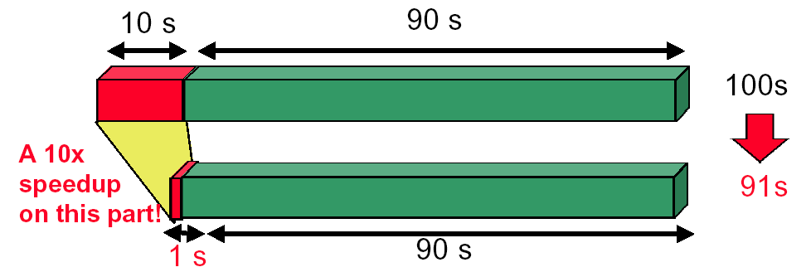
Amdahl’s Law
The performance improvement to be gained from using some faster mode of execution is limited by the fraction of the time the faster mode can be used.
Example

Slide 55
Amdahl’s law
Increasing the clock rate would not affect memory access time
Using a floating point processing unit does not speed integer ALU operations

Slide 56
Amdahl’s law
Amdahl's law defines the speedup
If we know two factors:
Fraction enhanced : Fraction of computation time in original machine that can be converted to take advantage of the enhancement.
Speedup enhanced in enhanced mode : Improvement gained by enhanced execution mode:

Slide 57
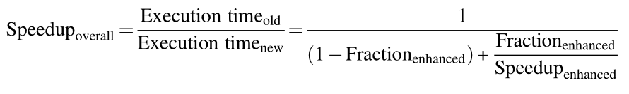
Speedup Equation
Example:
A server system with an enhanced CPU( 10 times faster than the original one) used for Web serving. Assuming the original CPU is busy with computation 40% of the time and is waiting for I/O 60% of the time.
Answer:
Fractionenhanced = 0.4, Speedupenhanced =10
Speedup = 1 = 1 = 1.56
0.6 + 0.4 0.64
10

Slide 58
example
Assume:
An enhancement to a computer that improves some mode of execution by a factor of 10.
Enhanced mode is used 50% of the time,measured as a percentage of the execution time when the enhancec mode is in use.
Question:
What is the speedup we have obtained from fast mode ?
What percentage of the original execution time has been converted of fast mode ?
Important Notes !
F is the fraction in original machine !

Slide 59
What the Amdahl’s Law imply ?
If an enhancement is only usable for a fraction of task, then the total speedup will be no more than 1/ (1-F).
Serve the guide
to how much an enhancement will improve performance
to how to distribute resource to improve cost-performance
Useful for comparing
the overall system performance of two alternatives,
two CPU design alternatives
We can improve the performance by
increasing the Fraction enhanced
or, increasing the Speedup enhanced

Slide 60
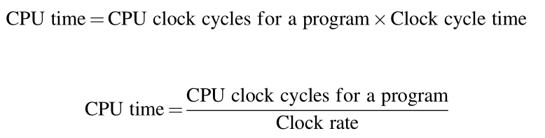
The CPU Performance Equation
The “Iron Law” of processor performance:
Often it is difficult to measure the improvement in time using a new enhancement directly.
CPU Performance Equation

Slide 61
Calculation of CPU Time
CPU time = Instruction count × CPI × Clock cycle time
Or
Architecture --> Implementation --> Realization
Compiler Designer Processor Designer Chip Designer

Slide 62
Related technologies
CPU performance is dependent upon 3 characteristics:
clock cycle (or rate) ( CCT )
clock cycles per instruction ( CPI )
instruction count. ( IC )
One difficulty: It is difficult to change one in isolation of the others.
Inst Count CPI Clock Rate
Program X
Compiler X (X)
Inst. Set. X X
Organization X X
Technology X

Slide 63


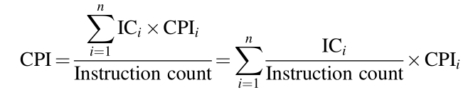
Other format of CPU Performance Equation

Slide 64
Example of CPUtime calculation
Suppose we have made the following measurements:
Frequency of FP operations (other than FPSQR) = 25%
Average CPI of FP operations = 4.0
Average CPI of other instructions = 1.33
Frequency of FPSQR = 2%
CPI of FPSQR = 20
Two design alternatives
decrease the CPI of FPSQR to 2
decrease the average CPI of all FP operations to 2.5.
Compare these two design alternatives using the CPU performance equation.

Slide 65
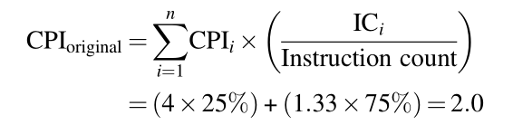

Answer to the question
Since the CPI of the overall FP enhancement is slightly lower, its performance will be marginally better.

Slide 66
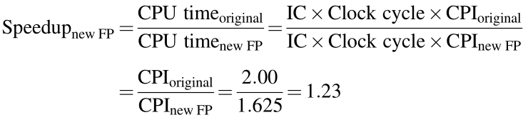
Compare the result with that from Amdahl’s law
This is the same speedup we obtained using Amdahl’s Law:

Slide 67
Topics in Chapter
1.1 Why take this course ?
1.2 Classes of computers in current computer market
1.3 Defining computer architecture and What’s the task of computer design?
1.4 Trends in Technology
1.5 Trends in power in Integrated circuits
1.6 Trends in Cost
1.7 Dependability
1.8 Measuring, Reporting and summerizing Perf.
1.9 Quantitative Principles of computer Design
1.10 Putting it altogether

Slide 68
Putting all together: Real-world examples
Measuring server-side application performance with SPECpower benchmark
ssj_ops: Server side Java operations per second
SPECpower exercises not only CPU, but also the cache, memory system, multiprocessor interconnection...
Price-performance
ssj_ops/watt
Power-performance analysis
ssj_ops/$
Notes:
PECpower uses a more modern software stack written in Java. It is based on SPECjbb, and it repre- sents the server side of business applications, with performance measured as the number of transactions per second, called ssj_ops for server side Java operations per second. It exercises not only the processor of the server, as does SPEC CPU, but also the caches, memory system, and even the multiprocessor interconnection system.

Slide 69
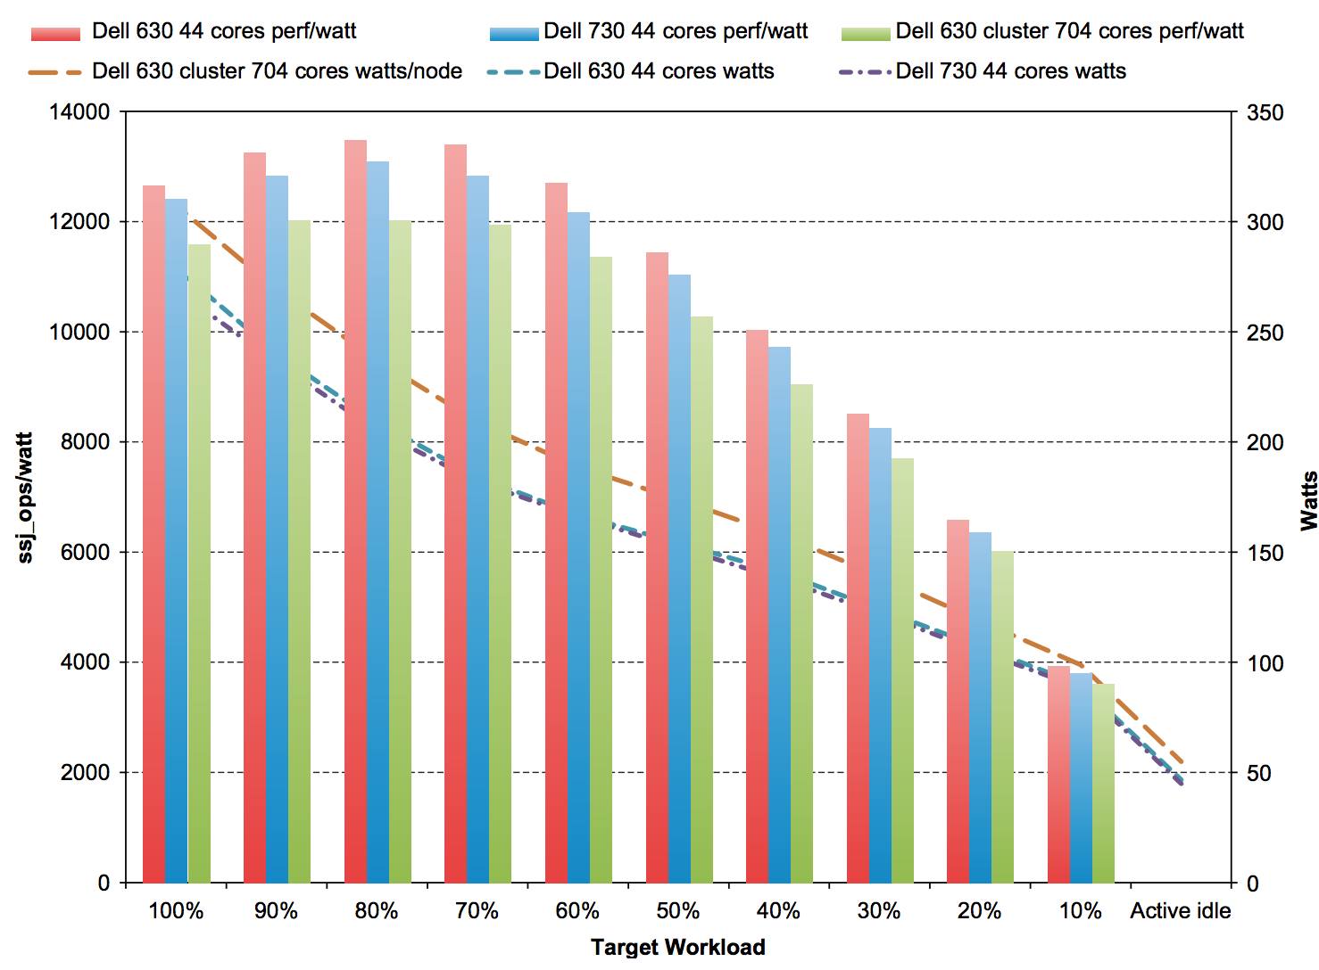
Power-performance
Power-performance of the three servers at different workload level
Notes:
Figure 1.21 Power-performance of the three servers in Figure 1.20. Ssj_ops/watt values are on the left axis, with the three columns associated with it, and watts are on the right axis, with the three lines associated with it. The hor- izontal axis shows the target workload, as it varies from 100% to Active Idle. The single node R630 has the best ssj_ops/watt at each workload level, but R730 consumes the lowest power at each level.

Slide 70
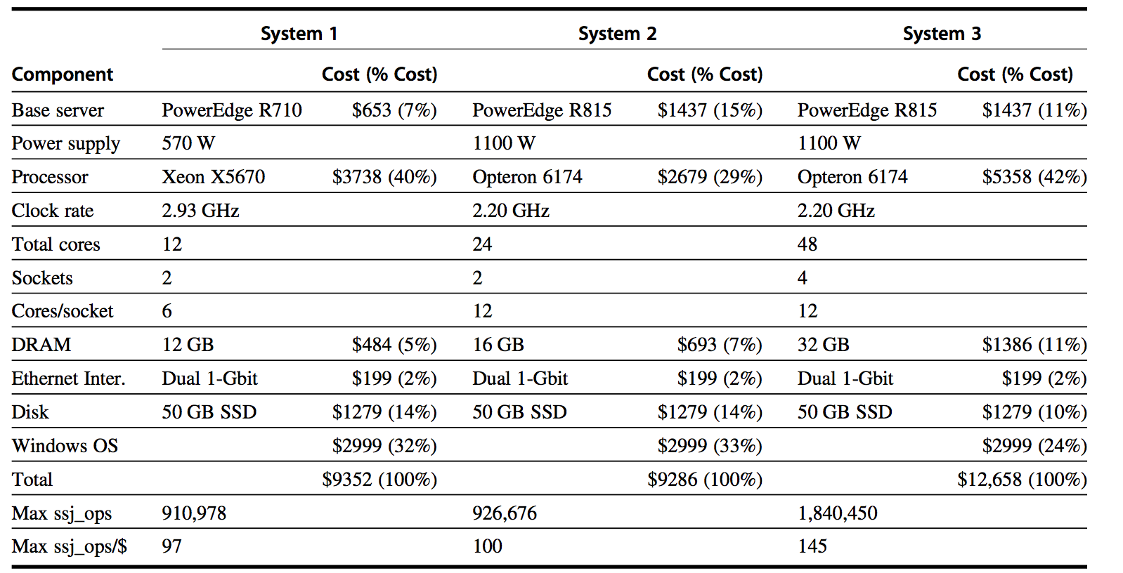
Price-performance
Winner: System 3 (48 cores, Opteron 6174)

Slide 71
Fallacies & pitfalls
Fallacy
Benchmarks remain valid indefinitely
Several factors influence the usefulness of a benchmark as a predictor of real performance, and some change over time.
The rated mean time to failure of the disks is 1200000 hours or almost 140 years, so disks practically never fail.
A survey of disk drives in real environments (Gray and van Ingen, 2005) found that 3%–7% of drives failed per year, for an MTTF of about 125,000–300,000 hours.
Peak performance tracks observed performance.
Peak performance is not generally useful in predicting observed performance.

Slide 72
Fallacy
The cost of the processor dominates the cost of the system.

Slide 73
Fallacies & pitfalls
Pitfall:
Falling prey to Amdahl’s Law.
We almost all occasionally expend tremendous effort optimizing some feature before we measure its usage.
A single point of failure
No matter how much more dependable we make the power supplies, the single fan will limit the reliability of the disk subsystem.
Fault detection can lower availability
because computer hardware has a fair amount of state that may not always be critical to proper operation. (e.g. branch predictor)
not all the operations are needed for correct execution of the program
Aggressively detecting faults without correcting them can lower availability

Slide 74
Homework for Chapter 1
Read chapter 1 of textbook.
Your task:
You can select any 4 questions from textbook.
Due time:
Before the next lecture begin
Write your answer in English.
Submit it to website, NOT via email.

Slide 75

THANK YOU
THANK YOU

