Slide 1

Computer Architecture ----A Quantitative Approach
陈文智
浙江大学计算机学院
chenwz@zju.edu.cn

Slide 2
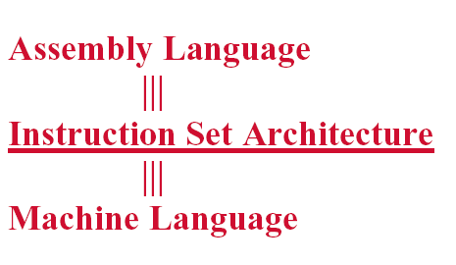
Instruction Set Architecture

Slide 3
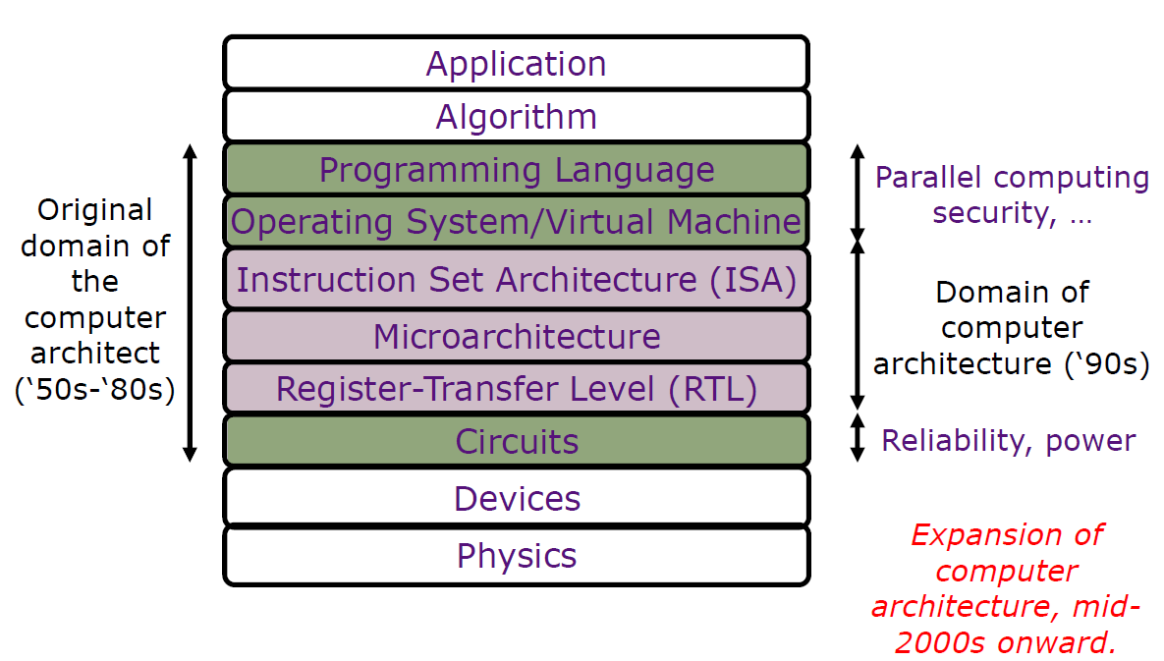
Instruction Set Architecture

Slide 4
Instruction Set Design Tasks
Classifying Instruction Set Architectures
Memory Addressing
Operations in the Instruction Set
Type and Size of Operands
Encoding an Instruction Set
Optimizing an Instruction Set

Slide 5
Recall: The Design Engineering
Evaluate Existing
Systems for
Bottlenecks
Requirements
Implementation
Complexity
Benchmarks
Technology
Trends
Implement Next
Generation System
Simulate New
Designs and
Organizations
Quantitative
principle
Workloads

Slide 6
Important step for ISA design
To analyze and evaluate the existing machines with a large collection of programs before making architectural decisions.
Compare with research/graduate project
reading a large amount of materials in the area
evaluating or classifying the existing methods
make your focus and your work plan
implement your ideas
write the report : summary of your work

Slide 7
Recall: Three application area
Desktop Computing
emphasizes performance of programs with integer and floating-point data types, with little regard for program size of processor power consumption
integer /floating-point programs
Servers
used primarily for databases, file server and Web applications, plus some time-sharing applications for many users.
Time-sharing applications for many users
FP performance is less important than that of integer/strings
Embedded Applications
value cost and power, so code size is important because less memory is both cheaper and lower power
code size

Slide 8
2.2 Classifying Instruction Set Architectures
The type of internal storage in CPU
Stack
The operands are implicitly on the top of the stack :B5000
Accumulator
One operand is implicitly the accumulator : PDP-8
GPR(General-Purpose Register) architecture
Have only explicit operands-either registers or memory locations
1975-now all machines use general purpose registers

Slide 9
Operand location for 4 ISA classes

Slide 10
Three general types of GPR
Max number of operands in ALU instruction.
Total memory-address operands in ALU instruction
Register-Register (0) ------ Load/Store
Data must be explicitly moved between registers and memory.
ALU operations use register operands only.
Usually 3 operands, all in registers.
Register-Memory (1)
Operations occur between register and memory (one operand in memory).
Usually 2 operands, one in a register (src and dest) and one in memory (src only).
Memory-Memory (2~3)
May have 2 or 3 operands in memory (VAX).

Slide 11
Examples of Computers
Number of Memory addresses | Maximum num. of operands allowed | Type of Architecture | Examples
0 | 3 | Load-store | Alpha, ARM, MIPS, PowerPC, SPARC, superH, TM
1 | 2 | Reg-Mem | IBM360/370, Inter80x86,Ti TM Motorola 6800,
2 | 2 | Mem-Mem | Vas(aoso has three-oprands formats)
3 | 3 | Mem-Mem | Vas(aoso has three-oprands formats)

Slide 12
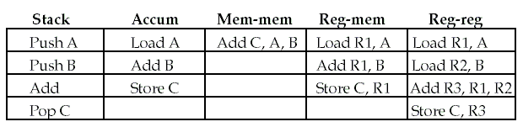
Code sequence of C=A+B
MIPS is one of these: this is what we’ll be learning

Slide 13
Why are GPR ISAs so popular ?
Registers are faster than memory
memory traffic is reduced, so program is speed up (since registers are faster than memory)
Registers can hold variables
registers are easier for a compiler to use:
e.g., (A*B) – (C*D) –(E*F) can do multiplies in any order vs. stack
code density improves (since register named with fewer bits than memory location)

Slide 14
ISA metrics
Code density :
How much space does a program require ?
Instruction count :
How many instructions are necessary for a specific task ?
Instruction complexity :
How much decoding is necessary to interpret an instruction ?
Instruction length :
Is length dependent on the type of instruction and addressing mode ?
Other metrics
Encoding Complexity, CPI

Slide 15
Pros and Cons of the three GPR computers
Computers with fewer alternatives simplify the compiler’s task.
The number of registers also affects the instruction size.

Slide 16
2.3 Memory Addressing
How memory addresses are interpreted ?
How the memory addresses are specified ?

Slide 17
Memory Organization
Viewed as a large, single-dimension array, with an address.
A memory address is an index into the array
Can be addressed in
Word: Easy to implement, not support for non-numerical computing
Bit: variable length computing, waste of address space
Byte: Most popular, exists data storage and align problems
"Byte addressing" means that the index points to a byte of memory.

Slide 18
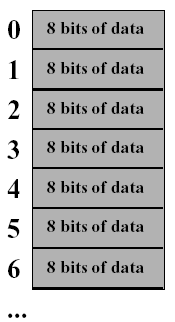
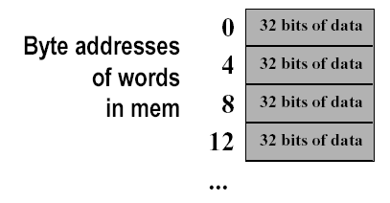
Addressed in Words or Bytes
232 bytes with byte addresses from 0 to 232-1
58 words with byte addresses 0, 4, 8, ... 232-4
Words are aligned

Slide 19
Little Endian vs. Big Endian
Two different conventions for ordering the bytes within a larger object
Little Endian
(Intel)
Big Endian
(IBM.Motorola)
7 | 6 | 5 | 4 | 3 | 2 | 1 | 0
0 | 1 | 2 | 3 | 4 | 5 | 6 | 7

Slide 20
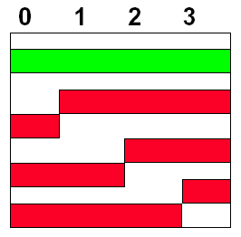
Aligned Memory Access
Aligned address of byte, half-word, word, and double-word
byte XXXXXXXXXXX
half-word XXXXXXXXXX 0
word XXXXXXXXX 0 0
double-word XXXXXXXX 0 0 0
3 2 1 0

Slide 21
Misaligned memory access
A misaligned memory access may take multiple aligned memory references
Even in computers that allow misaligned access, programs with aligned accesses run faster.
7
6
5
4
3
2
1
0
32 Bits Memory Bus
CPU

Slide 22
Hardware Alignment
Alignment network
External alignment：Data exchange between CPU and external storages
Internal alignment：Data exchange between CPU’s internal data bus and registers
Registers
Data Bus

Slide 23
Addressing Modes (Fig B.6)
Addressing Modes
Register Add R4, R3
Immediate Add R4, #3
Displacement Add R4, 100(R1)
Register indirect Add R4, (R1)
Indexed Add R3, (R1+R2)
Direct or absolute Add R1, (1000)
Memory indirect Add R1, @(R3)
Autoincrement Add R1, (R2)+
Autodecrement Add R1, -(R2)
Scaled Add R1,100(R2)[R3]

Slide 24
Measuring addressing mode
Addressing modes influence Instruction Set Architecture
Significantly reduce instruction counts
Add to the complexity of building a computer
May increase the average CPI
So, measuring various addressing modes is quite important in helping the architect choose what to include.

Slide 25
Summary: use of memory addressing modes

Slide 26
Summary: use of memory addressing modes
Register modes, which are not counted, account for one-half of the operand references
The PC-relative addressing modes, used almost exclusively for branches, are not included；
Displacement mode includes all displacement lengths (8, 16, and 32 bits)
Most popular memory addressing modes are:
Displacement 42%
Immediate 33%
Register indirect 13%

Slide 27
Displacement Addressing Mode
Provides the means of implementing pointers
Issue: What is the appropriate displacement field size ?
Important because it affects instruction length.

Slide 28
Summary of the range of displacement values

Slide 29
Summary of the range of displacement values(2)
Data were collected on a computer with 16-bit displacements, so can’t tell us about longer displacements.
Data are relative to the policies of compiler optimization.
The graph does not include the sign bit. Most displacements are positive, but a majority of the largest displacements(14+ bits) are negative.
Number of bits needed for displacement values:
≤12 bits 75%
≤16 bits 99%
16～31 bits 1%
Therefore, 12-16 bits is probably sufficient.

Slide 30
Immediate Addressing Mode
Immediate are mostly used in：arithmetic operations, comparisons, and data moves；
The last case occurs for constants written in the code-which tend to be small, and for address constants, which tend to be large；
Issue:
What is the appropriate immediate field size ?
Important because it affects instruction length.
Support all operations or only a subset？

Slide 31
Percent of instr. which provide immediates

Slide 32
The distribution of immediate values

Slide 33
Summary of Immediate mode
percent of instructions which provide immediate addressing mode
Integer ALU 21% 1/5
Floating-Point 16% 1/6
range of values for immediates
<8 Bits 65%~ 90%
<16 Bits 82%~ 99%
Therefore, 8-16 bits is probably sufficient.
Other addressing modes are certainly useful, but are they worth the chip space and design complexity ?

Slide 34
2.4 Addressing Modes for Signal Processing
Several novel addressing modes for DSPs:
Modulo or circular addressing mode
Bit reverse addressing
X1X2X3….Xn ----> XnX2X3….X1
There is often a mismatch between what programmers and compilers actually use versus what architects expect.

Slide 35
Summary: Memory Addressing
Support at least 3 addressing mode
Register indirect, displacement, immediate
Fig B.7, 75%~99%
The size of the address for displacement mode to be at least 12-16 bits
FigB.8, 75%~99%
The size of the immediate field to be at least 8-16 bits
FigB.10, 50%~80%

Slide 36
2.5 Type and Size of Operands
How is the type of an operand designated?
Encode in the opcode
Annotated with tags (interpreted by the hardware)
Common used operand types include:
byte(1B)、half word(2B)、word(4B)、single-precision floating point(4B)、double-precision floating point(8B)
packed decimal, character strings

Slide 37
Frequency of access to different data types
What types are most popular used which need to be supported by hardware?
Should the computer have a 64-bit access path, or would taking two cycles to access a double word be satisfactory?
How important is it to support bytes as primitives?

Slide 38
Most Common Used Data Types Statistics
double word
70%
59%
word
29%
26%
0%
half word
5%
floating-point average
1%
integer average
byte
10%
0%
10%
20%
30%
40%
50%
60%
70%
80%

Slide 39
Summary of the usage of integer Data types
Bytes or half words access accounts for no more than 12% of register references, or roughly 6% of all operand accesses (VAX)
Use more than one instructions to implement access of bytes and half words (Alpha)
Double words access frequency will be increased with the development of 64 bits computers

Slide 40
2.6 Operands for Media and Signal Processing
Data types used in 2D & 3D images:
Vertex (32-bit floating-point values)
x-coordinate, y-coordinate, z-coordinate, w (help with color or hidden surfaces)
Triangle (3 vertices)
Pixel (32bits)
R, G, B, A
Fixed point(special data type used in DSP, low-cost floating point)
Has a binary point just to the right of the sign bit
Fixed-point data are fractions between –1 and +1

Slide 41
Summary of Type and Size of Operands
A new 32-bit architecture to support 8-,16-,32-bit integer and 32- and 64-bit IEEE floating-point data.
A new 64-bit address architecture need to support 64-bit integer.
Support for decimal data is less clear.
DSPs need wider accumulating registers than the size in memory to aid accuracy in Fixed-point arithmetic.

Slide 42
2.7 Operations in the Instruction Set
Categories of instruction operators:
Basic instruction operators
Arithmetic and logical
Data transfer
Control
Special instruction operators
Floating point(scientific calculation)
Decimal(commercial)
String
Graphics
Privileged instruction operators
Virtual memory management instructions
Operating system call

Slide 43
Categories of instruction operators and examples
Operator type
Examples
Arithmetic and logical
Integer arithmetic and logical operations: add, subtract, and, or, multiple, divide
Data transfer
Loads-stores(move instructions on computers with memory addressing)
Control
Branch, jump, procedure call and return, traps
System
Operating system call, virtual memory management instructions
Floating point
Floating-point operations: add, multiple, divide, compare
Decimal
Decimal add, decimal multiple, decimal-to-character conversions
String
String move, string compare, string search
Graphics
Pixel and vertex operations, compression/decompression operations

Slide 44
Instruction Operations
All machines generally provide a full set of operations for the first three categories.
All machines MUST provide instruction support for basic system functions.
Floating point instructions are optional but are commonly provided.
Decimal and string instructions are optional, because they can be easily emulated by sequences of simpler instructions.
Graphic instructions are optional.

Slide 45
Decide which operations to support
Rule of thumb
most widely executed instructions are the simple operations of an instruction set. Hence, the implementor of these instructions should be sure to make these fast.
Remember MAKE THE COMMON CASE FAST ?
How to get the statistic data ?
usually use benchmarks

Slide 46
The top 10 instructions for the 80x86
Rank
80x86 instruction
Integer average
1
L
oad
22%
2
Conditional branch
20%
3
compare
16%
4
Store
12%
5
Add
8%
6
And
6%
7
Sub
5%
8
Move register-register
4%
9
Call
1%
10
Return
1%
Total
96%

Slide 47
2.8 Operations for Media and Signal Processing
Some special operations to Support media and signal processing:
Single-instruction multiple-data (SIMD), vector(Fig2.17)
fixed-width operations, performing multiple narrow operations on either a 64-bit or 128-bit ALU
partitioned add
paired single operations
Saturating arithmetic (for DSP)
Multiply-accumulate(MAC) instruction (for DSP)

Slide 48
2.9 Instructions for Control Flow
Conditional branches branch
Unconditional jumps
Procedure calls call
Procedure returns return
Frequencies of these control flow instructions
Call/Return
19%
Integer average
8%
6%
Floating-Point average
Jump
10%
Conditional
branch
75%
82%
0%
20%
40%
60%
80%
100%

Slide 49
Specification of destination address
The destination is specified explicitly in the instruction in the vast majority of cases
Procedure return is the major exception, since for return the target is not known at compiler time，
Notes:
绝大多数情况总是显式说明转移目标地址，
例外：过程返回，因为在编译时通常无法知道返回地址
因此绝大多数采用PC相对位移寻址来说明转移目标地址。
为了说明过程返回和间接跳转的目标地址，这两种
情况下在编译时难以确定目标地址，所以除PC相对寻址外，
还需引入其他寻址方式 。以便能动态说明目标地址，在运
是可变的。
在上面这三种情况下，编译时都无法知道转移目标地址。
运行时一般在转移语句前都需从存储器里取出转移目标
地址送入一个寄存器，因此寄存器间接转移就很有效。

Slide 50
How to specify the destination?
PC-relative
The target is often near the current instruction, so it requires fewer bits
Position independence(permit the code to run independently of where it is loaded)
How to do with procedure return or indirect jump?
Register indirect
case or switch
virtual functions or methods
high-order functions or function pointers
dynamically shared libraries

Slide 51
Bits of branch displacement
Most displacement can be encoded in 2~7 bits
≤ 7 bits：93%
About 75% of the branches are in the forward direction
Notes:
指令长度
指令编码

Slide 52
Conditional Branch Options
Since most changes in control flow are braches, deciding how to specify the branch conditions is important.
Three techniques to specify the branch conditions
condition code tests special bits set by ALU operations, possibly under program control.
condition register tests arbitrary register with the result of a comparison.
compare and branch compare is part of the branch. Often compare is limited to subset.

Slide 53
Pros and cons of three methods
Name
Examples
Advantages
Disadvantages
Condition Code(CC)
80x86,ARM,
PowerPC,
SPARC,
SuperH
Sometimes condition is set for free
CC is extra state. Condition codes constrain the ordering of instructions since they pass information from one instruction to a branch
Condition register
Alpha, MIPS
Simple
Uses up a register
Compare and branch
PA-RISC, VAX
One instruction rather than two for a branch
May be too much work per instruction for pipelined execution

Slide 54
Frequency of different types of compares in conditional branches

Slide 55
Analysis of different types of compares in conditional branches
Less than (or Equal) branches dominate this combination of compiler and architecture
Comparisons with 0：≥50% is “ =0 ”
(this leads to third method to specify the branch condition, “compare and branch”)
A special branch instruction：not only makes comparisons, but also branches
DSP add repeat instruction to avoid loop overhead.

Slide 56
Procedure invocation options (call & return)
State saving (at a minimum the return address must be saved somewhere)
Save registers
Provide a mechanism to save many registers
Require the complier to generate stores and loads for each register saved and restored
caller-saving: Caller saves any registers that it wants to use after the call, then invoke.
callee-saving: first invoke, then callee saves the registers.
Notes:
caller saving: 调用过程先将要用的寄存器保存起来，然后再调用子过程；
callee saving: 被调用过程若想用某个寄存器，则必须先将原
寄存器中的值先保存起来。
有时必须用caller saving,特别是遇到两个过程都要用某一全局变量的时候。
如P1调用P2， P1、P2均修改全局变量X。
P1已为X分配寄存器Rx，
caller saving: 将Rx存入一主存单元，将主存单元地址告诉P2；
callee saving: 在调用P2前编译必须知道P2是否使用X，以便
告诉P2可直接用Rx，这对编译来说是很困难的，尤其是在
下列情况时：P1 ----> P2 ----> P3
不用X 用X

Slide 57
Sometimes, caller save must be used
P1
P2
P3
Call P2
Call P3
Rx ----X
Caller save: store x to a location,which is known by P2.
Compiler should discover a called procedure may access register-allocated quantities. ------complicated by separate compilation.
Many compilers conservatively caller save any variable that may be accessed during a call.
Most real systems today use a combination of the two conventions.

Slide 58
Summary: Instructions for Control flow
Common used instructions shall be considered firstly：Load, store, add, sub, move R-R, and, shift, ＝, ≠, branch and etc.
Conditional branch: displacement 100 <=27 PC-relative branch: displacement > 8 bits
PC-relative conditional branches dominate the control instructions.
jump and link instruction for procedure call
register indirect jump for procedure return;

Slide 59

THANK YOU
THANK YOU

