Slide 1

Computer Architecture ----A Quantitative Approach
陈文智
浙江大学计算机学院
chenwz@zju.edu.cn

Slide 2
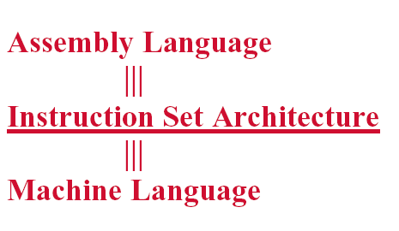
Instruction Set Architecture

Slide 3
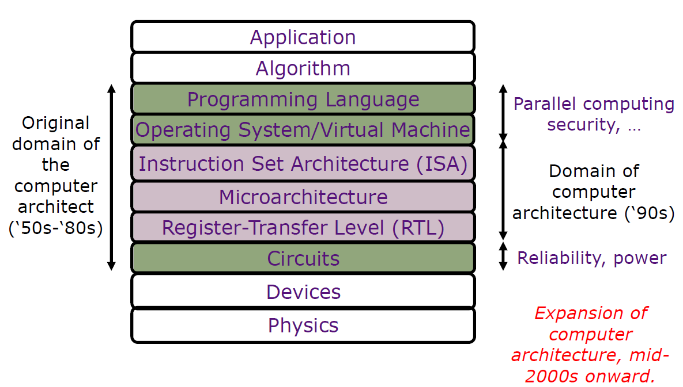
Instruction Set Architecture

Slide 4
Instruction Set Design Tasks
Classifying Instruction Set Architectures
Memory Addressing
Operations in the Instruction Set
Type and Size of Operands
Encoding an Instruction Set
Optimizing an Instruction Set

Slide 5
2.10 Encoding an Instruction Set
Encoding affect:
Size of compiled program
the implementation of the CPU
Balancing forces:
From the compiler viewpoint: to have as many registers and addressing modes as possible
Impact of register size and addressing mode fields on Average instruction size、average program size
Easy to implement

Slide 6
Key factors for Encoding
Key Factors
The range of addressing modes
The degree of independence between opcodes and addressing modes

Slide 7
Three popular choices for instruction encoding
Operation &
Address
Address
Address
Address
no. of operands
specifier1
field 1
…
specifier n
field n
(a)
Variable(e.g.,VAX,Intel 80x86)
Operation &
Address
Address
Address
no. of operands
field 1 field 2 field 3
(b)
Fixed(e.g.,Alpha,ARM,MIPS,PowerPC,SPARC,SuperH)
Operation
Address
Address
specifier field
Operation
Address
Address
Address
specifier1 specifier2 field
Operation
Address
Address
Address
specifier field 1 field 2
(c)
Hybrid(e.g.,IBM360/70,MIPS16,Thumb,TI TMS320C54x)

Slide 8
Comparison of three instruction encoding formats
Variable length：
Number of operations and addressing modes is big
Small program size, high code density, a variety of formats for one instruction
Fixed length：
Number of operations and addressing modes is small
Large program size, low code density, fixed format, easy to implement
Hybrid
Has multiple formats specified by the opcode, adding or or two fields to specify the addressing mode and one or two fields to specify the operand address

Slide 9
Reduced Code Size in RISCs
New hybrid version of RISC instructions, with both 16-bit and 32-bit instructions.
ARM Thumb , MIPS16
IBM CodePack : compress standard instruction set
full 32-bit instruction in instruction cache
compressed code kept in main memory, ROM, disk.
Hash table (TLB)
Hitachi：special RISC instruction set for embedded applications.
SuperH

Slide 10
2.11 The Role of Compilers
Understanding compiler technology is critical to designing an effective instruction set.
Assembly language programming has been largely replaced by compilers which work together with the hardware to optimize performance.
Therefore, design architectures to be compiler targets .
Notes:
编译器的目标（输出）是指令
系统结构 支持汇编程序设计（早期）
编译（现在）（代码质量、写编译程序的难易）

Slide 11
Compilers and Architecture
What features of an architecture lead to high quality code ?
What "makes it easy" to write efficient compilers for an architecture ?

Slide 12
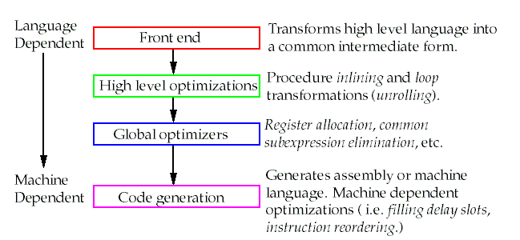
The Structure of Recent Compilers

Slide 13
About compiler
The goals of compiler
All valid programs must be compiled correctly
Fast speed of the compiled code
fast compilation, debugging support, interoperability among languages
Multiple-pass structure’s advantage：
Reduce compiler complexity
Easy writing a bug-free compiler
Disadvantages：
Phase-ordering problem
e.g. global common subexpression elimination

Slide 14
Optimizations Classification
High-level optimizations
Procedure inlining
Local optimizations within a straight-line code fragment
Common subexpression elimination、constant propagation、
Global optimizations extend the local optimizations across branches and introduce a set of transformations aimed at optimizing loops
Register allocation associates registers with operands
Calculate expressions、transfer parameters、store variables
Processor-dependent optimizations attempt to take advantage of specific architectural knowledge

Slide 15
The Impact of Compiler Technology on the Architect’s Decisions
Two important questions:
How are variables allocated and addressed?
How many registers are needed to allocate variables appropriately?
Three areas in which current high-level languages allocate the data：
Stack：local variables; scalars(single variables)
Global data area：global variables, constants; arrays
Heap：dynamic objects; accessed with pointers
At least 16 GPRs + separate floating-point registers

Slide 16
How the Architect Can Help the Compiler Writer ?
The difficulties of compiler
Big program size
Interactive
complexity of compiler’s structure
Basic principle of the compiler
Make the frequent case fast and the rare case correct

Slide 17
Architect’s Guidelines
Provide regularity
Provide primitives, not solutions
Providing special features that "match" language constructs is NOT a good idea.
These features may be good only for a certain language.
And, worse, they may match but do more or less than what's required.
Simplify trade-offs among alternatives
If there are 20 ways to implement an instruction sequence, it makes it difficult for the compiler writer to choose which is the most efficient.
provide instructions that bind quantities known at compile time as constants.

Slide 18
Summary for compiler’s role
At least 16 gerneral-purpose registers
all supported addressing modes apply to all instructions that transfer data
provide primitives instead of solutions
simplify trade-offs between alternatives
KEEP IT SIMPLE , Less is more
SIMD extensions are examples of good marketing than that of hardware-software codesign

Slide 19
2.12 The MIPS Architecture
MIPS emphasizes:
A simple load-store instruction set
Design for pipelining efficiency, including a fixed instruction set encoding
Efficiency as a complier target
MIPS provides a good architectural model for study, because of:
Popularity of this type of processor
An easy architecture to understand

Slide 20
Summary of the statistic data from above sections
B.2 Use GPRs with a load-store architecture
B.3 Addressing modes：
displacement(12-16), immediate(8-16), register indirect
B.4 Support the data size and types:
8-, 16-, 32-, and 64-bit integers and 64-bit IEEE 754 floating-point numbers
B.5 Support the simple instructions:
load, store, add, subtract, move register-register, and shift
B.6 compare equal, compare not equal, compare less, branch, jump, call, and return
B.7 Use fixed instruction encoding
B.8 Provide at least 16 GPRs, and all addressing modes apply to all data transfer instructions

Slide 21
MIPS emphasizes
A simple load-store instruction set
Design for pipelining efficiency, fixed instruction set encoding
Efficiency as a compiler target

Slide 22
MIPS Architecture
Registers for MIPS
R0~R31, F0~F31, a few special registers
Data Types for MIPS
8-bit bytes, 16-bit half words, 32-bit words, and 64-bit double words for integer data
32-bit single precision and 64-bit double precision for floating point
Addressing Modes for MIPS Data Transfers
Immediate, displacement
( register indirect ~ D=0
absolute addressing ~ base register=R0)
PC-relative addressing

Slide 23
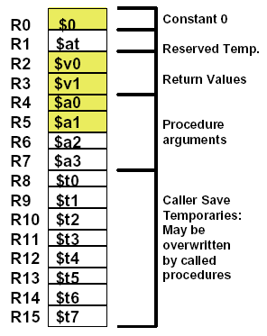
MIPS Register Conventions
Conventions
This is an agreed upon “contract” or
“protocol” that everybody follows
Specifies correct (and expected) usage,
and some naming conventions
Established part of architecture
Used by all compilers, programs,
and libraries
Assures compatibility

Slide 24
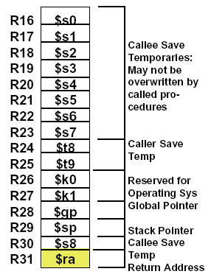
MIPS Register Convention (cont.)
Important Ones for Now (shaded)
R0 Constant 0
R2 Return Value
R3 Can use as temporary
R4 First argument
R5 Second argument
R31 Return address

Slide 25
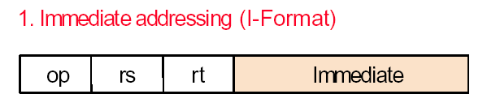

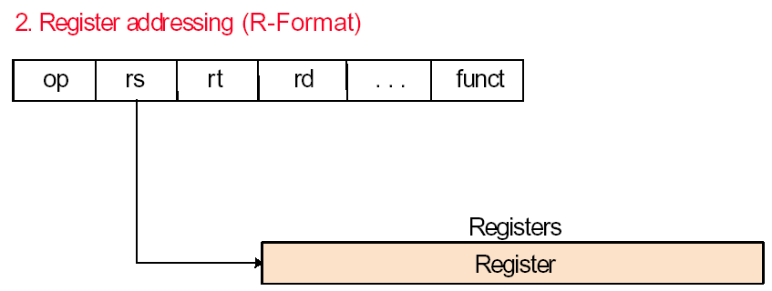

MIPS Addressing Modes
addi R1, R0, 10
add R2, R0, R1

Slide 26
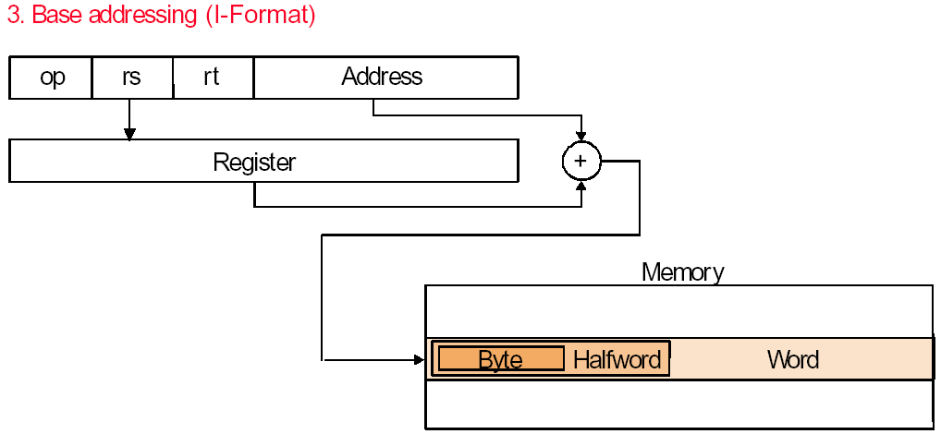

MIPS Addressing Modes
lw R1, 100(R2)

Slide 27
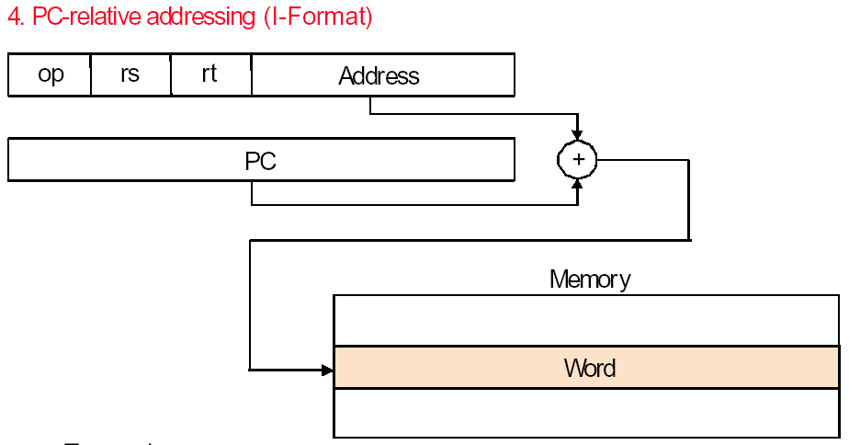

MIPS Addressing Modes
beq R1, R2, 100

Slide 28
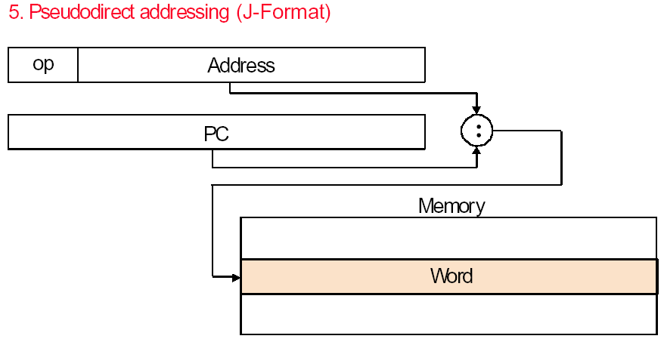

MIPS Addressing Modes
j 10000

Slide 29
MIPS Operations(Fig.B.23, pB-37)

Slide 30
Instruction layout of MIPS Fig.B.22, pB-35
I-type instruction
6
5
5
16
opcode
rs
rt
immediate
Encodes: loads and stores of bytes, half words, words, double words.
All immediate(rt  rs op immediate)
Conditional branch instructions(rs is register, rd unused)
Jump register, jump and link register
(rd = 0, rs = destination, immediate = 0)
6
R-type instruction
6
5
5
5
5
6
opcode
rs
rt
rd
shamt
funct
Register-register ALU operations: rd  rs funct rt
Function encodes the data path operation: Add, Sub, …
Read/write special registers and moves
J-type instruction
6
26
opcode
Offset added to PC
Jump and jump and link
Trap and return from exception
All instructions are encoded in one of three types, with common fields in the same
location in each format.

Slide 31
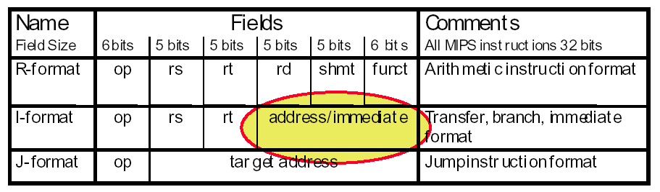
Loading Immediate Values
What’s the largest immediate value that can be loaded into a register?
But, how do we load larger numbers?

Slide 32
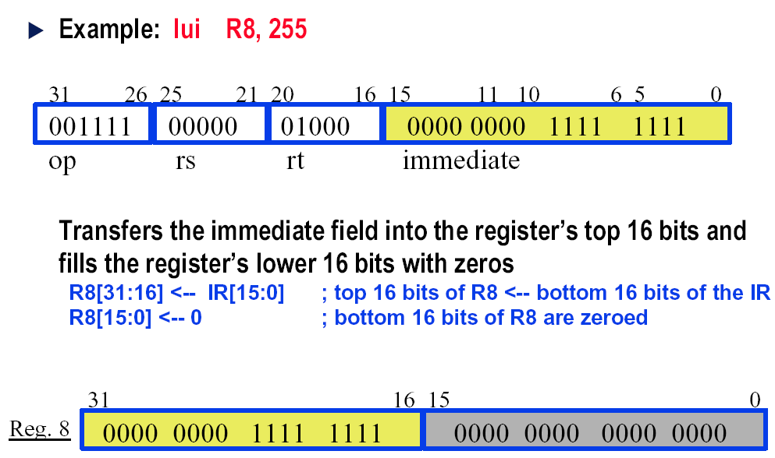
Load Upper Immediate

Slide 33
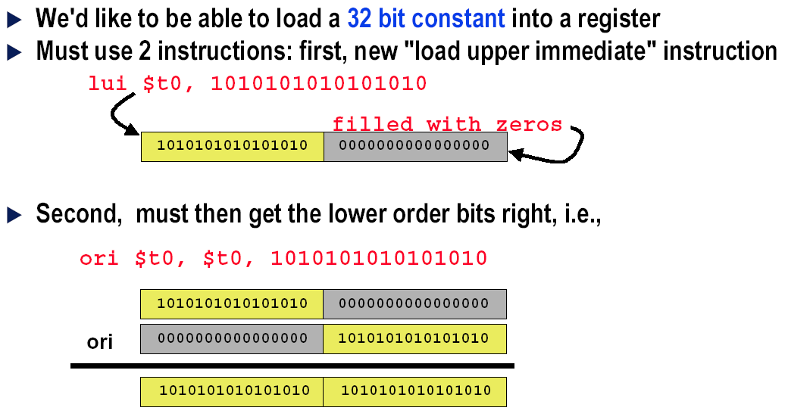
Larger Constants?

Slide 34
Procedure calls
Steps followed in executing a procedure call:
Place parameters in a place where the procedure (callee) can access them
Transfer control to the procedure
Acquire the storage resources needed for the procedure
Perform desired task
Place results in a place where the calling program (caller) can access them
Return control to the point of origin

Slide 35
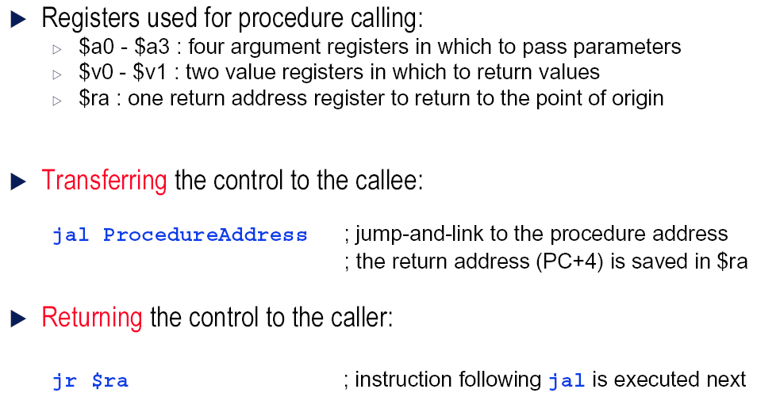
Resources Involved

Slide 36
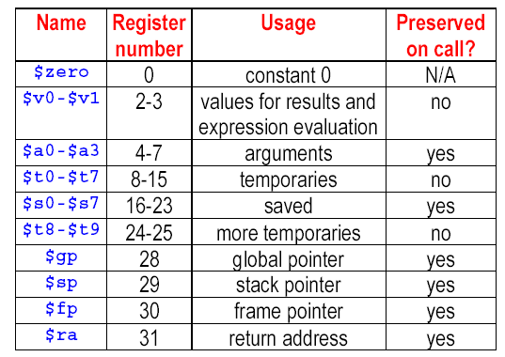
MIPS Register Convention

Slide 37
Alternative Architectures
About MIPS as an ISA
It’s a simple/small ISA;
It emphasizes a small number of instructions, formats, address modes
Design alternative:
Provide more powerful operations, and many of them
Goal is to reduce number of instructions executed
Danger is a slower cycle time and/or a higher CPI
Sometimes referred to as “RISC vs. CISC”
RISC: Reduced Instruction Set Computing
CISC: Complex Instruction Set Computing

Slide 38
CISC vs. RISC
CISC (Complex Instruction Set Computer)
Enhance the function of instructions, many kinds of operations, each instruction’s function is strong
RISC(Reduced Instruction Set Computer)
Reduce the function of instructions, Provide basic instructions, each instruction’s function is weak
Two completely different directions for Instruction Set Architectures

Slide 39
CISC
Complex Instruction Set Computer
Background: lack of storage resource, emphasize compiler optimization
Techniques: Enhance the function of the instructions, Design some complex instructions, instead of some functions which are originally implemented by software
CISC example was DEC VAX: min code size, make asm easy instructions from 1 to 54 bytes long!

Slide 40
RISC
Reduce CPI:
CPUtime=Instr_Count * CPI * Clock_cycle
Reduce the instruction set:
only keep the most basic ones
Load/Store architecture
Simple instructions, simple addressing modes, fixed-length instruction format…

Slide 41
A Brief history of RISC
Load/Store architecture：
CDC6600(1963)--CRAY1(1976)
IBM801(1979年),
first RISC computer
1980, Patterson(Berkeley) & Ditzel
first put forward RISC, RISC-Ι,Π
1981, Hennessy(Stanford)
MIPS
Commercial RISC CPU after 1985:
MIPS1(1986) & SPARC V1(1987) …

Slide 42
Some typical high performance RISC CPU
SUN, SPARC(1987)
MIPS, SGI:MIPS(1986)
HP, PA-RISC,
IBM, Motorola, PowerPC
DEC、Compaq, Alpha AXP
IBM RS6000(1990) first Superscalar RISC

Slide 43
Summary of ISA
Architecture = what’s visible to the program about the machine
Not everything in the deep implementation is “visible”
The name for this invisible stuff is “the implementation”
A big piece of the ISA = assembly language structure
Primitive instructions, execute sequentially, atomically
Issues are formats, computations, addressing modes, encoding etc

Slide 44
Summary of ISA
Two broad flavors:
CISC: lots of complicated instructions
RISC: a few, essential instructions
Basically all recent machines are RISC, but the dominant machine of
today, Intel x86, is still CISC (though they do RISC tricks in the guts…)
Example: MIPS

Slide 45
History of ISA
60’ Stack----reduce the gap between high-level programming language and machine language.
70’ reduce the software cost, replacing software with hardware
80’ processor performance → simple ISA

Slide 46
90’s ISA
Address size doubles: 32bit→ 64bit
Optimization conditional branch via conditional execution
Optimization of cache performance via prefetch
Support of multimedia
Faster floating-point operations
Long instruction word
Increased Conditional Execution

Slide 47
Homework

Slide 48

THANK YOU
THANK YOU

