Slide 1

Computer Architecture ----A Quantitative Approach
陈文智
浙江大学计算机学院
chenwz@zju.edu.cn

Slide 2
Three Questions
What is pipelining?
How is the pipelining implemented?
What makes pipelining hard to implement?

Slide 3
Definition
Pipelining is an implementation technique whereby multiple instructions are overlapped in execution; it takes advantage of parallelism that exists among the actions needed to execute an instruction.
Today, pipelining is the key implementation technique used to make fast CPUs.
Not only for CPU: a 12 level pipeline for geometry transformation in GPU(Clark 1982)

Slide 4
Parallelism
From dictionary: the quality or condition of being parallel; a parallel relationship.
The Nature of a TASK. Goal in parallel computing and Arch. design : seek parallelism and try using it to improve performance.

Slide 5
What is Pipelining ?
Pipelining:
“A technique designed into some computers to increase speed by starting the execution of one instruction before completing the previous one.”
----Modern English-Chinese Dictionary
implementation technique whereby different instructions are overlapped in execution at the same time.
implementation technique to make fast CPUs

Slide 6

It likes Auto Assembly line
An arrangement of workers, machines, and equipment in which the product being assembled passes consecutively from operation to operation until completed.
Ford installs first moving assembly line in 1913. The right picture shows the moving assembly line at Ford Motor Company’s Michigan plant.
( 84 distinct steps)

Slide 7
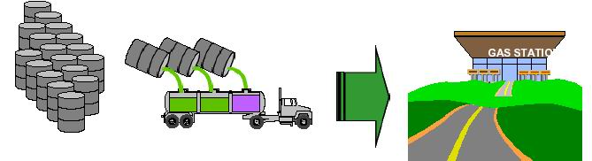
Trucking gas from depot to gas station
The steps:
Get the barrels
Load them into the truck
Drive to the gas station
Unload the gas
Return for more oil
Let’s do the math
Each truck can carry 5 barrels
Can load a truck with 5 barrels in 1 hour
It takes each truck 1 day to drive to and from gas station
How many barrels per week are delivered?

Slide 8
Looks a Lot Like a Multi-cycle Processor
What are the steps ?
Fetch an instruction (Get the barrels)
Decode the instruction (Load them into the truck)
ALU OP (Drive to the gas station)
Memory Access (Unload the gas)
Write-back (Return for more oil)

Slide 9
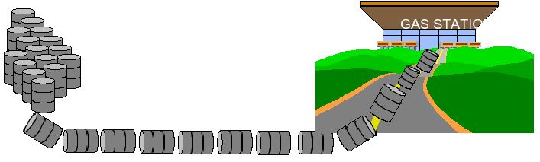
A better way, but dangerous
Roll the barrels down the road
Big fire hazard

Slide 10
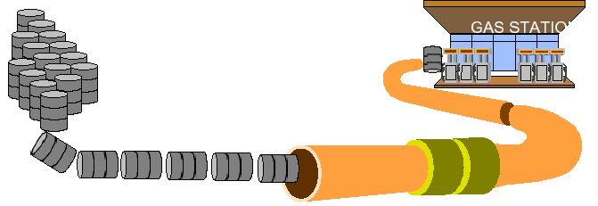
Big idea: Build a pipeline
Now let’s do the math
Pipeline can accept 1 barrel every hour
How many barrels get delivered to the gas station per day?

Slide 11
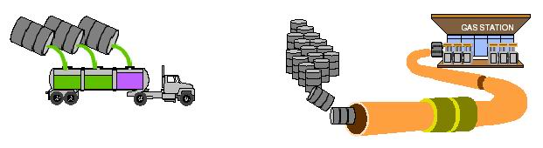
Trucking vs. Pipelines
Trucks
Truck with 5 barrels takes 1 day to drive to and from gas station, while need 2 hours for loading and unloading
LOTS of TIME when loading area,gas station, and pieces of the road are unused
Pipelines
Pipeline can accept 1 barrel every hour
Resources (loading area, gas station,pipelines) are always in use

Slide 12
Why Pipelining: Its Natural
Laundry
Ann, Brian, Cathy, Dave each have one load of clothes to wash, dry, and fold
Washer takes 30 minutes
Dryer takes 40 minutes
“Folder” takes 20 minutes
A
B
C
D

Slide 13
Sequential Laundry
6 PM
7
8
9
10
11
Midnight
Time
30
40
20
30
40
20
30
40
20
30
40
20
T
a
s
k
O
r
d
e
r
A
B
C
D
Sequential laundry takes 6 hours for 4 loads
If they learned pipelining, how long would laundry take?

Slide 14
Pipelined Laundry----Start work ASAP
6 PM
7
8
9
10
11
Midnight
Time
30
40
40
40
40
20
T
a
s
k
O
r
d
e
r
A
B
C
D
Pipelined laundry takes 3.5 hours for 4 loads

Slide 15
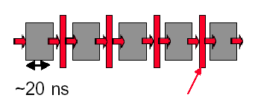
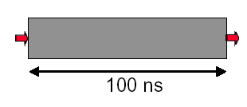
Why pipelining : overlapped
Latches, called pipeline registers’ break up computation into 5 stages
Deal 5 tasks at the same time.
Only deal one task each time.
This task takes
“ such a long time”

Slide 16
Why pipelining: more faster
Can “launch” a new computation every 100ns in this structure
Can finish 10⁷ computations per second
Can launch a new computation every 20ns in pipelined structure
Can finish 5×10⁷ computations per second

Slide 17
Why pipelining : conclusion
The key implementation technique used to Make fast CPU: decrease CPUtime.
Improving of Throughput ( rather than individual execution time)
Improving of efficiency for resources (functional unit)

Slide 18
What is a pipeline ?
A pipeline is like an auto assemble line
A pipeline has many stages
Each stage carries out a different part of instruction or operation
The stages, which cooperates at a synchronized clock, are connected to form a pipe
An instruction or operation enters through one end and progresses through the stages and exit through the other end
Pipelining is an implementation technique that exploits parallelism among the instructions in a sequential instruction stream

Slide 19
Ideal Performance for Pipelining
If the stages are perfectly balanced, The time per instruction on the pipelined processor equal to:
Time per instruction on unpipelined machine
Number of pipe stages
So, Ideal speedup equal to
Number of pipe stages.

Slide 20
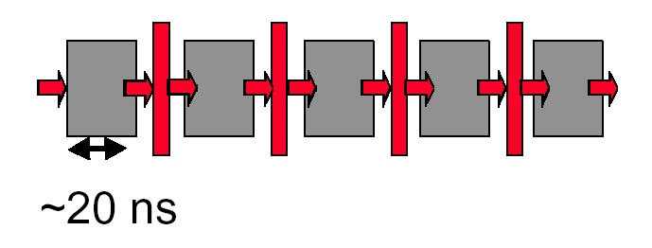
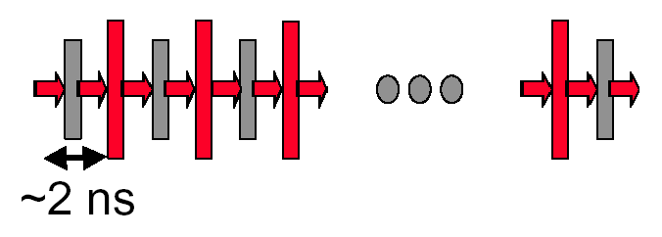
Why not just make a 50-stage pipeline ?
Some computations just won’t divide into any finer (shorter in time) logical implementation.
5 stages OK
50 stages NO. Sorry!

Slide 21
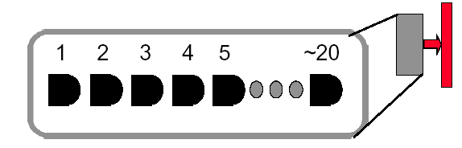
Why not just make a 50-stage pipeline ?
Those latches are NOT free, they take up area, and there is a real delay to go THRU the latch itself.
Machine cycle > latch latency + clock skew
In modern, deep pipeline (10-20 stages), this is a real effect
Typically see logic “depths” in one pipe stage of 10-20 “gates”.
At these speeds, and with this few levels of logic, latch delay is important

Slide 22
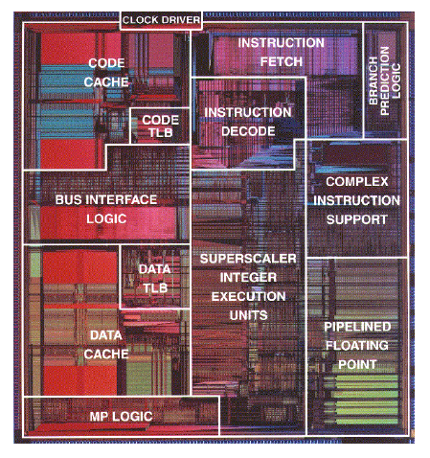
How Many Pipeline Stages?
E.g., Intel
Pentium III, Pentium 4: 20+ stages
More than 20 instructions in flight
High clock frequency (>1GHz)
High IPC
Too many stages:
Lots of complications
Should take care of possible dependencies among in-flight instructions
Control logic is huge

Slide 23
Simple implementation of a RISC Instruction Set (MIPS)
Start with Implementation without pipelining
single-cycle implementation
multi-cycle implementation
Pipelining the RISC Instruction Set
Pipelining performance issues
How can we do it efficiently ?
Examples

Slide 24
How MIPS instruction set is implemented without pipelining ?
Five phases
IF: Instruction fetch cycle
Send PC to memory and fetch the Instruction
Update the PC to NPC by adding 4
ID: Instruction decode/ register fetch cycle
Decode the instruction
read the registers
If needed, sign-extend the offset field of the instruction.

Slide 25
The other three phases
EX: Execution/ effective address cycle
Memory reference: calculate the address
R-R/ R-I ALU: ALU operation on R-R or R-I
Branch: Do the equality test, compute the possible target address and send it to NPC if the equality test is true.
MEM: Memory access
Load: send the effective address to the data memory and fetch the data
Store: write the data from the ID phases using the effective address.
WB: Write-back cycle
Load or ALU: write the result into the register file.

Slide 26
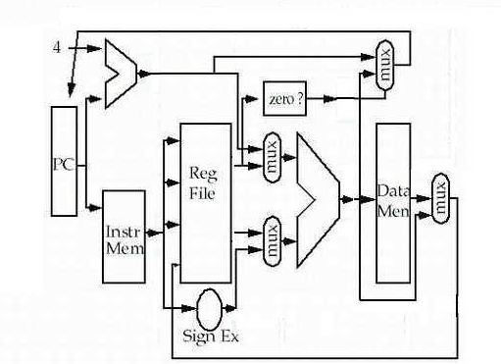
Single-cycle implementation
seldom used !

Slide 27
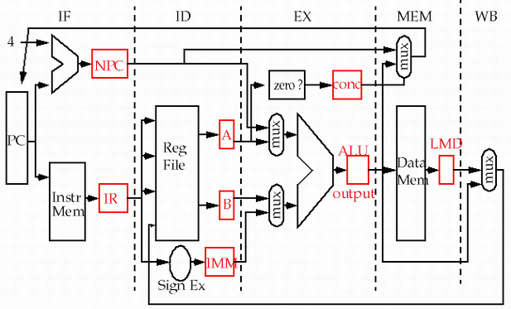
Multi-cycle implementation

Slide 28
About Multi-cycle implementation
The temporary storage locations were added to the datapath of the unpipelined machine to make it easy to pipeline.
Note that branch and store instructions take 4 clock cycles.
Assuming branch frequency of 12% and a store frequency of 10%, CPI is 4.78.
This implementation is not optimal.

Slide 29
How to improve the performance ?
For a possible branch, do the equality test and compute the possible branch target by adding the sign-extended offset to the incremented PC earlier in ID.
Completing ALU instructions during the MEM cycle
So, branch instructions take only 2 cycles, store and ALU instructions take 4 cycles, and load instruction takes the longest time 5 cycles.
CPI drops to 4.07 assuming 47% ALU operation frequency.
2×12％ ＋4×（10％＋47％）＋ 31%×5＝4.07

Slide 30
Optimized Multi-cycle implementation
Temporary storage locations

Slide 31
Improvement on hardware redundancy
ALU can be shared.
Data and instruction memory can be combined since access occurs on different clock cycles.

Slide 32
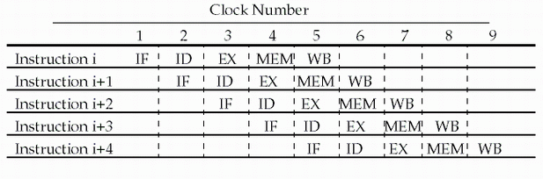
Pipelining MIPS instruction set
Since there are five separate stages, we can have a pipeline in which one instruction is in each stage.
CPI is decreased to 1, since one instruction will be issued (or finished) each cycle.
During any cycle, one instruction is present in each stage.
Ideally, performance is increased five fold !

Slide 33
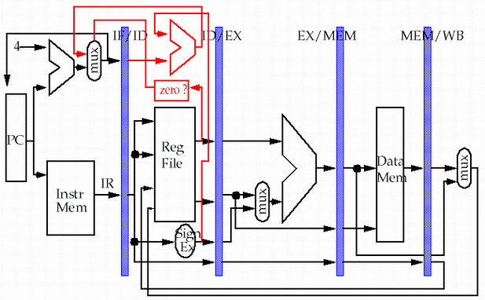
5-stage Version of MIPS Datapath
store
pipeline
registers or
latches
load

Slide 34
How pipelining decrease the execution time?
If your starting point is
a single clock cycle per instruction machine then
pipelining decreases cycle time.
a multiple clock cycle per instruction machine then
pipelining decreases CPI.

Slide 35
Single-cycle implementation vs. pipelining
Single Cycle Implementation: CPI=1, long clock cycle
Cycle 1
Cycle 2
Clk
Load
Store
Waste
Pipeline Implementation: CPI=1, clock cycle ≈ long clock cycle/5
Cycle 1
Cycle 2
Cycle 3
Cycle 4
Cycle 5
Cycle 6
Cycle 7
Cycle 8
Cycle 9
Cycle 10
Clk
Load
IF
ID
EX
MEM
WB
Store
IF
ID
EX
MEM
WB
R-type
IF
ID
EX
MEM
WB

Slide 36
Multi-cycle implementation vs. pipelining
Multip-Cycle Implementation: CPI=5,
Cycle 1
Cycle 2
Cycle 3
Cycle 4
Cycle 5
Cycle 6
Cycle 7
Cycle 8
Cycle 9
Cycle 10
Clk
Load
Store
R-type
IF
ID
EX
MEM
WB
IF
ID
EX
MEM
WB
Pipeline Implementation: CPI=1,
Cycle 1
Cycle 2
Cycle 3
Cycle 4
Cycle 5
Cycle 6
Cycle 7
Cycle 8
Cycle 9
Cycle 10
Clk
Load
IF
ID
EX
MEM
WB
Store
IF
ID
EX
MEM
WB
R-type
IF
ID
EX
MEM
WB

Slide 37
How simple as this ! Really ?
store
pipeline
registers or
latches
load
Why need to add this line?

Slide 38
Problems that pipelining introduces
Focus: different operations with the same data path resource on the same clock cycle is not possible. (structure hazard)
There is conflict about the memory !
Time (clock cycles)
I
n
s
t
r.
O
r
d
e
r
Ld/St
Mem
Reg
ALU
Mem
Reg
Instr 1
Mem
Reg
ALU
Mem
Reg
Instr 2
Mem
Reg
ALU
Mem
Reg
Instr 3
Mem
Reg
ALU
Mem
Reg

Slide 39
Separate instruction and data memories
Let’s split instruction and data cache
the memory system must deliver 5 times the bandwidth over the unpipelined version.
Time (clock cycles)
I
n
s
t
r.
O
r
d
e
r
Ld/St
IM
Reg
ALU
DM
Reg
Instr 1
IM
Reg
ALU
DM
Reg
Instr 2
IM
Reg
ALU
DM
Reg
Instr 3
IM
Reg
ALU
DM
Reg

Slide 40
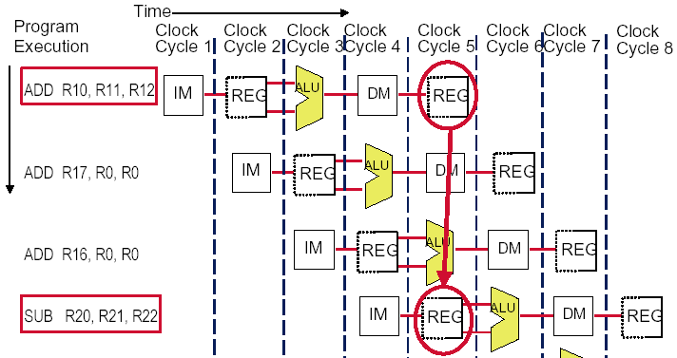
The conflict about the registers !

Slide 41
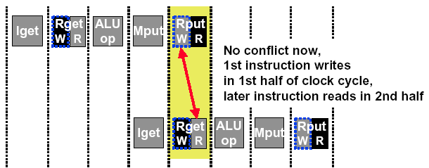
Sometimes we can redesign the resource
allow WRITE-then-READ in one clock cycle (double pump)
Two reads and one write required per clock.
Need to provide two read port and one write port.
What happens when a read and a write occur to the same register ? ( Data hazard )

Slide 42
Conflict occurs when PC update
Must increment and store the PC every clock cycle.
What happens when meet a branch ?
Branches change the value of the PC -- but the condition is not evaluated until ID !
If the branch is taken, the instructions fetched behind the branch are invalid !
This is clearly a serious problem ( Control hazard ) that needs to be addressed. We will deal it later.

Slide 43
Must latches be engaged ? Yeah !
Ensure the instructions in different stages do not interfere with one another .
Through the latches, can the stages be combined one by one to form a pipeline.
The latches are the pipeline registers , which are much more than those in multi-cycle version
IR: IF/ID.IR; ID/EX.IR; EX/DM.IR; DM/WB.IR
B: ID/EX.B; EX/DM.B
ALUoutput: EX/DM.ALUoutput, DM/WB.ALUoutput
Any value needed on a later stage must be placed in a register and copied from one register to the next, until it is no longer needed.

Slide 44
performance issues in pipelining
Latency: The execution time of each instruction in pipelining does not decrease, instead, always longer than that of unpipelined machine.
Imbalance among stages reduces performance
Overhead rise from register delay and clock skew also contribute to the lower limit of machine cycle.
Pipeline hazards are the major hurdle of pipeline, which prevent the machine from reaching the ideal performance.
Time to “fill” pipeline and time to “drain” it reduces speedup

Slide 45

THANK YOU
THANK YOU

